Slide 1
Year 2 Pure Mathematics
Trigonometry and Modelling
- Proving Trig Identities
Chapter 7
(Part 5 of 5)

Slide 2
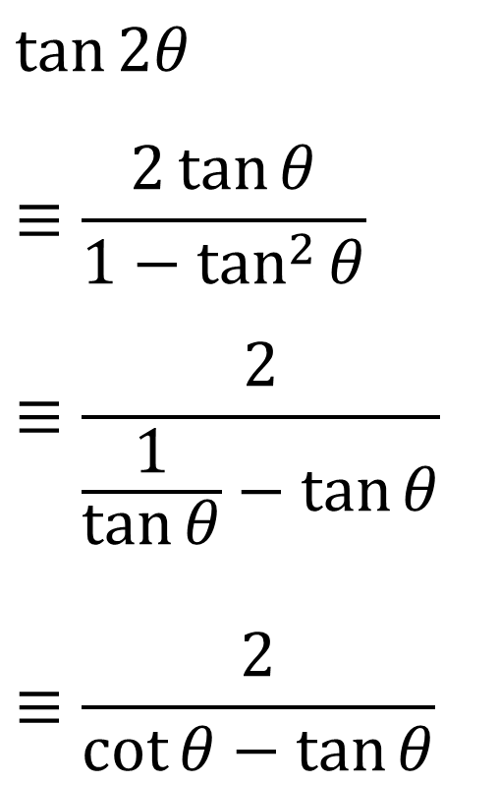
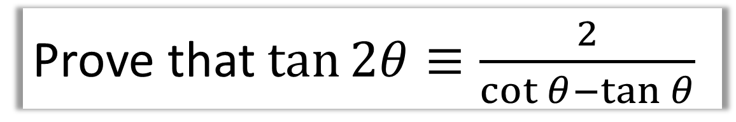
Proving Trigonometric Identities
Prove that $\tan{2θ}≡\frac{2}{\cot{θ}−\tan{θ}}$
$$\tan{2θ}$$
$$≡\frac{2\tan{θ}}{1−\tan^{2}{θ}}$$
$$≡\frac{2}{\frac{1}{\tan{θ}}−\tan{θ}}$$
$$≡\frac{2}{\cot{θ}−\tan{θ}}$$

Slide 3
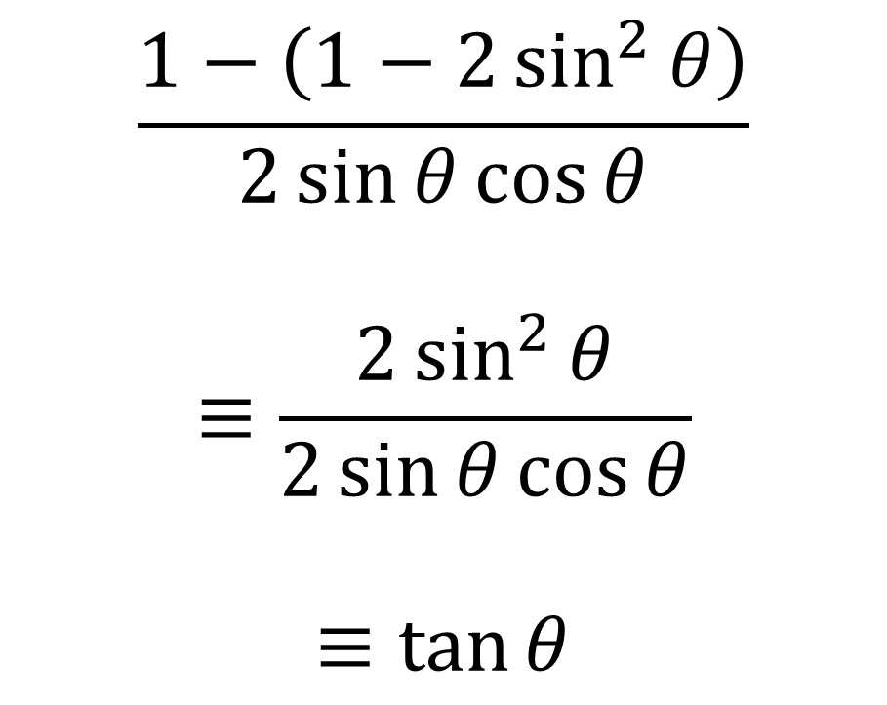
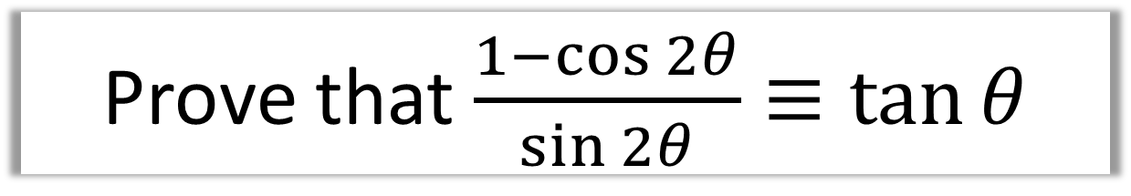
Proving Trigonometric Identities
Prove that $\frac{1−\cos{2θ}}{\sin{2θ}}≡\tan{θ}$
$$\frac{1−\left(1−2\sin^{2}{θ}\right)}{2\sin{θ}\cos{θ}}$$
$$≡\frac{2\sin^{2}{θ}}{2\sin{θ}\cos{θ}}$$
$$≡\tan{θ}$$

Slide 4
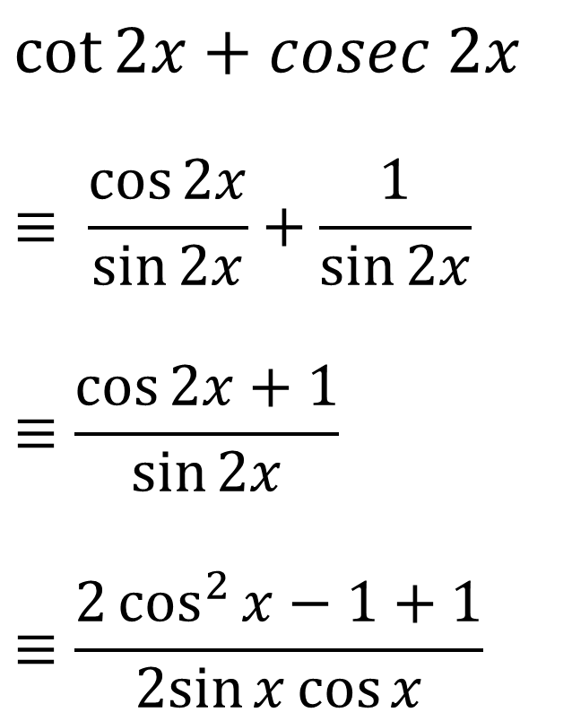
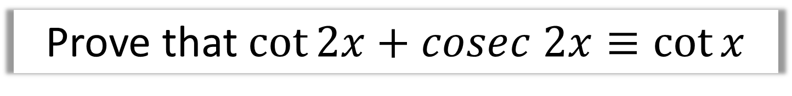
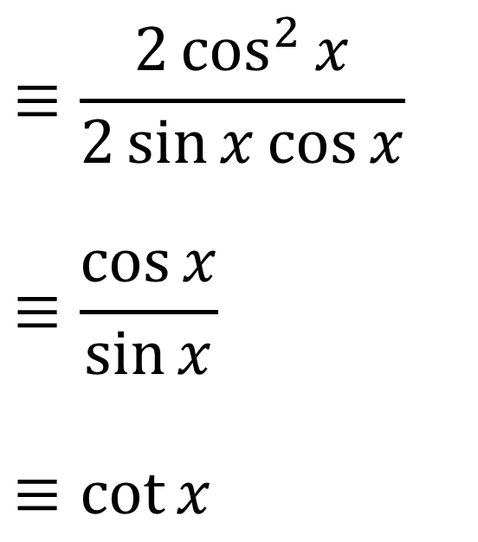
Proving Trigonometric Identities
Prove that $\cot{2x}+cosec 2x≡\cot{x}$
$$\cot{2x}+cosec 2x$$
$$≡ \frac{\cos{2x}}{\sin{2x}}+\frac{1}{\sin{2x}}$$
$$≡\frac{\cos{2x}+1}{\sin{2x}}$$
$$≡\frac{2\cos^{2}{x}−1+1}{2sin{x}\cos{x}}$$
$$≡\frac{2\cos^{2}{x}}{2\sin{x}\cos{x}}$$
$$≡\frac{\cos{x}}{\sin{x}}$$
$$≡\cot{x}$$

Slide 5
Exercise 7F
Pearson Pure Mathematics Year 2/AS
Pages 187-188
Complete before the lesson Q1-2
In Class:
Green Q3-5
Amber Q6-7
Red Q8-10

