Slide 1

P2 Chapter 3 :: Sequences & Series
jfrost@tiffin.kingston.sch.uk
www.drfrostmaths.com
@DrFrostMaths
Last modified: 6th September 2018

Slide 2








www.drfrostmaths.com
Everything is completely free.
Why not register?
Register now to interactively practise questions on this topic, including past paper questions and extension questions (including MAT + UKMT).
Teachers: you can create student accounts (or students can register themselves), to set work, monitor progress and even create worksheets.
With questions by:
Dashboard with points, trophies, notifications and student progress.
Questions organised by topic, difficulty and past paper.
Teaching videos with topic tests to check understanding.

Slide 3
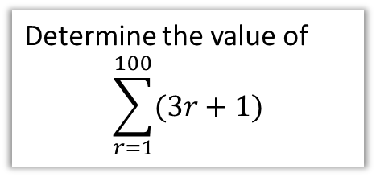
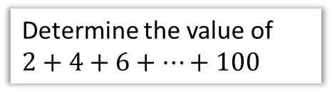
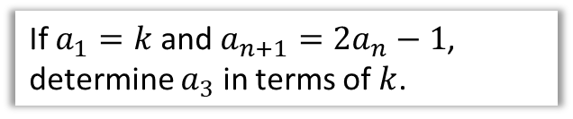
Chapter Overview
1:: Arithmetic Series
2:: Geometric Series
Determine the value of $2+4+6+…+100$
The first term of a geometric sequence is 3 and the second term 1. Find the sum to infinity.
3:: Sigma Notation
4:: Recurrence Relations
Determine the value of
$$\sum_{r=1}^{100}{(3r+1)}$$
If $a_{1}=k$ and $a_{n+1}=2a_{n}−1$, determine $a_{3}$ in terms of $k$.
NEW TO A LEVEL 2017!
Identifying whether a sequence is increasing, decreasing, or periodic.

Slide 4





Types of sequences
common difference $d$
?
+3
+3
+3
This is a:
2, 5, 8, 11, 14, …
?
Arithmetic Sequence
! An arithmetic sequence is one which has a common difference between terms.
common ratio $r$
?
$$×2$$
$$×2$$
$$×2$$
?
3, 6, 12, 24, 48, …
Geometric Sequence
(We will explore these later in the chapter)
?
This is the Fibonacci Sequence. The terms follow a recurrence relation because each term can be generated using the previous ones.
We will encounter recurrence relations later in the chapter.
1, 1, 2, 3, 5, 8, …

Slide 5
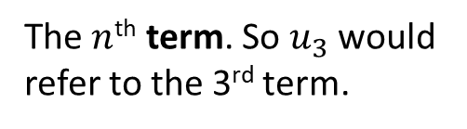

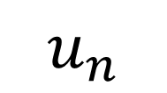

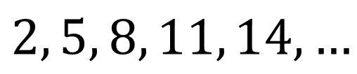
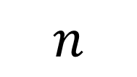
The fundamentals of sequences
$$u_{n}$$
? Meaning
The $n$^{th} term. So $u_{3}$ would refer to the 3rd term.
$$n$$
? Meaning
The position of the term in the sequence.
?
?
$$n=3$$
$$u_{3}=8$$
?
$$2, 5, 8, 11, 14, …$$

Slide 6

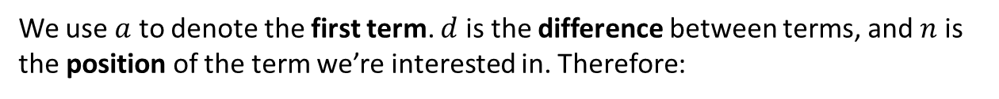



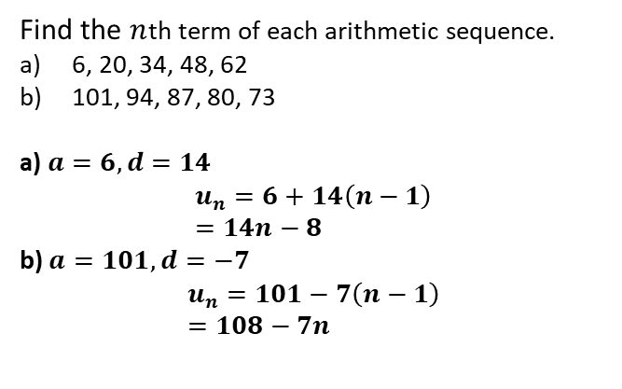

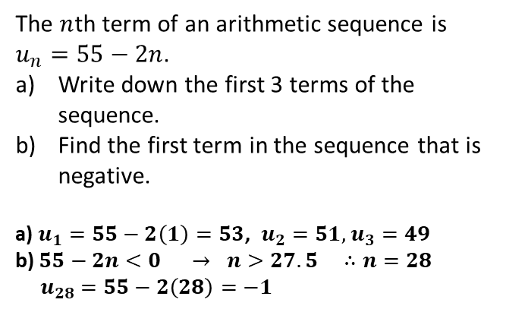


$n$^{th} term of an arithmetic sequence
We use $a$ to denote the first term. $d$ is the difference between terms, and $n$ is the position of the term we’re interested in. Therefore:
1st Term
2nd Term
3rd Term
. . .
$n$^{th} term
?
?
?
?
$$a$$
$$a+d$$
$$a+2d$$
. . .
$$a+(n−1)d$$
! $n$^{th} term of arithmetic sequence:
$$u_{n}=a+\left(n−1\right)d$$
Example 1
Example 2
The $n$th term of an arithmetic sequence is $u_{n}=55−2n$.
Write down the first 3 terms of the sequence.
Find the first term in the sequence that is negative.
a) $u_{1}=55−2\left(1\right)=53$, $u_{2}=51,$ $u_{3}=49$
b) $55−2n<0 → n>27.5 ∴n=28$
$u_{28}=55−2\left(28\right)=−1$
Find the $n$th term of each arithmetic sequence.
6, 20, 34, 48, 62
101, 94, 87, 80, 73
a) $a=6, d=14$
$$u_{n}=6+14\left(n−1\right) \\ =14n−8$$
b) $a=101, d=−7$
$$u_{n}=101−7\left(n−1\right) \\ =108−7n$$
Fro Tip: Always write out $a=, d=, n=$ first.
?
?
?
?

Slide 7
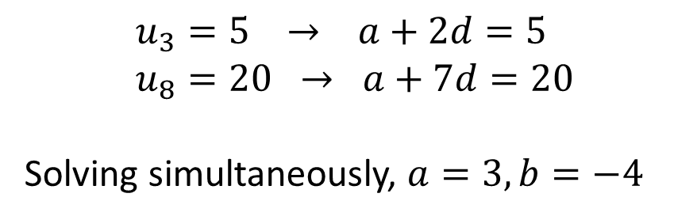
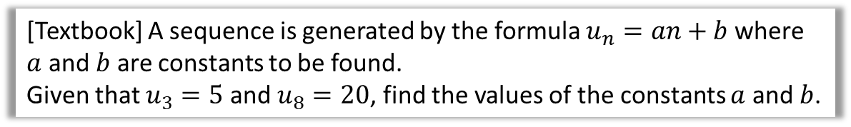

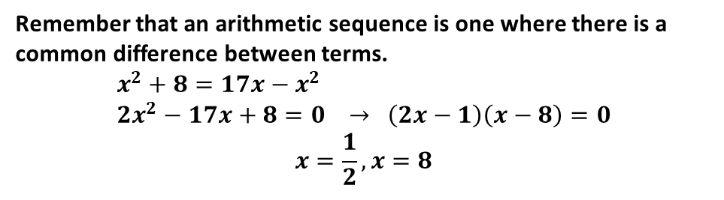
Further Examples
[Textbook] A sequence is generated by the formula $u_{n}=an+b$ where $a$ and $b$ are constants to be found.
Given that $u_{3}=5$ and $u_{8}=20$, find the values of the constants $a$ and $b$.
?
$$u_{3}=5 → a+2d=5 \\ u_{8}=20 → a+7d=20$$
Solving simultaneously, $a=3, b=−4$
For which values of $x$ would the expression $−8, x^{2}$ and $17x$ form the first three terms of an arithmetic sequence.
?
Remember that an arithmetic sequence is one where there is a common difference between terms.
$$x^{2}+8=17x−x^{2} \\ 2x^{2}−17x+8=0 → \left(2x−1\right)\left(x−8\right)=0$$
$$x=\frac{1}{2}, x=8$$

Slide 8
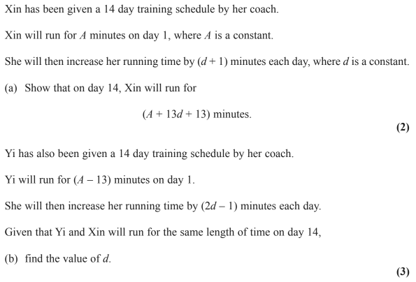
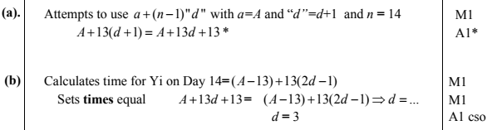
Test Your Understanding
Edexcel C1 May 2014(R) Q10
?
?

Slide 9
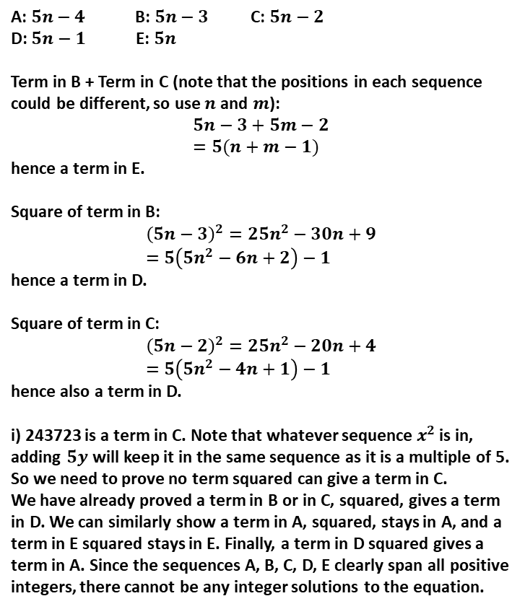
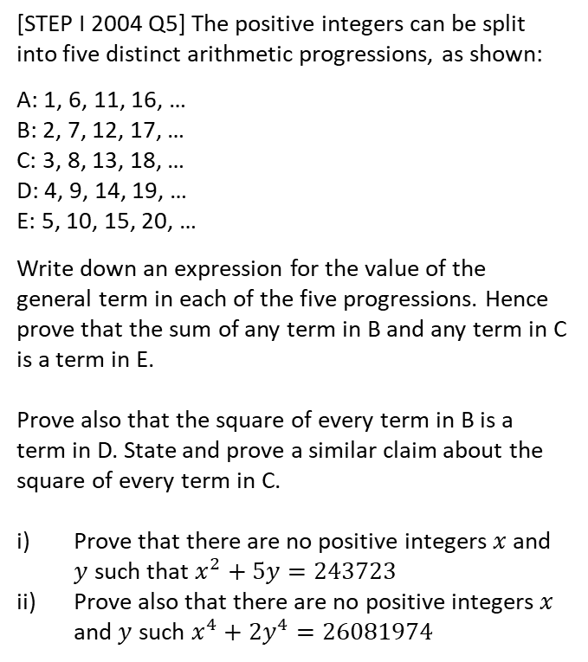
Exercise 3A
Pearson Pure Mathematics Year 2/AS
Pages 61-62
A: $5n−4$ B: $5n−3$ C: $5n−2$
D: $5n−1$ E: $5n$
Term in B + Term in C (note that the positions in each sequence could be different, so use $n$ and $m$):
$$5n−3+5m−2 \\ =5(n+m−1)$$
hence a term in E.
Square of term in B:
$${\left(5n−3\right)}^{2}=25n^{2}−30n+9 \\ =5\left(5n^{2}−6n+2\right)−1$$
hence a term in D.
Square of term in C:
$${\left(5n−2\right)}^{2}=25n^{2}−20n+4 \\ =5\left(5n^{2}−4n+1\right)−1$$
hence also a term in D.
i) 243723 is a term in C. Note that whatever sequence $x^{2}$ is in, adding $5y$ will keep it in the same sequence as it is a multiple of 5. So we need to prove no term squared can give a term in C.
We have already proved a term in B or in C, squared, gives a term in D. We can similarly show a term in A, squared, stays in A, and a term in E squared stays in E. Finally, a term in D squared gives a term in A. Since the sequences A, B, C, D, E clearly span all positive integers, there cannot be any integer solutions to the equation.
Extension
?
1
[STEP I 2004 Q5] The positive integers can be split into five distinct arithmetic progressions, as shown:
A: 1, 6, 11, 16, …
B: 2, 7, 12, 17, …
C: 3, 8, 13, 18, …
D: 4, 9, 14, 19, …
E: 5, 10, 15, 20, …
Write down an expression for the value of the general term in each of the five progressions. Hence prove that the sum of any term in B and any term in C is a term in E.
Prove also that the square of every term in B is a term in D. State and prove a similar claim about the square of every term in C.
Prove that there are no positive integers $x$ and $y$ such that $x^{2}+5y=243723$
Prove also that there are no positive integers $x$ and $y$ such $x^{4}+2y^{4}=26081974$

Slide 10
Exercise 3A
Pearson Pure Mathematics Year 2/AS
Pages 61-62
1
Complete before the lesson Q1-3
In Class:
Green Q4-7
Amber Q8-10
Red Challenge

Slide 11
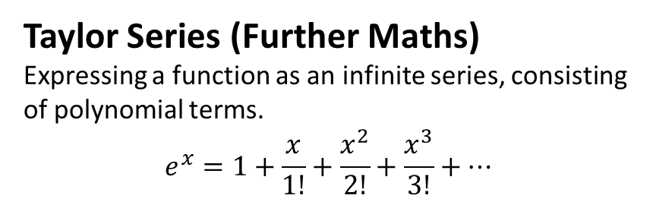

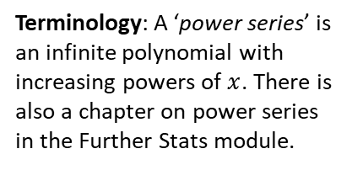
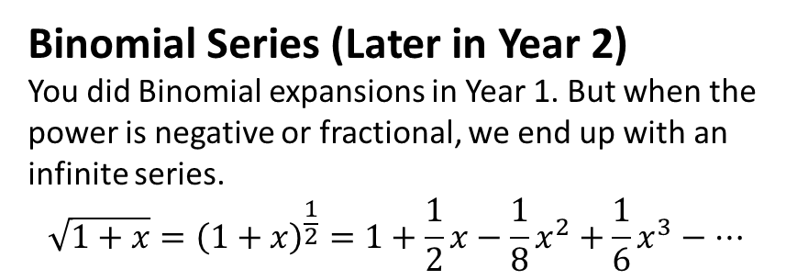
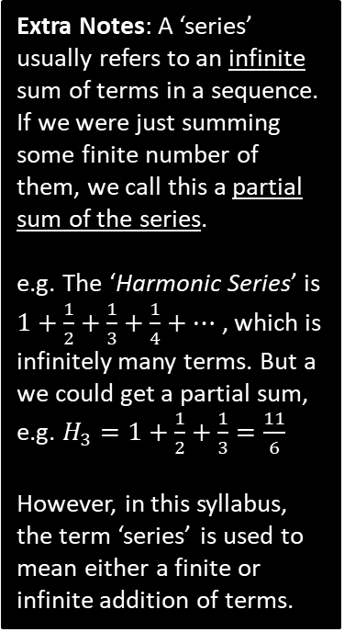
Series
A series is a sum of terms in a sequence.
You will encounter ‘series’ in many places in A Level:
Extra Notes: A ‘series’ usually refers to an infinite sum of terms in a sequence. If we were just summing some finite number of them, we call this a partial sum of the series.
e.g. The ‘Harmonic Series’ is $1+\frac{1}{2}+\frac{1}{3}+\frac{1}{4}+…$ , which is infinitely many terms. But a we could get a partial sum, e.g. $H_{3}=1+\frac{1}{2}+\frac{1}{3}=\frac{11}{6}$
However, in this syllabus, the term ‘series’ is used to mean either a finite or infinite addition of terms.
Arithmetic Series (this chapter!)
Sum of terms in an arithmetic sequence.
$$2+5+8+11$$
Binomial Series (Later in Year 2)
You did Binomial expansions in Year 1. But when the power is negative or fractional, we end up with an infinite series.
$$\sqrt{1+x}={\left(1+x\right)}^{\frac{1}{2}}=1+\frac{1}{2}x−\frac{1}{8}x^{2}+\frac{1}{6}x^{3}−…$$
Taylor Series (Further Maths)
Expressing a function as an infinite series, consisting of polynomial terms.
$$e^{x}=1+\frac{x}{1!}+\frac{x^{2}}{2!}+\frac{x^{3}}{3!}+…$$
Terminology: A ‘power series’ is an infinite polynomial with increasing powers of $x$. There is also a chapter on power series in the Further Stats module.

Slide 12
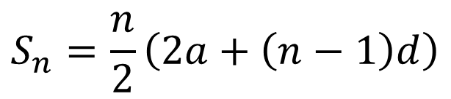
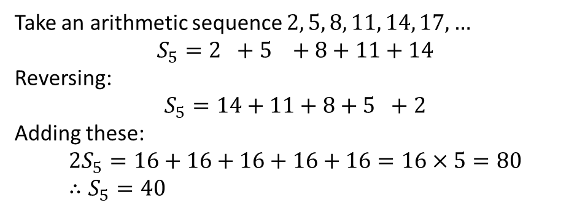

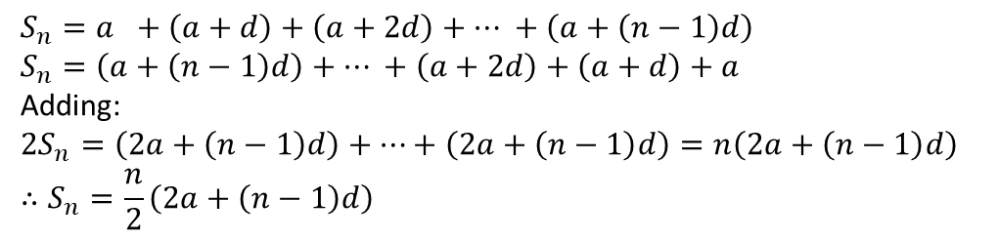


Arithmetic Series
$n$^{th} term
! Sum of first $n$ terms
?
$$S_{n}=\frac{n}{2}\left(2a+\left(n−1\right)d\right)$$
$$u_{n}=a+\left(n−1\right)d$$
Example:
Let’s prove it!
Take an arithmetic sequence $2, 5, 8, 11, 14, 17, …$
$$S_{5}=2 +5 +8+11+14$$
Reversing:
$$S_{5}=14+11+8+5 +2$$
Adding these:
$$2S_{5}=16+16+16+16+16=16×5=80 \\ ∴S_{5}=40$$
The idea is that each pair of terms, at symmetrically opposite ends, adds to the same number.
Proving more generally:
Fro Exam Note: The proof has been an exam question before. It’s also a university interview favourite!
$$S_{n}=a +\left(a+d\right)+\left(a+2d\right)+… +\left(a+\left(n−1\right)d\right) \\ S_{n}=\left(a+\left(n−1\right)d\right)+… +\left(a+2d\right)+\left(a+d\right)+a$$
Adding:
$$2S_{n}=\left(2a+\left(n−1\right)d\right)+…+\left(2a+\left(n−1\right)d\right)=n\left(2a+\left(n−1\right)d\right) \\ ∴S_{n}=\frac{n}{2}\left(2a+\left(n−1\right)d\right)$$

Slide 13
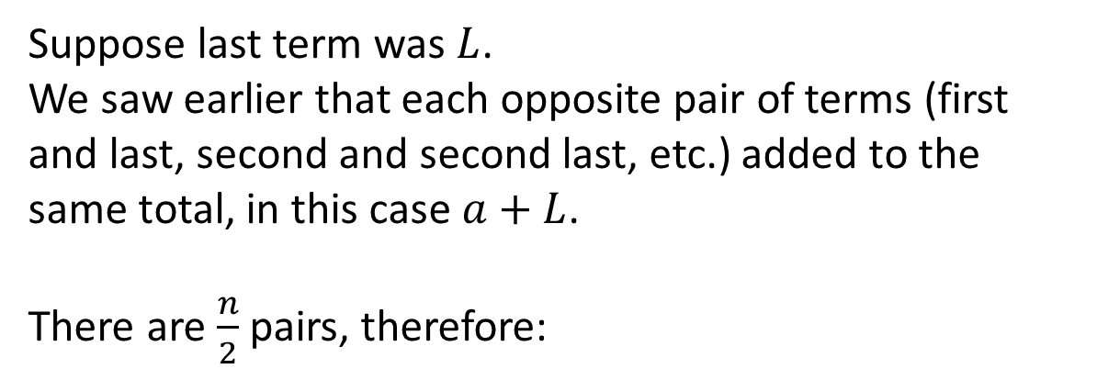

Alternative Formula
$$a+\left(a+d\right)+…+L$$
Suppose last term was $L$.
We saw earlier that each opposite pair of terms (first and last, second and second last, etc.) added to the same total, in this case $a+L$.
There are $\frac{n}{2}$ pairs, therefore:
!
$$S_{n}=\frac{n}{2}\left(a+L\right)$$

Slide 14

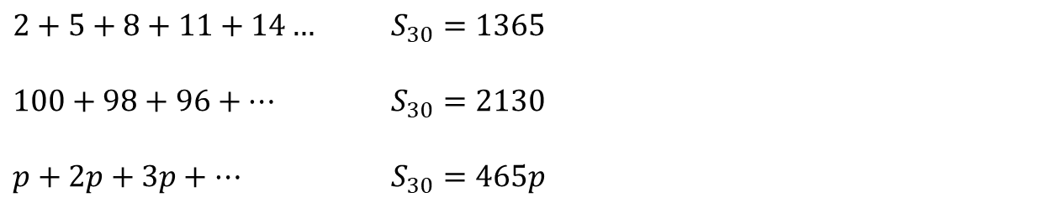
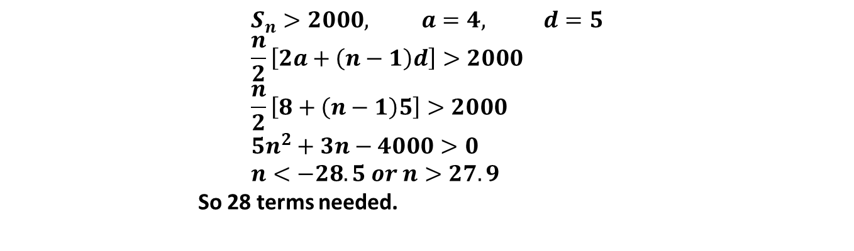
Examples
Find the sum of the first 30 terms of the following arithmetic sequences…
1
?
Fro Tips: Again, explicitly write out $"a=…, d=…, n=…$”. You’re less likely to make incorrect substitutions into the formula.
Make sure you write $S_{n}=…$ so you make clear to yourself (and the examiner) that you’re finding the sum of the first $n$ terms, not the $n$th term.
$2+5+8+11+14…$ $S_{30}=1365$
$100+98+96+…$ $S_{30}=2130$
$p+2p+3p+…$ $S_{30}=465p$
2
?
3
?
Find the minimum number of terms for the sum of $4+9+14+…$ to exceed 2000.
?
$$S_{n}>2000, a=4, d=5 \\ \frac{n}{2}\left[2a+\left(n−1\right)d\right]>2000 \\ \frac{n}{2}\left[8+\left(n−1\right)5\right]>2000 \\ 5n^{2}+3n−4000>0 \\ n<−28.5 or n>27.9$$
So 28 terms needed.

Slide 15
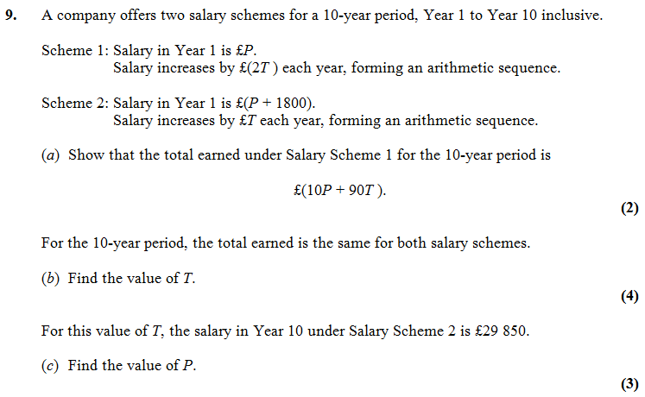


Test Your Understanding
Edexcel C1 Jan 2012 Q9
?
$$T=400$$
$$P=£24450$$
?

Slide 16
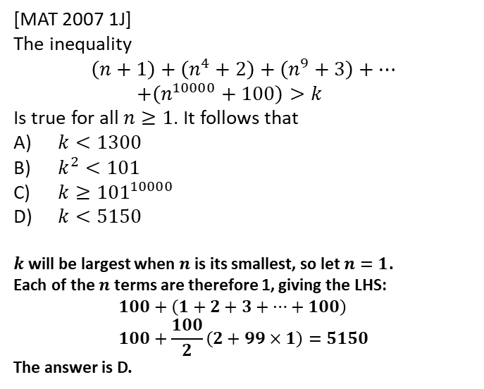
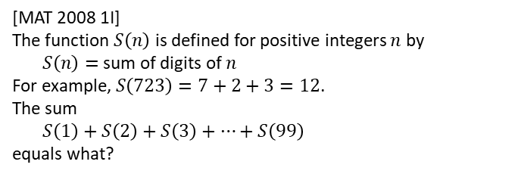
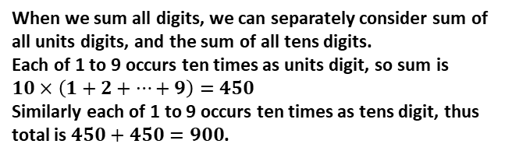
Exercise 3B
Pearson Pure Mathematics Year 2/AS
Pages 64-66
Extension
Complete before the lesson Q1-2
In Class:
Green Q3-6
Amber Q7-9
Red Q10-13 & Challenge
[MAT 2007 1J]
The inequality
$$\left(n+1\right)+\left(n^{4}+2\right)+\left(n^{9}+3\right)+… \\ +\left(n^{10000}+100\right)>k$$
Is true for all $n≥1$. It follows that
$k<1300$
$k^{2}<101$
$k≥{101}^{10000}$
$k<5150$
$k$ will be largest when $n$ is its smallest, so let $n=1$.
Each of the $n$ terms are therefore 1, giving the LHS:
$$100+\left(1+2+3+…+100\right) \\ 100+\frac{100}{2}\left(2+99×1\right)=5150$$
The answer is D.
?
3
[MAT 2008 1I]
The function $S\left(n\right)$ is defined for positive integers $n$ by
$S\left(n\right)=$sum of digits of $n$
For example, $S\left(723\right)=7+2+3=12$.
The sum
$S\left(1\right)+S\left(2\right)+S\left(3\right)+…+S\left(99\right)$
equals what?
?
When we sum all digits, we can separately consider sum of all units digits, and the sum of all tens digits.
Each of 1 to 9 occurs ten times as units digit, so sum is $10×\left(1+2+…+9\right)=450$
Similarly each of 1 to 9 occurs ten times as tens digit, thus total is $450+450=900$.

Slide 17
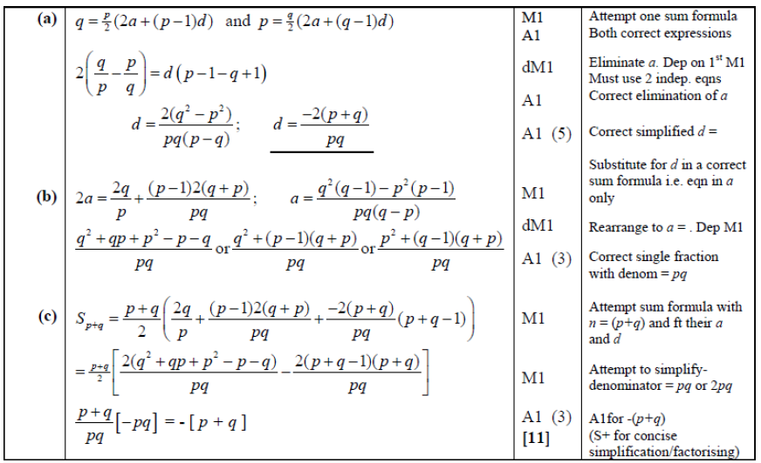
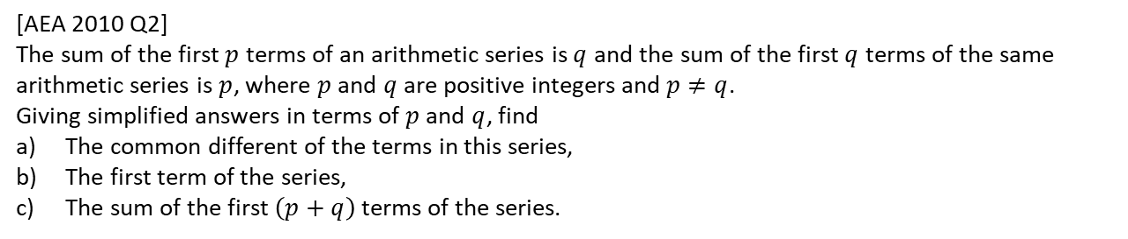
Solution to Extension Q2
[AEA 2010 Q2]
The sum of the first $p$ terms of an arithmetic series is $q$ and the sum of the first $q$ terms of the same arithmetic series is $p$, where $p$ and $q$ are positive integers and $p≠q$.
Giving simplified answers in terms of $p$ and $q$, find
The common different of the terms in this series,
The first term of the series,
The sum of the first $\left(p+q\right)$ terms of the series.

Slide 18





Recap of Arithmetic vs Geometric Sequences
common difference $d$
?
+3
+3
+3
This is a:
2, 5, 8, 11, 14, …
?
Arithmetic Sequence
common ratio $r$
?
$$×2$$
$$×2$$
$$×2$$
3, 6, 12, 24, 48, …
?
Geometric Sequence
! A geometric sequence is one in which there is a common ratio between terms.

Slide 19















Quickfire Common Ratio
Identify the common ratio $r$:
$$r=2$$
1
$$1, 2, 4, 8, 16, 32, …$$
?
$$27, 18, 12, 8, …$$
$$r=2/3$$
2
?
$$10, 5, 2.5, 1.25, …$$
$$r=1/2$$
3
?
An alternating sequence is one which oscillates between positive and negative.
$$5, −5, 5, −5, 5, −5, …$$
$$r=−1$$
4
?
$$x, −2x^{2}, 4x^{3}$$
$$r=−2x$$
5
?
?
6
$$1, p, p^{2}, p^{3}, …$$
$$r=p$$
$$r=−0.25$$
7
$$4, −1, 0.25, −0.0625, …$$
?

Slide 20





$n$^{th} term
Arithmetic Sequence
Geometric Sequence
?
?
$$u_{n}=a+\left(n−1\right)d$$
$$u_{n}=ar^{n−1}$$
Determine the 10th and $n$^{th} terms of the following:
$$a=3, r=2 \\ u_{10}=3×2^{9}=1536 \\ u_{n}=3\left(2^{n−1}\right)$$
?
3, 6, 12, 24, …
$$a=40, r=−\frac{1}{2} \\ u_{10}=40×{\left(−\frac{1}{2}\right)}^{9}=−\frac{5}{64} \\ u_{n}={\left(−1\right)}^{n−1}×\frac{5}{2^{n−4}}$$
40, -20, 10, -5, …
?
Fro Tip: As before, write out $a=$ and $r=$ first before substituting.

Slide 21
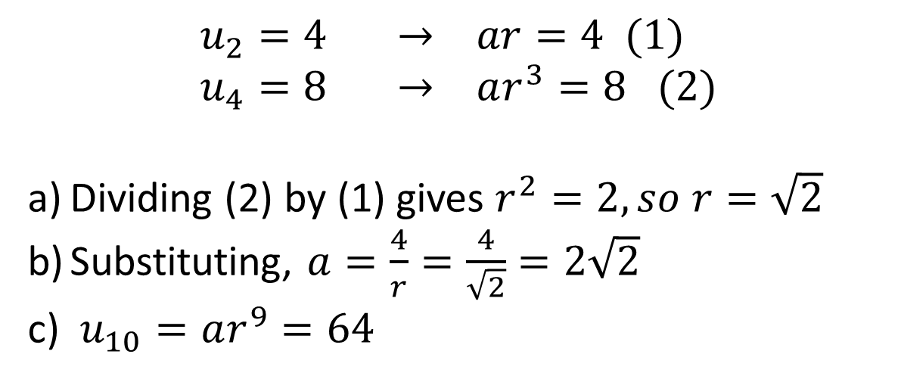
Further Example
[Textbook] The second term of a geometric sequence is 4 and the 4th term is 8. The common ratio is positive. Find the exact values of:
The common ratio.
The first term.
The 10th term.
?
$$u_{2}=4 → ar=4 (1) \\ u_{4}=8 → ar^{3}=8 (2)$$
Dividing (2) by (1) gives $r^{2}=2, so r=\sqrt{2}$
Substituting, $a=\frac{4}{r}=\frac{4}{\sqrt{2}}=2\sqrt{2}$
$u_{10}=ar^{9}=64$
Fro Tip: Explicitly writing $u_{2}=4$ first helps you avoid confusing the $n$^{th} term with the ‘sum of the first $n$ terms’ (the latter of which we’ll get onto).

Slide 22

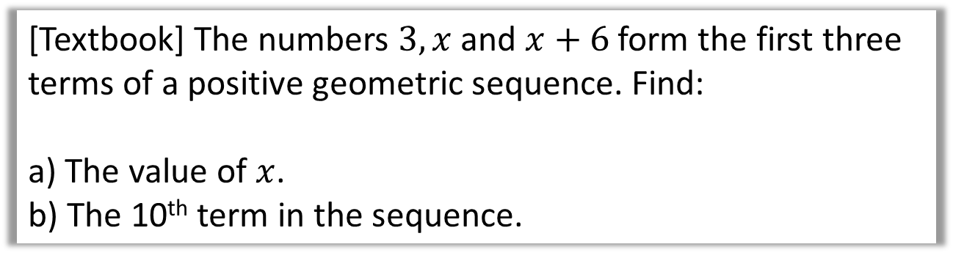

Further Example
[Textbook] The numbers $3, x$ and $x+6$ form the first three terms of a positive geometric sequence. Find:
a) The value of $x$.
b) The 10th term in the sequence.
Hint: You’re told it’s a geometric sequence, which means the ratio between successive terms must be the same. Consequently $\frac{u_{2}}{u_{1}}=\frac{u_{3}}{u_{2}}$
?
$$\frac{x}{3}=\frac{x+6}{x} → x^{2}=3x+18 \\ x^{2}−3x−18=0 \\ \left(x+3\right)\left(−6\right)=0$$
$$x=6 or −3$$
But there are no negative terms so $x=6$
$$r=\frac{x}{3}=\frac{6}{3}=2 a=3 n=10$$
$$u_{10}=3×2^{9}=1536$$
Exam Note: This kind of question has appeared in the exam multiple times.

Slide 23
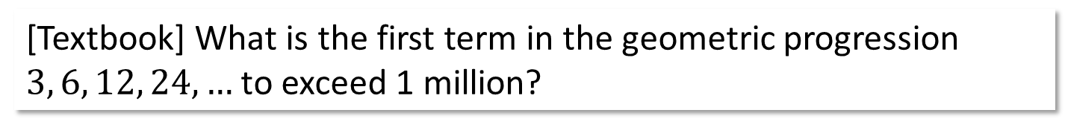

$n$^{th} term with inequalities
[Textbook] What is the first term in the geometric progression $3, 6, 12, 24, …$ to exceed 1 million?
$$u_{n}>1000000 a=3, r=2 \\ ∴ 3×2^{n−1}>1000000 \\ 2^{n−1}>\frac{1000000}{3} \\ \log{2^{n−1}>\log{\frac{1000000}{3}}} \\ n−1>\frac{\log\left(\frac{1000000}{3}\right)}{log2} \\ n−1>18.35 \\ n>19.35 \\ n=20$$
?

Slide 24
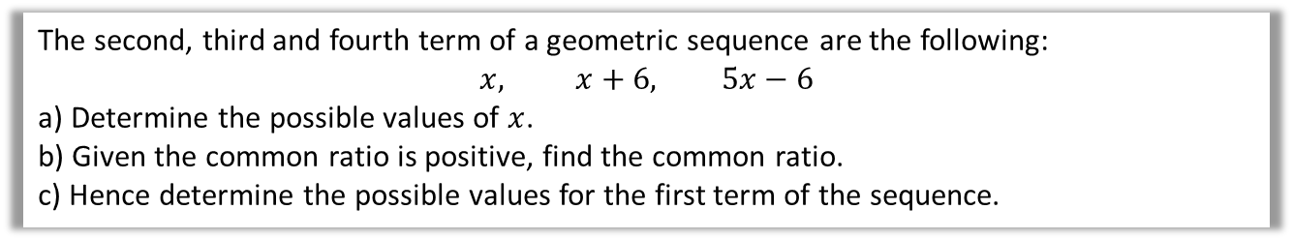



Test Your Understanding
All the terms in a geometric sequence are positive.
The third term of the sequence is 20 and the fifth term 80. What is the 20th term?
?
$$u_{3}=20 → ar^{2}=20 \\ u_{5}=80 → ar^{4}=80$$
Dividing: $r^{2}=4, ∴r=2$
$$a=\frac{20}{r^{2}}=\frac{20}{4}=5$$
$$u^{20}=5×2^{19}=2621440$$
The second, third and fourth term of a geometric sequence are the following:
$$x, x+6, 5x−6$$
a) Determine the possible values of $x$.
b) Given the common ratio is positive, find the common ratio.
c) Hence determine the possible values for the first term of the sequence.
?
$$\frac{x+6}{x}=\frac{5x−6}{x+6}$$
$${\left(x+6\right)}^{2}=x\left(5x−6\right) \\ x^{2}+12x+36=5x^{2}−6x \\ 4x^{2}−18x−36=0 \\ 2x^{2}−9x−18=0 \\ \left(2x+3\right)\left(x−6\right)$$
$$x=−\frac{3}{2} or x=6$$
$$r=\frac{x+6}{x}=\frac{6+6}{6}=2$$
$$u_{2}=x=6 \\ ar=6 \\ a=\frac{6}{2}=3$$

Slide 25
Exercise 3C
Pearson Pure Mathematics Year 2/AS
Pages 69-70
Complete before the lesson Q1-4
In Class:
Green Q5-7
Amber Q8-9
Red Q10-13

Slide 26
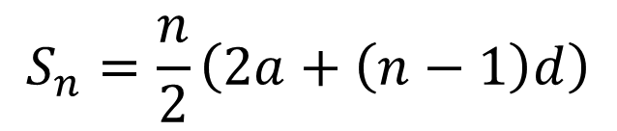

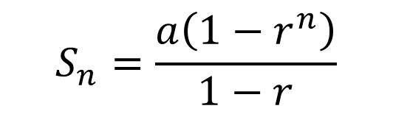
Sum of the first $n$ terms of a geometric series
Arithmetic Series
Geometric Series
?
$$S_{n}=\frac{n}{2}\left(2a+\left(n−1\right)d\right)$$
$$S_{n}=\frac{a\left(1−r^{n}\right)}{1−r}$$
?
Proof:
$$S_{n} =a+ar+ar^{2}+…+ar^{n−2}+ar^{n−1}$$
Mutiplying by $r$:
$$rS_{n}= ar+ar^{2}+… +ar^{n−1}+ar^{n}$$
Subtracting:
$$S_{n}−rS_{n}=a−ar^{n} \\ S_{n}\left(1−r\right)=a\left(1−r^{n}\right) \\ S_{n}=\frac{a\left(1−r^{n}\right)}{1−r}$$
?
Exam Note: This once came up in an exam. And again is a university interview favourite!

Slide 27





Examples
$$S_{n}=\frac{a\left(1−r^{n}\right)}{1−r}$$
Geometric Series
Find the sum of the first 10 terms.
$$3, 6, 12, 24, 48, …$$
?
?
?
$$a=3, r=2, n=10 \\ S_{n}=\frac{3\left(1−2^{10}\right)}{1−2}=3069$$
?
$$4, 2,1, \frac{1}{2},\frac{1}{4},\frac{1}{8}, …$$
$$a=4, r=\frac{1}{2}, n=10 \\ S_{n}=\frac{4\left(1−{\left(\frac{1}{2}\right)}^{10}\right)}{1−\frac{1}{2}}=\frac{1023}{128}$$
?
?
?
?

Slide 28



Harder Example
Find the least value of $n$ such that the sum of $1+2+4+8+…$ to $n$ terms would exceed 2 000 000.
?
$$a=1, r=2, n=? \\ S_{n}>2 000 000$$
$$\frac{1\left(1−2^{n}\right)}{1−2}>2 000 000 \\ 2^{n}−1>2 000 000 \\ 2^{n}>2 000 001 \\ n>\log_{2}{2000001} \\ n>20.9$$
So 21 terms needed.
?
$\log_{2}$ both sides to cancel out “2 to the power of”.

Slide 29


Test Your Understanding
Edexcel C2 June 2011 Q6
?
?
?

Slide 30


Exercise 3D
Pearson Pure Mathematics Year 2/AS
Pages 72-73
Complete before the lesson Q1-4
In Class:
Green Q5-6
Amber Q7-9
Red Q 10 -11 & Ext
Extension
There are interleaved sequences. If we want $2n$ terms, we want $n$ terms of $1, 2, 4, 8, …$ and $n$ terms of $1,\frac{1}{2},\frac{1}{4},…$
For first sequence:
$$S_{n}=\frac{1\left(1−2^{n}\right)}{1−2}=2^{n}−1$$
For second sequence:
$$S_{n}=\frac{1\left(1−{\left(\frac{1}{2}\right)}^{n}\right)}{1−\frac{1}{2}}=\frac{1−2^{−n}}{1/2}=2−2^{1−n}$$
Therefore the sum of both is (A).
[MAT 2010 1B]
The sum of the first $2n$ terms of
$$1, 1, 2,\frac{1}{2}, 4,\frac{1}{4},8,\frac{1}{8},16,\frac{1}{16},…$$
is
$2^{n}+1−2^{1−n}$
$2^{n}+2^{−n}$
$2^{2n}−2^{3−2n}$
$\frac{2^{n}−2^{−n}}{3}$
?

Slide 31



Divergent vs Convergent
What can you say about the sum of each series up to infinity?
1 + 2 + 4 + 8 + 16 + ...
?
This is divergent – the sum of the values tends towards infinity.
?
1 – 2 + 3 – 4 + 5 – 6 + …
This is divergent – the running total alternates either side of 0, but gradually gets further away from 0.
1 + 0.5 + 0.25 + 0.125 + ...
This is convergent – the sum of the values tends towards a fixed value, in this case 2.
?
Definitely NOT in the A Level syllabus, and just for fun...
$$\frac{1}{1}+\frac{1}{2}+\frac{1}{3}+\frac{1}{4}+…$$
?
This is divergent . This is known as the Harmonic Series
$$\frac{1}{1}+\frac{1}{4}+\frac{1}{9}+\frac{1}{16}+…$$
This is convergent . This is known as the Basel Problem, and the value is $π^{2}/6$.
?

Slide 32





Sum to Infinity
1 + 0.5 + 0.25 + 0.125 + ...
Why did this infinite sum converge (to 2)…
1 + 2 + 4 + 8 + 16 + ...
…but this diverge to infinity?
The infinite series will converge provided that $−1<r<1$ (which can be written as $\left|r\right|<1$), because the terms will get smaller.
! A geometric series is convergent if $\left|r\right|<1$.
Provided that $\left|r\right|<1$, what happens to $r^{n}$ as $n→∞$?
For example ${\left(\frac{1}{2}\right)}^{100000}$ is very close to 0.
We can see that as $n→∞, r^{n}→0$.
?
How therefore can we use the $S_{n}=\frac{a\left(1−r^{n}\right)}{1−r}$ formula to find the sum to infinity, i.e. $S_{∞}$?
! For a convergent geometric series,
$$S_{∞}=\frac{a}{1−r}$$

Slide 33









Quickfire Examples
$$1,\frac{1}{2},\frac{1}{4},\frac{1}{8},…$$
?
$$a=1, r=\frac{1}{2} S_{∞}=2$$
?
?
$$a=27, r=−\frac{1}{3} S_{∞}=\frac{81}{4}$$
?
?
?
$$27,−9,3,−1,…$$
?
?
$$a=p, r=p S_{∞}=\frac{p}{1−p}$$
$$p, p^{2},p^{3},p^{4},…$$
?
$$where −1<p<1$$
$$a=p, r=\frac{1}{p} S_{∞}=\frac{p^{2}}{p−1}$$
$$p, 1,\frac{1}{p},\frac{1}{p^{2}},…$$
?
?
?

Slide 34




Further Examples
[Textbook] The fourth term of a geometric series is 1.08 and the seventh term is 0.23328.
Show that this series is convergent.
Find the sum to infinity of this series.
[Textbook] For a geometric series with first term $a$ and common ratio $r$, $S_{4}=15$ and $S_{∞}=16$.
a) Find the possible values of $r$.
b) Given that all the terms in the series are positive, find the value of $a$.
Fro Warning: The power is $n$ in the $S_{n}$ formula but $n−1$ in the $u_{n}$ formula.
? a
$$u_{4}=1.08 → ar^{3}=1.08 \\ u_{7}=0.23328 → ar^{6}=0.23328$$
Dividing:
$$r^{3}=0.216 ∴r=0.6$$
The series converges because $\left|0.6\right|<1$.
$$a=\frac{1.08}{r^{3}}=\frac{1.08}{0.216}=5$$
$$∴S_{∞}=\frac{5}{1−0.6}=12.5$$
? a
$$S_{4}=15 → \frac{a\left(1−r^{4}\right)}{1−r}=15 (1)$$
$$S_{∞}=16 → \frac{a}{1−r}=16 (2)$$
Substituting $\frac{a}{1−r}$ for 16 in equation (1):
$$16\left(1−r^{4}\right)=15$$
Solving: $r=±\frac{1}{2}$
As terms positive, $r=\frac{1}{2}$, $∴a=16\left(1−\frac{1}{2}\right)=8$
? b
? b

Slide 35





Test Your Understanding
Edexcel C2 May 2011 Q6
?
$$r=\frac{3}{4}$$
?
$$a=256$$
?
$$S_{∞}=1024$$
?
$$\frac{256\left(1−{\left(\frac{3}{4}\right)}^{n}\right)}{0.25}>1000$$
$$n>\frac{log\left(\frac{6}{256}\right)}{log\left(0.75\right)} ⇒n=14$$

Slide 36


Exercise 3E
Pearson Pure Mathematics Year 2/AS
Pages 75-76
Complete before the lesson Q1-5
In Class:
Green Q6-7
Amber Q8-9
Red Q10-11 & Challenge & Ext
Extension
[MAT 2006 1H] How many solutions does the equation
$$2=\sin{x}+\sin^{2}{x}+\sin^{3}{x}+\sin^{4}{x}+…$$
have in the range $0≤x<2π$
RHS is geometric series. $a=\sin{x}, r=\sin{x}$.
$$2=\frac{\sin{x}}{1−\sin{x}} → 2−2\sin{x}=\sin{x} \\ \sin{x}=\frac{2}{3}$$
By considering the graph of sin for $0≤x<2π$, this has 2 solutions.
[Frost] Determine the value of $x$ where:
$$x=\frac{1}{1}+\frac{2}{2}+\frac{3}{4}+\frac{4}{8}+\frac{5}{16}+\frac{6}{32}+…$$
(Hint: Use an approach similar to proof of geometric $S_{n}$ formula)
Doubling:
$$2x=2+\frac{1}{1}+\frac{1}{2}+\frac{1}{4}+\frac{1}{8}+…$$
Subtracting the two equations:
$$x=2+\frac{1}{1}+\frac{1}{2}+\frac{1}{4}+\frac{1}{8}+… \\ =2+2=4$$
?
?

Slide 37















Sigma Notation
What does each bit of this expression mean?
The Greek letter, capital sigma, means ‘sum’.
$$\sum_{r=1}^{5}{(2r+1)}$$
We work out this expression for each value of $r$ (between 1 and 5), and add them together.
The numbers top and bottom tells us what $r$ varies between. It goes up by 1 each time.
$$r=1$$
$$r=2$$
$$r=3$$
$$r=4$$
$$r=5$$
$$=3$$
$$+5$$
$$+7$$
$$+9$$
$$+11$$
$$=35$$
If the expression being summed (in this case $2r+1$) is linear, we get an arithmetic series. We can therefore apply our usual approach of establishing $a, d$ and $n$ before applying the $S_{n}$ formula.

Slide 38















Determining the value
First few terms?
Values of $a, n, d or r$?
Final result?
$$\sum_{n=1}^{7}{3n}$$
?
?
?
$$S_{7}=\frac{7}{2}\left(6+6×3\right) \\ =84$$
$$=3+6+9+…$$
$$a=3, d=3, n=7$$
$$\sum_{k=5}^{15}{\left(10−2k\right)}$$
?
?
?
$$a=0, d=−2, n=11$$
$$S_{11}=\frac{11}{2}\left(0+10×−2\right) \\ =−110$$
$$=0+\left(−2\right)+\left(−4\right)+…$$
Be careful, there are 11 numbers between 5 and 15 inclusive. Subtract and +1.
$$\sum_{k=1}^{12}{5×3^{k−1}}$$
?
?
?
$$=5+15+45+…$$
$$a=5, r=3, n=12$$
$$S_{12}=\frac{5\left(1−3^{12}\right)}{1−3}=1328600$$
$$\sum_{k=5}^{12}{5×3^{k−1}}$$
?
Note: You can either find from scratch by finding the first few terms (the first when $k=5$), or by calculating:
$$\sum_{k=1}^{12}{5×3^{k−1}}−\sum_{k=1}^{4}{5×3^{k−1}}$$
i.e. We start with the first 12 terms, and subtract the first 4 terms.

Slide 39



Testing Your Understanding
Solomon Paper A
Method 1: Direct
$$\sum_{r=10}^{30}{\left(7+2r\right)=}27+29+31+…$$
$$a=27, d=2, n=21$$
$$∴S_{21}=\frac{21}{2}\left(54+20×2\right) \\ =987$$
Method 2: Subtraction
$$\sum_{r=10}^{30}{\left(7+2r\right)}=\sum_{r=1}^{30}{\left(7+2r\right)}−\sum_{r=1}^{9}{\left(7+2r\right)}$$
$$\sum_{r=1}^{30}{\left(7+2r\right)}=9+11+13+…$$
$$a=9, d=2, n=30 \\ S_{30}=\frac{30}{2}\left(18+29×2\right)=1140 \\ S_{9}=\frac{9}{2}\left(18+8×2\right)=153 \\ 1140−153=987$$
?
?

Slide 40




On your calculator
“Use of Technology” Monkey says:
The Classwiz and Casio Silver calculator has a $Σ$ button.
Try and use it to find:
$$\sum_{k=5}^{12}{2×3^{k}}$$

Slide 41
Exercise 3F
Pearson Pure Mathematics Year 2/AS
Pages 77-78
Complete before the lesson Q1-4
In Class:
Green Q5-7
Amber Q8-9
Red Q10-12 & Challenge

Slide 42




Recurrence Relations
This is an example of a position-to-term sequence, because each term is based on the position $n$.
$$u_{n}=2n^{2}+3$$
$$u_{n+1}=2u_{n}+4 \\ u_{1}=3$$
But a term might be defined based on previous terms.
If $u_{n}$ refers to the current term, $u_{n+1}$ refers to the next term.
So the example in words says “the next term is twice the previous term + 4”
We need the first term because the recurrence relation alone is not enough to know what number the sequence starts at.
This is known as a term-to-term sequence, or more formally as a recurrence relation, as the sequence ‘recursively’ refers to itself.

Slide 43






Example
Important Note: With recurrence relation questions, the the sequence will likely not be arithmetic nor geometric. So your previous $u_{n}$ and $S_{n}$ formulae do not apply.
Edexcel C1 May 2013 (R)
?
$$x_{2}={\left(x_{1}\right)}^{2}−kx_{1}=1−k$$
$$x_{3}={\left(x_{2}\right)}^{2}−kx_{2} \\ ={\left(1−k\right)}^{2}−k\left(1−k\right) \\ =1−3k+2k^{2}$$
?
$$k=\frac{3}{2}$$
?
?
$$=1+\left(−\frac{1}{2}\right)+1+\left(−\frac{1}{2}\right)+… \\ =50×\left(1−\frac{1}{2}\right)=25$$
Fro Tip: When a $Σ$ question comes up for recurrence relations, it will most likely be some kind of repeating sequence. Just work out the sum of terms in each repeating bit, and how many times it repeats.

Slide 44




Test Your Understanding
Edexcel C1 Jan 2012
?
$$x_{2}=a+5$$
?
$$x_{3}=a\left(a+5\right)+5=…$$
?
$$a^{2}+5a+5=41 \\ a^{2}+5a−36=0 \\ \left(a+9\right)\left(a−4\right)=0 \\ a=−9 or 4$$

Slide 45

Solution to Extension Question 3
[MAT 2016 1G] The sequence $\left(x_{n}\right)$, where $n≥0$, is defined by $x_{0}=1$ and
$x_{n}=\sum_{k=0}^{n−1}{\left(x_{k}\right)}$ for $n≥1$
Determine the value of the sum
$$\sum_{k=0}^{∞}{\frac{1}{x_{k}}}$$
Solution:
$$x_{0}=1 \\ x_{1}=1 \\ x_{2}=1+1=2 \\ x_{3}=1+1+2=4$$
This is a geometric sequence from $x_{1}$ onwards.
Therefore
$$\sum_{k=0}^{∞}{\frac{1}{x_{k}}}=\frac{1}{1}+\frac{1}{1}+\frac{1}{2}+\frac{1}{4}+\frac{1}{8}+… \\ =1+2=3$$

Slide 46



A somewhat esoteric Futurama joke explained
Bender (the robot) manages to self-clone himself, where some excess is required to produce the duplicates (e.g. alcohol), but the duplicates are smaller versions of himself. These smaller clones also have the capacity to clone themselves. The Professor is worried that the total amount mass $M$ consumed by the growing population is divergent, and hence they’ll consume to Earth’s entire resources.
This simplifies to
$$M=M_{0}\sum_{n=1}^{∞}{\frac{1}{n}}$$
The sum $\frac{1}{1}+\frac{1}{2}+\frac{1}{3}+…$is known as the harmonic series, which is divergent.

Slide 47


Increasing, decreasing and periodic sequences
A sequence is strictly increasing if the terms are always increasing, i.e.
$u_{n+1}>u_{n}$ for all $n∈ℕ$.
e.g. $1, 2, 4, 8, 16, …$
Similarly a sequence is strictly decreasing if $u_{n+1}<u_{n}$ for
all $n∈ℕ$
A sequence is periodic if the terms repeat in a cycle. The order $k$ of a sequence is how often it repeats, i.e. $u_{n+k}=u_{n}$ for all $n$.
e.g. 2, 3, 0, 2, 3, 0, 2, 3, 0, 2, … is periodic and has order 3.
Textbook Error: It uses the term ‘increasing’ when it means ‘strictly increasing’.
[Textbook] For each sequence:
State whether the sequence is increasing, decreasing or periodic.
If the sequence is periodic, write down its order.
$u_{n+1}=u_{n}+3, u_{1}=7$ Terms: 7, 10, 13,…. Increasing.
$u_{n+1}={\left(u_{n}\right)}^{2}, u_{1}=\frac{1}{2}$ Terms: $\frac{1}{2},\frac{1}{4},\frac{1}{8},\frac{1}{16},…$. Decreasing.
$u_{n+1}=\sin\left(90n°\right)$ Terms: 1, 0, -1, 0, 1, 0, … Periodic, order 4.
?
?
?

Slide 48



Exercise 3G
Pearson Pure Mathematics Year 2/AS
Pages 80-81
?
1
[AEA 2011 Q3] A sequence $\{u_{n}\}$ is given by
$$u_{1}=k \\ u_{2n}=u_{2n−1}×p, n≥1 \\ u_{2n+1}=u_{2n}×q n≥1$$
Write down the first 6 terms in the sequence.
Show that $\sum_{r=1}^{2n}{u_{r}}=\frac{k\left(1+p\right)\left(1−{\left(pq\right)}^{n}\right)}{1−pq}$
$[x]$ means the integer part of $x$, for example $\left[2.73\right]=2, \left[4\right]=4$.
Find $\sum_{r=1}^{∞}{6×{\left(\frac{4}{3}\right)}^{\left[\frac{r}{2}\right]}×{\left(\frac{3}{5}\right)}^{\left[\frac{r−1}{2}\right]}}$
2
[MAT 2014 1H] The function $F\left(n\right)$ is defined for all positive integers as follows: $F\left(1\right)=0$ and for all $n≥2$,
$F\left(n\right)=F\left(n−1\right)+2$ if 2 divides $n$ but 3 does not divide $,$
$F\left(n\right)=F\left(n−1\right)+3$ if 3 divides $n$ but 2 does not divide $n,$
$F\left(n\right)=F\left(n−1\right)+4$ if 2 and 3 both divide $n$
$F\left(n\right)=F\left(n−1\right)$ if neither 2 nor 3 divides $n$.
Then the value of $F\left(6000\right)$ equals what?
Solution: 11000
3
[MAT 2016 1G] The sequence $\left(x_{n}\right)$, where $n≥0$, is defined by $x_{0}=1$ and
$x_{n}=\sum_{k=0}^{n−1}{\left(x_{k}\right)}$ for $n≥1$
Determine the value of the sum
$$\sum_{k=0}^{∞}{\frac{1}{x_{k}}}$$
Solution on next slide.
?

Slide 49
Exercise 3H. - NB Skipped 3G
Pearson Pure Mathematics Year 2/AS
Pages 82-83
Complete before the lesson Q1-2
In Class:
Green Q3-4
Amber Q5
Red Challenge

Slide 50



Modelling
Anything involving compound changes (e.g. bank interest) will form a geometric sequence, as there is a constant ratio between terms.
We can therefore use formulae such as $S_{n}$ to solve problems.
[Textbook] Bruce starts a new company. In year 1 his profits will be £20 000. He predicts his profits to increase by £5000 each year, so that his profits in year 2 are modelled to be £25 000, in year 3, £30 000 and so on. He predicts this will continue until he reaches annual profits of £100 000. He then models his annual profits to remain at £100 000.
Calculate the profits for Bruce’s business in the first 20 years.
State one reason why this may not be a suitable model.
Bruce’s financial advisor says the yearly profits are likely to increase by 5% per annum. Using this model, calculate the profits for Bruce’s business in the first 20 years.
a
The sequence is arithmetic up until £100 000, but stops increasing thereafter. We need to know the position of this term.
$$a=20 000, d=5000$$
$$u_{n}=a+\left(n−1\right)d → 100000=20000+\left(n−1\right)d \\ ∴n=17$$
First find sum of first 17 terms (where sequence is arithmetic):
$$S_{17}=\frac{17}{2}(2\left(20000\right)+16\left(5000\right)+1 020 000 \\ ∴S_{20}=1 020 000+3\left(100 000\right)=1 320 000$$
? a
b
? b
It is unlikely that Bruce’s profits will increase by exactly the same amount each year.
$$a=20 000 r=1.05 \\ S_{20}=\frac{20000\left({1.05}^{20}−1\right)}{1.05−1} \\ =£ 661 319.08$$
c
? c

Slide 51

Geometric Modelling Example
[Textbook] A piece of A4 paper is folded in half repeatedly. The thickness of the A4 paper is 0.5 mm.
Work out the thickness of the paper after four folds.
Work out the thickness of the paper after 20 folds.
State one reason why this might be an unrealistic model.
a
$$a=0.5 mm, r=2$$
After 4 folds:
$$u_{5}=0.5×2^{4}=8 mm$$
After 20 folds
$$u_{21}=0.5×2^{20}=524 288 mm$$
It is impossible to fold the paper that many times so the model is unrealistic.
?
b
?
c
?

Slide 52



Test Your Understanding
Edexcel C2 Jan 2013 Q3
? a
? c
? b

Slide 53



Exercise 3I
Pearson Pure Mathematics Year 2/AS
Pages 84-86
Extension
The figure shows part of a sequence $S_{1}, S_{2}, S_{3},…$, of model snowflakes. The first term $S_{1}$ consist of a single square of side $a$. To obtain $S_{2}$, the middle third of each edge is replaced with a new square, of side $\frac{a}{3}$, as shown. Subsequent terms are added by replacing the middle third of each external edge of a new square formed in the previous snowflake, by a square $\frac{1}{3}$ of the size, as illustrated by $S_{3}$.
a) Deduce that to form $S_{4}$, 36 new squares of side $\frac{a}{27}$ must be added to $S_{3}$.
b) Show that the perimeters of $S_{2}$ and $S_{3}$ are $\frac{20a}{3}$ and $\frac{28a}{3}$ respectively.
c) Find the perimeter of $S_{n}$.
1
[AEA 2007 Q5]
Complete Q1-4
In Class:
Green Q5-6
Amber Q7-9
Red Q10-16
?

Slide 54













Just for your interest…
DrFrostMaths.com
Tell me about this ‘harmonic series’…
A harmonic series is the infinite summation:
$$1+\frac{1}{2}+\frac{1}{3}+\frac{1}{4}+…$$
We can also use $H_{k}$ to denote the sum up to the $k$^{th} term (known as a partial sum), i.e.
$$H_{k}=1+\frac{1}{2}+\frac{1}{3}+…+\frac{1}{k}$$
Is it convergent or divergent?
The terms we are adding gradually get smaller, so we might wonder if the series ‘converges’ to an upper limit (just like $1+\frac{1}{2}+\frac{1}{4}+\frac{1}{8}+…$ approaches/converges to 2), or is infinitely large (i.e. ‘diverges’).
Proof
$$10mph$$
We can prove the series diverges by finding a value which is smaller, but that itself diverges:
$$H=1+\frac{1}{2}+\frac{1}{3}+\frac{1}{4}+\frac{1}{5}+\frac{1}{6}+\frac{1}{7}+\frac{1}{8}+\frac{1}{9}+… \\ x=1+\frac{1}{2}+\frac{1}{4}+\frac{1}{4}+\frac{1}{8}+\frac{1}{8}+\frac{1}{8}+\frac{1}{8}+\frac{1}{16}+…$$
Above we defined a new series $x$, such that we use one $\frac{1}{2},$ two $\frac{1}{4}s$, four $\frac{1}{8}s$, eight $\frac{1}{16}$s and so on. Each term is clearly less than (or equal to) each term in $H$. But it simplifies to:
$$x=1+\frac{1}{2}+\frac{1}{2}+\frac{1}{2}+\frac{1}{2}+…$$
which diverges. Since $x<H$, $H$ must also diverge.
It is also possible to prove that $H_{k}$ is never an integer for any $k>1$.
$$Pippin$$
$$20mph$$
$$Tree$$
Where does the name come from?
The ‘harmonic mean’ is used to find the average of rates. For example, if a cat runs to a tree at 10mph and back at 20mph, its average speed across the whole journey is $13\frac{1}{3}$ mph (not 15mph!).
Each term in the harmonic series is the harmonic mean of the two adjacent terms, e.g. $\frac{1}{3}$ is the harmonic mean of $\frac{1}{2}$ and $\frac{1}{4}$. The actual word ‘harmonic’ comes from music/physics and is to do with sound waves.
The harmonic mean of $x$ and $y$ is $\frac{2xy}{x+y}$.

Slide 55











Really cool applications:
How far can a stack of $n$ books protrude over the edge of a table?
The time Dr Frost solved a maths problem for
My mum, who worked at John Lewis, was selling London Olympics ‘trading cards’, of which there were about 200 different cards to collect, and could be bought in packs. Her manager was curious how many cards you would have to buy on average before you collected them all. The problem was passed on to me…
1 book: $\frac{1}{2}$ a length.
$$\frac{1}{2}$$
$$\frac{3}{4}$$
2 books: $\frac{1}{2}+\frac{1}{4}=\frac{3}{4}$ of a length.
It is known as the ‘coupon collector’s problem’.
The key is dividing purchasing into separate stages where each stage involves getting the next unseen card
There is an initial probability of 1 that a purchase results in an unseen card. There is then a $\frac{199}{200}$ chance the next purchase results in an unseen card. Reciprocating this probability gives us the number of cards on average, i.e. $\frac{200}{199}$ , we’d have to buy until we get our second unseen card. Eventually, there is a $\frac{1}{200}$ chance of a purchase giving us the last unseen card, for which we’d have to purchase $\frac{200}{1}=200$ cards on average. The total number of cards on average we need to buy is therefore:
$$\frac{200}{200}+\frac{200}{199}+…+\frac{200}{2}+\frac{200}{1} \\ =200\left(\frac{1}{200}+\frac{1}{199}+…+\frac{1}{2}+1\right) \\ =200×H_{200}=1176 cards$$
You’re welcome John Lewis.
$$\frac{11}{12}$$
3 books: $\frac{1}{2}+\frac{1}{4}+\frac{1}{6}=\frac{11}{12}$
Each of these additions is half the sum of the first $n$ terms of the harmonic series.
e.g. 3 books: $\frac{1}{2}\left(1+\frac{1}{2}+\frac{1}{3}\right)=\frac{11}{12}$
The overhang for $n$ books is therefore $\frac{1}{2}H_{n}$
Because the harmonic series is divergent, we can keep adding books to get an arbitrarily large amount of overhang. But note that the harmonic series increases very slowly. A stack of 10,000 books would only overhang by 5 book lengths!

