Slide 1
Year 2 Pure Mathematics
Algebraic Methods
- Improper Fractions
Chapter 1
(Part 4 of 4)

Slide 2
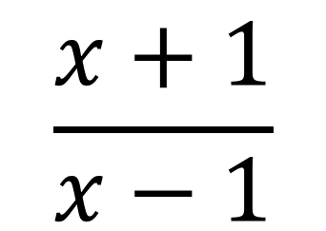
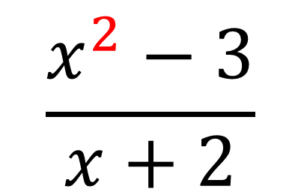
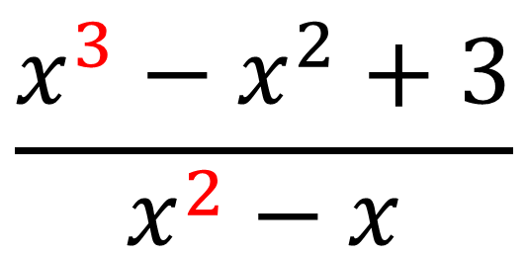
Improper Fractions
An algebraic fraction is improper if
the power of the numerator is
equal to or more than
the power of the denominator.
$$\frac{x^{2}−3}{x+2}$$
$$\frac{x^{3}−x^{2}+3}{x^{2}−x}$$
$$\frac{x+1}{x−1}$$

Slide 3
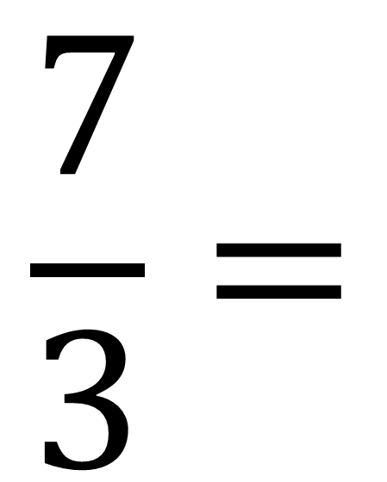
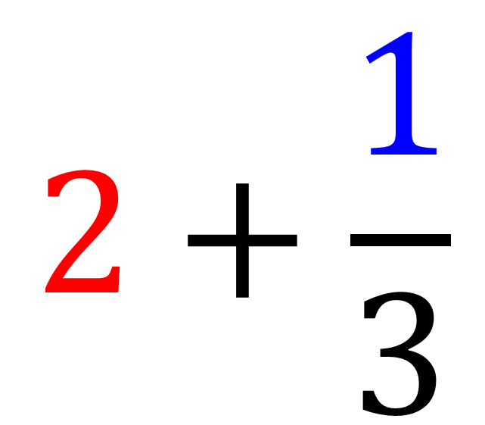
Improper Fractions – Whole Number and Remainder
Remainder
$$\frac{7}{3}=$$
$$2+\frac{1}{3}$$
Whole Number

Slide 4
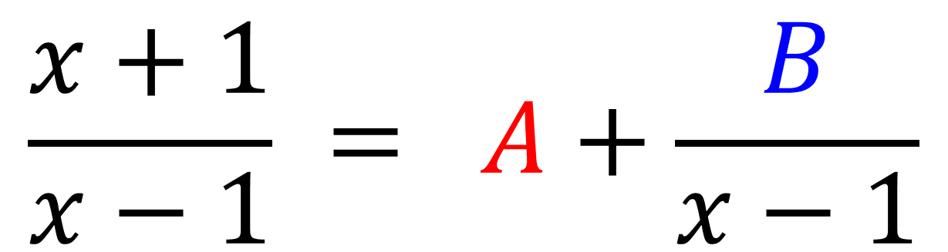
Improper Fractions – Whole Number and Remainder
Remainder
Whole Number
$$\frac{x+1}{x−1} = A+\frac{B}{x−1}$$

Slide 5
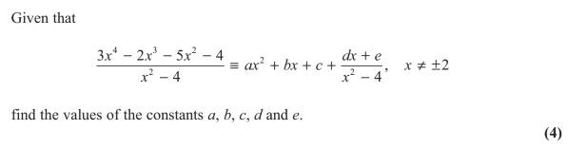
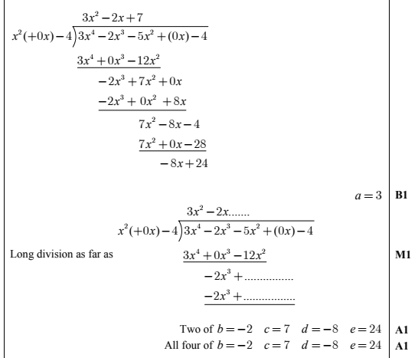
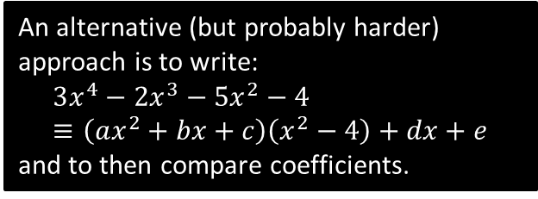
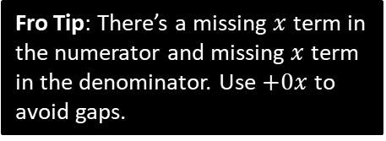
Test Your Understanding
Edexcel C4 June 2013 Q1
Fro Tip: There’s a missing $x$ term in the numerator and missing $x$ term in the denominator. Use $+0x$ to avoid gaps.
?
An alternative (but probably harder) approach is to write:
$$3x^{4}−2x^{3}−5x^{2}−4≡\left(ax^{2}+bx+c\right)\left(x^{2}−4\right)+dx+e$$
and to then compare coefficients.

Slide 6
Exercise 1F
Pearson Pure Mathematics Year 2/AS
Pages 16-17
Complete before the lesson Q1-3
In Class:
Amber Q4-7
Red Q8-10

Slide 7
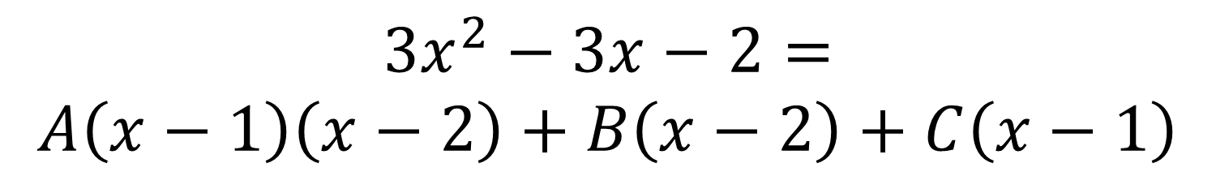
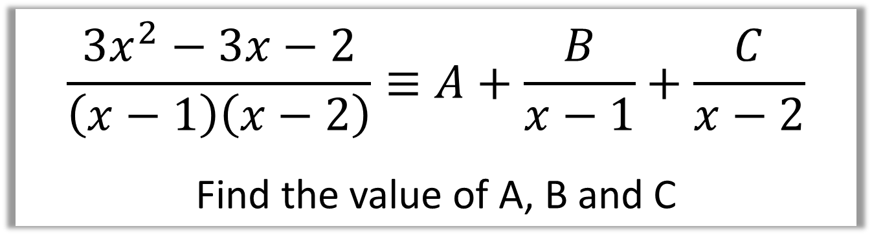
Improper Fractions – Example
$$\frac{3x^{2}−3x−2}{\left(x−1\right)\left(x−2\right)}≡A+\frac{B}{x−1}+\frac{C}{x−2}$$
Find the value of A, B and C
$$3x^{2}−3x−2=$$
$$A\left(x−1\right)\left(x−2\right)+B\left(x−2\right)+C\left(x−1\right)$$

Slide 8
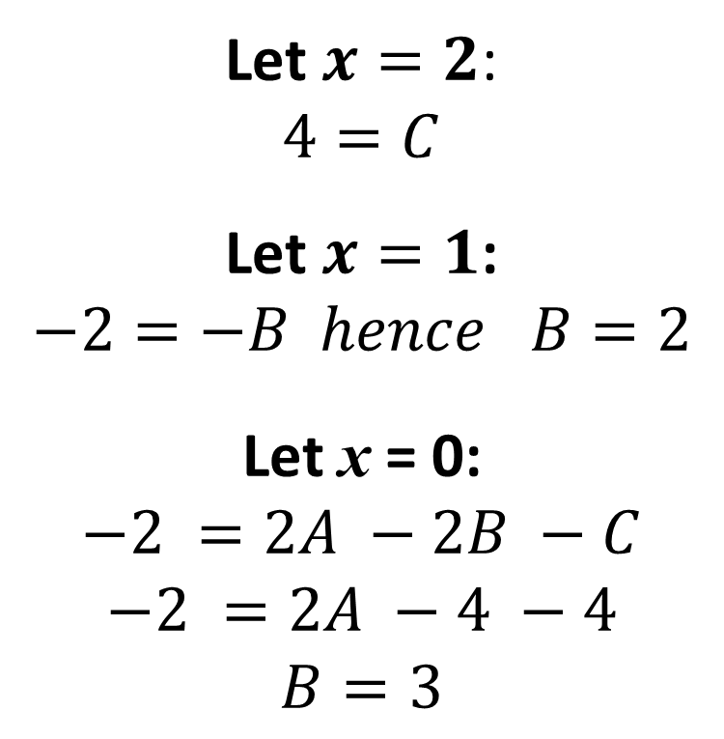

Improper Fractions - Example
$$3x^{2}−3x−2≡A\left(x−1\right)\left(x−2\right)+B\left(x−2\right)+C\left(x−1\right)$$
Let $x=2$:
$$4=C$$
Let $x=1$:
$$−2=−B hence B=2$$
Let x = 0:
$$−2 =2A −2B −C$$
$$−2 =2A −4 −4$$
$$B=3$$
$$\frac{3x^{2}−3x−2}{\left(x−1\right)\left(x−2\right)}≡ 3+\frac{B}{2−1}+\frac{4}{x−2}$$

Slide 9

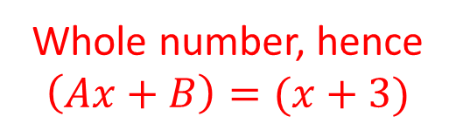


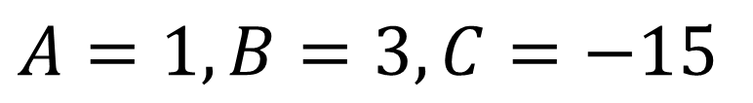
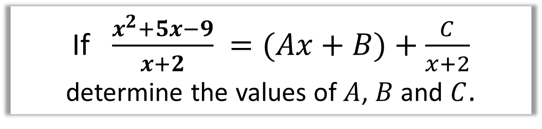

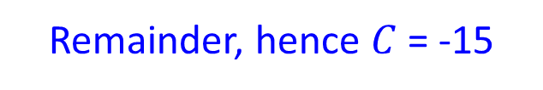

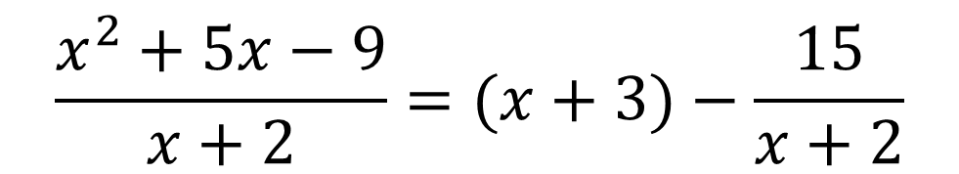


Improper Fraction - Quotient and Remainder
If $\frac{x^{2}+5x−9}{x+2} =(Ax+B)+\frac{C}{x+2}$
determine the values of $A$, $B$ and $C$.
Whole number, hence
$$\left(Ax+B\right)=(x+3)$$
$$x + 3$$
$$x+2$$
$$x^{2}+5x−9$$
$$x^{2}+2x$$
$$3x−9$$
Remainder, hence $C$ = -15
$$3x+6$$
$$−15$$
$$\frac{x^{2}+5x−9}{x+2}=(x+3)−\frac{15}{x+2}$$
$$A=1, B=3, C=−15$$

Slide 10

Improper Fraction - Quotient and Remainder

Slide 11

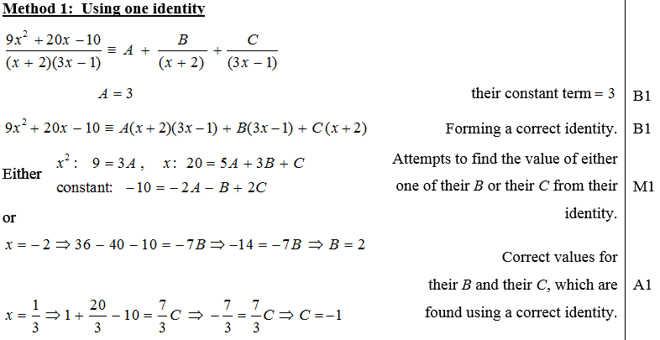
Test Your Understanding
C4 Jan 2013 Q3
?

Slide 12
Exercise 1G
Pearson Pure Mathematics Year 2/AS
Page 18
Complete before the lesson Q1-3
In Class:
Green Q4-6
Amber Q7-8
Red Q9-10

