Slide 1
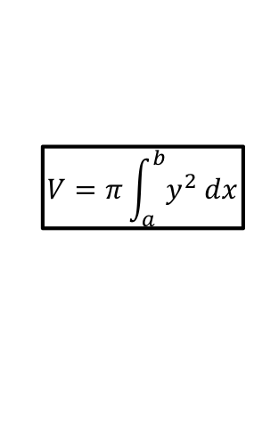
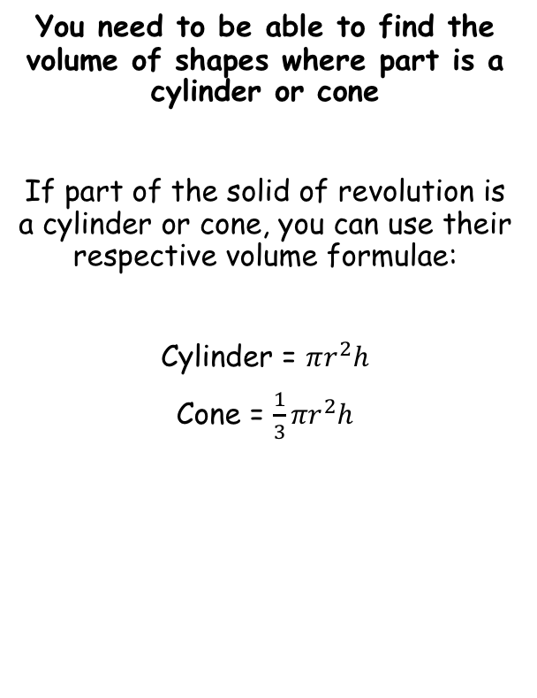

Volumes of Revolution
$$V=π\int_{a}^{b}{y^{2} dx}$$
$$V=π\int_{a}^{b}{x^{2} dy}$$
For rotation about the x axis
For rotation about the y axis
y
A cylinder can be formed by starting with a horizontal line and rotating it about the x-axis (or a vertical line about the y-axis)
You need to be able to find the volume of shapes where part is a cylinder or cone
If part of the solid of revolution is a cylinder or cone, you can use their respective volume formulae:
Cylinder = $πr^{2}h$
Cone = $\frac{1}{3}{πr}^{2}h$
Radius
x
Height
y
A cone can be formed by starting with a straight diagonal line and rotating it about one of the x or y axes
→ The radius and height depend on which way it is rotated!
Radius
Height
x
Radius
Height
5C

Slide 2




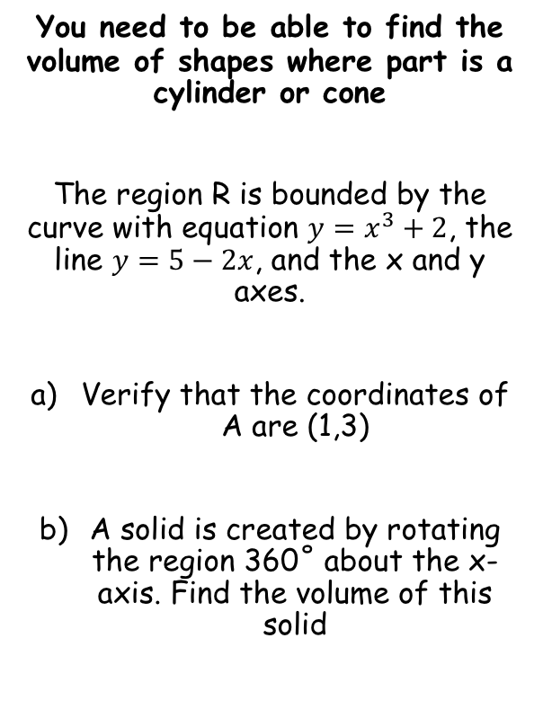






Volumes of Revolution
$$V=π\int_{a}^{b}{y^{2} dx}$$
$$V=π\int_{a}^{b}{x^{2} dy}$$
For rotation about the x axis
For rotation about the y axis
y
You need to be able to find the volume of shapes where part is a cylinder or cone
The region R is bounded by the curve with equation $y=x^{3}+2$, the line $y=5−2x$, and the x and y axes.
Verify that the coordinates of A are (1,3)
A solid is created by rotating the region 360˚ about the x-axis. Find the volume of this solid
$$y=x^{3}+2$$
$$R$$
$$y=5−2x$$
x
Sub $x=1$ into both equations and show we get 3 for $y$ in both cases
$$y=x^{3}+2$$
$$y=5−2x$$
$$y={(1)}^{3}+2$$
$$y=5−2(1)$$
$$y=3$$
$$y=3$$
5C

Slide 3

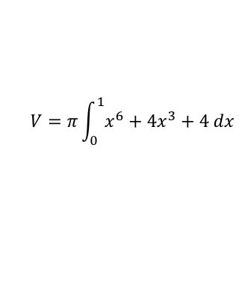


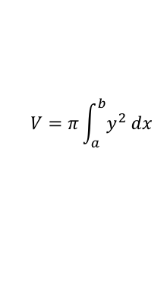




Volumes of Revolution
$$V=π\int_{a}^{b}{y^{2} dx}$$
$$V=π\int_{a}^{b}{x^{2} dy}$$
For rotation about the x axis
For rotation about the y axis
y
You need to be able to find the volume of shapes where part is a cylinder or cone
The region R is bounded by the curve with equation $y=x^{3}+2$, the line $y=5−2x$, and the x and y axes.
Verify that the coordinates of A are (1,3)
A solid is created by rotating the region 360˚ about the x-axis. Find the volume of this solid
You can split the area into 2 parts and find both separately…
$$y=x^{3}+2$$
(1,3)
$$R_{1}$$
$$R$$
$$R_{2}$$
$$y=5−2x$$
x
1
2.5
Volume of revolution for $R_{1}$
$$V=π\int_{a}^{b}{y^{2} dx}$$
Sub in the equation for y
$$V=π\int_{0}^{1}{{\left(x^{3}+2\right)}^{2} dx}$$
Square the bracket
$$V=π\int_{0}^{1}{x^{6}+4x^{3}+4 dx}$$
Integrate and use a square bracket
$$V=π{\left[\frac{x^{7}}{7}+x^{4}+4x\right]}_{0}^{1}$$
Volume of revolution for $R_{1}$ = $\frac{36π}{7}$
Calculate (you need to write the substitution step as well remember!)
$$V=\frac{36π}{7}$$
5C

Slide 4








Volumes of Revolution
$$V=π\int_{a}^{b}{y^{2} dx}$$
$$V=π\int_{a}^{b}{x^{2} dy}$$
For rotation about the x axis
For rotation about the y axis
y
You need to be able to find the volume of shapes where part is a cylinder or cone
The region R is bounded by the curve with equation $y=x^{3}+2$, the line $y=5−2x$, and the x and y axes.
Verify that the coordinates of A are (1,3)
A solid is created by rotating the region 360˚ about the x-axis. Find the volume of this solid
You can split the area into 2 parts and find both separately…
$$y=x^{3}+2$$
(1,3)
$$r$$
$$R_{1}$$
$$R_{2}$$
$$y=5−2x$$
x
1
$$h$$
2.5
Volume of revolution for $R_{2}$
This will be a cone with height $h$ and radius $r$, as shown…
$$V=\frac{1}{3}πr^{2}h$$
Sub in the equation for y
$$V=\frac{1}{3}π{\left(3\right)}^{2}(1.5)$$
Sub in the equation for y
$$V=\frac{9π}{2}$$
Volume of revolution for $R_{1}$ = $\frac{36π}{7}$
Volume of revolution for $R_{2}$ = $\frac{9π}{2}$
$$Total Volume=\frac{135π}{14}$$
5C

Slide 5




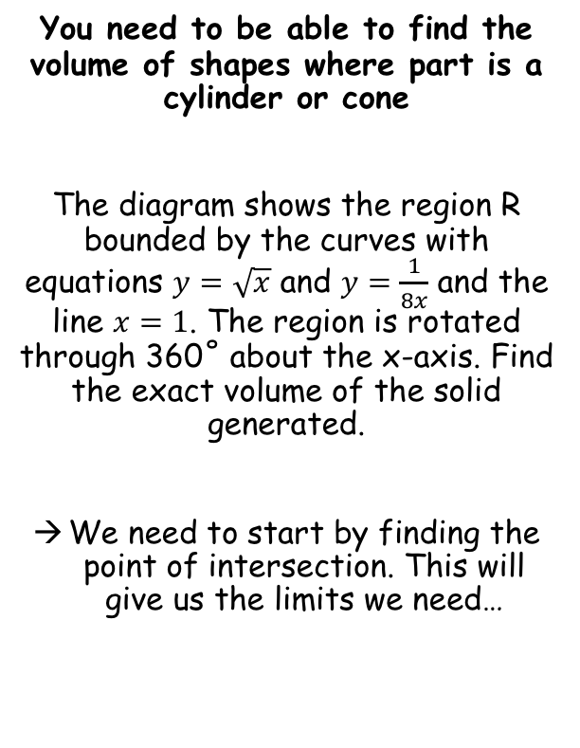

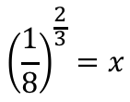

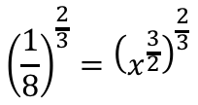

Volumes of Revolution
$$V=π\int_{a}^{b}{y^{2} dx}$$
$$V=π\int_{a}^{b}{x^{2} dy}$$
For rotation about the x axis
For rotation about the y axis
y
You need to be able to find the volume of shapes where part is a cylinder or cone
The diagram shows the region R bounded by the curves with equations $y=\sqrt{x}$ and $y=\frac{1}{8x}$ and the line $x=1$. The region is rotated through 360˚ about the x-axis. Find the exact volume of the solid generated.
We need to start by finding the point of intersection. This will give us the limits we need…
$$y=\sqrt{x}$$
$$R$$
$$y=\frac{1}{8x}$$
$$\frac{1}{8x}=\sqrt{x}$$
x
Multiply by x
1
$$\frac{1}{8}=x^{\frac{3}{2}}$$
Raise each side to the power $\frac{2}{3}$
$${\left(\frac{1}{8}\right)}^{\frac{2}{3}}={\left(x^{\frac{3}{2}}\right)}^{\frac{2}{3}}$$
Simplify right side
$${\left(\frac{1}{8}\right)}^{\frac{2}{3}}=x$$
Calculate left side
$$\frac{1}{4}=x$$
5C

Slide 6

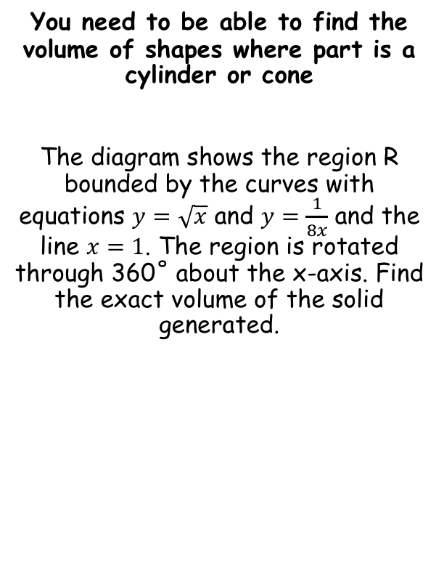



Volumes of Revolution
$$V=π\int_{a}^{b}{y^{2} dx}$$
$$V=π\int_{a}^{b}{x^{2} dy}$$
For rotation about the x axis
For rotation about the y axis
y
You need to be able to find the volume of shapes where part is a cylinder or cone
The diagram shows the region R bounded by the curves with equations $y=\sqrt{x}$ and $y=\frac{1}{8x}$ and the line $x=1$. The region is rotated through 360˚ about the x-axis. Find the exact volume of the solid generated.
The volume will be the volume for the part under the red line, subtract the volume for the part under the blue line
$$y=\sqrt{x}$$
$$R$$
$$y=\frac{1}{8x}$$
x
1 4
1
y
y
$$y=\sqrt{x}$$
MINUS
$$R_{1}$$
$$y=\frac{1}{8x}$$
$$R_{2}$$
x
x
1 4
1
1 4
1
5C

Slide 7
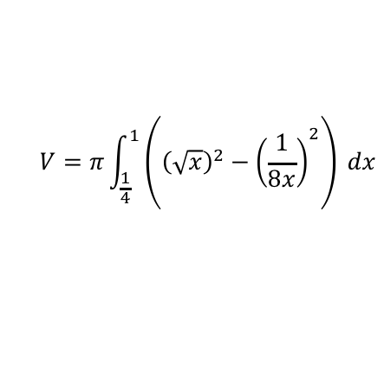

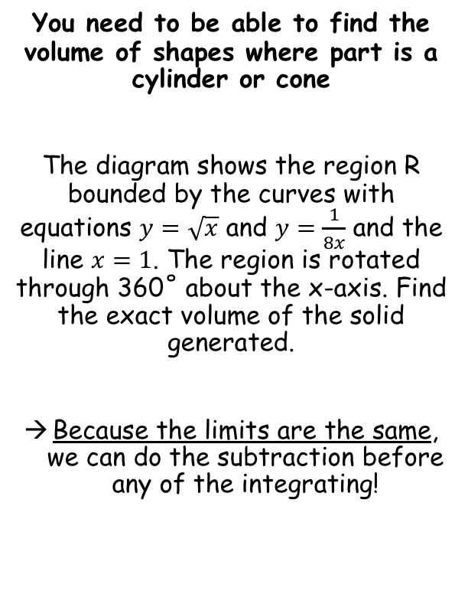

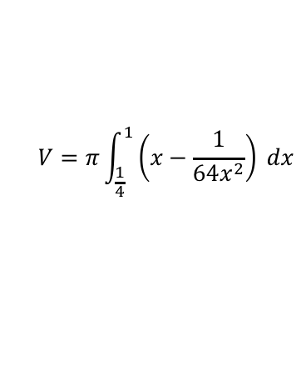

Volumes of Revolution
$$V=π\int_{a}^{b}{y^{2} dx}$$
$$V=π\int_{a}^{b}{x^{2} dy}$$
For rotation about the x axis
For rotation about the y axis
y
You need to be able to find the volume of shapes where part is a cylinder or cone
The diagram shows the region R bounded by the curves with equations $y=\sqrt{x}$ and $y=\frac{1}{8x}$ and the line $x=1$. The region is rotated through 360˚ about the x-axis. Find the exact volume of the solid generated.
Because the limits are the same, we can do the subtraction before any of the integrating!
The volume will be the volume for the part under the red line, subtract the volume for the part under the blue line
$$y=\sqrt{x}$$
$$R$$
$$y=\frac{1}{8x}$$
x
1 4
1
$$V=π\int_{a}^{b}{\left(y_{2}^{2}−y_{1}^{2}\right) dx}$$
Sub in each equation (make sure you put them the correct way)
$$V=π\int_{\frac{1}{4}}^{1}{\left({\left(\sqrt{x}\right)}^{2}−{\left(\frac{1}{8x}\right)}^{2}\right)} dx$$
Square each function
$$V=π\int_{\frac{1}{4}}^{1}{\left(x−\frac{1}{{64x}^{2}}\right)} dx$$
Integrate and use a square bracket
You could also do this by finding the two volumes separately and subtracting – it is up to you which method you are most confident with
$$V=π{\left[\frac{1}{2}x^{2}+\frac{1}{64x}\right]}_{\frac{1}{4}}^{1}$$
Sub in limits and subtract (you will need to show this step)
$$V=\frac{27π}{64}$$
5C

Slide 8
Exercise 5C
Pearson Further Core Mathematics Year 1/AS
Complete before the lesson Q1-2
In Class:
Green Q3-6
Amber Q7-8
Red Q9 & challenge

