Slide 1
Year 1 Pure Mathematics
Binomial Expansion
- Estimation
Chapter 8
(Part 3 of 3)

Slide 2
Estimating Powers
Expand (2 + 3x)(1 – 3x)³
to the term x⁴
= (2 + 3x)(1 – 9x + 27x² – 27x³)
= 2 – 18x + 54x² – 54x³ + 3x – 27x² + 81x³ – 81x⁴
= 2 – 15x + 27x² + 27x³ – 81x⁴

Slide 3
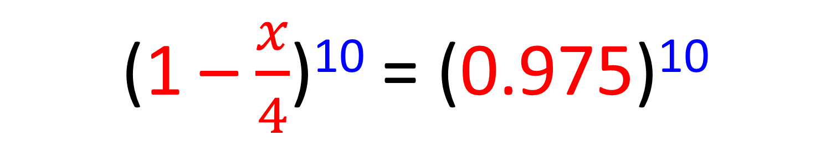
Estimating Powers
Given the following statement
can you work out the value of x?
(1 – $\frac{x}{4}$)¹⁰ = (0.975)¹⁰
x =
0.1

Slide 4

Estimating Powers
Estimate the value of (0.975)¹⁰
giving you answer to 4 decimal places.
(1 – $\frac{x}{4}$)¹⁰ = 1 – 2.5x + 2.8125x² – 1.875x³ + …… +….
(0.975)¹⁰ 1 – 2.5(0.1) + 2.8125(0.1)² – 1.875(0.1)³
(0.975)¹⁰
0.7763 (4 d.p.)

Slide 5

Estimating Powers
Given the following statement
can you work out the value of x?
(2 + $\frac{x}{5}$)¹⁰ = (2.1)¹⁰
x =
0.5

Slide 6

Estimating Powers
Given the following statement
can you work out the value of x?
(1 – $\frac{x}{4}$)⁹ = (0.6)⁹
x = 1.6

Slide 7
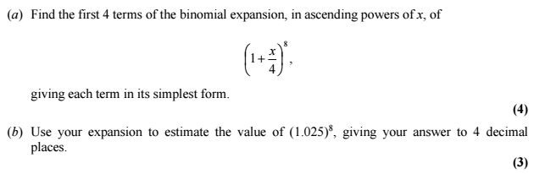
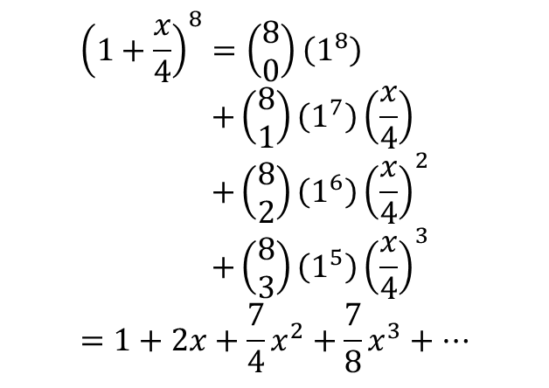
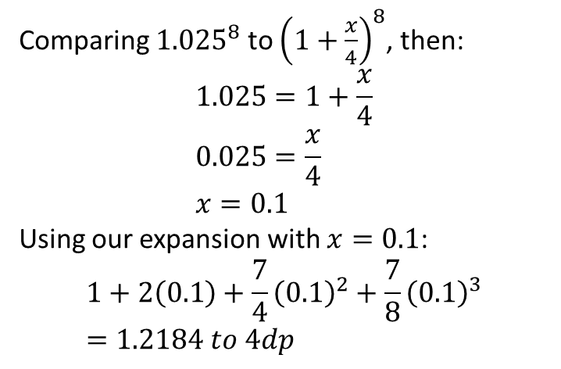
Estimating Powers
a
b
Comparing ${1.025}^{8}$ to ${\left(1+\frac{x}{4}\right)}^{8}$, then:
$$1.025=1+\frac{x}{4} \\ 0.025=\frac{x}{4} \\ x=0.1$$
Using our expansion with $x=0.1$:
$$1+2\left(0.1\right)+\frac{7}{4}{\left(0.1\right)}^{2}+\frac{7}{8}{\left(0.1\right)}^{3} \\ =1.2184 to 4dp$$
$${\left(1+\frac{x}{4}\right)}^{8}=\left(\begin{matrix}8 \\ 0\end{matrix}\right)\left(1^{8}\right) \\ +\left(\begin{matrix}8 \\ 1\end{matrix}\right)\left(1^{7}\right)\left(\frac{x}{4}\right) \\ +\left(\begin{matrix}8 \\ 2\end{matrix}\right)\left(1^{6}\right){\left(\frac{x}{4}\right)}^{2} \\ +\left(\begin{matrix}8 \\ 3\end{matrix}\right)\left(1^{5}\right){\left(\frac{x}{4}\right)}^{3} \\ =1+2x+\frac{7}{4}x^{2}+\frac{7}{8}x^{3}+…$$

Slide 8
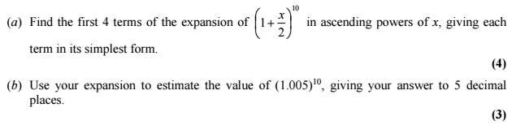
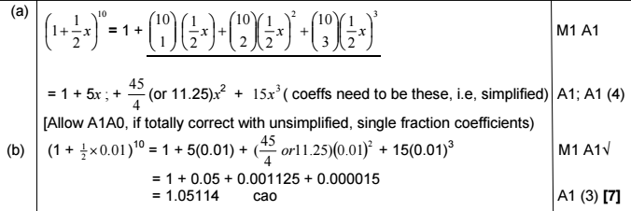
Estimating Powers

Slide 9
Exercise 8E
Pearson Pure Mathematics Year 1/AS
Page 168-169
Complete before the lesson Q1-2
Green Q3-4
Amber Q5-6
Red Q7-9

