Slide 1
Year 2 Pure Mathematics
Integration
- Differential Equations
Chapter 11
(Part 11 of 11)

Slide 2
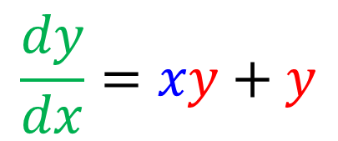
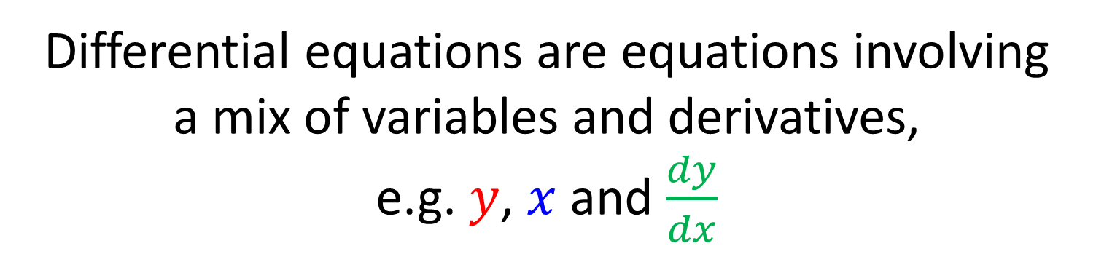
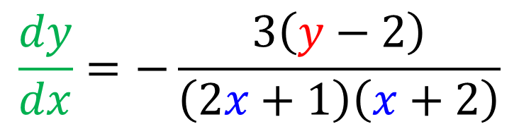
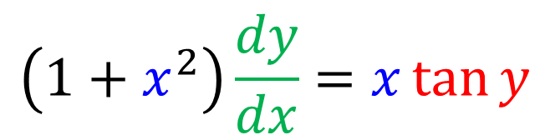
SKILL #11: Differential Equations
Differential equations are equations involving
a mix of variables and derivatives,
e.g. $y$, $x$ and $\frac{dy}{dx}$
$$\frac{dy}{dx}=xy+y$$
$$\left(1+x^{2}\right)\frac{dy}{dx}=x\tan{y}$$
$$\frac{dy}{dx}=−\frac{3\left(y−2\right)}{\left(2x+1\right)\left(x+2\right)}$$

Slide 3
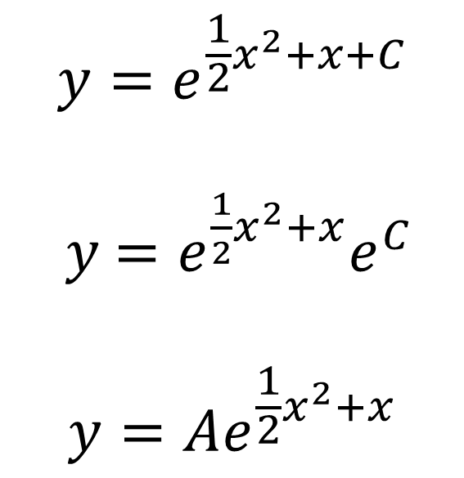
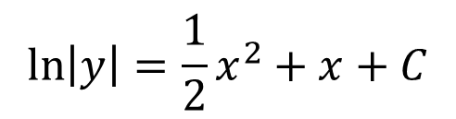
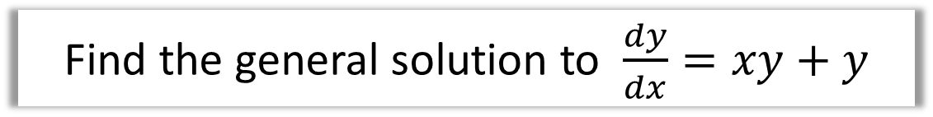
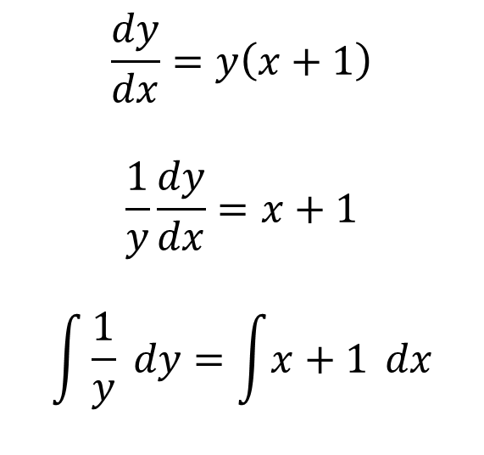

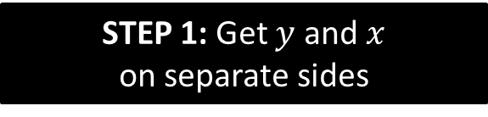
Differential Equations
Find the general solution to $\frac{dy}{dx}=xy+y$
STEP 1: Get $y$ and $x$
on separate sides
STEP 3: Make $y$ the subject,
if the question asks.
$$\frac{dy}{dx}=y\left(x+1\right)$$
$$\frac{1}{y}\frac{dy}{dx}=x+1$$
$$\int{\frac{1}{y}} dy=\int{x+1} dx$$
$$y=e^{\frac{1}{2}x^{2}+x+C}$$
$y$ $=e^{\frac{1}{2}x^{2}+x}e^{C}$
$$y=Ae^{\frac{1}{2}x^{2}+x}$$
STEP 2: Integrate both sides
$$\ln\left|y\right|=\frac{1}{2}x^{2}+x+C$$

Slide 4
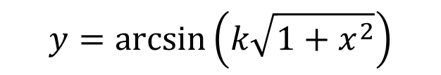
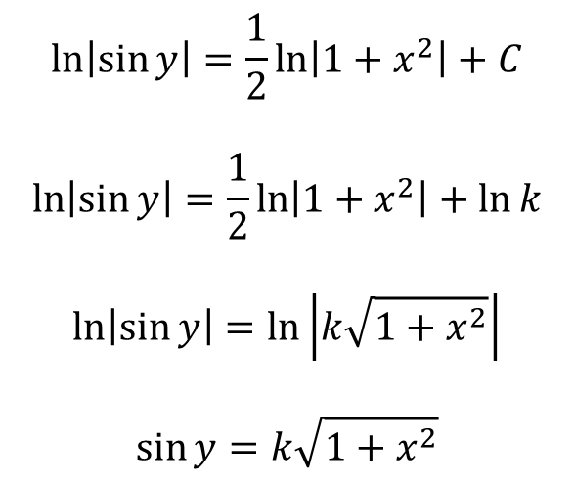
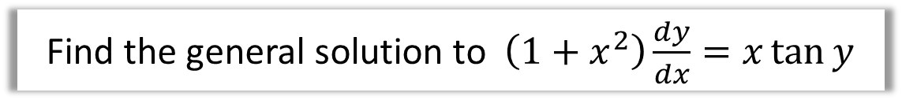
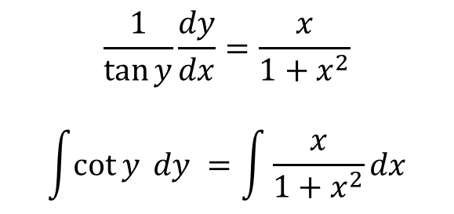

Differential Equations
Find the general solution to $\left(1+x^{2}\right)\frac{dy}{dx}=x\tan{y}$
STEP 1: Get $y$ and $x$
on separate sides
STEP 2: Integrate both sides
$$\ln\left|\sin{y}\right|=\frac{1}{2}\ln\left|1+x^{2}\right|+C$$
$$\ln\left|\sin{y}\right|=\frac{1}{2}\ln\left|1+x^{2}\right|+\ln{k}$$
$$\ln\left|\sin{y}\right|=\ln\left|k\sqrt{1+x^{2}}\right|$$
$$\sin{y}=k\sqrt{1+x^{2}}$$
$$\frac{1}{\tan{y}}\frac{dy}{dx}=\frac{x}{1+x^{2}}$$
$$\int{\cot{y} dy }=\int{\frac{x}{1+x^{2}}dx}$$
STEP 3: Make $y$ the subject,
if the question asks.
$$y=\arcsin\left(k\sqrt{1+x^{2}}\right)$$

Slide 5
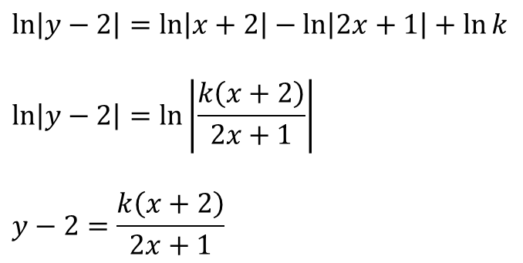
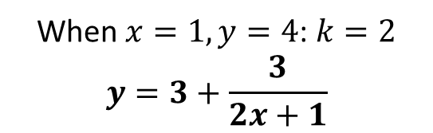
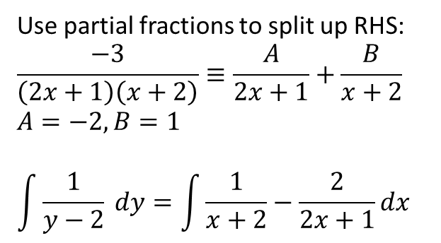
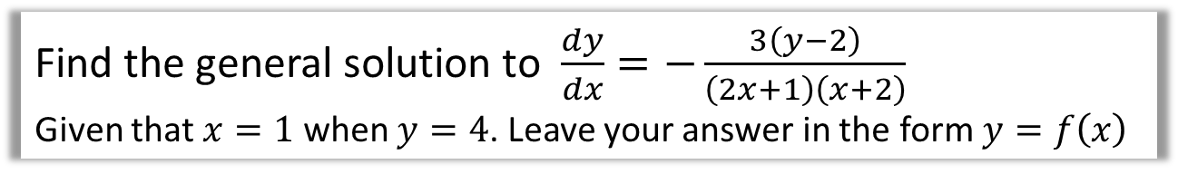
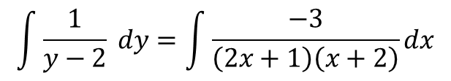

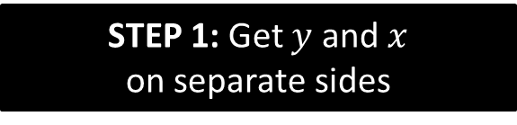
Differential Equations (and partial fractions)
Find the general solution to $\frac{dy}{dx}=−\frac{3\left(y−2\right)}{\left(2x+1\right)\left(x+2\right)}$
Given that $x=1$ when $y=4$. Leave your answer in the form $y=f\left(x\right)$
STEP 1: Get $y$ and $x$
on separate sides
STEP 2: Integrate both sides
$$\ln\left|y−2\right|=\ln\left|x+2\right|−\ln\left|2x+1\right|+\ln{k}$$
$$\ln\left|y−2\right|=\ln\left|\frac{k\left(x+2\right)}{2x+1}\right|$$
$$y−2=\frac{k\left(x+2\right)}{2x+1}$$
$$\int{\frac{1}{y−2} dy}=\int{\frac{−3}{\left(2x+1\right)\left(x+2\right)}dx}$$
Use partial fractions to split up RHS:
$$\frac{−3}{\left(2x+1\right)\left(x+2\right)}≡\frac{A}{2x+1}+\frac{B}{x+2}$$
$$A=−2, B=1$$
$$\int{\frac{1}{y−2} dy}=\int{\frac{1}{x+2}−\frac{2}{2x+1}dx}$$
STEP 3: Make $y$ the subject,
if the question asks.
When $x=1,y=4$: $k=2$
$$y=3+\frac{3}{2x+1}$$

Slide 6
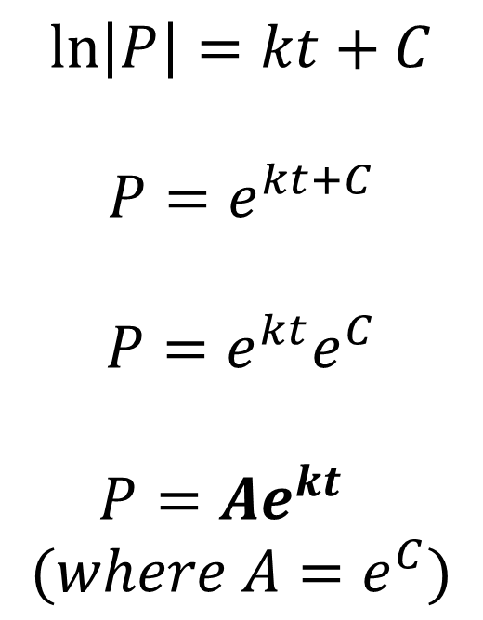
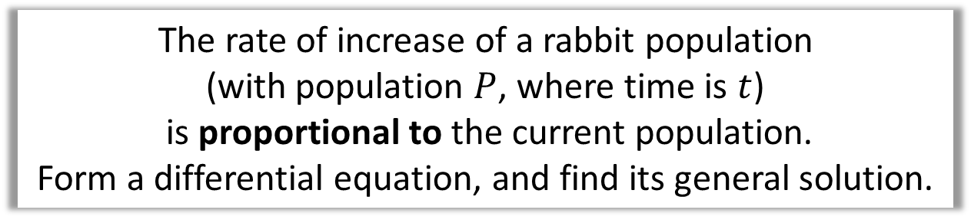
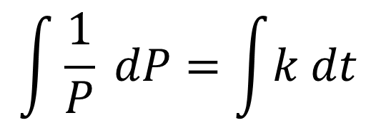
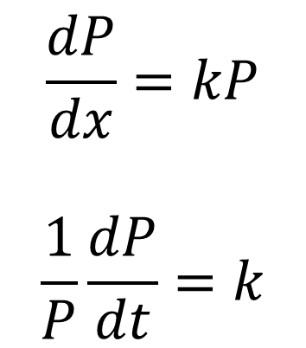
Differential Equations (forming equations)
The rate of increase of a rabbit population
(with population $P$, where time is $t$)
is proportional to the current population.
Form a differential equation, and find its general solution.
$$\frac{dP}{dx}=kP$$
$$\frac{1}{P}\frac{dP}{dt}=k$$
$$\ln\left|P\right|=kt+C$$
$$P=e^{kt+C}$$
$$P=e^{kt}e^{C}$$
$$P=Ae^{kt}$$
$$(where A=e^{C})$$
$$\int{\frac{1}{P} dP}=\int{k dt}$$

Slide 7
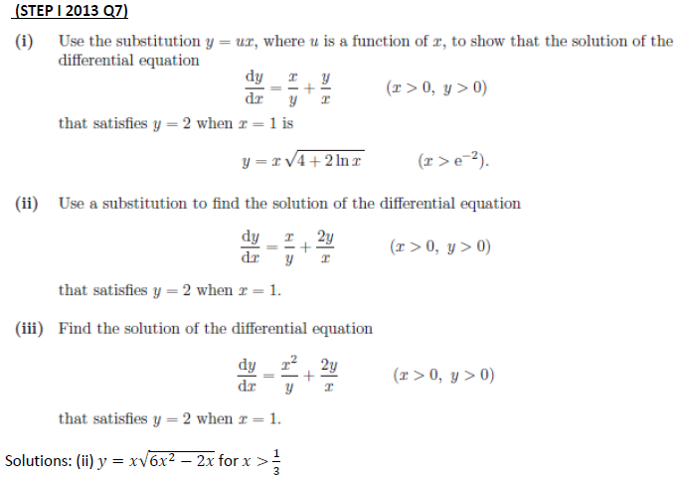
Exercise 11J
Pearson Pure Mathematics Year 2/AS
Pages 324-326
Extension:
Complete before the lesson Q1-2
In Class:
Green Q3-8
Amber Q9-11
Red Q12-15
& Ext
?

