Slide 1

CorePure1 Chapter 4 ::
Roots of Polynomials
jfrost@tiffin.kingston.sch.uk
www.drfrostmaths.com
@DrFrostMaths
Last modified: 14th September 2018

Slide 2








www.drfrostmaths.com
Everything is completely free.
Why not register?
Register now to interactively practise questions on this topic, including past paper questions and extension questions (including MAT + UKMT).
Teachers: you can create student accounts (or students can register themselves), to set work, monitor progress and even create worksheets.
With questions by:
Dashboard with points, trophies, notifications and student progress.
Questions organised by topic, difficulty and past paper.
Teaching videos with topic tests to check understanding.

Slide 3
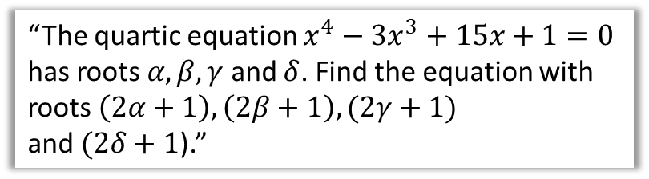
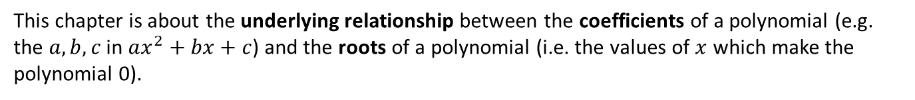
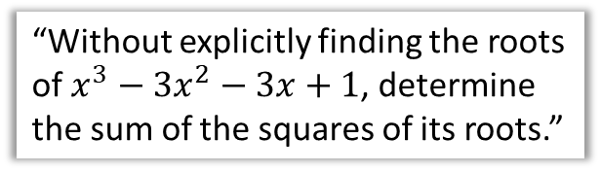

Chapter Overview
This chapter is about the underlying relationship between the coefficients of a polynomial (e.g. the $a,b,c$ in $ax^{2}+bx+c$) and the roots of a polynomial (i.e. the values of $x$ which make the polynomial 0).
1:: Use relationships between coefficients and roots of a quadratic, cubic or quartic equation.
2:: Find the value of expressions based on the roots of a polynomial.
“Given that $kx^{2}+\left(k−3\right)x−2=0$, find the value of $k$ if the sum of the roots is 4.”
“Without explicitly finding the roots of $x^{3}−3x^{2}−3x+1$, determine the sum of the squares of its roots.”
3:: Find the new polynomial when the roots undergo a linear transformation.
“The quartic equation $x^{4}−3x^{3}+15x+1=0$ has roots $α,β,γ$ and $δ$. Find the equation with roots $\left(2α+1\right),\left(2β+1\right),(2γ+1)$
and $(2δ+1$).”
Teacher Notes:
This topic is completely new to the Edexcel A Level syllabus. It used to be covered in the pre-2017 OCR syllabus.

Slide 4



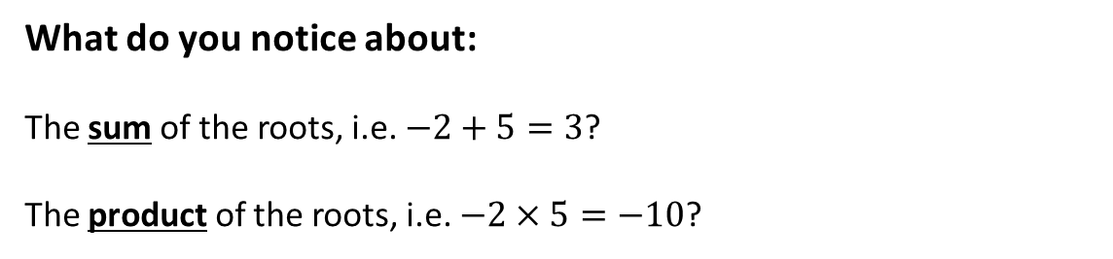

Introduction
$$p\left(x\right)$$
$$p\left(x\right)=x^{2}−3x−10$$
$$x$$
-2
5
The purpose of this chapter is to understand the underlying relationship between the roots of a polynomial, and the coefficients of each term.
What do you notice about:
The sum of the roots, i.e. $−2+5=3$?
The product of the roots, i.e. $−2×5=−10$?
It’s the negation of the coefficient of the $x$ term!
?
It’s the constant term in the polynomial!
?
This is not yet exactly surprising: At GCSE you found the factorisation of a quadratic by finding two numbers that added to give the middle coefficient and multiplied to give the last number; this in turn allowed you to find the roots...

Slide 5
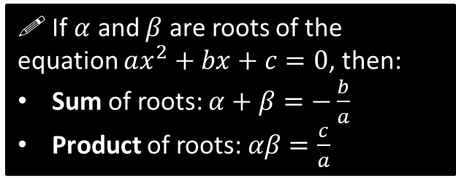
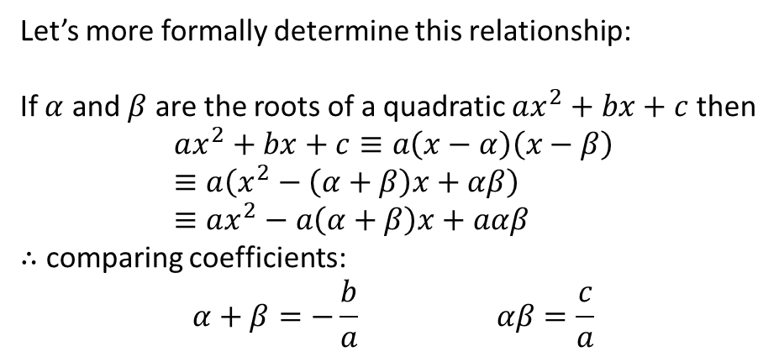
Introduction
Let’s more formally determine this relationship:
If $α$ and $β$ are the roots of a quadratic $ax^{2}+bx+c$ then
$$ax^{2}+bx+c≡a\left(x−α\right)\left(x−β\right) \\ ≡a\left(x^{2}−\left(α+β\right)x+αβ\right) \\ ≡ax^{2}−a\left(α+β\right)x+aαβ$$
$∴$ comparing coefficients:
$$α+β=−\frac{b}{a} αβ=\frac{c}{a}$$
?
?
?
! If $α$ and $β$ are roots of the equation $ax^{2}+bx+c=0$, then:
Sum of roots: $α+β=−\frac{b}{a}$
Product of roots: $αβ=\frac{c}{a}$

Slide 6
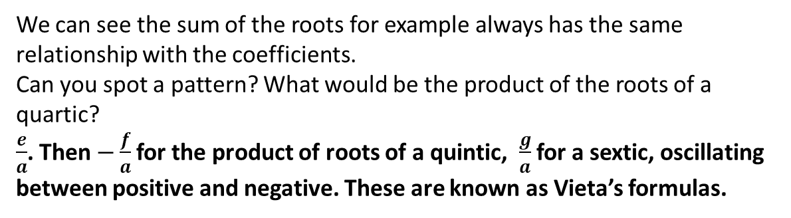
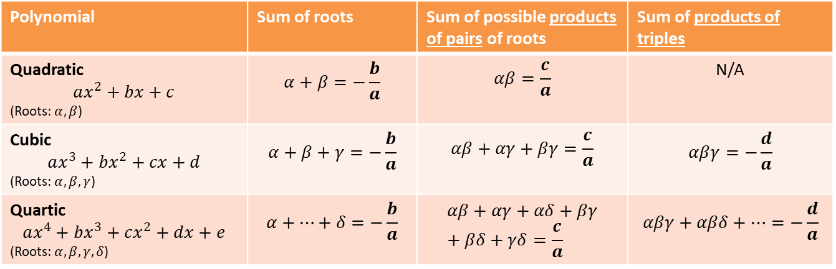
Does this generalise to higher-order polynomials?
We will see there are very similar relationship between roots of higher order polynomials, and their coefficients:
Polynomial | Sum of roots | Sum of possible products of pairs of roots | Sum of products of triples
Quadratic $$ax^{2}+bx+c$$ (Roots: $α, β$) | $$α+β=−\frac{b}{a}$$ | $$αβ=\frac{c}{a}$$ | N/A
Cubic $$ax^{3}+bx^{2}+cx+d$$ (Roots: $α, β,γ$) | $$α+β+γ=−\frac{b}{a}$$ | $$αβ+αγ+βγ=\frac{c}{a}$$ | $$αβγ=−\frac{d}{a}$$
Quartic $$ax^{4}+bx^{3}+cx^{2}+dx+e$$ (Roots: $α, β,γ,δ$) | $$α+…+δ=−\frac{b}{a}$$ | $$αβ+αγ+αδ+βγ+βδ+γδ=\frac{c}{a}$$ | $$αβγ+αβδ+…=−\frac{d}{a}$$
We can see the sum of the roots for example always has the same relationship with the coefficients.
Can you spot a pattern? What would be the product of the roots of a quartic?
$\frac{e}{a}$. Then $−\frac{f}{a}$ for the product of roots of a quintic, $\frac{g}{a}$ for a sextic, oscillating between positive and negative. These are known as Vieta’s formulas.
?

Slide 7
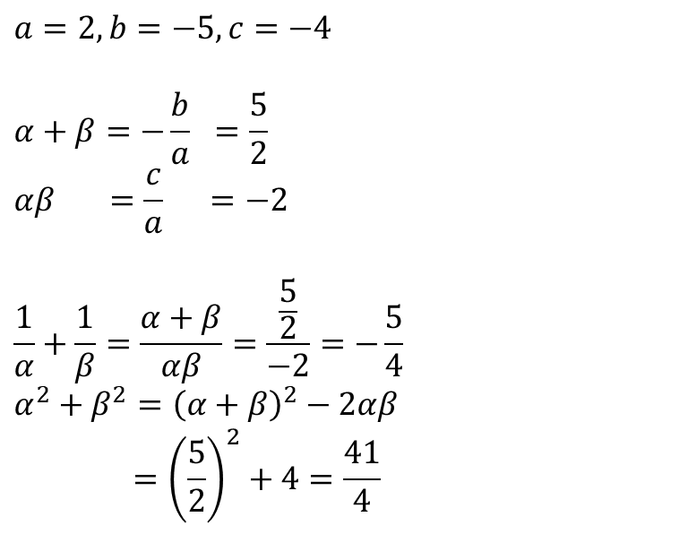
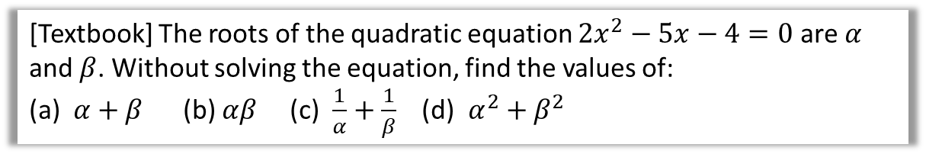
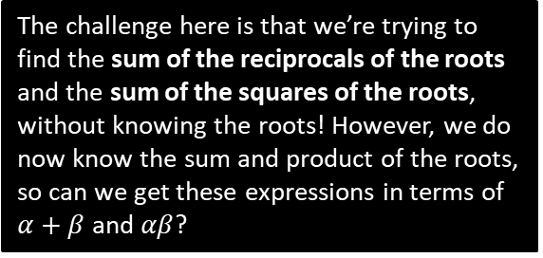
Back to roots of quadratics…
[Textbook] The roots of the quadratic equation $2x^{2}−5x−4=0$ are $α$ and $β$. Without solving the equation, find the values of:
(a) $α+β$ (b) $αβ$ (c) $\frac{1}{α}+\frac{1}{β}$ (d) $α^{2}+β^{2}$
Use your formulae for the sum and product of roots. The underlying point here is that we can find these quantities without needing the roots themselves.
$$a=2, b=−5, c=−4$$
$$α+β=−\frac{b}{a} =\frac{5}{2} \\ αβ =\frac{c}{a} =−2$$
$$\frac{1}{α}+\frac{1}{β}=\frac{α+β}{αβ}=\frac{\frac{5}{2}}{−2}=−\frac{5}{4} \\ α^{2}+β^{2}={\left(α+β\right)}^{2}−2αβ \\ ={\left(\frac{5}{2}\right)}^{2}+4=\frac{41}{4}$$
?
?
The challenge here is that we’re trying to find the sum of the reciprocals of the roots and the sum of the squares of the roots, without knowing the roots! However, we do now know the sum and product of the roots, so can we get these expressions in terms of $α+β$ and $αβ$?
?
?
?
?

Slide 8

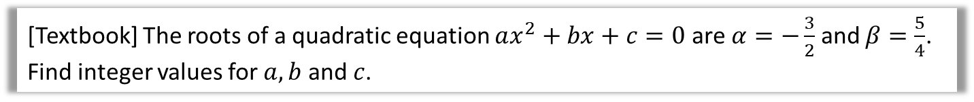

Further Example
[Textbook] The roots of a quadratic equation $ax^{2}+bx+c=0$ are $α=−\frac{3}{2}$ and $β=\frac{5}{4}$. Find integer values for $a, b$ and $c$.
?
$$α+β=−\frac{3}{2}+\frac{5}{4}=−\frac{1}{4} ∴−\frac{b}{a}=−\frac{1}{4} \\ αβ=−\frac{3}{2}×\frac{5}{4}=−\frac{15}{8} ∴\frac{c}{a}=−\frac{15}{8}$$
Suppose that $a=1$, then
$b=\frac{1}{4}$ and $c=−\frac{15}{8}$
$$∴x^{2}+\frac{1}{4}x−\frac{15}{8}=0$$
We can scale without changing the roots:
$$8x^{2}+2x−15=0 \\ a=8, b=2, c=−15$$
Initially let $a$ be 1 so that we can get initial values of $b$ and $c$.

Slide 9
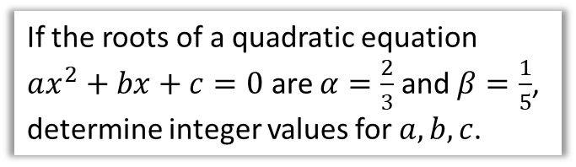
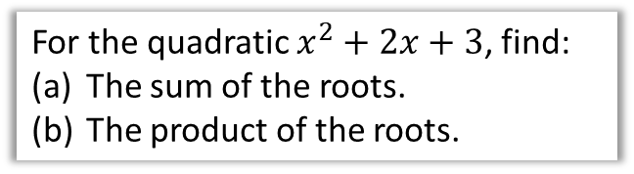


Test Your Understanding
For the quadratic $x^{2}+2x+3$, find:
The sum of the roots.
The product of the roots.
If the roots of a quadratic equation $ax^{2}+bx+c=0$ are $α=\frac{2}{3}$ and $β=\frac{1}{5}$, determine integer values for $a,b,c$.
?
?
$$a=1, b=2, c=3 \\ α+β=−\frac{b}{a}=−2 \\ αβ=\frac{c}{a}=3$$
$$\frac{2}{3}+\frac{1}{5}=\frac{13}{15}=−\frac{b}{a} \\ \frac{2}{3}×\frac{1}{5}=\frac{2}{15}=\frac{c}{a}$$
Letting $a=1$,
$$b=−\frac{13}{15}, c=\frac{2}{15}$$
$$x^{2}−\frac{13}{15}x+\frac{2}{15}=0 \\ 15x^{2}−13x+2=0 \\ a=15, b=−13, c=2$$

Slide 10
Exercise 4A
Pearson Core Pure Mathematics Book 1
Pages 56-57
Complete before the lesson Q1-2
In Class:
Green Q3-7
Amber Q8-11
Red Q12-14 & challenge

Slide 11
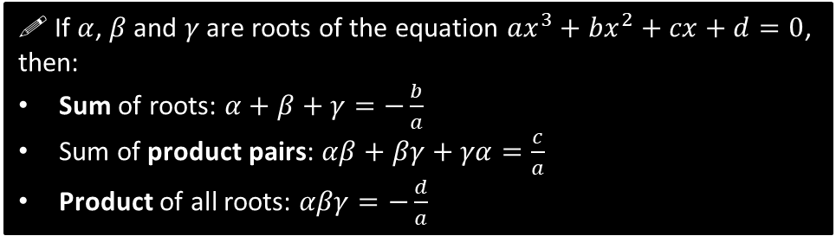
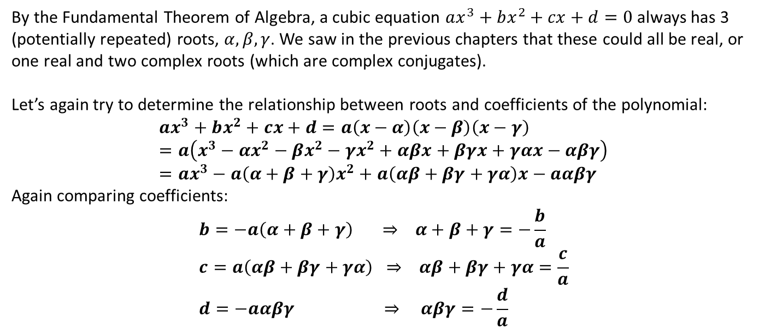
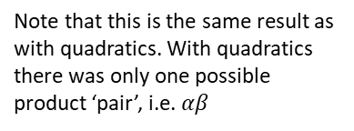
Roots of Cubics
By the Fundamental Theorem of Algebra, a cubic equation $ax^{3}+bx^{2}+cx+d=0$ always has 3 (potentially repeated) roots, $α,β,γ$. We saw in the previous chapters that these could all be real, or one real and two complex roots (which are complex conjugates).
Let’s again try to determine the relationship between roots and coefficients of the polynomial:
$$ax^{3}+bx^{2}+cx+d=a\left(x−α\right)\left(x−β\right)\left(x−γ\right) \\ =a\left(x^{3}−αx^{2}−βx^{2}−γx^{2}+αβx+βγx+γαx−αβγ\right) \\ =ax^{3}−a\left(α+β+γ\right)x^{2}+a\left(αβ+βγ+γα\right)x−aαβγ$$
Again comparing coefficients:
$$b=−a\left(α+β+γ\right) ⇒ α+β+γ=−\frac{b}{a} \\ c=a\left(αβ+βγ+γα\right) ⇒ αβ+βγ+γα=\frac{c}{a} \\ d=−aαβγ ⇒ αβγ=−\frac{d}{a}$$
?
?
?
?
?
?
?
Note that this is the same result as with quadratics. With quadratics there was only one possible product ‘pair’, i.e. $αβ$
! If $α$, $β$ and $γ$ are roots of the equation $ax^{3}+bx^{2}+cx+d=0$, then:
Sum of roots: $α+β+γ=−\frac{b}{a}$
Sum of product pairs: $αβ+βγ+γα=\frac{c}{a}$
Product of all roots: $αβγ=−\frac{d}{a}$
Continuing the pattern, this is the sum of all product ‘triples’. There just happens to be only one triple when there’s three roots!

Slide 12
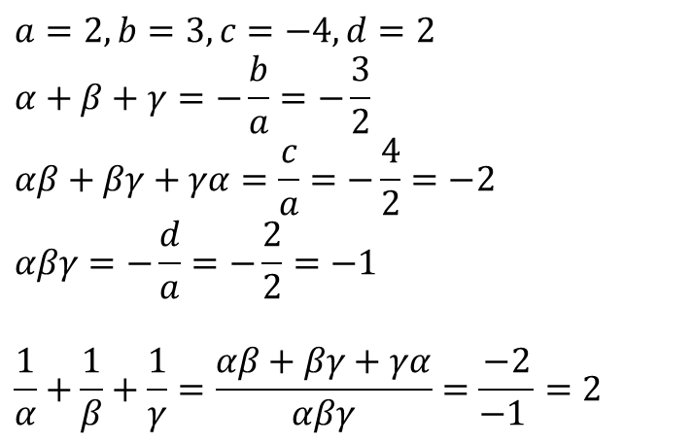
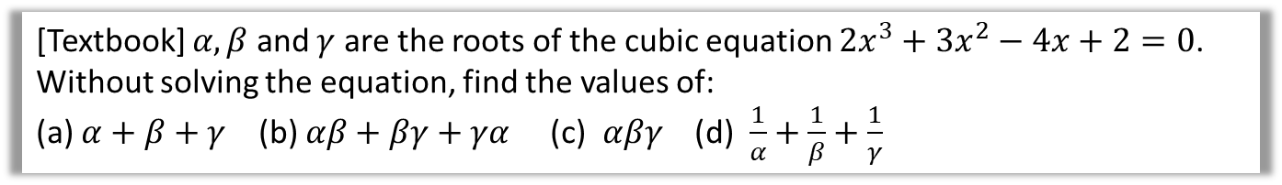
Examples
[Textbook] $α, β$ and $γ$ are the roots of the cubic equation $2x^{3}+3x^{2}−4x+2=0$. Without solving the equation, find the values of:
(a) $α+β+γ$ (b) $αβ+βγ+γα$ (c) $αβγ$ (d) $\frac{1}{α}+\frac{1}{β}+\frac{1}{γ}$
$$a=2, b=3,c=−4,d=2 \\ α+β+γ=−\frac{b}{a}=−\frac{3}{2} \\ αβ+βγ+γα=\frac{c}{a}=−\frac{4}{2}=−2 \\ αβγ=−\frac{d}{a}=−\frac{2}{2}=−1$$
$$\frac{1}{α}+\frac{1}{β}+\frac{1}{γ}=\frac{αβ+βγ+γα}{αβγ}=\frac{−2}{−1 }=2$$
?
?
?
Once again, we need to get this in terms of the expressions above.
?

Slide 13

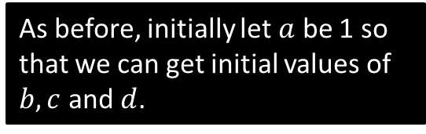
Examples
[Textbook] The roots of a cubic equation $ax^{3}+bx^{2}+cx+d=0$ are $α=1−2i$, $β=1+2i$ and $γ=2$. Find integers values for $a,b,c$ and $d$.
?
$$α+β+γ=4 ∴−\frac{b}{a}=4 \\ αβ+βγ+γα=\left(1−2i\right)\left(1+2i\right)+2\left(1−2i\right)+2\left(1+2i\right)=9 ∴\frac{c}{a}=9 \\ αβγ=\left(1−2i\right)\left(1+2i\right)\left(2\right)=10 ∴−\frac{d}{a}=10$$
Suppose that $a=1$, then
$b=−4$ and $c=9, d=−10$
$$∴x^{3}−4x^{2}+9x−10=0$$
$$a=1, b=−4, c=9, d=−10$$
As before, initially let $a$ be 1 so that we can get initial values of $b,c$ and $d$.

Slide 14
Exercise 4B
Pearson Core Pure Mathematics Book 1
Pages 58-59
Complete before the lesson Q2-4
In Class:
Green Q5-7
Amber Q8-10
Red Q11-13 & challenge

Slide 15
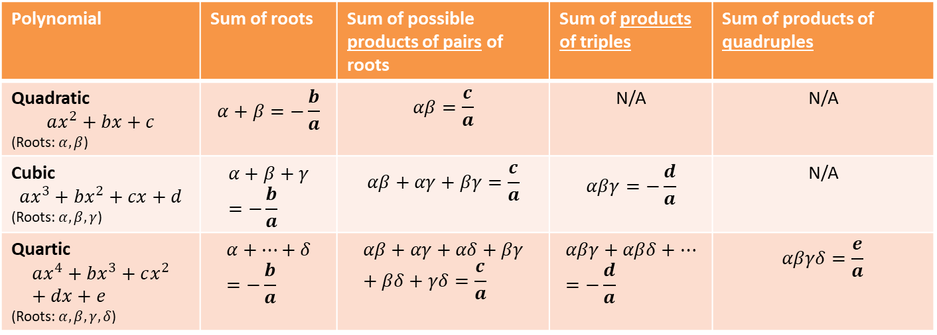
Roots of Quartics
The pattern continues!
Polynomial | Sum of roots | Sum of possible products of pairs of roots | Sum of products of triples | Sum of products of quadruples
Quadratic $$ax^{2}+bx+c$$ (Roots: $α, β$) | $$α+β=−\frac{b}{a}$$ | $$αβ=\frac{c}{a}$$ | N/A | N/A
Cubic $$ax^{3}+bx^{2}+cx+d$$ (Roots: $α, β,γ$) | $$α+β+γ=−\frac{b}{a}$$ | $$αβ+αγ+βγ=\frac{c}{a}$$ | $$αβγ=−\frac{d}{a}$$ | N/A
Quartic $$ax^{4}+bx^{3}+cx^{2}+dx+e$$ (Roots: $α, β,γ,δ$) | $$α+…+δ=−\frac{b}{a}$$ | $$αβ+αγ+αδ+βγ+βδ+γδ=\frac{c}{a}$$ | $$αβγ+αβδ+…=−\frac{d}{a}$$ | $$αβγδ=\frac{e}{a}$$

Slide 16

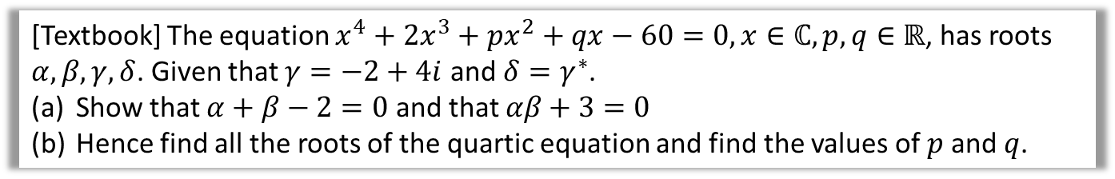


Example
[Textbook] The equation $x^{4}+2x^{3}+px^{2}+qx−60=0, x∈ℂ, p,q∈ℝ$, has roots $α, β,γ,δ$. Given that $γ=−2+4i$ and $δ=γ^{∗}$.
Show that $α+β−2=0$ and that $αβ+3=0$
Hence find all the roots of the quartic equation and find the values of $p$ and $q$.
$ℂ$ is the set of all complex numbers.
$$α+β+γ+δ=\frac{b}{a} \\ α+β+\left(−2+4i\right)+\left(−2i−4i\right)=\frac{2}{1} \\ ∴α+β−2=0$$
$$αβγδ=\frac{e}{a}=\frac{−60}{1} \\ αβ\left(−2+4i\right)\left(−2−4i\right)=−60 \\ 20αβ=−60 → αβ+3=0$$
Solving these two equations simultaneously gives $α=3, β=−1$ or $α=−1, β=3$
Either way, roots are $3, −1, −2±4i$
$p$ is the coefficient of $x^{2}$ so need to use $Σαβ=\frac{c}{a}$
$$3\left(−1\right)+3\left(−2+4i\right)+3\left(−2−4i\right)−1\left(−2+4i\right)−1(−2−4i)+(−2+4i)(−2−4i)=p/1 \\ ∴p=9$$
$q$ is the coefficient of $x$ so need to use $Σαβγ=−\frac{d}{a}$
$$3\left(−1\right)\left(−2+4i\right)+3\left(−1\right)\left(−2−4i\right)−1\left(−2+4i\right)\left(−2−4i\right)+3\left(−2+4i\right)\left(−2−4i\right)=−\frac{q}{1} \\ ∴q=−52$$
?
$Σαβ$ is a shorthand for “sum of product of all possible root pairs”.

Slide 17
Exercise 4C
Pearson Core Pure Mathematics Book 1
Pages 60-61
Complete before the lesson Q1-2
In Class:
Green Q3-7
Amber Q7810
Red Q11-13

Slide 18
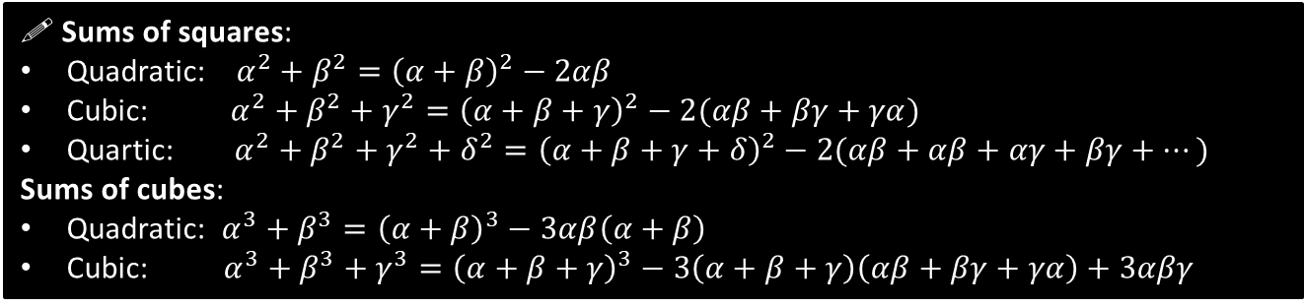
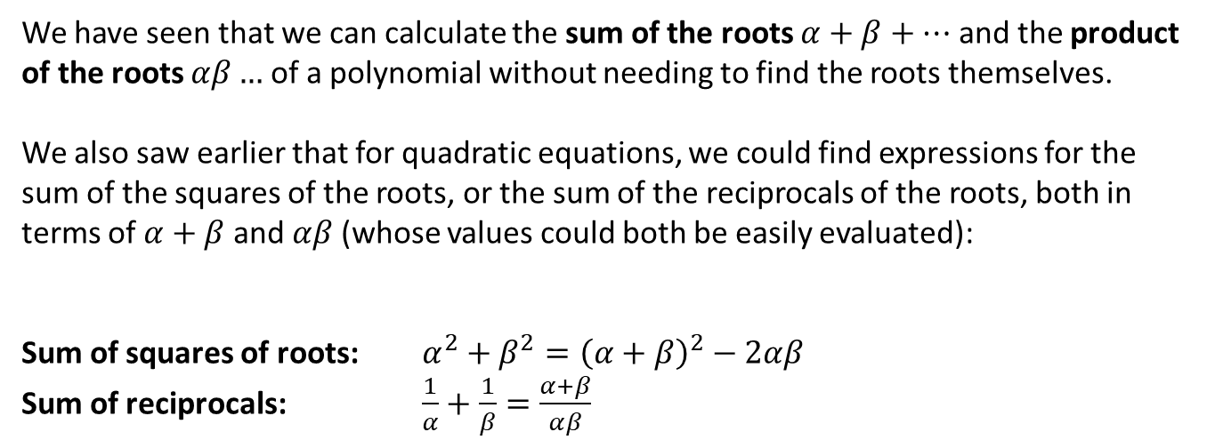
Expressions related to the roots of a polynomial
We have seen that we can calculate the sum of the roots $α+β+…$ and the product of the roots $αβ…$ of a polynomial without needing to find the roots themselves.
We also saw earlier that for quadratic equations, we could find expressions for the sum of the squares of the roots, or the sum of the reciprocals of the roots, both in terms of $α+β$ and $αβ$ (whose values could both be easily evaluated):
Sum of squares of roots: $α^{2}+β^{2}={\left(α+β\right)}^{2}−2αβ$
Sum of reciprocals: $\frac{1}{α}+\frac{1}{β}=\frac{α+β}{αβ}$
Such identities can be extended to cubics and quartics:
(You can use these results without proof)
! Sums of squares:
Quadratic: $α^{2}+β^{2}={\left(α+β\right)}^{2}−2αβ$
Cubic: $α^{2}+β^{2}+γ^{2}={\left(α+β+γ\right)}^{2}−2(αβ+βγ+γα)$
Quartic: $α^{2}+β^{2}+γ^{2}+δ^{2}={\left(α+β+γ+δ\right)}^{2}−2(αβ+αβ+αγ+βγ+…)$
Sums of cubes:
Quadratic: $α^{3}+β^{3}={\left(α+β\right)}^{3}−3αβ\left(α+β\right)$
Cubic: $α^{3}+β^{3}+γ^{3}={\left(α+β+γ\right)}^{3}−3\left(α+β+γ\right)\left(αβ+βγ+γα\right)+3αβγ$
(We can see these cubes formulae don’t generalise nicely as we increase the order of the polynomial. For this reason you are not required to know the sum of cubes for quartics)

Slide 19
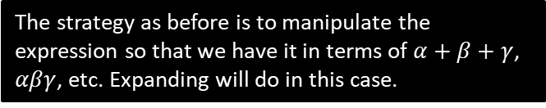
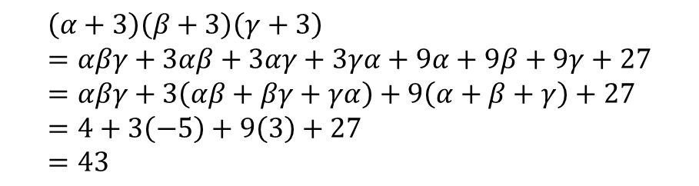
Example
[Textbook] The three roots of a cubic equation are $α,β$ and $γ$. Given that $αβγ=4$, $αβ+βγ+γα=−5$ and $α+β+γ=3$, find the value of $\left(α+3\right)\left(β+3\right)(γ+3)$
The strategy as before is to manipulate the expression so that we have it in terms of $α+β+γ$, $αβγ$, etc. Expanding will do in this case.
$$\left(α+3\right)\left(β+3\right)\left(γ+3\right) \\ =αβγ+3αβ+3αγ+3γα+9α+9β+9γ+27 \\ =αβγ+3\left(αβ+βγ+γα\right)+9\left(α+β+γ\right)+27 \\ =4+3\left(−5\right)+9\left(3\right)+27 \\ =43$$
?

Slide 20
Exercise 4D
Pearson Core Pure Mathematics Book 1
Pages 63-64
Complete before the lesson Q2-4
In Class:
Green Q5-7
Amber Q8-10
Red Q11-16

Slide 21


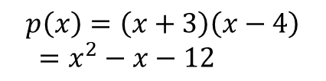

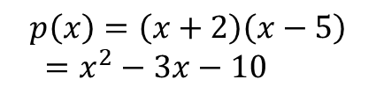


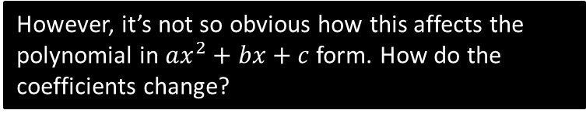
Linear Transformations of Roots
Suppose we transform the roots of a polynomial.
$$p\left(x\right)$$
$$p\left(x\right)$$
$$α→α−1$$
$$x$$
$$x$$
-2
5
-3
4
$$p\left(x\right)=\left(x+2\right)\left(x−5\right) \\ =x^{2}−3x−10$$
$$p\left(x\right)=\left(x+3\right)\left(x−4\right) \\ =x^{2}−x−12$$
If the polynomial was in factorised form, then the transformation is obvious: we can just replace each root with 1 less in the equation.
However, it’s not so obvious how this affects the polynomial in $ax^{2}+bx+c$ form. How do the coefficients change?

Slide 22

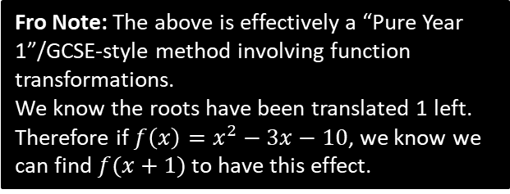

Continuing this example
On the previous slide, we had the polynomial $x^{2}−3x−10=0$ which has the roots $α$ and $β$. Without finding the roots, determine the equation with roots $α−1$ and $β−1$.
Method 1: Use relationship between roots and coefficients.
Method 2: Use a substitution
(probably recommended over Method 1)
?
?
Using original polynomial:
$$α+β=\frac{3}{1}=3 \\ αβ=\frac{c}{a}=−\frac{10}{1}=−10$$
$∴$ For new polynomial with roots $α−1,β−1$:
Sum of roots:
$$\left(α−1\right)+\left(β−1\right)=3−2=1=−\frac{b}{a}$$
Product of roots:
$$\left(α−1\right)\left(β−1\right)=αβ−α−β+1 \\ =−10−3+1=−12=\frac{c}{a}$$
Letting $a=1$, then $b=−1, c=−12$
$$x^{2}−x−12=0$$
Use a new variable to represent the transformed value.
Let $w=x−1$
$$∴x=w+1 \\ ∴x^{2}−3x−10=0 \\ →{\left(w+1\right)}^{2}−3\left(w+1\right)−10=0 \\ w^{2}+2w+1−3w−3−10=0 \\ w^{2}−w−12=0$$
Fro Note: The above is effectively a “Pure Year 1”/GCSE-style method involving function transformations.
We know the roots have been translated 1 left. Therefore if $f\left(x\right)=x^{2}−3x−10$, we know we can find $f(x+1)$ to have this effect.

Slide 23


Quartic Example
[Textbook] The quartic equation $x^{4}−3x^{3}+15x+1=0$ has roots $α, β,γ,δ$. Find the equation with roots $(2α+1)$, $\left(2β+1\right)$, $\left(2γ+1\right)$ and $(2δ+1)$.
Method 1: Use relationship between roots and coefficients.
(You’d have to be a complete muppet to use this method for quartics)
Method 2: Use a substitution
(Yes. Do this!)
Let $w=2x+1 → x=\frac{w−1}{2}$
Substituting:
$${\left(\frac{w−1}{2}\right)}^{4}−3{\left(\frac{w−1}{2}\right)}^{3}+15\left(\frac{w−1}{2}\right)+1=0$$
Multiply by 16:
$${\left(w−1\right)}^{4}−6{\left(w−1\right)}^{2}+120+16=0 \\ … \\ w^{4}−10w^{3}+24w^{2}+98w−97=0$$
?
?
Using original polynomial:
$$α+β+γ+δ=−\frac{−3}{1}=3 \\ αβ+αγ+…+γδ=\frac{0}{1}=0 \\ αβγ+…+βγδ=−\frac{15}{1}=−15 \\ αβγδ=\frac{1}{1}=1$$
$∴$ For new polynomial with roots $2α+1,…$:
Root sum: $\left(2α+1\right)+\left(2β+1\right)+\left(2γ+1\right)+\left(2δ+1\right)$
$$=2\left(α+β+γ+δ\right)+4=10=−\frac{b}{a}$$
Pair-product sum: $\left(2α+1\right)\left(2β+1\right)+\left(2α+1\right)\left(2γ+1\right)+…$
$$=4\left(αβ+αγ+…\right)+6\left(α+…+δ\right)+1 \\ =4\left(0\right)+6\left(3\right)+6=24=\frac{c}{a}$$
…
Letting $a=1$, then $b=−10, c=24, d=98, e=−97$
$$w^{4}−10w^{3}+24w^{2}+98w−97=0$$

Slide 24


Test Your Understanding
The cubic equation $x^{3}−2x^{2}+4=0$ has roots $α, β,γ,δ$. Find the equation with roots $(3α−1)$, $\left(3β−1\right)$, $\left(3γ−1\right)$ and $(3δ−1)$.
Method 1: Use relationship between roots and coefficients.
Method 2: Use a substitution
(Yes. Do this!)
?
Let $w=3x−1→ x=\frac{w+1}{3}$
Substituting:
$${\left(\frac{w+1}{3}\right)}^{3}−2{\left(\frac{w+1}{3}\right)}^{2}+4=0$$
Multiply by 27:
$${\left(w+1\right)}^{3}−6{\left(w+1\right)}^{2}+108=0 \\ w^{3}+3w^{2}+3w+1−{6w}^{2} −12w −6+108=0 \\ w^{3}−3w^{2}−9w+103=0$$
?
Bla
Bla
Bla
…
$$w^{3}+3w^{2}−15w−5=0$$

Slide 25
Exercise 4E
Pearson Core Pure Mathematics Book 1
Pages 66-67
Complete before the lesson Q1-2
In Class:
Green Q3-4
Amber Q5-6
Red Q7-8 & challenge

Slide 26
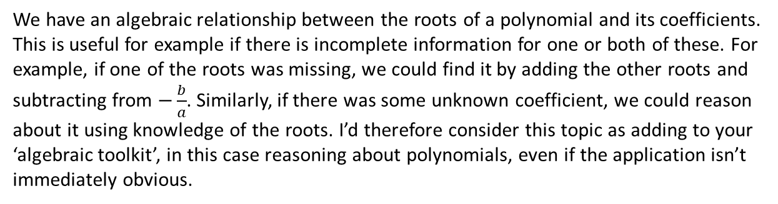
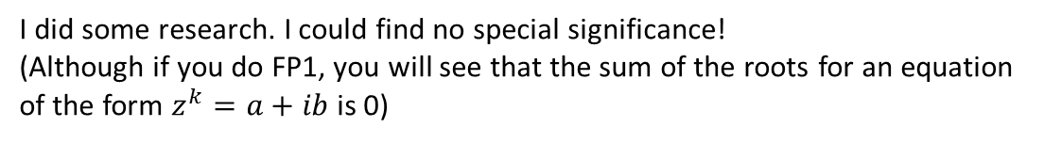
What is the point of all this?
Does the “sum of roots” or “product of roots” have any special geometric/algebraic significance?
I did some research. I could find no special significance!
(Although if you do FP1, you will see that the sum of the roots for an equation of the form $z^{k}=a+ib$ is 0)
So why is it useful then?
We have an algebraic relationship between the roots of a polynomial and its coefficients. This is useful for example if there is incomplete information for one or both of these. For example, if one of the roots was missing, we could find it by adding the other roots and subtracting from $−\frac{b}{a}$. Similarly, if there was some unknown coefficient, we could reason about it using knowledge of the roots. I’d therefore consider this topic as adding to your ‘algebraic toolkit’, in this case reasoning about polynomials, even if the application isn’t immediately obvious.
Why would we need to find the sum of squares of roots or the sum of reciprocals?
Again, I couldn’t find a practical use for this. However, there is a certain algebraic elegance that these quantities can be obtained without requiring the individual roots.

