Slide 1
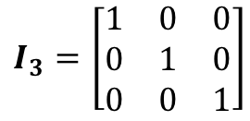

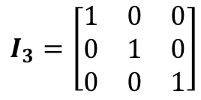

Matrices
$$I_{2}=\left[\begin{matrix}1 & 0 \\ 0 & 1\end{matrix}\right]$$
$$I_{3}=\left[\begin{matrix}1 & 0 & 0 \\ 0 & 1 & 0 \\ 0 & 0 & 1\end{matrix}\right]$$
You can calculate the determinant of a square matrix. The determinant is a scalar value associated with that matrix
You can find identity matrices for any square matrix
Identity matrix for a 2x2 square:
Identity matrix for a 3x3 square:
This section focuses on calculating determinants and minors, which are all useful in finding the inverse of a matrix
$$I_{3}=\left[\begin{matrix}1 & 0 & 0 \\ 0 & 1 & 0 \\ 0 & 0 & 1\end{matrix}\right]$$
$$I_{2}=\left[\begin{matrix}1 & 0 \\ 0 & 1\end{matrix}\right]$$
If you multiply a square matrix by its identity, you will get the same as what you start with
If you multiply a matrix by its inverse, you will get the identity matrix
Multiplying by the identity matrix is a bit like multiplying by 1!
6C

Slide 2


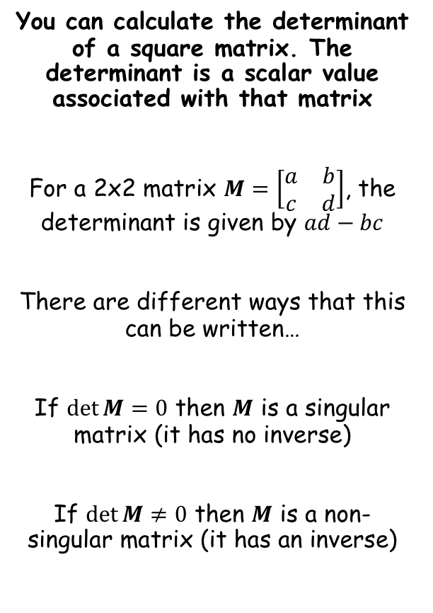


Matrices
$$I_{3}=\left[\begin{matrix}1 & 0 & 0 \\ 0 & 1 & 0 \\ 0 & 0 & 1\end{matrix}\right]$$
$$\left|\begin{matrix}a & b \\ c & d\end{matrix}\right|=ad−bc$$
$$I_{2}=\left[\begin{matrix}1 & 0 \\ 0 & 1\end{matrix}\right]$$
You can calculate the determinant of a square matrix. The determinant is a scalar value associated with that matrix
For a 2x2 matrix $M=\left[\begin{matrix}a & b \\ c & d\end{matrix}\right]$, the determinant is given by $ad−bc$
There are different ways that this can be written…
If $\det{M}=0$ then $M$ is a singular matrix (it has no inverse)
If $\det{M}≠0$ then $M$ is a non-singular matrix (it has an inverse)
$$\det{M}=ad−bc$$
$$\left|M\right|=ad−bc$$
$$\left|\begin{matrix}a & b \\ c & d\end{matrix}\right|=ad−bc$$
6C

Slide 3




Matrices
$$I_{3}=\left[\begin{matrix}1 & 0 & 0 \\ 0 & 1 & 0 \\ 0 & 0 & 1\end{matrix}\right]$$
$$\left|\begin{matrix}a & b \\ c & d\end{matrix}\right|=ad−bc$$
$$I_{2}=\left[\begin{matrix}1 & 0 \\ 0 & 1\end{matrix}\right]$$
You can calculate the determinant of a square matrix. The determinant is a scalar value associated with that matrix
Given that $A=\left[\begin{matrix}6 & 5 \\ 1 & 2\end{matrix}\right]$, find $\det{A}$
$$\det{A}=ad−bc$$
Sub in values correctly!
$$\det{A}=(6)(2)−(5)(1)$$
Calculate
$$\det{A}=7$$
6C

Slide 4


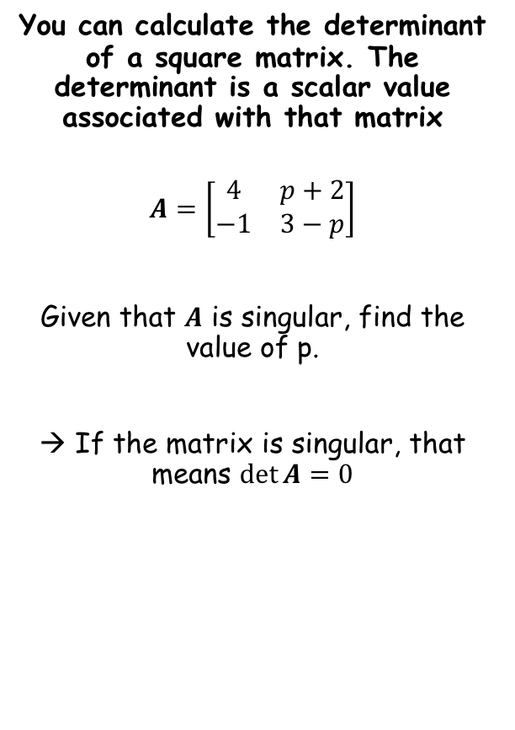

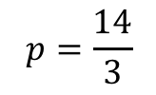

Matrices
$$I_{3}=\left[\begin{matrix}1 & 0 & 0 \\ 0 & 1 & 0 \\ 0 & 0 & 1\end{matrix}\right]$$
$$\left|\begin{matrix}a & b \\ c & d\end{matrix}\right|=ad−bc$$
$$I_{2}=\left[\begin{matrix}1 & 0 \\ 0 & 1\end{matrix}\right]$$
You can calculate the determinant of a square matrix. The determinant is a scalar value associated with that matrix
$$A=\left[\begin{matrix}4 & p+2 \\ −1 & 3−p\end{matrix}\right]$$
Given that $A$ is singular, find the value of p.
→ If the matrix is singular, that means $\det{A}=0$
$$\det{A}=ad−bc$$
Sub in values correctly!
$$0=(4)(3−p)−(p+2)(−1)$$
Calculate
$$0=12−4p+p+2$$
Calculate
$$0=14−3p$$
$$p=\frac{14}{3}$$
Calculate
6C

Slide 5
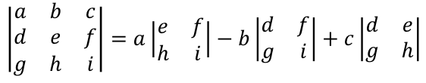
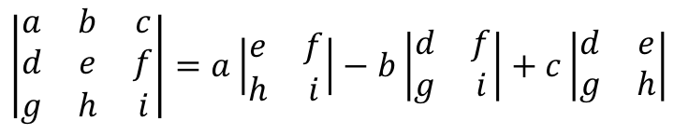
Matrices
$$I_{3}=\left[\begin{matrix}1 & 0 & 0 \\ 0 & 1 & 0 \\ 0 & 0 & 1\end{matrix}\right]$$
$$\left|\begin{matrix}a & b \\ c & d\end{matrix}\right|=ad−bc$$
$$\left|\begin{matrix}a & b & c \\ d & e & f \\ g & h & i\end{matrix}\right|=a\left|\begin{matrix}e & f \\ h & i\end{matrix}\right|−b\left|\begin{matrix}d & f \\ g & i\end{matrix}\right|+c\left|\begin{matrix}d & e \\ g & h\end{matrix}\right|$$
$$I_{2}=\left[\begin{matrix}1 & 0 \\ 0 & 1\end{matrix}\right]$$
You can calculate the determinant of a square matrix. The determinant is a scalar value associated with that matrix
It is more difficult to find the inverse of a 3x3 matrix. This is the formula:
$$\left|\begin{matrix}a & b & c \\ d & e & f \\ g & h & i\end{matrix}\right|=a\left|\begin{matrix}e & f \\ h & i\end{matrix}\right|−b\left|\begin{matrix}d & f \\ g & i\end{matrix}\right|+c\left|\begin{matrix}d & e \\ g & h\end{matrix}\right|$$
Each of the top numbers is multiplied by the determinant of its ‘minor’
The minor is the 2x2 matrix which remains when you cross off any numbers in the same row or column as the starting one…
6C

Slide 6


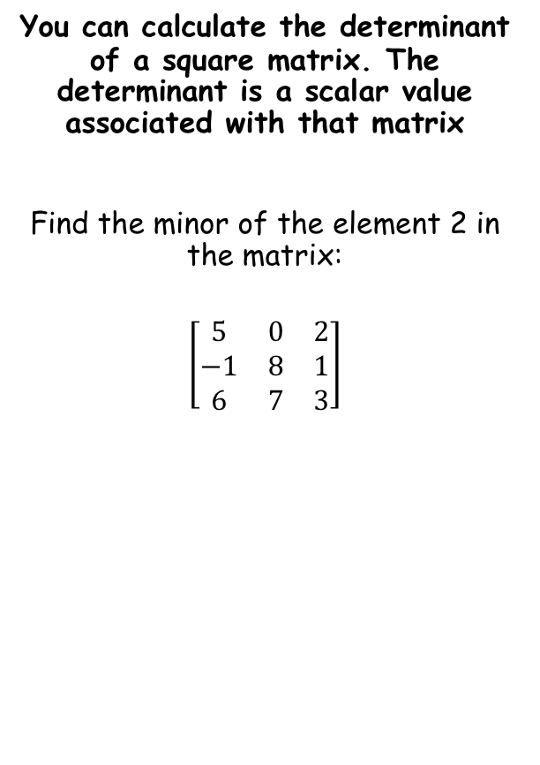

Matrices
$$I_{3}=\left[\begin{matrix}1 & 0 & 0 \\ 0 & 1 & 0 \\ 0 & 0 & 1\end{matrix}\right]$$
$$\left|\begin{matrix}a & b \\ c & d\end{matrix}\right|=ad−bc$$
$$\left|\begin{matrix}a & b & c \\ d & e & f \\ g & h & i\end{matrix}\right|=a\left|\begin{matrix}e & f \\ h & i\end{matrix}\right|−b\left|\begin{matrix}d & f \\ g & i\end{matrix}\right|+c\left|\begin{matrix}d & e \\ g & h\end{matrix}\right|$$
$$I_{2}=\left[\begin{matrix}1 & 0 \\ 0 & 1\end{matrix}\right]$$
You can calculate the determinant of a square matrix. The determinant is a scalar value associated with that matrix
Find the minor of the element 2 in the matrix:
$$\left[\begin{matrix}5 & 0 & 2 \\ −1 & 8 & 1 \\ 6 & 7 & 3\end{matrix}\right]$$
$$\left|\begin{matrix}−1 & 8 \\ 6 & 7\end{matrix}\right|$$
Sub in values correctly!
$$=\left(−1\right)\left(7\right)−(8)(6)$$
Calculate
$$=−55$$
6C

Slide 7

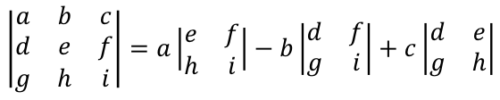



Matrices
$$I_{3}=\left[\begin{matrix}1 & 0 & 0 \\ 0 & 1 & 0 \\ 0 & 0 & 1\end{matrix}\right]$$
$$\left|\begin{matrix}a & b \\ c & d\end{matrix}\right|=ad−bc$$
$$\left|\begin{matrix}a & b & c \\ d & e & f \\ g & h & i\end{matrix}\right|=a\left|\begin{matrix}e & f \\ h & i\end{matrix}\right|−b\left|\begin{matrix}d & f \\ g & i\end{matrix}\right|+c\left|\begin{matrix}d & e \\ g & h\end{matrix}\right|$$
$$I_{2}=\left[\begin{matrix}1 & 0 \\ 0 & 1\end{matrix}\right]$$
You can calculate the determinant of a square matrix. The determinant is a scalar value associated with that matrix
Find the value of $\left|\begin{matrix}1 & 2 & 4 \\ 3 & 2 & 1 \\ −1 & 4 & 3\end{matrix}\right|$
$$\left|\begin{matrix}a & b & c \\ d & e & f \\ g & h & i\end{matrix}\right|=a\left|\begin{matrix}e & f \\ h & i\end{matrix}\right|−b\left|\begin{matrix}d & f \\ g & i\end{matrix}\right|+c\left|\begin{matrix}d & e \\ g & h\end{matrix}\right|$$
Sub in values
$$=1\left|\begin{matrix}2 & 1 \\ 4 & 3\end{matrix}\right|−2\left|\begin{matrix}3 & 1 \\ −1 & 3\end{matrix}\right|+4\left|\begin{matrix}3 & 2 \\ −1 & 4\end{matrix}\right|$$
Calculate the determinants
$$=1(2)−2(10)+4(14)$$
Calculate
$$=38$$
You can use your calculator to calculate some of these – we will see how on the next slide!
6C

Slide 8
Matrices
$$I_{3}=\left[\begin{matrix}1 & 0 & 0 \\ 0 & 1 & 0 \\ 0 & 0 & 1\end{matrix}\right]$$
$$\left|\begin{matrix}a & b \\ c & d\end{matrix}\right|=ad−bc$$
$$\left|\begin{matrix}a & b & c \\ d & e & f \\ g & h & i\end{matrix}\right|=a\left|\begin{matrix}e & f \\ h & i\end{matrix}\right|−b\left|\begin{matrix}d & f \\ g & i\end{matrix}\right|+c\left|\begin{matrix}d & e \\ g & h\end{matrix}\right|$$
$$I_{2}=\left[\begin{matrix}1 & 0 \\ 0 & 1\end{matrix}\right]$$
You can calculate the determinant of a square matrix. The determinant is a scalar value associated with that matrix
How to do matrix calculations on your calculator…
DEMONSTRATION
6C

Slide 9


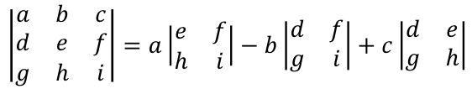

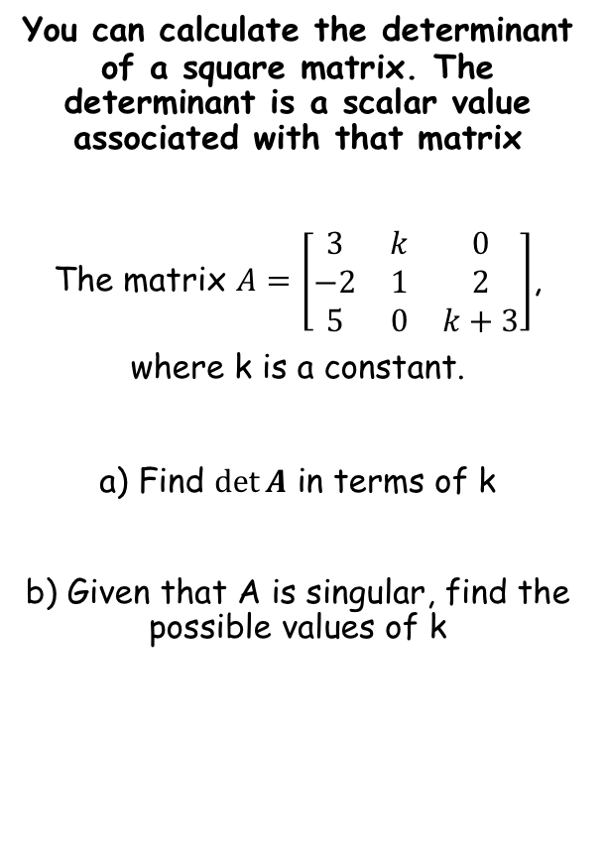


Matrices
$$I_{3}=\left[\begin{matrix}1 & 0 & 0 \\ 0 & 1 & 0 \\ 0 & 0 & 1\end{matrix}\right]$$
$$\left|\begin{matrix}a & b \\ c & d\end{matrix}\right|=ad−bc$$
$$\left|\begin{matrix}a & b & c \\ d & e & f \\ g & h & i\end{matrix}\right|=a\left|\begin{matrix}e & f \\ h & i\end{matrix}\right|−b\left|\begin{matrix}d & f \\ g & i\end{matrix}\right|+c\left|\begin{matrix}d & e \\ g & h\end{matrix}\right|$$
$$I_{2}=\left[\begin{matrix}1 & 0 \\ 0 & 1\end{matrix}\right]$$
You can calculate the determinant of a square matrix. The determinant is a scalar value associated with that matrix
The matrix $A=\left[\begin{matrix}3 & k & 0 \\ −2 & 1 & 2 \\ 5 & 0 & k+3\end{matrix}\right]$,
where k is a constant.
a) Find $\det{A}$ in terms of k
b) Given that A is singular, find the possible values of k
$$\left|\begin{matrix}a & b & c \\ d & e & f \\ g & h & i\end{matrix}\right|=a\left|\begin{matrix}e & f \\ h & i\end{matrix}\right|−b\left|\begin{matrix}d & f \\ g & i\end{matrix}\right|+c\left|\begin{matrix}d & e \\ g & h\end{matrix}\right|$$
Sub in values
$$=3\left|\begin{matrix}1 & 2 \\ 0 & k+3\end{matrix}\right|−k\left|\begin{matrix}−2 & 2 \\ 5 & k+3\end{matrix}\right|+0\left|\begin{matrix}−2 & 1 \\ 5 & 0\end{matrix}\right|$$
Calulate determin-ants
$$=3\left(\left(k+3\right)−\left(0\right)\right)−k(\left(−2k−6\right)−10)$$
Simplify brackets
$$=3\left(k+3\right)−k(−2k−16)$$
Multiply out
$$=3k+9+{2k}^{2}+16k$$
Simplify
$$={2k}^{2}+19k+9$$
$$={2k}^{2}+19k+9$$
6C

Slide 10



Matrices
$$I_{3}=\left[\begin{matrix}1 & 0 & 0 \\ 0 & 1 & 0 \\ 0 & 0 & 1\end{matrix}\right]$$
$$\left|\begin{matrix}a & b \\ c & d\end{matrix}\right|=ad−bc$$
$$\left|\begin{matrix}a & b & c \\ d & e & f \\ g & h & i\end{matrix}\right|=a\left|\begin{matrix}e & f \\ h & i\end{matrix}\right|−b\left|\begin{matrix}d & f \\ g & i\end{matrix}\right|+c\left|\begin{matrix}d & e \\ g & h\end{matrix}\right|$$
$$I_{2}=\left[\begin{matrix}1 & 0 \\ 0 & 1\end{matrix}\right]$$
You can calculate the determinant of a square matrix. The determinant is a scalar value associated with that matrix
The matrix $A=\left[\begin{matrix}3 & k & 0 \\ −2 & 1 & 2 \\ 5 & 0 & k+3\end{matrix}\right]$,
where k is a constant.
a) Find $\det{A}$ in terms of k
b) Given that A is singular, find the possible values of k
$${2k}^{2}+19k+9=0$$
Factorise
$$(2k+1)(k+9)=0$$
$$k=−\frac{1}{2}, 9$$
Solve
$$={2k}^{2}+19k+9$$
Singular means that the determinant is 0
6C

Slide 11
Exercise 6C
Pearson Further Core Mathematics Year 1/AS
Complete before the lesson Q1-6
In Class:
Green Q7-9
Amber Q10-12
Red Q13-15 & challenge

