Slide 1
Year 1 Applied Mathematics
Modelling in Mechanics
- Constructing a Model
Chapter 8
(Part 1 of 4)

Slide 2
Constructing a Model
Mechanics deals with the motion of an object.
- You construct a model of a real-life situation.
- Then Describe the motion of the object using an equation or graph.
The solution to a mathematical model
should be interpreted in the context
of the original problem.

Slide 3
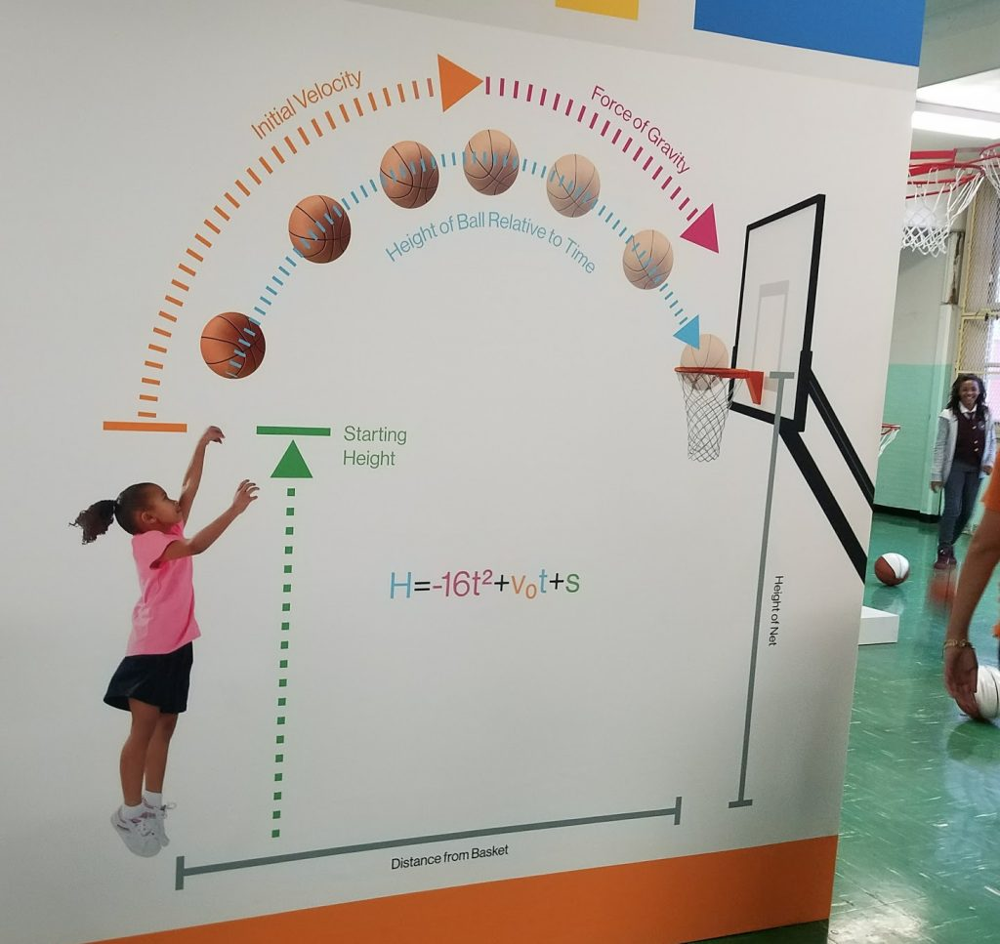
Constructing a Model

Slide 4
Constructing a Model
The motion of a basketball can be
modelled using the equation:
h = 2 + 1.1t – 0.1t²
What is the height when
the basketball is released?
2 metres
What is the height when t = 0.5?
2.525 metres

Slide 5
Constructing a Model
h = 2 + 1.1t – 0.1t²
What is the height when
when t = 15?
-4 metres
Comment on the validity of this prediction.
The ball cannot be 4 metre below ground! So the model is not valid when t = 15

Slide 6
Exercise 8A
Pearson Stats/Mechanics Year 2
Pages 127-129
Complete before the lesson Q1-2
In Class:
Green Q3-6

