Slide 1

CorePure1 Chapter 6 ::
Matrices
jfrost@tiffin.kingston.sch.uk
www.drfrostmaths.com
@DrFrostMaths
Last modified: 14th September 2018

Slide 2








www.drfrostmaths.com
Everything is completely free.
Why not register?
Register now to interactively practise questions on this topic, including past paper questions and extension questions (including MAT + UKMT).
Teachers: you can create student accounts (or students can register themselves), to set work, monitor progress and even create worksheets.
With questions by:
Dashboard with points, trophies, notifications and student progress.
Questions organised by topic, difficulty and past paper.
Teaching videos with topic tests to check understanding.

Slide 3
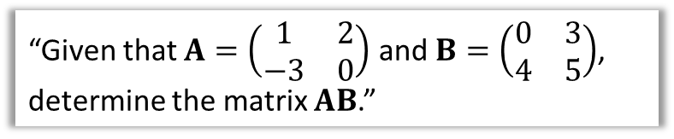
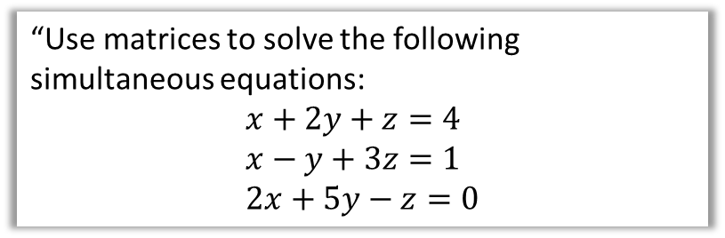

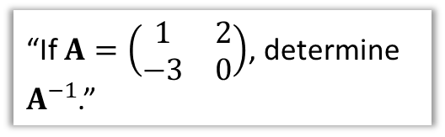
Chapter Overview
Those who have done either IGCSE Further Mathematics would have encountered some of this content. Otherwise it will be completely new!
1:: Understand matrices and perform basic operations (adding, scalar multiplication)
2:: Multiply Matrices
“Given that $A=\left(\begin{matrix}1 & 2 \\ −3 & 0\end{matrix}\right)$ and $B=\left(\begin{matrix}0 & 3 \\ 4 & 5\end{matrix}\right)$, determine the matrix $AB$.”
3:: Find the determinant or inverse of a matrix.
4:: Solve simultaneous equations using matrices.
“Use matrices to solve the following simultaneous equations:
$$x+2y+z=4 \\ x−y+3z=1 \\ 2x+5y−z=0$$
“If $A=\left(\begin{matrix}1 & 2 \\ −3 & 0\end{matrix}\right)$, determine $A^{−1}$.”
Teacher Notes: The matrices chapter from the old FP1 has largely been split into two, with the latter half (Chapter 7) dedicated to transformations. $3×3$ matrices from the old FP3 has been moved here. There is some new discussion about the consistency of systems of equations.

Slide 4


Introduction
A matrix (plural: matrices) is simply an ‘array’ of numbers, e.g.
$$\left(\begin{matrix}1 & 0 & −2 \\ 3 & 3 & 0\end{matrix}\right)$$
On a simple level, a matrix is just a way to organise values into rows and columns, and represent these multiple values as a single structure.
But the power of matrices comes from them representing linear transformations/functions (which we will particularly see in Chapter 7). We can
Represent linear transformations using matrices (e.g. rotations, reflections and enlargements)
Use them to solve linear simultaneous equations.
Matrices are particularly useful in 3D graphics, as matrices can be used to carry out rotations/enlargements (useful for changing the camera angle) or project into a 2D ‘viewing’ plane.

Slide 5
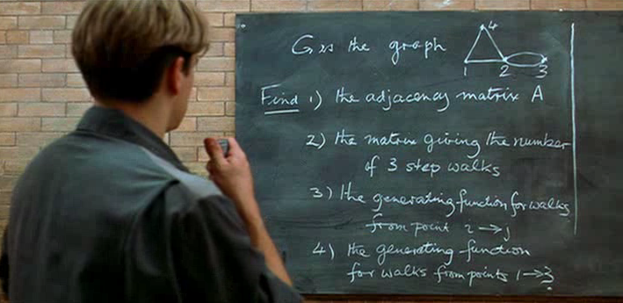
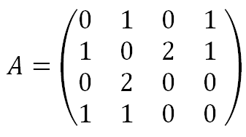
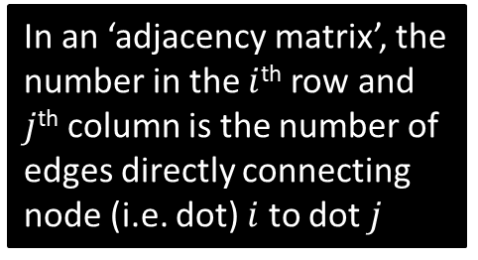
(Just for Fun) Using matrices to represent data
This is a scene from the film Good Will Hunting.
Maths professor Lambeau poses a “difficult”* problem for his graduate students from algebraic graph theory, the first part asking for a matrix representation of this graph. Matt Damon anonymously solves the problem while on a cleaning shift.
?
In an ‘adjacency matrix’, the number in the $i$^{th} row and $j$^{th} column is the number of edges directly connecting node (i.e. dot) $i$ to dot $j$
?
* It really isn’t.

Slide 6
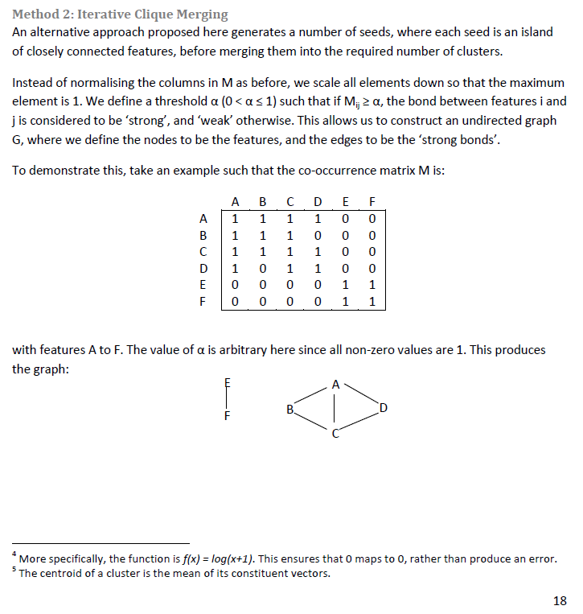
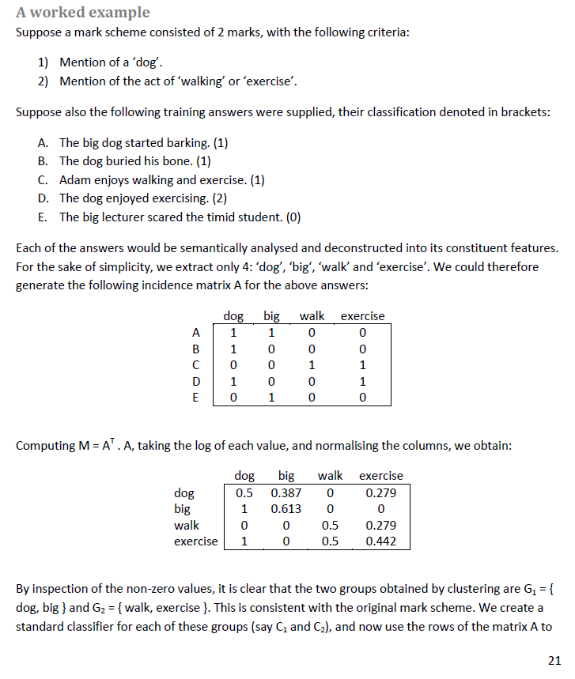
(Just for Fun) Using matrices to represent data
In my 4th year undergraduate dissertation, I used matrices to help ‘learn’ mark schemes from GCSE biology scripts*. Matrix algebra helped me to initially determine how words (and more complex semantic information) tended to occur together with other words.
* Shameless Brag Opportunity: I won the “Best Undergraduate Dissertation Prize” for this!

Slide 7
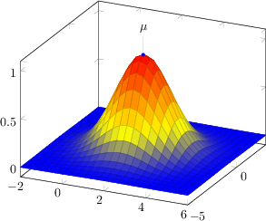
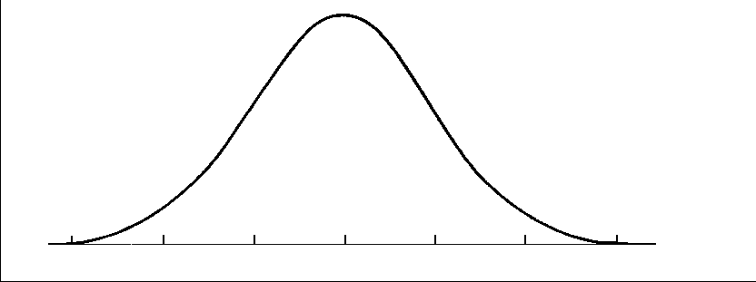


(Just for Fun) And matrices in Statistics…
In Stats Year 2, you have/will come across the Normal Distribution, where you need to specify the variance. This can be extended to 2D (and beyond) by using a “covariance matrix”, where each number in the matrix gives the extent to which each axis varies with each other.
1D
2D

Slide 8






Matrix Fundamentals
#1 Dimensions of Matrices
The dimension of a matrix is its size, in terms of its number of rows and columns (in that order).
Matrix
Dimensions
$$2×3$$
?
$$3×1$$
?
$$1×3$$

Slide 9



Matrix Fundamentals
#2 Notation/Names for Matrices
A matrix can have square or curvy brackets*.
Matrix
Column Vector
Row Vector
A matrix with one column is simply a vector in the usual sense!
* The textbook only uses curvy.

Slide 10
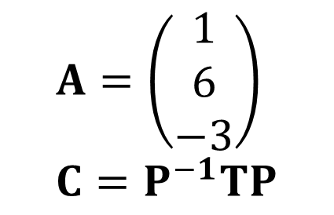
Matrix Fundamentals
#3 Variables for Matrices
If the value of a variable is a matrix, we use bold, capital letters
(In contrast, vectors use bold, lowercase letters)
$$A=\left(\begin{matrix}1 \\ 6 \\ −3\end{matrix}\right) \\ C=P^{−1}TP$$

Slide 11
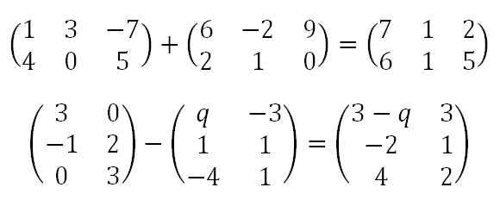
Matrix Fundamentals
#4 Adding/Subtracting Matrices
Simply add/subtract the corresponding elements of each matrix.
They must be of the same dimension.
?
?

Slide 12
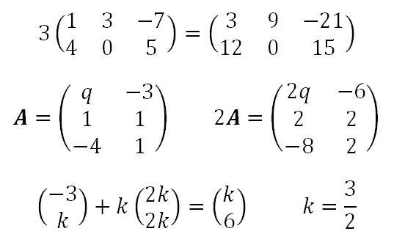
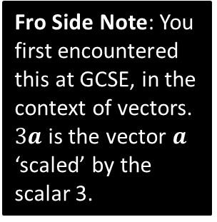
Matrix Fundamentals
#5 Scalar Multiplication
A scalar is a number which can ‘scale’ the elements inside a matrix.
Fro Side Note: You first encountered this at GCSE, in the context of vectors. $3a$ is the vector $a$ ‘scaled’ by the scalar 3.
1
?
?
2
?
3

Slide 13
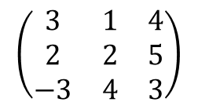

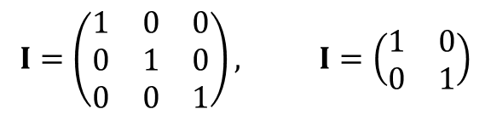
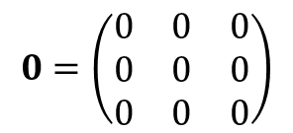
Matrix Fundamentals
#6 Special Matrices
A matrix is square if it has the same number of rows as columns.
$$\left(\begin{matrix}3 & 1 & 4 \\ 2 & 2 & 5 \\ −3 & 4 & 3\end{matrix}\right)$$
$$\left(\begin{matrix}1 & 2 \\ 3 & 4\end{matrix}\right)$$
A zero matrix is one in which all its elements are 0. The dimensions are usually clear from the context.
$$0=\left(\begin{matrix}0 & 0 & 0 \\ 0 & 0 & 0 \\ 0 & 0 & 0\end{matrix}\right)$$
A identity matrix $I$ is a square matrix which has 1’s in the ‘leading diagonal’ (starting top-left) and 0 elsewhere. Again, the dimensions depend on the context.
$$I=\left(\begin{matrix}1 & 0 & 0 \\ 0 & 1 & 0 \\ 0 & 0 & 1\end{matrix}\right), I=\left(\begin{matrix}1 & 0 \\ 0 & 1\end{matrix}\right)$$
We will see the significance of the identity matrix when we cover matrix multiplication imminently.

Slide 14
Exercise 6A
Pearson Pure Mathematics Year 1/AS
Pages 97-99
(Classes in a rush could probably get away with skipping this exercise)
Complete before the lesson Q1-5
In Class:
Green Q6-9
Amber Q10-15
Red Q16-18

Slide 15

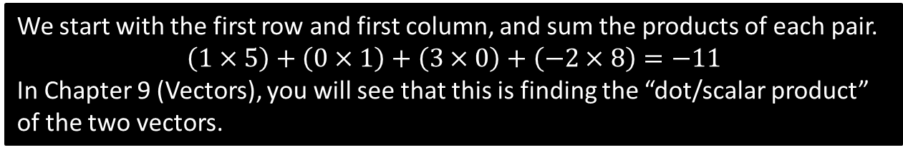
Matrix Multiplication
Now repeat the process with the first row and second column.
Now repeat for the next row of the left matrix...
1 0 3 -2
2 8 4 3
7 -1 0 2
5 1
1 7
0 3
8 -3
-11
16
$$=$$
42
61
50
-6
We start with the first row and first column, and sum the products of each pair.
$$\left(1×5\right)+\left(0×1\right)+\left(3×0\right)+\left(−2×8\right)=−11$$
In Chapter 9 (Vectors), you will see that this is finding the “dot/scalar product” of the two vectors.

Slide 16
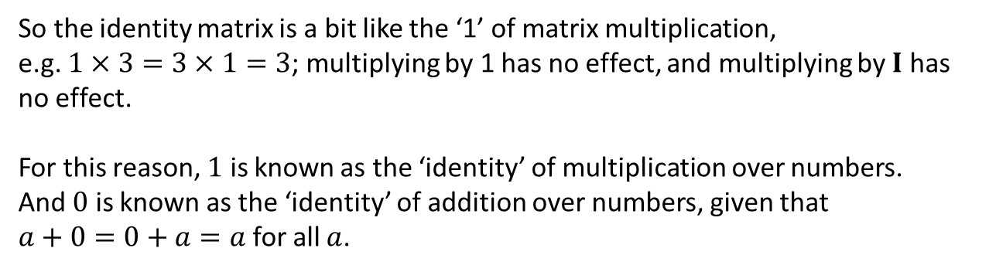

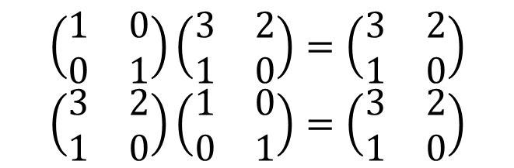
Matrix Multiplication involving $I$
We earlier saw the identity matrix $I=\left(\begin{matrix}1 & 0 \\ 0 & 1\end{matrix}\right)$. What do you notice about…
?
$$\left(\begin{matrix}1 & 0 \\ 0 & 1\end{matrix}\right)\left(\begin{matrix}3 & 2 \\ 1 & 0\end{matrix}\right)=\left(\begin{matrix}3 & 2 \\ 1 & 0\end{matrix}\right) \\ \left(\begin{matrix}3 & 2 \\ 1 & 0\end{matrix}\right)\left(\begin{matrix}1 & 0 \\ 0 & 1\end{matrix}\right)=\left(\begin{matrix}3 & 2 \\ 1 & 0\end{matrix}\right)$$
?
In general $AI=IA=A$ for all matrices $A$.
So the identity matrix is a bit like the ‘1’ of matrix multiplication,
e.g. $1×3=3×1=3$; multiplying by 1 has no effect, and multiplying by $I$ has no effect.
For this reason, $1$ is known as the ‘identity’ of multiplication over numbers.
And $0$ is known as the ‘identity’ of addition over numbers, given that
$a+0=0+a=a$ for all $a$.

Slide 17

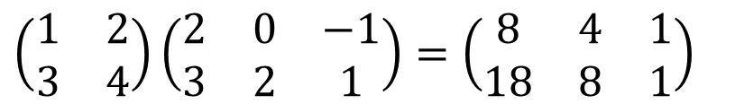
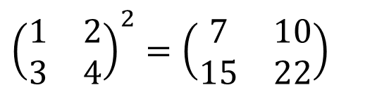
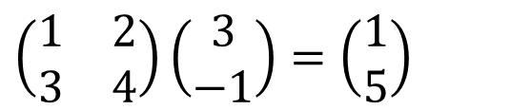
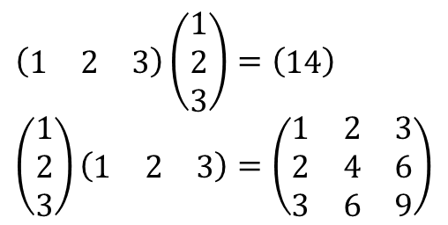
Test Your Understanding
?
$$\left(\begin{matrix}1 & 2 \\ 3 & 4\end{matrix}\right)\left(\begin{matrix}3 \\ −1\end{matrix}\right)=\left(\begin{matrix}1 \\ 5\end{matrix}\right)$$
a
?
$$\left(\begin{matrix}1 & 2 \\ 3 & 4\end{matrix}\right)\left(\begin{matrix}2 & 0 & −1 \\ 3 & 2 & 1\end{matrix}\right)=\left(\begin{matrix}8 & 4 & 1 \\ 18 & 8 & 1\end{matrix}\right)$$
b
?
?
$$\left(\begin{matrix}1 & 2 & 3\end{matrix}\right)\left(\begin{matrix}1 \\ 2 \\ 3\end{matrix}\right)=\left(\begin{matrix}14\end{matrix}\right) \\ \left(\begin{matrix}1 \\ 2 \\ 3\end{matrix}\right)\left(\begin{matrix}1 & 2 & 3\end{matrix}\right)=\left(\begin{matrix}1 & 2 & 3 \\ 2 & 4 & 6 \\ 3 & 6 & 9\end{matrix}\right)$$
$${\left(\begin{matrix}1 & 2 \\ 3 & 4\end{matrix}\right)}^{2}=\left(\begin{matrix}7 & 10 \\ 15 & 22\end{matrix}\right)$$
N₂
c
?
N₃
?
N₁

Slide 18
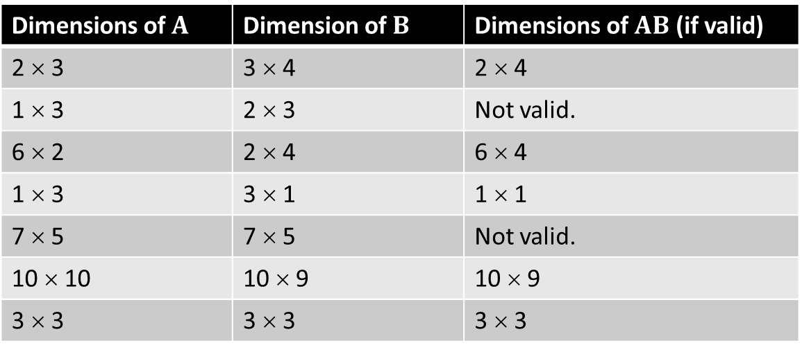
Matrix Fundamentals
#7 Matrix Multiplication
Matrix multiplications are not always valid: the dimensions have to agree.
Dimensions of $A$ | Dimension of $B$ | Dimensions of $AB$ (if valid)
2 × 3 | 3 × 4 | 2 × 4
1 × 3 | 2 × 3 | Not valid.
6 × 2 | 2 × 4 | 6 × 4
1 × 3 | 3 × 1 | 1 × 1
7 × 5 | 7 × 5 | Not valid.
10 × 10 | 10 × 9 | 10 × 9
3 × 3 | 3 × 3 | 3 × 3
?
?
?
?
?
?
?
Note that only square matrices (i.e. same width as height) can be raised to a power.

Slide 19
Exercise 6B
Pearson Pure Mathematics Year 1/AS
Pages 101-103
Complete before the lesson Q1-4
In Class:
Green Q5-9
Amber Q10-14
Red Q15-19 & challenge

Slide 20



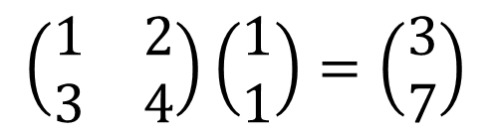

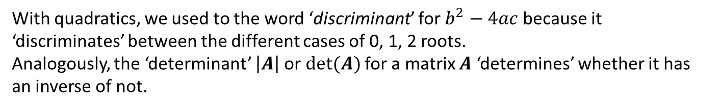



Determinant of a matrix
In Chapter 7, you will see that matrices can be thought of as a function that can transform a point, eg:
$$\left(\begin{matrix}1 & 2 \\ 3 & 4\end{matrix}\right)$$
$$\left(\begin{matrix}1 & 2 \\ 3 & 4\end{matrix}\right)\left(\begin{matrix}1 \\ 1\end{matrix}\right)=\left(\begin{matrix}3 \\ 7\end{matrix}\right)$$
$$(3,7)$$
$$(1,1)$$
A question might naturally be whether there is an ‘inverse function/transformation’ that can retrieve the original point:
$$(3,7)$$
$$\left(\begin{matrix}? & ? \\ ? & ?\end{matrix}\right)\left(\begin{matrix}3 \\ 7\end{matrix}\right)=\left(\begin{matrix}1 \\ 1\end{matrix}\right)$$
$$(1,1)$$
$$\left(\begin{matrix}? & ? \\ ? & ?\end{matrix}\right)$$
This matrix would be known as the inverse of $\left(\begin{matrix}1 & 2 \\ 3 & 4\end{matrix}\right)$.
With quadratics, we used to the word ‘discriminant’ for $b^{2}−4ac$ because it ‘discriminates’ between the different cases of 0, 1, 2 roots.
Analogously, the ‘determinant’ $\left|A\right|$or $det⁡(A)$ for a matrix $A$ ‘determines’ whether it has an inverse of not.

Slide 21
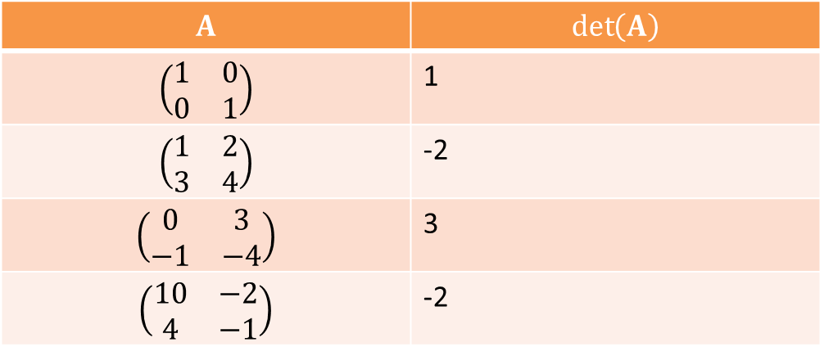
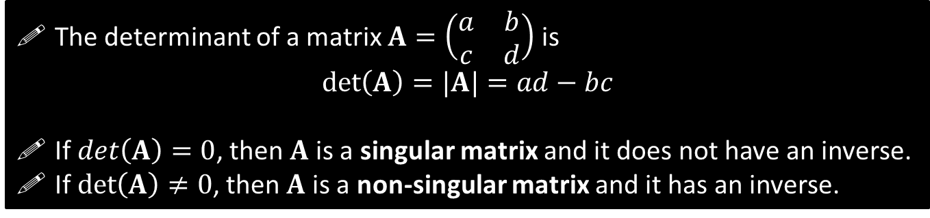
Determinants
The determinant of a matrix $A=\left(\begin{matrix}a & b \\ c & d\end{matrix}\right)$ is
$\det\left(A\right)=|A|=ad−bc$
If $det\left(A\right)=0$, then $A$ is a singular matrix and it does not have an inverse.
If $\det\left(A\right)≠0$, then $A$ is a non-singular matrix and it has an inverse.
Quickfire Questions:
$$A$$ | $$\det\left(A\right)$$
$$\left(\begin{matrix}1 & 0 \\ 0 & 1\end{matrix}\right)$$ | 1
$$\left(\begin{matrix}1 & 2 \\ 3 & 4\end{matrix}\right)$$ | -2
$$\left(\begin{matrix}0 & 3 \\ −1 & −4\end{matrix}\right)$$ | 3
$$\left(\begin{matrix}10 & −2 \\ 4 & −1\end{matrix}\right)$$ | -2
?
?
?
?

Slide 22
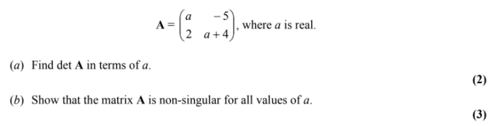
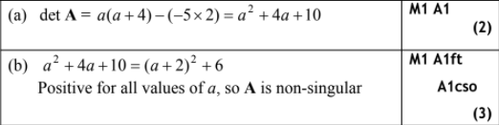


Test Your Understanding So Far
[Textbook]
$$A=\left(\begin{matrix}4 & p+2 \\ −1 & 3−p\end{matrix}\right)$$
Given that $A$ is singular, find the value of $p$.
?
$$\det\left(A\right)=4\left(3−p\right)−\left(−1\right)\left(p+2\right)=0 \\ 14−3p=0 ⇒ p=\frac{14}{3}$$
Edexcel FP1(Old) Jan 2010 Q5
?
?

Slide 23
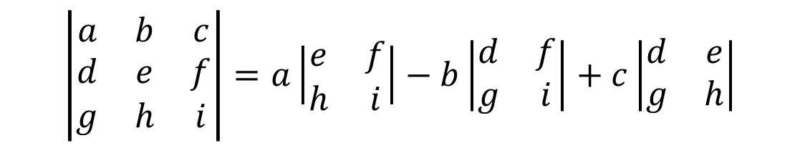
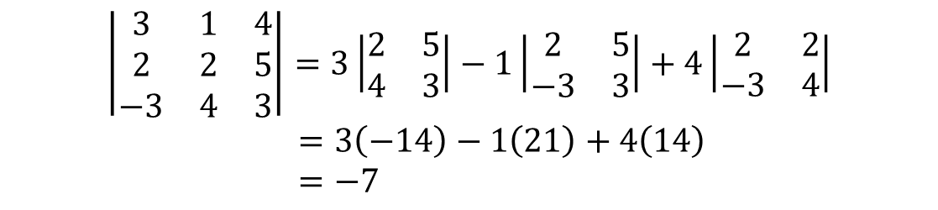



Determinants of $3×3$ matrices
(note the minus for the middle one)
$$\left|\begin{matrix}a & b & c \\ d & e & f \\ g & h & i\end{matrix}\right|=a\left|\begin{matrix}e & f \\ h & i\end{matrix}\right|−b\left|\begin{matrix}d & f \\ g & i\end{matrix}\right|+c\left|\begin{matrix}d & e \\ g & h\end{matrix}\right|$$
$$a$$
$$b$$
$$c$$
$$\left|\begin{matrix}3 & 1 & 4 \\ 2 & 2 & 5 \\ −3 & 4 & 3\end{matrix}\right|=3\left|\begin{matrix}2 & 5 \\ 4 & 3\end{matrix}\right|−1\left|\begin{matrix}2 & 5 \\ −3 & 3\end{matrix}\right|+4\left|\begin{matrix}2 & 2 \\ −3 & 4\end{matrix}\right| \\ =3\left(−14\right)−1\left(21\right)+4\left(14\right) \\ =−7$$
?

Slide 24

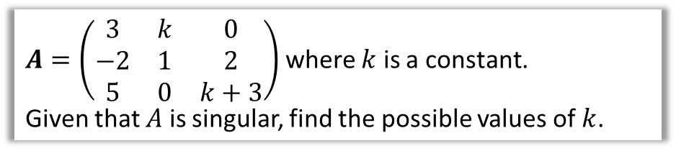
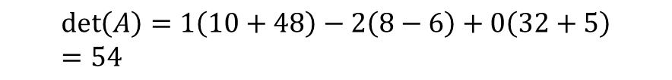
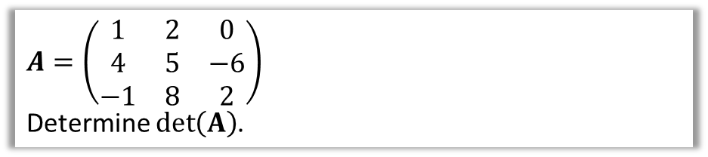
Test Your Understanding
$A=\left(\begin{matrix}1 & 2 & 0 \\ 4 & 5 & −6 \\ −1 & 8 & 2\end{matrix}\right)$
Determine $\det\left(A\right)$.
?
$$\det\left(A\right)=1\left(10+48\right)−2\left(8−6\right)+0\left(32+5\right) \\ =54$$
$A=\left(\begin{matrix}3 & k & 0 \\ −2 & 1 & 2 \\ 5 & 0 & k+3\end{matrix}\right)$ where $k$ is a constant.
Given that $A$ is singular, find the possible values of $k$.
?
$$\det\left(A\right)=2k^{2}+19k+9$$
If singular, $2k^{2}+19k+9=0$.
Solving:
$$k=−\frac{1}{2}, −9$$

Slide 25
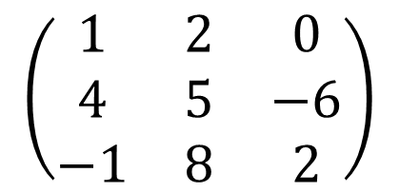



Minors
The minor of an element in a $3×3$ matrix is the determinant of the $2×2$ matrix that remains after the row and column containing that element have been crossed out.
Minor of 0:
$$\left|\begin{matrix}4 & 5 \\ −1 & 8\end{matrix}\right|=37$$
?
$$\left(\begin{matrix}1 & 2 & 0 \\ 4 & 5 & −6 \\ −1 & 8 & 2\end{matrix}\right)$$
Minor of -6:
$$\left|\begin{matrix}1 & 2 \\ −1 & 8\end{matrix}\right|=10$$
?
Minor of 5:
$$\left|\begin{matrix}1 & 0 \\ −1 & 2\end{matrix}\right|=2$$
?

Slide 26
Exercise 6C
Pearson Pure Mathematics Year 1/AS
Pages 106-108
Complete before the lesson Q1-6
In Class:
Green Q7-9
Amber Q10-12
Red Q13-15 & challenge

Slide 27
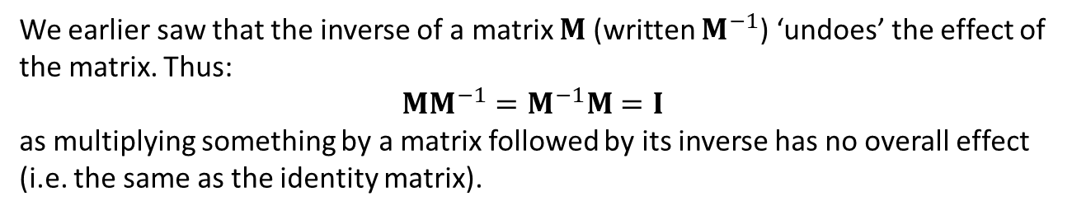
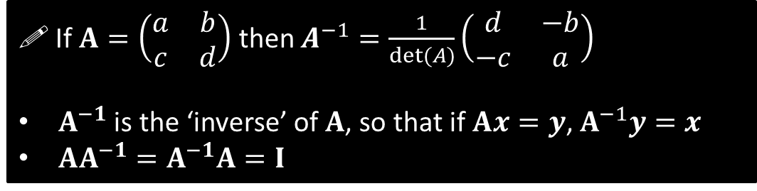
Inverting a $2×2$ matrix
We earlier saw that the inverse of a matrix $M$ (written $M^{−1}$) ‘undoes’ the effect of the matrix. Thus:
$$MM^{−1}=M^{−1}M=I$$
as multiplying something by a matrix followed by its inverse has no overall effect (i.e. the same as the identity matrix).
?
! If $A=\left(\begin{matrix}a & b \\ c & d\end{matrix}\right)$ then $A^{−1}=\frac{1}{det⁡(A)}\left(\begin{matrix}d & −b \\ −c & a\end{matrix}\right)$
$A^{−1}$ is the ‘inverse’ of $A$, so that if $Ax=y$, $A^{−1}y=x$
$AA^{−1}=A^{−1}A=I$

Slide 28

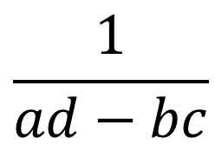





Practising the Inverse
$$a$$
$$b$$
Click to Froinverse
$$\frac{1}{ad−bc}$$
$$−$$
$$c$$
$$d$$
$$−$$
Divide by determinant.
Swap NW-SE elements.
Make SW-NE elements negative.

Slide 29
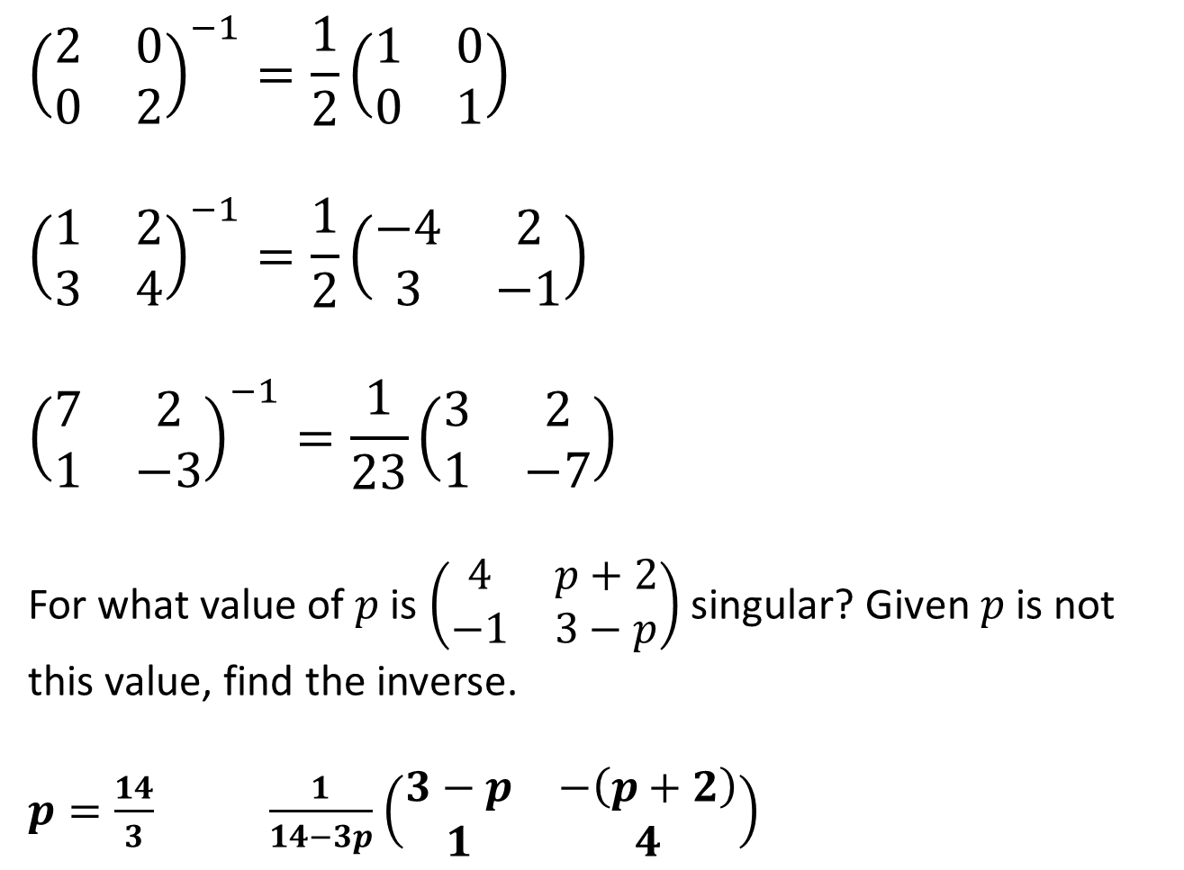
Test Your Understanding
$${\left(\begin{matrix}2 & 0 \\ 0 & 2\end{matrix}\right)}^{−1}=\frac{1}{2}\left(\begin{matrix}1 & 0 \\ 0 & 1\end{matrix}\right)$$
$${\left(\begin{matrix}1 & 2 \\ 3 & 4\end{matrix}\right)}^{−1}=\frac{1}{2}\left(\begin{matrix}−4 & 2 \\ 3 & −1\end{matrix}\right)$$
$${\left(\begin{matrix}7 & 2 \\ 1 & −3\end{matrix}\right)}^{−1}=\frac{1}{23}\left(\begin{matrix}3 & 2 \\ 1 & −7\end{matrix}\right)$$
For what value of $p$ is $\left(\begin{matrix}4 & p+2 \\ −1 & 3−p\end{matrix}\right)$ singular? Given $p$ is not this value, find the inverse.
$p=\frac{14}{3} \frac{1}{14−3p}$ $\left(\begin{matrix}3−p & −\left(p+2\right) \\ 1 & 4\end{matrix}\right)$
?
?
?
?
?

Slide 30


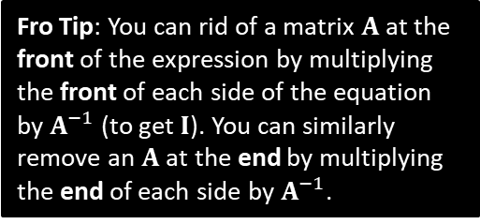
Matrix Proofs Involving Inverse
Exam Note: I couldn’t find any (old spec) FP1 questions of this type.
If $P$ and $Q$ are non-singular matrices, prove that ${\left(PQ\right)}^{−1}=Q^{−1}P^{−1}$
?
Let $C={\left(PQ\right)}^{−1}$ then $\left(PQ\right)C=I$
$$P^{−1}PQC=P^{−1}I \\ IQC=P^{−1} \\ QC=P^{−1} \\ Q^{−1}QC=Q^{−1}P^{−1} \\ IC=Q^{−1}P^{−1} \\ C=Q^{−1}P^{−1}$$
Fro Tip: You can rid of a matrix $A$ at the front of the expression by multiplying the front of each side of the equation by $A^{−1}$ (to get $I$). You can similarly remove an $A$ at the end by multiplying the end of each side by $A^{−1}$.
If $A$ and $B$ are non-singular matrices such that $BAB=I$, prove that $A=B^{−1}B^{−1}$
?
$$BAB=I \\ B^{−1}BAB=B^{−1}I \\ IAB=B^{−1} \\ AB=B^{−1} \\ ABB^{−1}=B^{−1}B^{−1} \\ AI=B^{−1}B^{−1} \\ A=B^{−1}B^{−1}$$

Slide 31
Exercise 6D
Pearson Pure Mathematics Year 1/AS
Pages 110-111
Complete before the lesson Q1-2
In Class:
Green Q3-7
Amber Q8-10
Red Q11-13

Slide 32
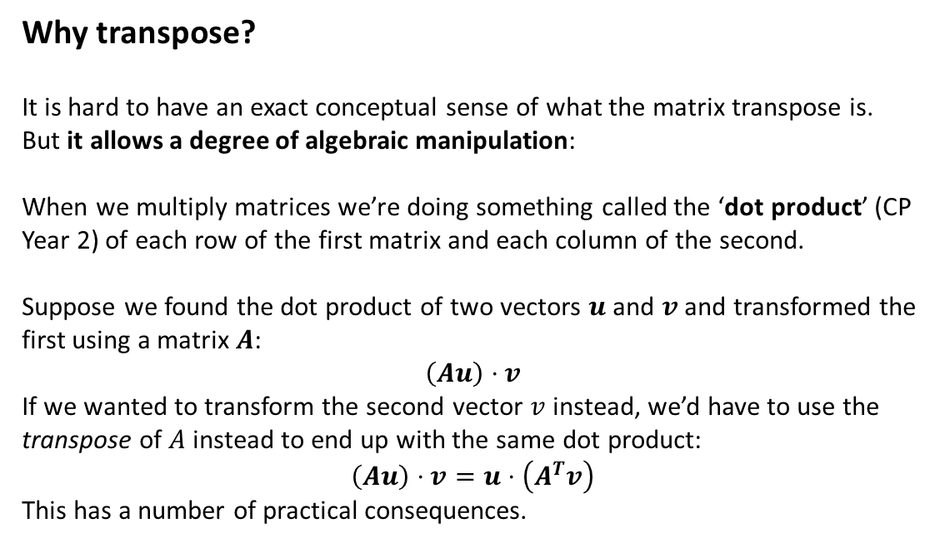
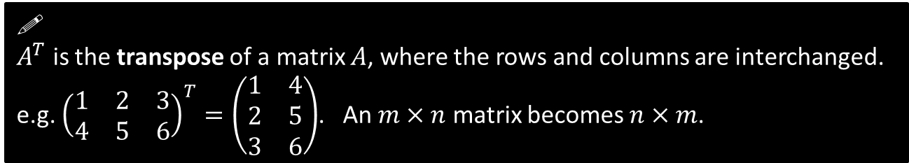

Matrix Transpose
!
$A^{T}$ is the transpose of a matrix $A$, where the rows and columns are interchanged.
e.g. ${\left(\begin{matrix}1 & 2 & 3 \\ 4 & 5 & 6\end{matrix}\right)}^{T}=\left(\begin{matrix}1 & 4 \\ 2 & 5 \\ 3 & 6\end{matrix}\right)$. An $m×n$ matrix becomes $n×m$.
(Far beyond understanding required for exam)
Why transpose?
It is hard to have an exact conceptual sense of what the matrix transpose is.
But it allows a degree of algebraic manipulation:
When we multiply matrices we’re doing something called the ‘dot product’ (CP Year 2) of each row of the first matrix and each column of the second.
Suppose we found the dot product of two vectors $u$ and $v$ and transformed the first using a matrix $A$:
$$\left(Au\right)⋅v$$
If we wanted to transform the second vector $v$ instead, we’d have to use the transpose of $A$ instead to end up with the same dot product:
$$\left(Au\right)⋅v=u⋅\left(A^{T}v\right)$$
This has a number of practical consequences.
e.g.
$$\left(\begin{matrix}1 & 2 \\ 3 & 4\end{matrix}\right)\left(\begin{matrix}5 \\ 6\end{matrix}\right)⋅\left(\begin{matrix}7 \\ 8\end{matrix}\right)=\left(\begin{matrix}17 \\ 39\end{matrix}\right)⋅\left(\begin{matrix}7 \\ 8\end{matrix}\right)=431 \\ \left(\begin{matrix}5 \\ 6\end{matrix}\right)⋅\left(\begin{matrix}1 & 3 \\ 2 & 4\end{matrix}\right)\left(\begin{matrix}7 \\ 8\end{matrix}\right)=\left(\begin{matrix}5 \\ 6\end{matrix}\right)\left(\begin{matrix}31 \\ 46\end{matrix}\right)=431$$

Slide 33














Inversing a $3×3$ matrix
If $A=\left(\begin{matrix}1 & 2 \\ 3 & 4\end{matrix}\right)$, find $A^{−1}$.
The method we previously used was a specific case of a more general method which can be used for matrices of any size:
! Step 1: Find $det⁡(A)$
$$\det\left(A\right)=4−6=−2$$
! Step 2: Form a matrix of minors, $M$
Recap: The minor of each element in a matrix is the determinant of the remaining matrix when the row and column are crossed out.
$$\left(\begin{matrix}1 & 2 \\ 3 & 4\end{matrix}\right)$$
$$\left(\begin{matrix}4 & \\ & \end{matrix}\right)$$
The minor of 1 is 4 because the determinant of $\left(\begin{matrix}4\end{matrix}\right)$ is 4.
?
$$M=\left(\begin{matrix}4 & 3 \\ 2 & 1\end{matrix}\right)$$
! Step 3: Form a matrix of cofactors, $C$
A cofactor by definition is ‘a signed minor’. We simply apply signs to each minor using the following alternating pattern: (+ top left)
$$\left(\begin{matrix}+ & − \\ − & +\end{matrix}\right)$$
$$M=\left(\begin{matrix}4 & 3 \\ 2 & 1\end{matrix}\right)$$
?
$$C=\left(\begin{matrix}4 & −3 \\ −2 & 1\end{matrix}\right)$$
! Step 4: $A^{−1}=\frac{1}{\det\left(A\right)}C^{T}$
$$A^{−1}=−\frac{1}{2}\left(\begin{matrix}4 & −2 \\ −3 & 1\end{matrix}\right)$$

Slide 34









Inversing a $3×3$ matrix
If $A=\left(\begin{matrix}1 & 3 & 1 \\ 0 & 4 & 1 \\ 2 & −1 & 0\end{matrix}\right)$, find $A^{−1}$.
! Step 1: Find $det⁡(A)$
?
$$\det\left(A\right)=1\left(1\right)−3\left(−2\right)+1\left(−8\right)=−1$$
$$M=\left(\begin{matrix}1 & −2 & −8 \\ 1 & −2 & −7 \\ −1 & 1 & 4\end{matrix}\right)$$
Fro Tip: Note we’ve already found the top row from above.
! Step 2: Form a matrix of minors, $M$
?
$$C=\left(\begin{matrix}1 & 2 & −8 \\ −1 & −2 & 7 \\ −1 & −1 & 4\end{matrix}\right)$$
?
$$\left(\begin{matrix}+ & − & + \\ − & + & − \\ + & − & +\end{matrix}\right)$$
! Step 3: Form a matrix of cofactors, $C$
$$A^{−1}=\frac{1}{−1}\left(\begin{matrix}1 & −1 & −1 \\ 2 & −2 & −1 \\ −8 & 7 & 4\end{matrix}\right)=\left(\begin{matrix}−1 & 1 & 1 \\ −2 & 2 & 1 \\ 8 & −7 & −4\end{matrix}\right)$$
?
! Step 4: $A^{−1}=\frac{1}{\det\left(A\right)}C^{T}$

Slide 35

Doing with your Classwiz
If $A=\left(\begin{matrix}1 & 3 & 1 \\ 0 & 4 & 1 \\ 2 & −1 & 0\end{matrix}\right)$, find $A^{−1}$.
Mode → Matrix.
Select $MatA$. This allows you to input your matrix, which will be saved in a special variable ‘$MatA$’.
Select 3 rows/cols and input each number, pressing = after each.
Press AC to start a calculation.
You want to write $MatA^{−1}$. To get the $MatA$ in your expression: OPTN for the matrix menu, then select $MatA$ to insert it into your expression.
Use the special $x^{−1}$ key on your calculator, because the general power button will not work in matrix mode.
Press =, and look appropriately smug.

Slide 36


Further Example
$A=\left(\begin{matrix}−2 & 3 & −3 \\ 0 & 1 & 0 \\ 1 & −1 & 2\end{matrix}\right)$, and the matrix $B$ is such that ${\left(AB\right)}^{−1}=\left(\begin{matrix}8 & −17 & 9 \\ −5 & 10 & −6 \\ −3 & 5 & −4\end{matrix}\right)$.
(a) Show that $A^{−1}=A$.
(b) Find $B^{−1}$.
a
If $A^{−1}=A$ then $AA^{−1}=A^{2}$ and hence $A^{2}=I$.
$$A^{2}=\left(\begin{matrix}−2 & 3 & −3 \\ 0 & 1 & 0 \\ 1 & −1 & 2\end{matrix}\right)\left(\begin{matrix}−2 & 3 & −3 \\ 0 & 1 & 0 \\ 1 & −1 & 2\end{matrix}\right)=\left(\begin{matrix}1 & 0 & 0 \\ 0 & 1 & 0 \\ 0 & 0 & 1\end{matrix}\right)$$
$${\left(AB\right)}^{−1}=B^{−1}A^{−1} \\ {\left(AB\right)}^{−1}A=B^{−1}A^{−1}A \\ {\left(AB\right)}^{−1}A=B^{−1} \\ ∴B^{−1}=\left(\begin{matrix}8 & −17 & 9 \\ −5 & 10 & −6 \\ −3 & 5 & −4\end{matrix}\right)\left(\begin{matrix}−2 & 3 & −3 \\ 0 & 1 & 0 \\ 1 & −1 & 2\end{matrix}\right)=\left(\begin{matrix}−7 & −2 & −6 \\ 4 & 1 & 3 \\ 2 & 0 & 1\end{matrix}\right)$$
?
b
?

Slide 37


Test Your Understanding
?
?

Slide 38
Exercise 6E
Pearson Pure Mathematics Year 1/AS
Pages 115-116
Complete before the lesson Q1-3
In Class:
Green Q4&5
Amber Q6-8
Red Q9-10

Slide 39

Frost Life StoriesTM
In the game Assassin’s Creed II, you encounter a variety of concentric ring picture puzzles, which upon successfully completing, you unlock a segment of a secret video.
Rings are connected in pairs, and must be rotated together in their pairs. The aim is to form a complete picture. Different possible pairs can be selected, for example, where there just 3 rings, you could rotate A and B together, B and C together or C and A together.
Only certain pairings are available.
Because I got stuck on one (this was back in my uni days) and because I’m incredibly uncool, I formed simultaneous equations and used a matrix inverse to solve them, which therefore told me how many times to rotate each pair.
We’ll see how we can do this.

Slide 40



Using Matrices For Simultaneous Equations
! If $A\left(\begin{matrix}x \\ y \\ z\end{matrix}\right)=v$ then $\left(\begin{matrix}x \\ y \\ z\end{matrix}\right)=A^{−1}v$
[Textbook] Use an inverse matrix to solve the simultaneous equations:
$$−x+6y−2z=21 \\ 6x−2y−z=−16 \\ −2x+3y+5z=24$$
We can write using a matrix multiplication:
$$\left(\begin{matrix}−1 & 6 & −2 \\ 6 & −2 & −1 \\ −2 & 3 & 5\end{matrix}\right)\left(\begin{matrix}x \\ y \\ z\end{matrix}\right)=\left(\begin{matrix}21 \\ −16 \\ 24\end{matrix}\right)$$
Find inverse of LHS matrix:
$$\frac{1}{189}\left(\begin{matrix}7 & 36 & 10 \\ 28 & 9 & 13 \\ −14 & 9 & 34\end{matrix}\right)$$
$$∴\left(\begin{matrix}x \\ y \\ z\end{matrix}\right)=\frac{1}{189}\left(\begin{matrix}7 & 36 & 10 \\ 28 & 9 & 13 \\ −14 & 9 & 34\end{matrix}\right)\left(\begin{matrix}21 \\ −16 \\ 24\end{matrix}\right) \\ =\left(\begin{matrix}−1 \\ 4 \\ 2\end{matrix}\right)$$
$$∴x=−1, y=4, z=2$$
?
If we multiplied out the LHS it’s easy to see this gives us the equations in the original question.
?
Use your calculator to find this directly.
?
Calculator Tip: You could check your answer using the simultaneous equation solver.

Slide 41



Forming the equations yourself
[Textbook] A colony of 1000 mole-rats is made up of adult males, adult females and youngsters. Originally there were 100 more adult females than adult males.
After one year:
The number of adult males had increased by 2%
The number of adult females had increased by 3%
The number of youngsters had decreased by 4%
The total number of mole-rats had decreased by 20
Form and solve a matrix equation to find out how many of each type of mole-rat were in the original colony.
Let $x=$ number of adult males
$y=$ number of adult females
$z=$ number of youngsters
$$x +y +z =1000 \\ x −y =−100 \\ 1.02x+1.03y+0.96z=980$$
$$\left(\begin{matrix}1 & 1 & 1 \\ 1 & −1 & 0 \\ 1.02 & 1.03 & 0.96\end{matrix}\right)\left(\begin{matrix}x \\ y \\ z\end{matrix}\right)=\left(\begin{matrix}1000 \\ −100 \\ 980\end{matrix}\right) →$$
“1000 mole-rats”
?
“Originally 100 more adult females than adult males”
?
?
“Total mole-rats after 1 year decreased by 20.”
?
$$\left(\begin{matrix}x \\ y \\ z\end{matrix}\right)=\frac{1}{13}\left(\begin{matrix}−96 & 7 & 100 \\ −96 & −6 & 100 \\ 205 & −1 & −200\end{matrix}\right)\left(\begin{matrix}1000 \\ −100 \\ 980\end{matrix}\right)=\left(\begin{matrix}100 \\ 200 \\ 700\end{matrix}\right)$$
100 adult males, 200 adult females, 700 youngsters in the original colony.

Slide 42












Consistency of linear equations
From Pure Year 1 you are already familiar with the idea that the solution of a system of two equations (with two unknowns) can be visualised by finding the point of intersection of two lines. A system of linear equations is known as consistent if there is at least one set of values that satisfies all the equations simultaneously (i.e. at least one point of intersection).
$$x+2y=1 \\ 3x−y=0$$
$$x−3y=1 \\ x−3y=2$$
$$x−3y=1 \\ 2x−6y=2$$
$$3x−y=0$$
$$x−3y=1$$
$$x+2y=1$$
$$x−3y=2$$
$$x−3y=1$$
$$2x−6y=2$$
System of equations is consistent. It has one solution.
The corresponding matrix $\left(\begin{matrix}1 & 2 \\ 3 & −1\end{matrix}\right)$ is non-singular.
System of equations is inconsistent. It has no solutions.
Matrix $\left(\begin{matrix}1 & −3 \\ 1 & −3\end{matrix}\right)$ is singular.
System of equations is consistent. It has infinitely many solutions.
Matrix $\left(\begin{matrix}1 & −3 \\ 1 & −3\end{matrix}\right)$ is singular.

Slide 43

Extending consistency to 3 variables
In Chapter 9 you will learn that just as $ax+by=c$ gives the equation of a straight line, $ax+by+cz=d$ gives the equation of a plane.
Again, we get solutions to the system of linear equations when all of the planes intersect:
Scenario 1: Planes all meet at a single point.
System of equations consistent, and one solution.
Scenario 2: Planes form a sheaf.
They have a line of intersection consisting of infinitely many points. System of equations consistent and infinitely many solutions.
Scenario 3: Planes form a prism.
While planes intersect in pairs, they don’t all intersect at any point. System of equations is inconsistent.
Scenario 4: Two of more planes parallel and non-identical.
Again, inconsistent, as the parallel planes never intersect, and thus all equations can’t be satisfied.
Any rows in the corresponding matrix which are multiples of each other will be parallel.

Slide 44
Extending consistency to 3 variables
In Chapter 9 you will learn that just as $ax+by=c$ gives the equation of a straight line, $ax+by+cz=d$ gives the equation of a plane.
Again, we get solutions to the system of linear equations when all of the planes intersect:
Scenario 5: Planes represented by equations are equivalent.
System of equations consistent, and infinitely many solutions.

Slide 45


Example
[Textbook] A system of equations is shown below:
$$3x−ky−6z=k \\ kx+3y+3z=2 \\ −3x−y+3z=−2$$
For each of the following values of $k$, determine whether the system of equations is consistent or inconsistent. If the system is consistent, determine whether there is a unique solution or an infinity of solutions. In each case, identify the geometric configuration of the plane corresponding to each value of $k$.
(a) $k=0$ (b) $k=1$ (c) $k=−6$
Remember that the system of equations is consistent if the corresponding matrix is non-singular, i.e. its determinant is non-0.
a
?
$k=0$: $\left|\begin{matrix}3 & 0 & −6 \\ 0 & 3 & 3 \\ −3 & −1 & 3\end{matrix}\right|=−18$
Matrix non-singular so a unique solution, i.e. planes meet at single point.

Slide 46

Example
[Textbook] A system of equations is shown below:
$$3x−ky−6z=k \\ kx+3y+3z=2 \\ −3x−y+3z=−2$$
For each of the following values of $k$, determine whether the system of equations is consistent or inconsistent. If the system is consistent, determine whether there is a unique solution or an infinity of solutions. In each case, identify the geometric configuration of the plane corresponding to each value of $k$.
(a) $k=0$ (b) $k=1$ (c) $k=−6$
b
?
$k=1$: $\left|\begin{matrix}3 & −1 & −6 \\ 1 & 3 & 3 \\ −3 & −1 & 3\end{matrix}\right|=0$
$$3x−y−6z=1 (1) \\ x+3y+3z=2 (2) \\ −3x−y+3z=−2 (3)$$
$\left(1\right)+2×\left(2\right):$ $5x+5y=5 (4)$
$\left(2\right)−\left(3\right):$ $4x+4y=4$ $(5)$
Equations (4) and (5) are consistent so system is consistent and has an infinity of solutions. Planes meet at a sheaf.
If the matrix is singular, the system of equations could still be consistent: recall that we might have a sheaf (i.e. planes intersect at a line) or equations represent same plane.
Eliminate one of the variables. If resulting two equations are consistent, then system will be consistent.

Slide 47


Test Your Understanding
The system of equations is consistent and has a single solution. Determine the possible values of $k$.
$$2x+3y−z=13 \\ 3x−y+kz=11 \\ x+y+z=7$$
?
$$\left|\begin{matrix}2 & 3 & −1 \\ 3 & −1 & k \\ 1 & 1 & 1\end{matrix}\right|=k−15$$
To have a solution, we require that $k−15≠0$, thus $k≠15$.

Slide 48
Exercise 6F
Pearson Pure Mathematics Year 1/AS
Pages 120-121
Complete before the lesson Q1
In Class:
Green Q2
Amber Q3&4
Red Q5&6

