Slide 1

P2 Chapter 2 :: Functions & Graphs
jfrost@tiffin.kingston.sch.uk
www.drfrostmaths.com
@DrFrostMaths
Last modified: 6th September 2018

Slide 2








www.drfrostmaths.com
Everything is completely free.
Why not register?
Register now to interactively practise questions on this topic, including past paper questions and extension questions (including MAT + UKMT).
Teachers: you can create student accounts (or students can register themselves), to set work, monitor progress and even create worksheets.
With questions by:
Dashboard with points, trophies, notifications and student progress.
Questions organised by topic, difficulty and past paper.
Teaching videos with topic tests to check understanding.

Slide 3
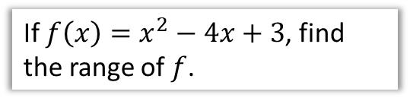
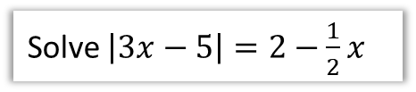
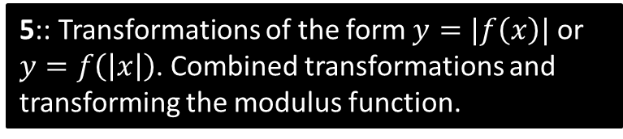
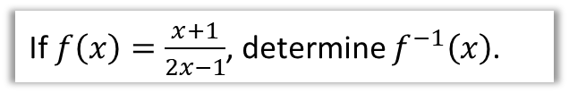
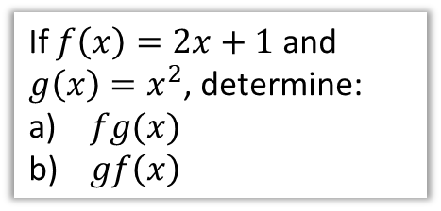
Chapter Overview
1:: The Modulus Function
2:: Mappings vs Functions, Domain and Range
Solve $\left|3x−5\right|=2−\frac{1}{2}x$
If $f\left(x\right)=x^{2}−4x+3$, find the range of $f$.
3:: Composite Functions
4:: Inverse Functions
If $f\left(x\right)=2x+1$ and
$g\left(x\right)=x^{2}$, determine:
$fg(x)$
$gf\left(x\right)$
If $f\left(x\right)=\frac{x+1}{2x−1}$, determine $f^{−1}\left(x\right)$.
5:: Transformations of the form $y=|f\left(x\right)|$ or $y=f\left(\left|x\right|\right)$. Combined transformations and transforming the modulus function.

Slide 4

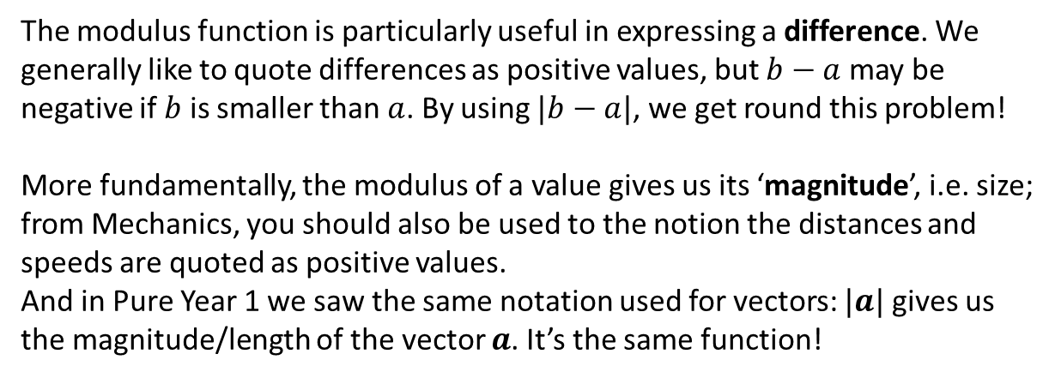

1 :: The Modulus Function
! The modulus of a number $a$, written $|a|$, is its non-negative numerical value.
e.g. $\left|6\right|=6$ and $\left|−7.1\right|=7.1$
$$b$$
$$a$$
1
2
3
4
5
6
7
8
The modulus function is particularly useful in expressing a difference. We generally like to quote differences as positive values, but $b−a$ may be negative if $b$ is smaller than $a$. By using $|b−a|$, we get round this problem!
More fundamentally, the modulus of a value gives us its ‘magnitude’, i.e. size; from Mechanics, you should also be used to the notion the distances and speeds are quoted as positive values.
And in Pure Year 1 we saw the same notation used for vectors: $|a|$ gives us the magnitude/length of the vector $a$. It’s the same function!

Slide 5
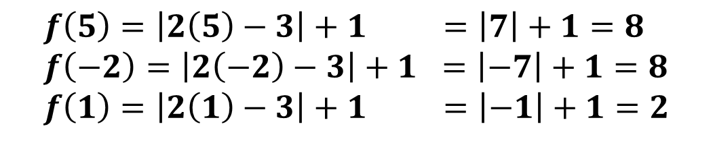
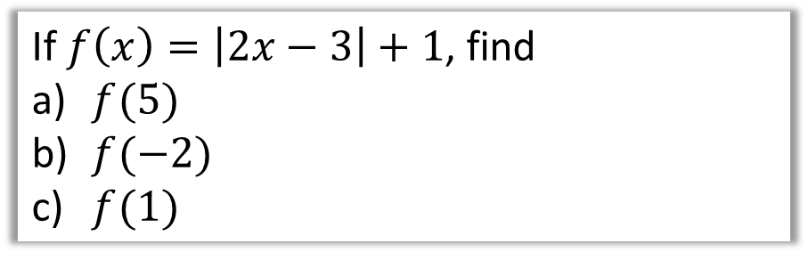
Examples
If $f\left(x\right)=\left|2x−3\right|+1$, find
$f(5)$
$f(−2)$
$f(1)$
?
$$f\left(5\right)=\left|2\left(5\right)−3\right|+1 =\left|7\right|+1=8 \\ f\left(−2\right)=\left|2\left(−2\right)−3\right|+1 =\left|−7\right|+1=8 \\ f\left(1\right)=\left|2\left(1\right)−3\right|+1 =\left|−1\right|+1=2$$

Slide 6



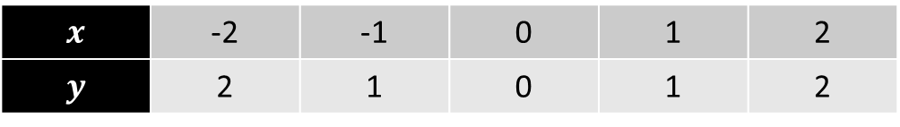



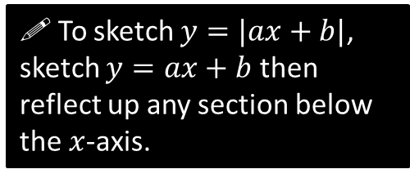
Modulus Graphs
$$y=|x|$$
$$x$$ | -2 | -1 | 0 | 1 | 2
$$y$$ | 2 | 1 | 0 | 1 | 2
?
?
?
?
?
$$(−2,2)$$
$$(2,2)$$
$$(−1,1)$$
$$(1,1)$$
$$(0,0)$$
! To sketch $y=|ax+b|$, sketch $y=ax+b$ then reflect up any section below the $x$-axis.

Slide 7









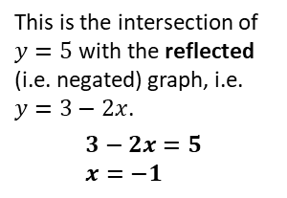
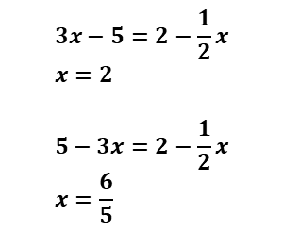




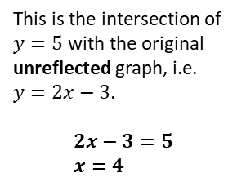






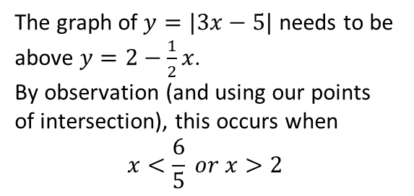
Modulus Graphs
Sketch $y=|2x−3|$
Solve $\left|2x−3\right|=5$
$$y$$
$$y$$
As you would have done in Pure Year 1, sketch a line for each side of the equation, so that we can use the points of intersection.
Fro Tip: I like to sketch the non-modulus graph first with a dotted line.
$$y=5$$
$$3$$
$$3$$
This is the intersection of $y=5$ with the original unreflected graph, i.e. $y=2x−3$.
$$2x−3=5 \\ x=4$$
$$x$$
$$x$$
$$\frac{3}{2}$$
This is the intersection of $y=5$ with the reflected (i.e. negated) graph, i.e. $y=3−2x$.
$$3−2x=5 \\ x=−1$$
$$\frac{3}{2}$$
$$−3$$
$$−3$$
Solve $\left|3x−5\right|=2−\frac{1}{2}x$
Solve $\left|3x−5\right|>2−\frac{1}{2}x$
$$y$$
The graph of $y=|3x−5|$ needs to be above $y=2−\frac{1}{2}x$.
By observation (and using our points of intersection), this occurs when
$$x<\frac{6}{5} or x>2$$
$$3x−5=2−\frac{1}{2}x \\ x=2$$
$$5−3x=2−\frac{1}{2}x \\ x=\frac{6}{5}$$
$$5$$
$$2$$
$$\frac{6}{5}$$
$$x$$
$$2$$

Slide 8




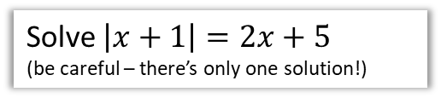




Test Your Understanding
Solve $\left|x+1\right|=2x+5$
(be careful – there’s only one solution!)
Solve $\left|4x−1\right|<2x$
$$y$$
$$y$$
$$5$$
$$1$$
$$1$$
$$x$$
$$x$$
$$\frac{1}{4}$$
?
?
We can see the line $y=2x+5$ only intersects with the reflected part of the modulus graph.
$$−x−1=2x+5 \\ 3x=−6 \\ x=−2$$
Determine ‘critical values’:
$$4x−1=2x \\ x=\frac{1}{2}$$
$$1−4x=2x \\ x=\frac{1}{6}$$
$$∴\frac{1}{6}<x<\frac{1}{2}$$

Slide 9
Exercise 2A
Pearson Pure Mathematics Year 2/AS
Page 18
Complete before the lesson Q1-4
In Class:
Green Q5&6
Amber Q7-9
Red Q10-13 & Challenge

Slide 10
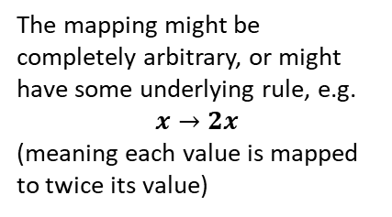
What is a mapping?
Inputs
A mapping is something which maps one set of numbers to another.
The mapping might be completely arbitrary, or might have some underlying rule, e.g.
$$x→2x$$
(meaning each value is mapped to twice its value)
-1
-1
Outputs
0
1
1.7
4.4
2
5
Also notice that one input might map to multiple outputs, or multiple inputs to one output.
Notice also that not all values in the set of inputs necessarily have a mapping to a value in the set of outputs.
3.1
7.2
...
...
! The domain is the set of possible inputs.
! The range is the set of possible outputs.

Slide 11


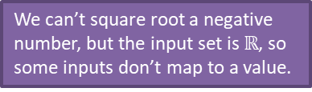








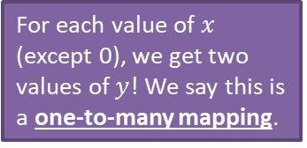

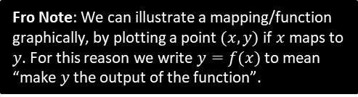


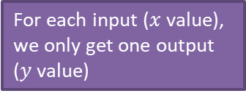

What is a function?
A function is: a mapping such that every element of the domain is mapped to
exactly one element of the range.
?
Notation:
$$f\left(x\right)=2x+1$$
$$f:x→2x+1$$
$f\left(x\right)$ refers to the output of the function.
Function?
Fro Note: We can illustrate a mapping/function graphically, by plotting a point $(x,y)$ if $x$ maps to $y$. For this reason we write $y=f(x)$ to mean “make $y$ the output of the function”.
$$y$$
$$y$$
For each value of $x$ (except 0), we get two values of $y$! We say this is a one-to-many mapping.
Fro Tip: Use the ‘vertical ray test’. If a vertically fired ray can hit the curve multiple times, it is NOT a function.
For each input ($x$ value), we only get one output ($y$ value)
$$x$$
No
Yes
$$x$$
$$f\left(x\right)=\sqrt{x}$$
No
Yes
Domain: $x∈ℝ$
No
Yes
We can’t square root a negative number, but the input set is $ℝ$, so some inputs don’t map to a value.
$$f\left(x\right)=2^{x}$$
Domain: $x∈ℝ$
(i.e. all real values)
$$f\left(x\right)=±\sqrt{x}$$
Domain: $x≥0$
No
Yes
No
Yes
$f\left(4\right)=2$ but $f\left(4\right)=−2$ also. This is one-to-many so not a function.

Slide 12





One-to-one vs Many-to-one
While functions permit an input only to be mapped to one output, there’s nothing stopping multiple different inputs mapping to the same output.
Type
Description
Example
?
?
$$y$$
Many-to-one
function
Multiple inputs can map to the same output.
$$y=x^{2}$$
$$f\left(x\right)=x^{2}$$
e.g. $f\left(2\right)=4$
$$f\left(−2\right)=4$$
2
4
$$x$$
-2
You can use the ‘horizontal ray test’ to see if a function is one-to-one or many-to-one.
?
?
One-to-one
function
Each output has one input and vice versa.
$$f\left(x\right)=2x+1$$
5
2
3
7
4
9

Slide 13


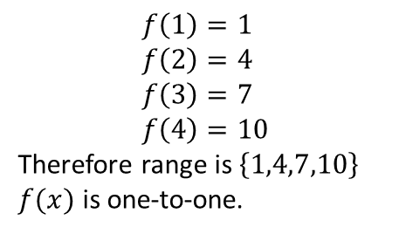


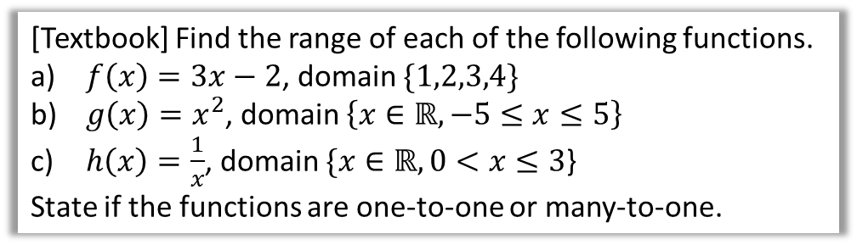




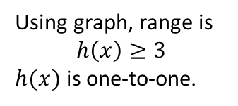

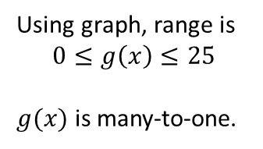


Further Examples
It is often helpful to sketch the function to reason about the range.
[Textbook] Find the range of each of the following functions.
$f\left(x\right)=3x−2$, domain $\{1,2,3,4\}$
$g\left(x\right)=x^{2}$, domain $\left\{x∈ℝ, −5≤x≤5\right\}$
$h\left(x\right)=\frac{1}{x}$, domain $\{x∈ℝ, 0<x≤3$}
State if the functions are one-to-one or many-to-one.
We use $x$ to refer to the input, and $f(x)$ to refer to the output.
Thus your ranges should be in terms of $f(x)$.
?
$$y$$
$$y$$
a
b
?
c
?
$$f\left(1\right)=1 \\ f\left(2\right)=4 \\ f\left(3\right)=7 \\ f\left(4\right)=10$$
Therefore range is $\left\{1,4,7,10\right\}$
$f(x)$ is one-to-one.
$$25$$
$$y=g(x)$$
$$\frac{1}{3}$$
$$x$$
$$3$$
$$x$$
$$−5$$
$$5$$
Using graph, range is
$$0≤g\left(x\right)≤25$$
$g(x)$ is many-to-one.
Using graph, range is
$$h\left(x\right)≥3$$
$h(x)$ is one-to-one.

Slide 14






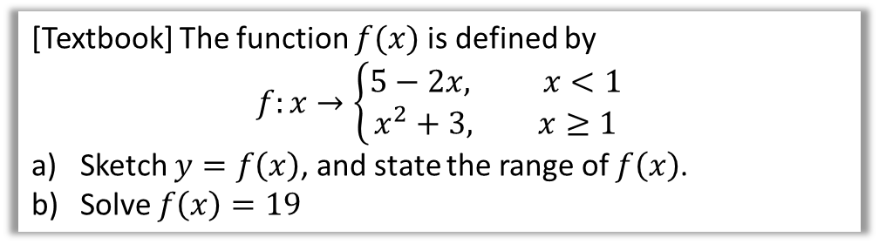

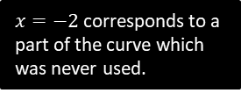








Piecewise Functions
A ‘piecewise function’ is one which is defined in parts: we can use different rules for different intervals within the domain.
[Textbook] The function $f(x)$ is defined by
$$f:x→\left\{\begin{aligned}5−2x, x<1 \\ x^{2}+3, x≥1\end{aligned}\right.$$
Sketch $y=f\left(x\right)$, and state the range of $f\left(x\right)$.
Solve $f\left(x\right)=19$
$$y$$
Using the graph, the range is $f\left(x\right)>3$
When $x≥1$:
$$x^{2}+3=19 \\ x=±4 \\ x=4$$
When $x<1$:
$$5−2x=19 \\ x=−7$$
a
?
b
?
$$y=5−2x$$
$$y=x^{2}+3$$
$$y$$
$$y=x^{2}+3$$
$$19$$
$$5$$
The filled/unfilled circles have the same meaning as with inequalities on a number line – unfilled indicates not included.
$$4$$
$$5$$
$$3$$
$$4$$
$$3$$
$$x$$
$$1$$
$$x$$
$$1$$
$x=−2$ corresponds to a part of the curve which was never used.

Slide 15


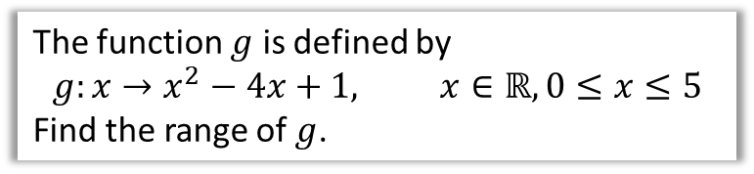


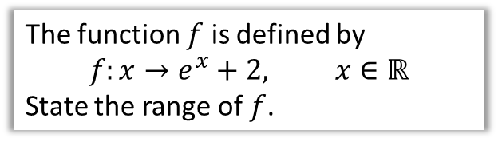





Test Your Understanding
Edexcel C4 June 2012 Q6a
Edexcel C4 June 2010 Q4d
The function $f$ is defined by
$$f:x→e^{x}+2, x∈ℝ$$
State the range of $f$.
The function $g$ is defined by
$$g:x→x^{2}−4x+1, x∈ℝ, 0≤x≤5$$
Find the range of $g$.
$$y$$
Hint: Identify the minimum point first, as this may or may not affect the range.
Extra Hint: Carefully consider the stated domain.
?
$$y=2$$
?
$$y$$
$$x^{2}−4x+1 \\ ={\left(x−2\right)}^{2}−4+1 \\ ={\left(x−2\right)}^{2}−3$$
So minimum point is $(2,−3)$
At two end points of curve:
$$f\left(0\right)=1 \\ f\left(5\right)=6$$
Therefore range:
$$−3≤f\left(x\right)≤6$$
$$x$$
$$(5,6)$$
$$1$$
$$x$$
$$f\left(x\right)>2$$
$$\left(2,−3\right)$$
Notice the range doesn’t include 2, as the line never reaches the asymptote.

Slide 16
Exercise 2B
Pearson Pure Mathematics Year 2/AS
Pages 30-32
Complete before the lesson Q1-3
In Class:
Green Q4-6
Amber Q7-8
Red Q9-12

Slide 17
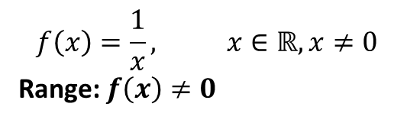
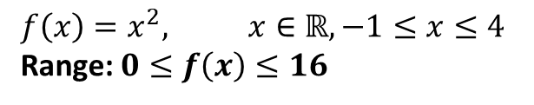
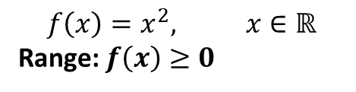
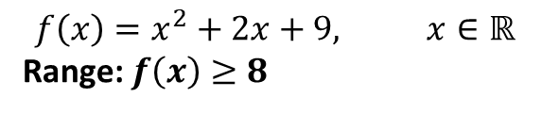
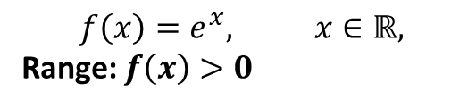
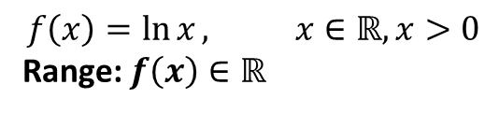
Summary of Domain/Range
It is important that you can identify the range for common graphs, using a suitable sketch:
$$f\left(x\right)=\frac{1}{x}, x∈ℝ, x≠0$$
Range: $f\left(x\right)≠0$
$$f\left(x\right)=x^{2}, x∈ℝ$$
Range: $f\left(x\right)≥0$
?
?
$$f\left(x\right)=\ln{x}, x∈ℝ, x>0$$
Range: $f\left(x\right)∈ℝ$
$$f\left(x\right)=e^{x}, x∈ℝ,$$
Range: $f\left(x\right)>0$
?
?
$$f\left(x\right)=x^{2}+2x+9, x∈ℝ$$
Range: $f\left(x\right)≥8$
?
Be careful in noting the domain – it may be ‘restricted’, which similarly restricts the range. Again, use a sketch!
$$f\left(x\right)=x^{2}, x∈ℝ, −1≤x≤4$$
Range: $0≤f\left(x\right)≤16$
?

Slide 18


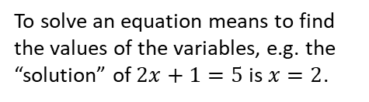
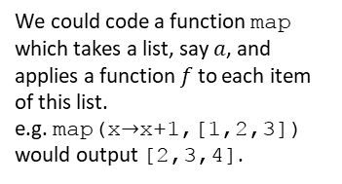
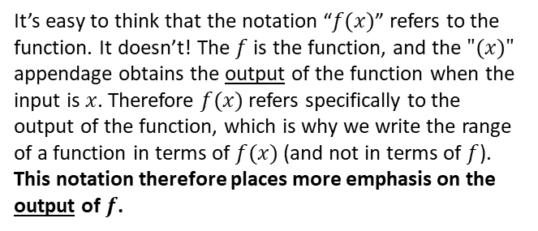

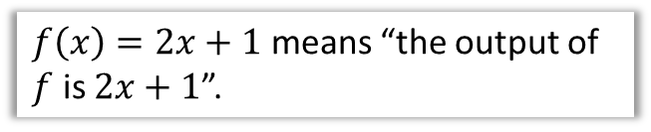

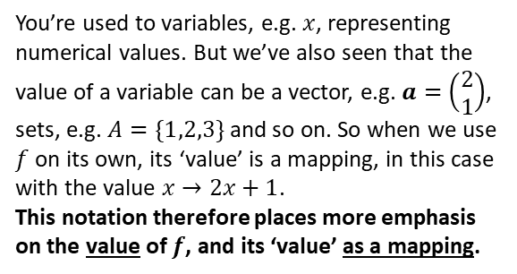
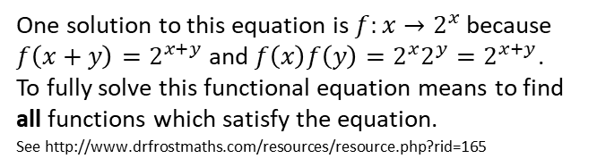
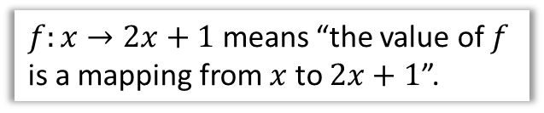

Just for your interest…
What is the difference between the notation
$f\left(x\right)=2x+1$ and $f:x→2x+1$?
$f:x→2x+1$ means “the value of $f$ is a mapping from $x$ to $2x+1$”.
To solve an equation means to find the values of the variables, e.g. the “solution” of $2x+1=5$ is $x=2$.
You’re used to variables, e.g. $x$, representing numerical values. But we’ve also seen that the value of a variable can be a vector, e.g. $a=\left(\begin{matrix}2 \\ 1\end{matrix}\right)$, sets, e.g. $A=\{1,2,3\}$ and so on. So when we use $f$ on its own, its ‘value’ is a mapping, in this case with the value $x→2x+1$.
This notation therefore places more emphasis on the value of $f$, and its ‘value’ as a mapping.
Consequence 1
To solve a functional equation means to find the ‘values’ of $f$.
Solve $f\left(x+y\right)=f\left(x\right)f\left(y\right)$
One solution to this equation is $f:x→2^{x}$ because $f\left(x+y\right)=2^{x+y}$ and $f\left(x\right)f\left(y\right)=2^{x}2^{y}=2^{x+y}$.
To fully solve this functional equation means to find all functions which satisfy the equation.
See http://www.drfrostmaths.com/resources/resource.php?rid=165
Consequence 2
$f\left(x\right)=2x+1$ means “the output of $f$ is $2x+1$”.
A bit of Computer Science!
In many programming languages, we can pass functions as the parameters of a method, when a variable is allowed to have a function as its value.
It’s easy to think that the notation “$f(x)$” refers to the function. It doesn’t! The $f$ is the function, and the $"(x)"$ appendage obtains the output of the function when the input is $x$. Therefore $f(x)$ refers specifically to the output of the function, which is why we write the range of a function in terms of $f(x)$ (and not in terms of $f$).
This notation therefore places more emphasis on the output of $f$.
We could code a function map which takes a list, say $a$, and applies a function $f$ to each item of this list.
e.g. map(x$→$x+1,[1,2,3])
would output [2,3,4].
function map(f, a) {
let b be a new list
for(i from 1 to size(a)) {
b_{i} = f(a_{i})
}
return b
}

Slide 19






Composite Functions
Sometimes we may apply multiple functions in succession to an input.
These combined functions are known as a composite function.
$$f$$
$$g$$
$$x$$
$$f\left(x\right)$$
$$gf\left(x\right)$$
$$gf$$
! $gf(x)$ means $g(f\left(x\right))$, i.e. $f$ is applied first, then $g$.

Slide 20
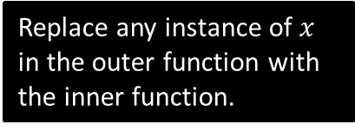

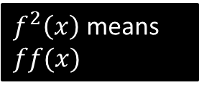
Examples
Let $f\left(x\right)=x^{2}+1$, and $g\left(x\right)=4x−2$.
What is…
$fg(2)$? $=f\left(g\left(2\right)\right)=f\left(6\right)=37$
$fg(x)$? $f\left(g\left(x\right)\right)=f\left(4x−2\right)$
$$={\left(4x−2\right)}^{2}+1 \\ =16x^{2}−16x+5$$
$gf(x)$? $g\left(f\left(x\right)\right)=g\left(x^{2}+1\right)$
$$=4\left(x^{2}+1\right)−2 \\ =4x^{2}+2$$
$f^{2}\left(x\right)$? $=f\left(f\left(x\right)\right)={\left(x^{2}+1\right)}^{2}+1$
Solve $gf\left(x\right)=38$ $4x^{2}+2=38$
$$x=±3$$
?
?
Replace any instance of $x$ in the outer function with the inner function.
?
?
$f^{2}\left(x\right)$ means $ff(x)$
?

Slide 21








Further Examples
The functions $f$ and $g$ are defined by
$$f:x→\left|2x−8\right| \\ g:x→\frac{x+1}{2}$$
a) Find $fg\left(3\right)$ b) Solve $fg\left(x\right)=x$
a
?
$$fg\left(3\right)=f\left(g\left(3\right)\right)=f\left(2\right) \\ =\left|4−8\right|=\left|−4\right|=4$$
$$fg\left(x\right)=f\left(\frac{x+1}{2}\right)=\left|2\left(\frac{x+1}{2}\right)−8\right| \\ =\left|x−7\right|$$
$$\left|x−7\right|=x$$
b
?
$$y$$
$$y=x$$
$$y=|x−7|$$
$$−x+7=x \\ x=3.5$$
It’s the reflected (negated) part of $|x−7|$ that is intersecting with $y=x$
$$7$$
$$7$$
$$x$$

Slide 22





Test Your Understanding
Edexcel C4 June 2013(R) Q4
Edexcel C4 June 2012 Q6
The functions and $f$ and $g$ are defined by
$$f:x→2\left|x\right|+3, x∈ℝ$$
$$g:x→3−4x, x∈ℝ$$
b) Find $fg\left(1\right)$
d) Solve the equation
$$gg\left(x\right)+{\left[g\left(x\right)\right]}^{2}=0$$
The functions $f$ and $g$ are defined by
$$f:x→e^{x}+2, x∈ℝ \\ g:x→\ln{x}, x>0$$
b) Find $fg\left(x\right)$, giving your answer in its simplest form.
? b
?
$$fg\left(1\right)=f\left(−1\right) \\ =2\left|−1\right|+3=5$$
$$3−4\left(3−4x\right)+{\left(3−4x\right)}^{2}=0 \\ 3−12+16x+9−24x+16x^{2}=0 \\ 16x^{2}−8x=0 \\ 2x^{2}−x=0 \\ x\left(2x−1\right)=0 \\ x=0, 0.5$$
$$fg\left(x\right)=f(\ln{x)} \\ =e^{\ln{x}}+2 \\ =x+2$$
? d
“$e$ to the power of” and “$ln$ of” are inverse functions so cancel each other out.

Slide 23

Exercise 2C
Pearson Pure Mathematics Year 2/AS
Pages 34-35
Extension
[MAT 2014 1F]
The functions $S$ and $T$ are defined for real numbers by $S\left(x\right)=x+1$ and $T\left(x\right)=−x$.
The function $S$ is applied $s$ times and the function $T$ is applied $t$ times, in some order, to produce the function
$$F\left(x\right)=8−x$$
It is possible to deduce that:
$s=8$ and $t=1$
$s$ is odd and $t$ is even.
$s$ is even and $t$ is odd.
$s$ and $t$ are powers of 2.
none of the above.
Each application of $T$ will oscillate the sign of $x$, so clearly $t$ is odd, eliminating (ii) and (iv). Each application of $T$ doesn’t change the magnitude of the constant term.
If $t=0$ we’d need 8 applications of $S$ to get to 8. An application of $T$ might get us from say 3 to -3. We’d then require and even number of applications of $S$ to get back up to 3 (in this case 6). So $s$ must be even. This leaves (i) and (iii), but there is more than one way, so the answer is (iii).
Complete before the lesson Q1-2
In Class:
Green Q3-4
Amber Q5-7
Red Q8-11
?

Slide 24














Inverse Functions
$$f$$
An inverse function $f^{−1}$ does the opposite of the original function. For example, if $f\left(4\right)=2$, then $f^{−1}\left(2\right)=4$.
If $f\left(x\right)=2x+1$, we could do the opposite operations within the function in reverse order to get back to the original input:
$$x$$
$$y$$
$$f^{−1}$$
Notation: Just like $f^{2}$ means “apply $f$ twice”, $f^{−1}$ means “apply $f$ -1 times”, i.e. once backwards!
This is why we write $\sin^{−1}{(x)}$ to mean “inverse sin”.
$$×2$$
$$+1$$
$$x$$
$$2x$$
$$2x+1$$
$$−1$$
$$÷2$$
Thus $f^{−1}\left(x\right)=\frac{x−1}{2}$
This has appeared in exams before.
Explain why the function must be one-to-one for an inverse function to exist:
If the mapping was many-to-one, then the inverse mapping would be one-to-many. But this is not a function!
?

Slide 25












More on Inverse Functions
$$f$$
In the original function, we have the output $y$ in terms of the input $x$, e.g. $y=2x+1$
Therefore if we change the subject to get $x$ in terms of $y$, then we have the input in terms of the output, i.e. the inverse function!
$$x=\frac{y−1}{2}$$
However, we tend to write a function in terms of $x$, so would write;
$$f^{−1}\left(x\right)=\frac{x−1}{2}$$
$$x$$
$$y$$
$$f^{−1}$$
If $f\left(x\right)=3−4x$, find $f^{−1}(x)$
If $f\left(x\right)=\frac{x+2}{2x−1}$, $x≠\frac{1}{2}$, determine $f^{−1}\left(x\right)$
?
$$y=\frac{x+2}{2x−1} \\ y\left(2x−1\right)=x+2 \\ 2xy−y=x+2 2xy−x=y+2 \\ x\left(2y−1\right)=y+2 \\ x=\frac{y+2}{2y−1} \\ f^{−1}\left(x\right)=\frac{x+2}{2x−1}$$
$$y=3−4x \\ 4x=3−y \\ x=\frac{3−y}{4} \\ f^{−1}\left(x\right)=\frac{3−x}{4}$$
Use $y$ instead of $f\left(x\right)$ for convenience.
?
Make $x$ the subject.
Replace $y$’s with $x$ at end.

Slide 26














Graphing an Inverse Function
Notice that $x$-intercepts become $y$-intercepts, and vertical asymptotes become horizontal ones.
We saw that the inverse function effectively swaps the input $x$ and output $y$. Thus the $x$ and $y$ axis are swapped when sketching the original function and its inverse.
And since the set of inputs and set of outputs is swapped…
$$y$$
$$x=1$$
$$y=f^{−1}(x)$$
$$y=f(x)$$
$$2$$
$$y=1$$
! The domain of $f\left(x\right)$ is the range of $f^{−1}\left(x\right)$ and vice versa.
$$x$$
$$2$$
$$y=x$$
$y=f(x)$ and $y=f^{−1}\left(x\right)$ have the line $y=x$ as a line of symmetry.
Domain of $f$:
$$x>1$$
Range of $f^{−1}$:
$$f^{−1}\left(x\right)>1$$
?
?
The domain of the function is the same as the range of the inverse, but remember that we write a domain in terms of $x$, but a range in terms of $f\left(x\right)$ or $f^{−1}\left(x\right)$.

Slide 27









Example
[Textbook] If $g(x)$ is defined as $g\left(x\right)=\sqrt{x−2} \left\{x∈ℝ,x≥2\right\}$
Find the range of $g\left(x\right)$.
Calculate $g^{−1}\left(x\right)$
Sketch the graphs of both functions.
State the domain and range of $g^{−1}\left(x\right)$.
$$y$$
?
c
?
d
Domain of $g^{−1}\left(x\right)$ is range of $g(x)$ and range of $g^{−1}\left(x\right)$ the domain of $g(x)$.
Domain:
$$x≥0$$
Range:
$$f^{−1}\left(x\right)≥2$$
a
?
$$f\left(x\right)≥0$$
Start with $y=\sqrt{x−2}$ and make $x$ the subject, before swapping $y$ and $x$.
$$y=\sqrt{x−2}$$
$$x=y^{2}+2$$
$$g^{−1}\left(x\right)=x^{2}+2$$
$$y=g^{−1}(x)$$
b
?
$$2$$
$$y=g(x)$$
$$x$$
$$2$$

Slide 28







Further Example
[Textbook] The function is defined by $f\left(x\right)=x^{2}−3$, $x∈ℝ$, $x≥0$.
Find $f^{−1}\left(x\right)$
Sketch $y=f(x)$ and $y=f^{−1}\left(x\right)$ and state the domain of $f^{−1}$.
Solve the equation $f\left(x\right)=f^{−1}\left(x\right)$.
$$y=x^{2}−3 \\ x=\sqrt{y+3} \\ f^{−1}\left(x\right)=\sqrt{x+3}$$
If the function is equal to its inverse, it must lie on the line $y=x$, i.e. $f\left(x\right)=x$:
$$x^{2}−x=3 \\ x^{2}−x−3=0 \\ x=\frac{1±\sqrt{1+12}}{2} \\ =\frac{1+\sqrt{13}}{2}$$
a
?
c
?
b
$$y$$
?
$$y=f\left(x\right)$$
$$y=x$$
$$3$$
$$y=f^{−1}\left(x\right)$$
Note: There was once an exam question based on this principle.
$$3$$
$$x$$
From graph, we can see we only want positive solution.

Slide 29


Test Your Understanding
Edexcel C4 June 2012 Q6
The function $f$ is defined by
$f:x→e^{x}+2$, $x∈ℝ$
(d) Find $f^{−1}$, the inverse function of $f$, stating its domain.
(e) On the same axe sketch the curves with equation $y=f\left(x\right)$ and $y=f^{−1}\left(x\right)$, giving the coordinates of all the points where the curves cross the axes.
?
?

Slide 30
Exercise 2D
Pearson Pure Mathematics Year 2/AS
Pages 38-39
Complete before the lesson Q1-3
In Class:
Green Q4-5
Amber Q6-8
Red Q9-12

Slide 31














Sketching $y=|f\left(x\right)|$ and $y=f\left(\left|x\right|\right)$
$$y$$
This is a sketch of $y=f(x)$ where $f\left(x\right)=(x−3)(x+1)$
$$y=f(x)$$
Sketch $y=\left|f\left(x\right)\right|$
Sketch $y=f\left(\left|x\right|\right)$
Sketch >
$$y=|f\left(x\right)|$$
Sketch >
$$3$$
$$x$$
$$−3$$
$$−1$$
$$3$$
$$y=f\left(\left|x\right|\right)$$
$$−3$$
The $|…|$ is outside the function so affects the $y$ value. Any negative $y$ values will be made positive, so any parts of the graph below the $x$-axis are flipped upwards.
Ensure the $y$-intercept is indicated.
When $x=−3$ for example, this becomes +3 before being fed into the function, therefore we actually use the $y$ value when $x$ would have been 3 instead of the original -3.
The result is that the graph left of the $y$-axis is discarded and the graph right of it copied over by reflection in the $y$-axis.

Slide 32

Test Your Understanding
Edexcel C4 June 2012 Q4
Sketch >
Sketch >

Slide 33













Further Test Your Understanding
[Textbook] Sketch for $−2π≤x≤2π$:
a) $y=\left|\sin\left(x\right)\right|$
b) $y=sin⁡(\left|x\right|)$
b
a
?
$$y$$
$$y$$
?
$$x$$
$$x$$
$$−360°$$
$$−180°$$
$$180°$$
$$360°$$
$$−360°$$
$$−180°$$
$$180°$$
$$360°$$

Slide 34


Exercise 2E
Pearson Pure Mathematics Year 2/AS
Pages 42-44
Extension
[SMC 2008 Q25] What is the area of the polygon forms by all the points $(x,y)$ in the plane satisfying the inequality $\left|\left|x\right|−2\right|+\left|\left|y\right|−2\right|≤4$ ?
A 24 B 32 C 64 D 96 E 112
Complete before
the lesson Q1-3
In Class:
Green Q4
Amber Q5-6
Red Q7-10 & Ext
?

Slide 35



















Combining Transformations
RECAP:
Affects which axis?
What we expect or opposite?
Change inside $f( )$
?
$$x$$
?
Opposite
$$y$$
Change outside $f( )$
?
?
What we expect
There is nothing new here relative to Year 1, except that you might have to do more than one transformation…
?
Here is a graph of $y=f(x)$.
Sketch the graph of:
a) $y=2f\left(x+2\right)$
Subtract 2 from $x$ values.
$y$ values multiplied by 2.
$$y$$
$$y=f(x)$$
$$y$$
Start with the points you have coordinates of first!
$$B\left(6,4\right)$$
$$y=f(x)$$
$$\left(5,8\right)$$
$$x$$
$$B\left(6,4\right)$$
$$O$$
$$x$$
$$A\left(2,−1\right)$$
$$O$$
$$A\left(2,−1\right)$$
$$\left(0,−2\right)$$

Slide 36



















Combining Transformations
$$y$$
Here is a graph of $y=f(x)$.
Sketch the graph of:
b) $y=−f\left(2x\right)$
? b
Halve $x$ values.
$y$ values negated.
$$y=f(x)$$
$$y$$
$$B\left(6,4\right)$$
$$y=f(x)$$
$$x$$
$$O$$
$$\left(1,1\right)$$
$$A\left(2,−1\right)$$
$$x$$
$$O$$
c) $y=\left|f\left(−x\right)\right|$
$$\left(3,−4\right)$$
$$y$$
? c
$$B\left(−6,4\right)$$
$$A\left(−2,1\right)$$
$$y=f(x)$$
$x$ values negated.
Negative $y$ flipped up.
$$x$$
$$O$$

Slide 37



Test Your Understanding
C4 June 2011 Q3
? a
? b

Slide 38









What if two $x$ changes or two $y$ changes?
$$y=2f\left(x\right)+1$$
Sketch $y=\ln\left(1−2x\right)$
Inverse of $1−2x$ is $\frac{1−x}{2}=−\frac{1}{2}x+\frac{1}{2}$
So multiply $x$ values by $−\frac{1}{2}$ and then add $\frac{1}{2}$.
?
The $y$ values are multiplied by 2, and then 1 is added.
?
$$y=f\left(2x+1\right)$$
You will not get multiple $x$ transformations in your exam, but theoretically…
The easiest way is the think of the inverse function of $2x+1$, i.e. $\frac{x−1}{2}$.
This gives us the changes to the $x$ values, and in the correct order! In this case, we would -1 from the $x$ values (translation 1 left) and then halve the $x$ values (stretch on $x$-axis of scale factor $\frac{1}{2}$)
Original asymptote was $x=0$.
$$\left(0×−\frac{1}{2}\right)+\frac{1}{2}=\frac{1}{2}$$
So new asymptote is $x=\frac{1}{2}$
$$y$$
$$x=\frac{1}{2}$$
?
$$x$$

Slide 39





















Solving Modulus Problems
[Textbook] Given the function $f\left(x\right)=3\left|x−1\right|−2, x∈ℝ$,
Sketch the graph of $y=f\left(x\right)$
State the range of $f$.
Solve the equation $f\left(x\right)=\frac{1}{2}x+3$
a
It is often helpful to sketch the graph in stages as we apply more transformations:
$$y$$
$$y$$
$$y=\left|x−1\right|$$
$$y$$
$$3$$
$$y=3\left|x−1\right|$$
$$y=\left|x\right|$$
$$1$$
$$x$$
$$1$$
$$x$$
$$1$$
$$x$$
3 is outside modulus function so affects $y$ values.
Start with the ‘simplest’ version of the graph, $y=\left|x\right|$
-1 is ‘inside’ function so translate 1 right.
$$y$$
$$y=3\left|x−1\right|−2$$
$$1$$
-2 is outside modulus function so translate 2 down.
$$x$$
$$\left(1,−2\right)$$

Slide 40






Solving Modulus Problems
[Textbook] Given the function $f\left(x\right)=3\left|x−1\right|−2, x∈ℝ$,
Sketch the graph of $y=f\left(x\right)$
State the range of $f$.
Solve the equation $f\left(x\right)=\frac{1}{2}x+3$
$$y$$
?
b
$$y=3\left|x−1\right|−2$$
From the graph we observe the possible outputs (i.e. $y$ values):
$$f\left(x\right)≥−2$$
$$1$$
$$x$$
$$\left(1,−2\right)$$

Slide 41











Solving Modulus Problems
[Textbook] Given the function $f\left(x\right)=3\left|x−1\right|−2, x∈ℝ$,
Sketch the graph of $y=f\left(x\right)$
State the range of $f$.
Solve the equation $f\left(x\right)=\frac{1}{2}x+3$
c
?
$$y=3\left|x−1\right|−2$$
In Year 1 we saw how we could sketch the line representing each side of the equation, then find the point of intersection, i.e.
$$y=3\left|x−1\right|−2 \\ y=\frac{1}{2}x+3$$
$$y$$
$$A$$
$$3$$
$$B$$
$$1$$
$$x$$
At $A$, this is the intersection of the original unreflected line (i.e. $y=3\left(x−1\right)−2$) with the line $y=\frac{1}{2}x+3$
$$3\left(x−1\right)−2=\frac{1}{2}x+3 \\ x=\frac{16}{5}$$
At $B$, this is the intersection of the negated reflected line (i.e. $y=3\left(−x+1\right)−2$) with the line $y=\frac{1}{2}x+3$
$$3\left(−x+1\right)−2=\frac{1}{2}x+3 \\ x=−\frac{4}{7}$$
$$\left(1,−2\right)$$
Fro Note: Only the modulus bit is negated, not the whole equation.

Slide 42





Test Your Understanding
You can sketch this function by starting with $y=|x|$ and gradually transform it as per the previous example.
C4 June 2008 Q3
b
?
$$2−\left|x+1\right|=\frac{1}{2}x$$
When $x+1$ is not reflected:
$$2−x−1=\frac{1}{2}x \\ x=\frac{2}{3}$$
When $x+1$ is reflected:
$$2+x+1=\frac{1}{2}x \\ x=−6$$
Check:
$2−\left|\frac{2}{3}+1\right|=\frac{1}{2}\left(\frac{2}{3}\right)$ works
$2−\left|−6+1\right|=\frac{1}{2}\left(−6\right)$ works
$Q$: When $x=0$, $f\left(x\right)=2−\left|0+1\right|=1$
$$Q\left(0,1\right)$$
$R$: When $y=0$, $2−\left|x+1\right|=0$
$$\left|x+1\right|=2$$
Either $x+1=2 → x=1$
Or $−x−1=2 →x=−3$
$$R\left(1,0\right)$$
$P$: Graph is at its maximum when $\left|x+1\right|=0$
Thus $x=−1$ (alternative by symmetry, -1 is halfway between -3 and 1)
$$P\left(−1,2\right)$$
a
?

Slide 43

Exercise 2G – NB Skipped Ex2F
Pearson Pure Mathematics Year 2/AS
Pages 51-52
Complete before the lesson Q1-3
In Class:
Green Q4-5
Amber Q6
Red Q7-10 & Challenge
Extension
[MAT 2006 1I]
The equation $\left|x\right|+\left|x−1\right|=0$ has how many solutions?
0 solutions. $|x|$ and $|x−1|$ are each at least 0, and thus must both be 0 to add to 0. But if $\left|x\right|=0$ then $x=0$, but then $\left|x−1\right|=1$.
Alternatively, if we sketch
$y=\left|x\right|+|x−1|$ we can see it never touches the $x$-axis, and therefore has no roots.
?

