Slide 1
Year 2 Applied Mathematics
Normal Distribution
– Standard Normal Distribution
Chapter 3 (Part 4)

Slide 2
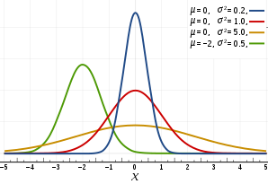
Standard Normal Distribution
The Standard Normal Distribution
Coding occurs here so that
all different possible normal distributions become
a single unified distribution (the standard normal distribution).

Slide 3
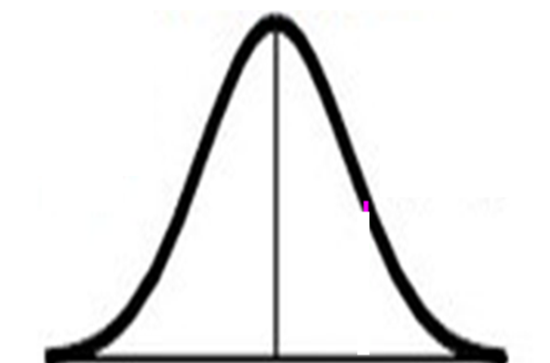


Standard Normal Distribution
The great thing about the
standard normal distribution is
the mean is always 0
and the standard deviation is always 1.
$μ=0$
$$σ=1$$
$0$

Slide 4
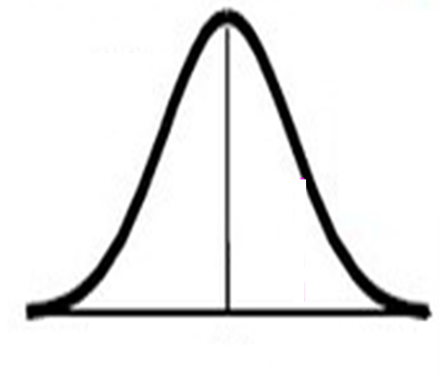


Standard Normal Distribution
Normal
Distribution
Standard
Distribution
$μ=0$
$$σ=1$$
$$μ$$
0
Z
X
X scale
Z scale

Slide 5
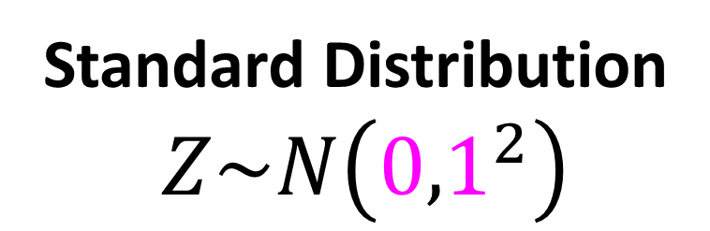
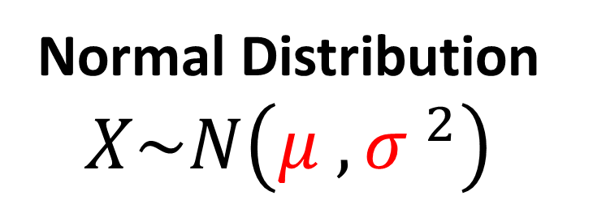
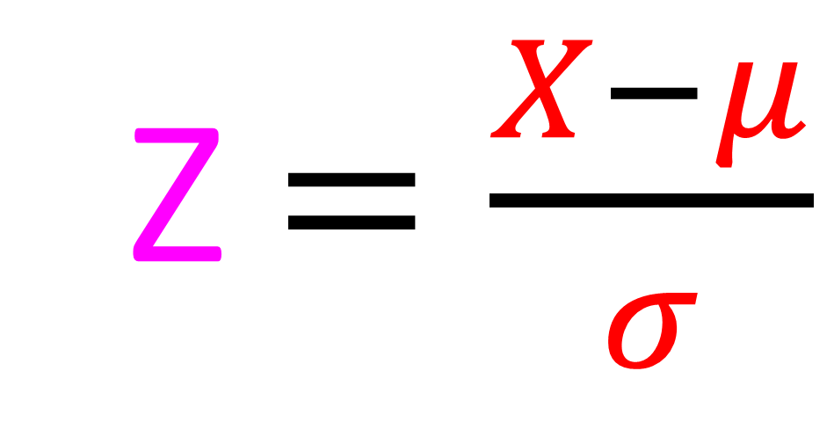
Standard Normal Distribution – Finding Z Numbers
Normal Distribution
$$X\sim N\left({μ ,σ }^{2}\right)$$
Standard Distribution
$Z\sim N\left({0,1}^{2}\right)$
Z $=\frac{X−μ}{σ}$

Slide 6
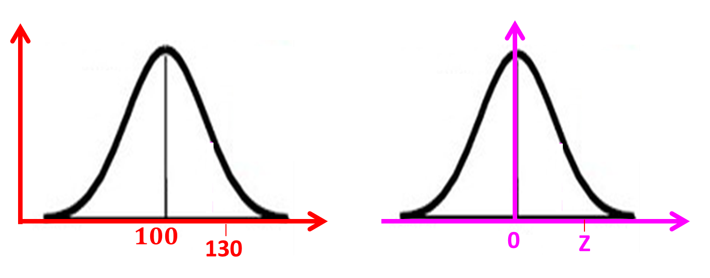
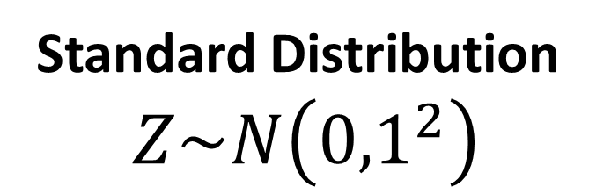
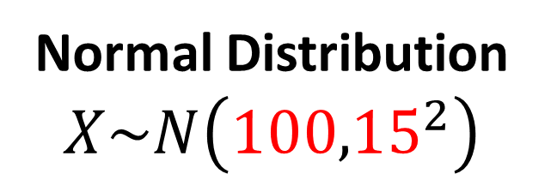
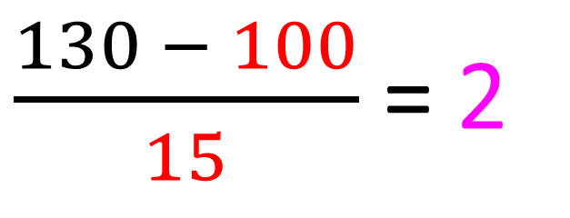
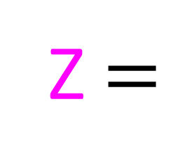
Standard Normal Distribution – Finding Z Numbers
Normal Distribution
$$X\sim N\left({100,15}^{2}\right)$$
Standard Distribution
$Z\sim N\left({0,1}^{2}\right)$
$\frac{130 − 100}{15}$ = 2
Z $=$

Slide 7

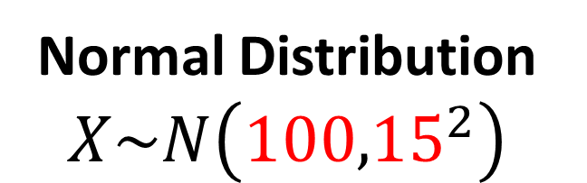

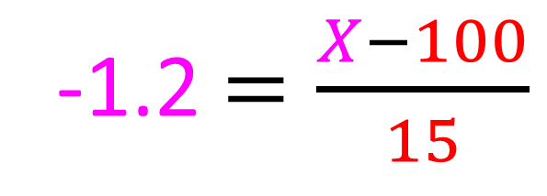
Standard Normal Distribution – Finding Z Numbers
Normal Distribution
$$X\sim N\left({100,15}^{2}\right)$$
Standard Distribution
$Z\sim N\left({0,1}^{2}\right)$
X
$$100$$
-1.2
0
-1.2 $=\frac{X−100}{15}$
X $=82$

Slide 8

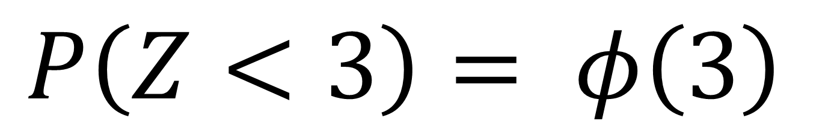
Standard Normal Distribution – Other Notation
Other notation that
you may come across is
phi $φ$
$$P\left(Z<3\right)= φ\left(3\right)$$

Slide 9
Exercise 3D
Pearson Stats/Mechanics Year 2
Page 49
Complete before the lesson Q1-2
In Class:
Green Q3
Amber Q4
Red Q5-7

