Slide 1

CorePure1 Chapter 8 ::
Proof by Induction
jfrost@tiffin.kingston.sch.uk
www.drfrostmaths.com
@DrFrostMaths
Last modified: 14th September 2018

Slide 2








www.drfrostmaths.com
Everything is completely free.
Why not register?
Register now to interactively practise questions on this topic, including past paper questions and extension questions (including MAT + UKMT).
Teachers: you can create student accounts (or students can register themselves), to set work, monitor progress and even create worksheets.
With questions by:
Dashboard with points, trophies, notifications and student progress.
Questions organised by topic, difficulty and past paper.
Teaching videos with topic tests to check understanding.

Slide 3
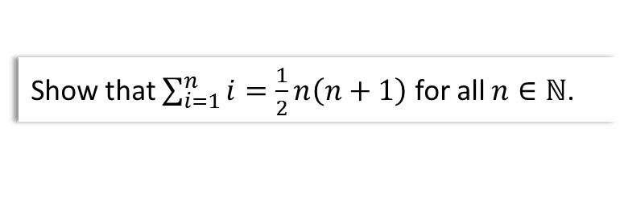

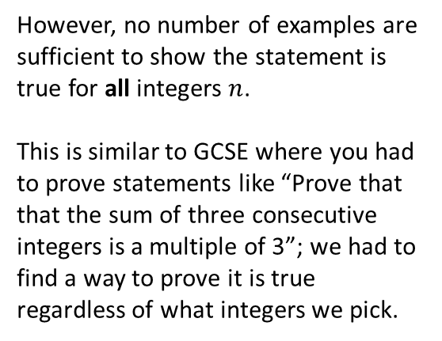
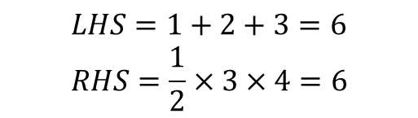
What is Proof by Induction?
We can often use proof by induction whenever we want to show some property holds for all integers (usually positive) up to infinity.
Example
Show that $\sum_{i=1}^{n}{i}=\frac{1}{2}n\left(n+1\right)$ for all $n∈ℕ$.
We could show it’s true for certain examples:
However, no number of examples are sufficient to show the statement is true for all integers $n$.
This is similar to GCSE where you had to prove statements like “Prove that that the sum of three consecutive integers is a multiple of 3”; we had to find a way to prove it is true regardless of what integers we pick.
$$n=3$$
$$LHS=1+2+3=6 \\ RHS=\frac{1}{2}×3×4=6$$

Slide 4


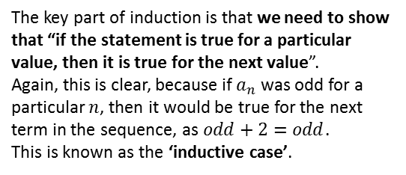

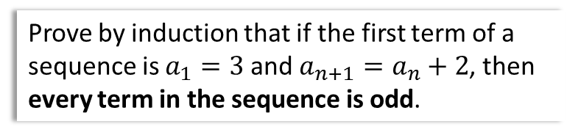

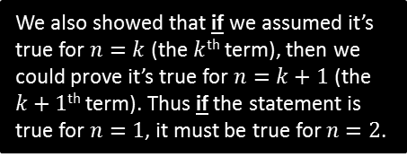

How it works
Very Basic Example
Prove by induction that if the first term of a sequence is $a_{1}=3$ and $a_{n+1}=a_{n}+2$, then every term in the sequence is odd.
We also showed that if we assumed it’s true for $n=k$ (the $k$^{th} term), then we could prove it’s true for $n=k+1$ (the $k+1$^{th} term). Thus if the statement is true for $n=1$, it must be true for $n=2$.
Clearly the statement is true for the first term, because 3 is odd. This is known as the ‘base case’, i.e. a starting point.
If it’s true for $n=3$, it must be true for $n=4$.
Again by using the inductive case, if it’s true for $n=2$, it must be true for $n=3$.
3
5
7
9
11
And so on. Hence the statement must be true for all $n$.
We managed to show the statement is true for the first value of $n$, i.e. $n=1$.
This is analogous to an infinite line of dominoes: each domino falling over causes the next domino to fall over – we just need to push the first!
The key part of induction is that we need to show that “if the statement is true for a particular value, then it is true for the next value”.
Again, this is clear, because if $a_{n}$ was odd for a particular $n$, then it would be true for the next term in the sequence, as $odd+2=odd$.
This is known as the ‘inductive case’.

Slide 5
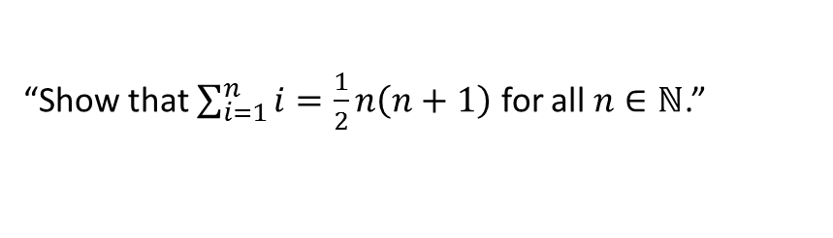


Chapter Overview
We will use Proof of Induction for 3 different types of proof:
1
Summation Proofs
“Show that $\sum_{i=1}^{n}{i}=\frac{1}{2}n\left(n+1\right)$ for all $n∈ℕ$.”
2
Divisibility Proofs
“Prove that $n^{3}−7n+9$ is divisible by 3 for all $n∈ℤ^{+}$.”
3
Matrix Proofs
“Prove that ${\left(\begin{matrix}1 & −1 \\ 0 & 3\end{matrix}\right)}^{n}=\left(\begin{matrix}1 & 1−2^{n} \\ 0 & 2^{n}\end{matrix}\right)$ for all $n∈ℤ^{+}$.”
Fro Note: Recall that $ℤ$ is the set of all integers, and $ℤ^{+}$ is the set of all positive integers. Thus $ℕ=ℤ^{+}$ (where $ℕ$ is the set of ‘natural’ numbers).

Slide 6
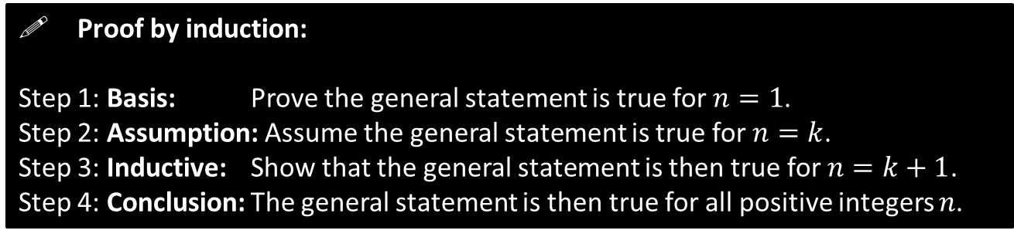
The Four Steps of Induction
For all these types the process of proof is the same:
! Proof by induction:
Step 1: Basis: Prove the general statement is true for $n=1$.
Step 2: Assumption: Assume the general statement is true for $n=k$.
Step 3: Inductive: Show that the general statement is then true for $n=k+1$.
Step 4: Conclusion: The general statement is then true for all positive integers $n$.
(Step 1 is commonly known as the ‘base case’ and Step 3 as the ‘inductive case’)

Slide 7

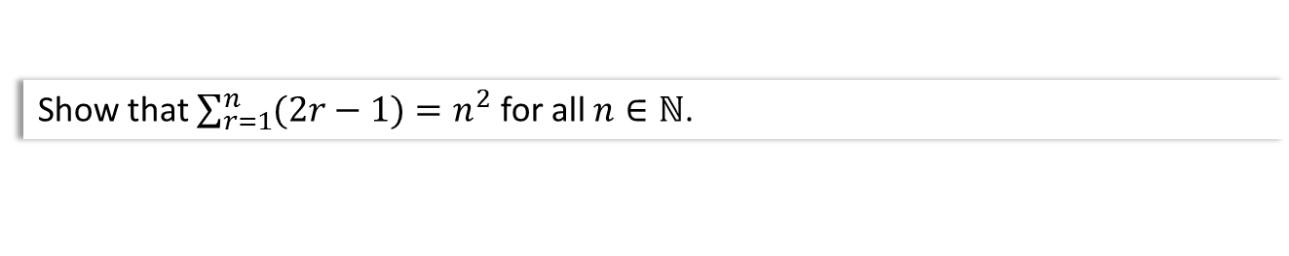



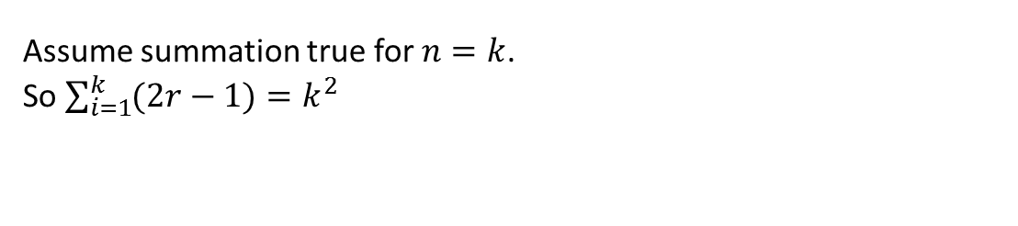
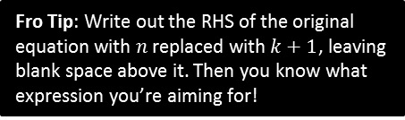
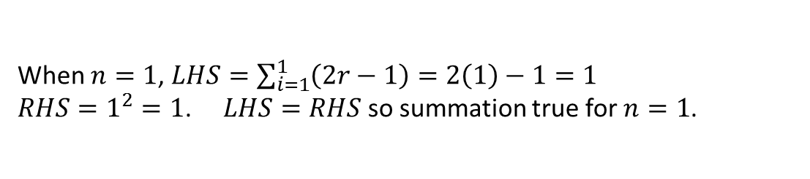
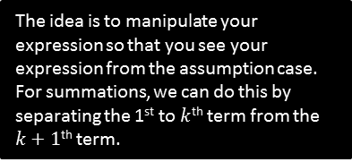
Type 1: Summation Proofs
Step 1: Basis: Prove the general statement is true for $n=1$.
Step 2: Assumption: Assume the general statement is true for $n=k$.
Step 3: Inductive: Show that the general statement is then true for $n=k+1$.
Step 4: Conclusion: The general statement is then true for all positive integers $n$.
Show that $\sum_{r=1}^{n}{(2r−1)}=n^{2}$ for all $n∈ℕ$.
?
1 Basis Step
When $n=1$, $LHS=\sum_{i=1}^{1}{\left(2r−1\right)=2\left(1\right)−1}=1$
$RHS=1^{2}=1$. $LHS=RHS$ so summation true for $n=1$.
?
2 Assumption
For assumption, just write out the statement with $n$ replaced with $k$.
Assume summation true for $n=k$.
So $\sum_{i=1}^{k}{(2r−1)}=k^{2}$
When $n=k+1$:
$$\sum_{i=1}^{k+1}{\left(2r−1\right)}=\left(\sum_{i=1}^{k}{\left(2r−1\right)}\right)+\left(2\left(k+1\right)−1\right) \\ =k^{2}+2k+1 \\ ={\left(k+1\right)}^{2}$$
Hence true when $n=k+1$.
3 Inductive
?
The idea is to manipulate your expression so that you see your expression from the assumption case. For summations, we can do this by separating the 1st to $k$^{th} term from the $k+1$^{th} term.
Fro Tip: Write out the RHS of the original equation with $n$ replaced with $k+1$, leaving blank space above it. Then you know what expression you’re aiming for!
Since true for $n=1$ and if true for $n=k$, true for $n=k+1$,
$∴$ true for all $n$.
4 Conclusion
?

Slide 8
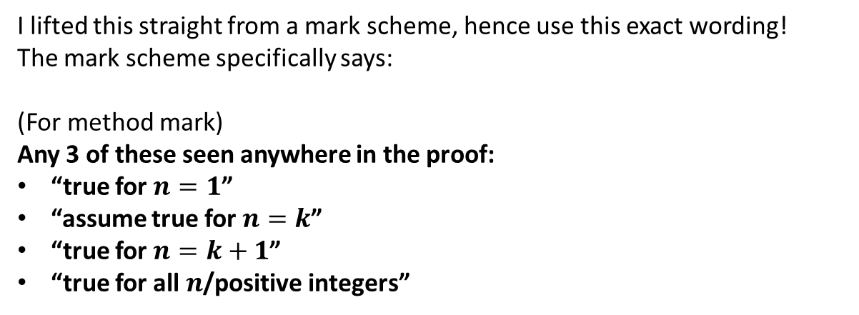
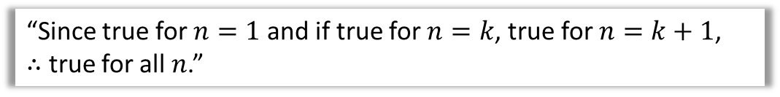
More on the ‘Conclusion Step’
“Since true for $n=1$ and if true for $n=k$, true for $n=k+1$,
$∴$ true for all $n$.”
I lifted this straight from a mark scheme, hence use this exact wording!
The mark scheme specifically says:
(For method mark)
Any 3 of these seen anywhere in the proof:
“true for $n=1$”
“assume true for $n=k$”
“true for $n=k+1$”
“true for all $n$/positive integers”

Slide 9


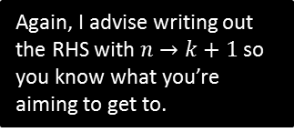
Further Example
[Textbook] Prove by induction that for all positive integers $n$,
$$\sum_{r=1}^{n}{r2^{r}}=2\left(1+\left(n−1\right)2^{n}\right)$$
When $n=1$, $LHS=1×2^{1}=2$
$$RHS=2\left(1+\left(1−1\right)2^{1}\right)=2$$
Therefore true when $n=1$.
Assume true when $n=k$:
$$\sum_{r=1}^{k}{r2^{r}}=2\left(1+\left(k−1\right)2^{k}\right)$$
When $n=k+1$:
$$\sum_{r=1}^{k+1}{r2^{r}}=\sum_{r=1}^{k}{r2^{r}}+\left(k+1\right)2^{k+1} \\ =2\left(1+\left(k−1\right)2^{k}\right)+\left(k+1\right)2^{k+1} \\ =… \\ =2\left(1+\left(\left[k+1\right]−1\right)2^{k+1}\right)$$
Therefore true when $n=k+1$.
Since true for $n=1$ and if true for $n=k$, true for $n=k+1$,
$∴$ true for all $n$.
1 Basis Step
?
2 Assumption
?
3 Inductive
?
Again, I advise writing out the RHS with $n→k+1$ so you know what you’re aiming to get to.
4 Conclusion
?

Slide 10
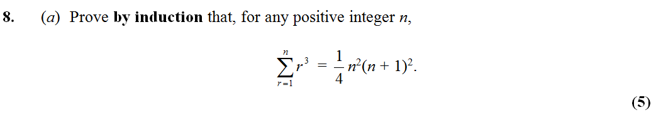
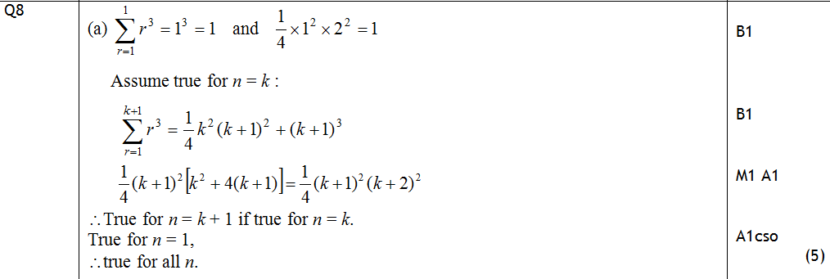
Test Your Understanding
Edexcel FP1 Jan 2010
?

Slide 11
Exercise 8A
Pearson Pure Mathematics Year 1/AS
Pages 158-159
Complete before the lesson Q1
In Class:
Green Q2-3
Amber Q4-5
Red Q6-7 & challenge

Slide 12
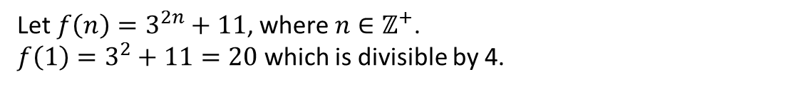
Type 2: Divisibility Proofs
Step 1: Basis: Prove the general statement is true for $n=1$.
Step 2: Assumption: Assume the general statement is true for $n=k$.
Step 3: Inductive: Show that the general statement is then true for $n=k+1$.
Step 4: Conclusion: The general statement is then true for all positive integers $n$.
Prove by induction that $3^{2n}+11$ is divisible by 4 for all positive integers $n$.
Let $f\left(n\right)=3^{2n}+11$, where $n∈ℤ^{+}$.
$f\left(1\right)=3^{2}+11=20$ which is divisible by 4.
1 Basis Step
?
2 Assumption
?
Assume that for $n=k$, $f\left(k\right)=3^{2k}+11$ is divisible by 4 for $k∈ℤ^{+}$.
… Continued on next slide

Slide 13


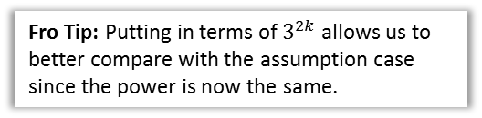

Type 2: Divisibility Proofs
Step 1: Basis: Prove the general statement is true for $n=1$.
Step 2: Assumption: Assume the general statement is true for $n=k$.
Step 3: Inductive: Show that the general statement is then true for $n=k+1$.
Step 4: Conclusion: The general statement is then true for all positive integers $n$.
Prove by induction that $3^{2n}+11$ is divisible by 4 for all positive integers $n$.
3 Inductive
Method 1 (the textbook’s method, which I don’t like)
Find the difference between successive terms and show this is divisible by the number of interest.
?
$$f\left(k+1\right)=3^{2\left(k+1\right)}+11 \\ =3^{2k}⋅3^{2}+11 \\ =9\left(3^{2k}\right)+11$$
$$∴f\left(k+1\right)−f\left(k\right)=\left[9\left(3^{2k}\right)+11\right]−\left[3^{2k}+11\right] \\ =8\left(3^{2k}\right)=4\left(2\left(3^{2k}\right)\right)$$
$$∴f\left(k+1\right)=f\left(k\right)+4\left(2\left(3^{2k}\right)\right)$$
Therefore $f(n)$ is divisible by 4 when $n=k+1$.
Fro Tip: Putting in terms of $3^{2k}$ allows us to better compare with the assumption case since the power is now the same.
Method: You need to explicitly factor out 4 to show divisibility by 4.
Method: Then write $f\left(k+1\right)$ back in term of $f(k)$ and the difference. We know both the terms on the RHS are divisible by 4.
4 Conclusion
?
Since true for $n=1$ and if true for $n=k$, true for $n=k+1$,
$∴$ true for all $n$.

Slide 14
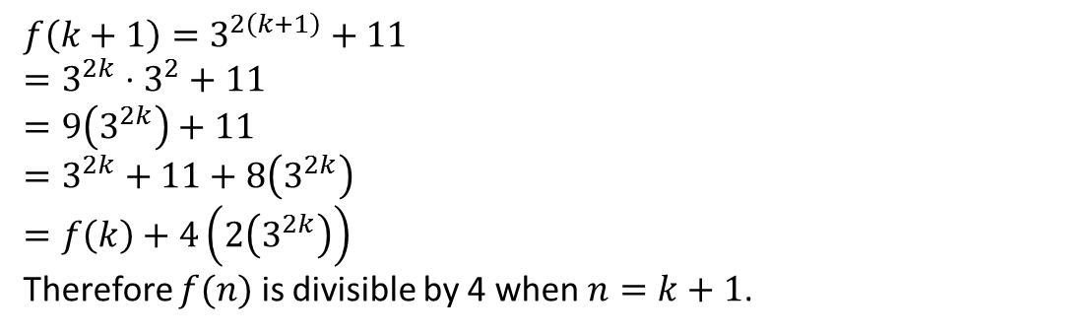
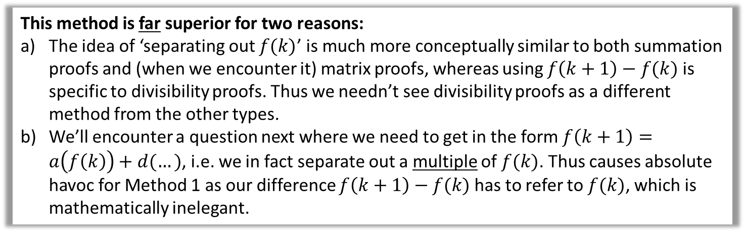
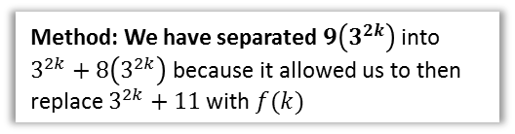
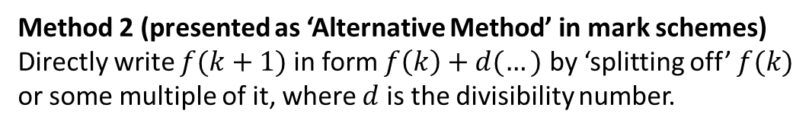
Type 2: Divisibility Proofs
Prove by induction that $3^{2n}+11$ is divisible by 4 for all positive integers $n$.
3 Inductive
Method 2 (presented as ‘Alternative Method’ in mark schemes)
Directly write $f(k+1)$ in form $f\left(k\right)+d(…)$ by ‘splitting off’ $f(k)$ or some multiple of it, where $d$ is the divisibility number.
$$f\left(k+1\right)=3^{2\left(k+1\right)}+11 \\ =3^{2k}⋅3^{2}+11 \\ =9\left(3^{2k}\right)+11$$
$=3^{2k}+11+8\left(3^{2k}\right)$
$$=f\left(k\right)+4\left(2\left(3^{2k}\right)\right)$$
Therefore $f(n)$ is divisible by 4 when $n=k+1$.
?
Method: We have separated $9\left(3^{2k}\right)$ into $3^{2k}+8\left(3^{2k}\right)$ because it allowed us to then replace $3^{2k}+11$ with $f(k)$
This method is far superior for two reasons:
The idea of ‘separating out $f(k)$’ is much more conceptually similar to both summation proofs and (when we encounter it) matrix proofs, whereas using $f\left(k+1\right)−f(k)$ is specific to divisibility proofs. Thus we needn’t see divisibility proofs as a different method from the other types.
We’ll encounter a question next where we need to get in the form $f\left(k+1\right)=a\left(f\left(k\right)\right)+d(…)$, i.e. we in fact separate out a multiple of $f(k)$. Thus causes absolute havoc for Method 1 as our difference $f\left(k+1\right)−f(k)$ has to refer to $f(k)$, which is mathematically inelegant.

Slide 15
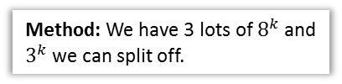
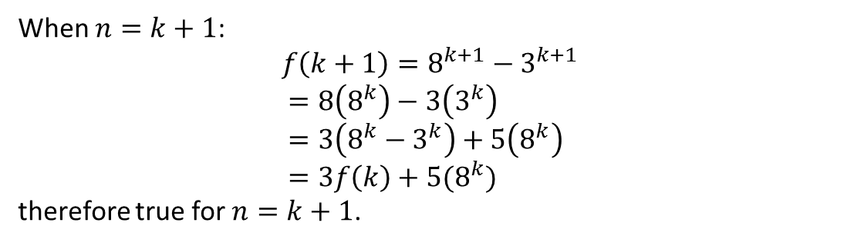
Type 2: Divisibility Proofs
Prove by induction that $8^{n}−3^{n}$ is divisible by 5.
2 Assumption
?
Assume that for $n=k$, $f\left(k\right)=8^{k}−3^{k}$ is divisible by 5 for $k∈ℤ^{+}$.
3 Inductive
When $n=k+1$:
$$f\left(k+1\right)=8^{k+1}−3^{k+1} \\ =8\left(8^{k}\right)−3\left(3^{k}\right) \\ =3\left(8^{k}−3^{k}\right)+5\left(8^{k}\right) \\ =3f\left(k\right)+5(8^{k})$$
therefore true for $n=k+1$.
?
Using Method 2
Method: We have 3 lots of $8^{k}$ and $3^{k}$ we can split off.

Slide 16
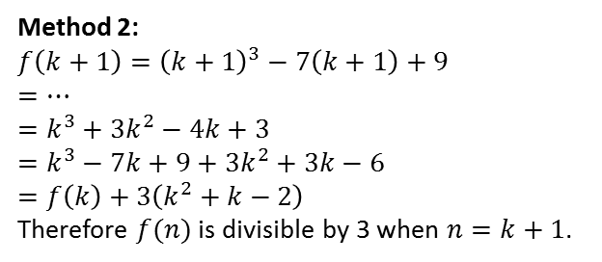


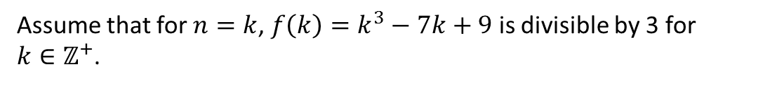
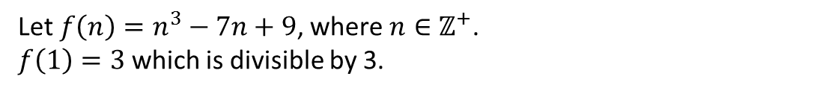
Test Your Understanding
Step 1: Basis: Prove the general statement is true for $n=1$.
Step 2: Assumption: Assume the general statement is true for $n=k$.
Step 3: Inductive: Show that the general statement is then true for $n=k+1$.
Step 4: Conclusion: The general statement is then true for all positive integers $n$.
Prove by induction that $n^{3}−7n+9$ is divisible by 3 for all positive integers $n$.
1 Basis Step
Let $f\left(n\right)=n^{3}−7n+9$, where $n∈ℤ^{+}$.
$f\left(1\right)=3$ which is divisible by 3.
?
2 Assumption
Assume that for $n=k$, $f\left(k\right)=k^{3}−7k+9$ is divisible by 3 for $k∈ℤ^{+}$.
?
3 Inductive
?
Method 1:
$$f\left(k+1\right)={\left(k+1\right)}^{3}−7\left(k+1\right)+9 \\ =… \\ =k^{3}+3k^{2}−4k+3$$
$$∴f\left(k+1\right)−f\left(k\right)=…=3\left(k^{2}+k−2\right)$$
$$∴f\left(k+1\right)=f\left(k\right)+3\left(k^{2}+k−2\right)$$
Therefore $f(n)$ is divisible by 3 when $n=k+1$.
Method 2:
$$f\left(k+1\right)={\left(k+1\right)}^{3}−7\left(k+1\right)+9 \\ =… \\ =k^{3}+3k^{2}−4k+3$$
$$=k^{3}−7k+9+3k^{2}+3k−6 \\ =f\left(k\right)+3\left(k^{2}+k−2\right)$$
Therefore $f(n)$ is divisible by 3 when $n=k+1$.
4 Conclusion
Since true for $n=1$ and if true for $n=k$, true for $n=k+1$,
$∴$ true for all $n$.
?

Slide 17
Exercise 8B
Pearson Pure Mathematics Year 1/AS
Page 162
Complete before the lesson Q1
In Class:
Green Q2
Amber Q3-4
Red Q5-6

Slide 18
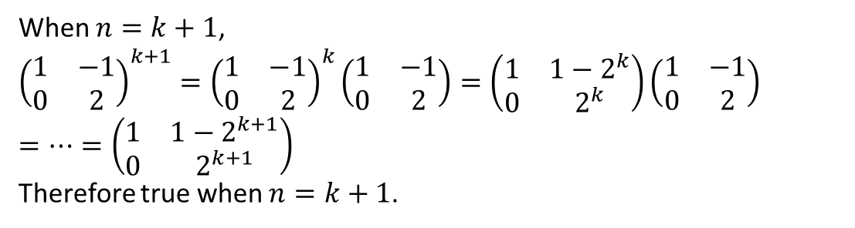

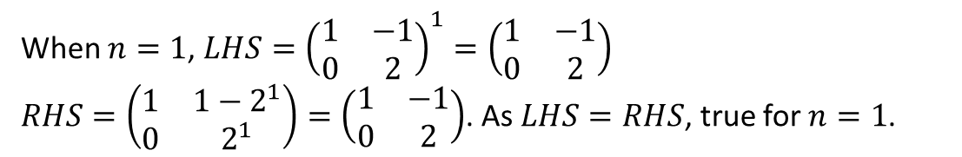
Type 3: Matrix Proofs
Step 1: Basis: Prove the general statement is true for $n=1$.
Step 2: Assumption: Assume the general statement is true for $n=k$.
Step 3: Inductive: Show that the general statement is then true for $n=k+1$.
Step 4: Conclusion: The general statement is then true for all positive integers $n$.
Prove by induction that ${\left(\begin{matrix}1 & −1 \\ 0 & 2\end{matrix}\right)}^{n}=\left(\begin{matrix}1 & 1−2^{n} \\ 0 & 2^{n}\end{matrix}\right)$ for all $n∈ℤ^{+}$.
?
1 Basis Step
When $n=1$, $LHS={\left(\begin{matrix}1 & −1 \\ 0 & 2\end{matrix}\right)}^{1}=\left(\begin{matrix}1 & −1 \\ 0 & 2\end{matrix}\right)$
$RHS=\left(\begin{matrix}1 & 1−2^{1} \\ 0 & 2^{1}\end{matrix}\right)=\left(\begin{matrix}1 & −1 \\ 0 & 2\end{matrix}\right)$. As $LHS=RHS$, true for $n=1$.
2 Assumption
Assume true $n=k$, i.e. ${\left(\begin{matrix}1 & −1 \\ 0 & 3\end{matrix}\right)}^{k}=\left(\begin{matrix}1 & 1−2^{k} \\ 0 & 2^{k}\end{matrix}\right)$
?
3 Inductive
When $n=k+1$,
$${\left(\begin{matrix}1 & −1 \\ 0 & 2\end{matrix}\right)}^{k+1}={\left(\begin{matrix}1 & −1 \\ 0 & 2\end{matrix}\right)}^{k}\left(\begin{matrix}1 & −1 \\ 0 & 2\end{matrix}\right)=\left(\begin{matrix}1 & 1−2^{k} \\ 0 & 2^{k}\end{matrix}\right)\left(\begin{matrix}1 & −1 \\ 0 & 2\end{matrix}\right)$$
$$=…=\left(\begin{matrix}1 & 1−2^{k+1} \\ 0 & 2^{k+1}\end{matrix}\right)$$
Therefore true when $n=k+1$.
?
Method: As with summation and divisibility proofs, it’s just a case of ‘separating off’ the assumption expression.
4 Conclusion
?
Since true for $n=1$ and if true for $n=k$, true for $n=k+1$,
$∴$ true for all $n$.

Slide 19
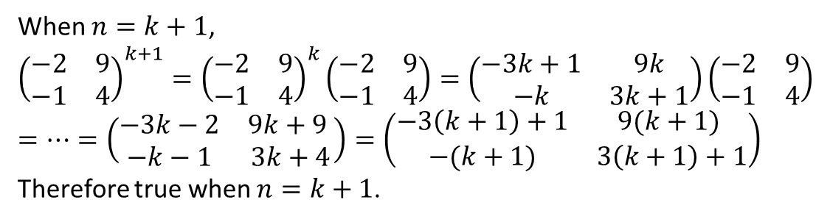
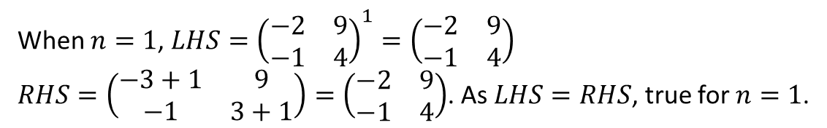
Test Your Understanding
Step 1: Basis: Prove the general statement is true for $n=1$.
Step 2: Assumption: Assume the general statement is true for $n=k$.
Step 3: Inductive: Show that the general statement is then true for $n=k+1$.
Step 4: Conclusion: The general statement is then true for all positive integers $n$.
Prove by induction that ${\left(\begin{matrix}−2 & 9 \\ −1 & 4\end{matrix}\right)}^{n}=\left(\begin{matrix}−3n+1 & 9n \\ −n & 3n+1\end{matrix}\right)$ for all $n∈ℤ^{+}$.
?
1 Basis Step
When $n=1$, $LHS={\left(\begin{matrix}−2 & 9 \\ −1 & 4\end{matrix}\right)}^{1}=\left(\begin{matrix}−2 & 9 \\ −1 & 4\end{matrix}\right)$
$RHS=\left(\begin{matrix}−3+1 & 9 \\ −1 & 3+1\end{matrix}\right)=\left(\begin{matrix}−2 & 9 \\ −1 & 4\end{matrix}\right)$. As $LHS=RHS$, true for $n=1$.
Assume true $n=k$, i.e.${\left(\begin{matrix}−2 & 9 \\ −1 & 4\end{matrix}\right)}^{k}=\left(\begin{matrix}−3k+1 & 9k \\ −k & 3k+1\end{matrix}\right)$
2 Assumption
?
When $n=k+1$,
$${\left(\begin{matrix}−2 & 9 \\ −1 & 4\end{matrix}\right)}^{k+1}={\left(\begin{matrix}−2 & 9 \\ −1 & 4\end{matrix}\right)}^{k}\left(\begin{matrix}−2 & 9 \\ −1 & 4\end{matrix}\right)=\left(\begin{matrix}−3k+1 & 9k \\ −k & 3k+1\end{matrix}\right)\left(\begin{matrix}−2 & 9 \\ −1 & 4\end{matrix}\right)$$
$$=…=\left(\begin{matrix}−3k−2 & 9k+9 \\ −k−1 & 3k+4\end{matrix}\right)=\left(\begin{matrix}−3\left(k+1\right)+1 & 9(k+1) \\ −(k+1) & 3\left(k+1\right)+1\end{matrix}\right)$$
Therefore true when $n=k+1$.
3 Inductive
?
4 Conclusion
?
Since true for $n=1$ and if true for $n=k$, true for $n=k+1$,
$∴$ true for all $n$.

Slide 20
Exercise 8C
Pearson Pure Mathematics Year 1/AS
Page 164
Complete before the lesson Q1
In Class:
Green Q2
Amber Q3-4
Red Q5 & challenge

