Slide 1
Year 1 Pure Mathematics
Quadratics
- Sketching Quadratics
Chapter 2
(Part 3 of 4)

Slide 2



Sketching Quadratic Graphs
Features needed in sketch of quadratic:
$$y$$
Roots
$$x$$
General shape: Happy or Sad?
$y$-intercept
Turning point

Slide 3
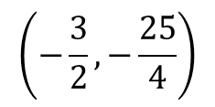
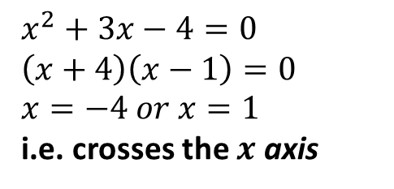
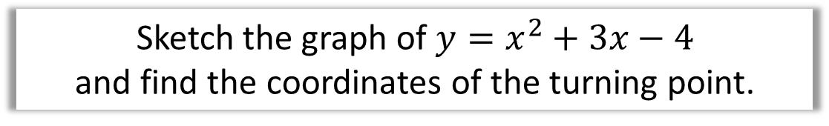
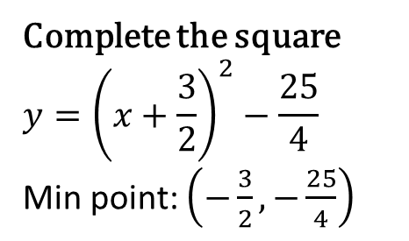
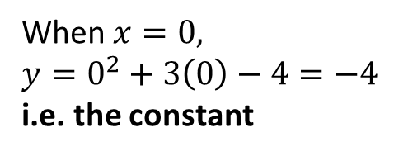



Sketching Quadratic Graphs
Sketch the graph of $y=x^{2}+3x−4$
and find the coordinates of the turning point.
$$y$$
Roots:
$$x^{2}+3x−4=0 \\ \left(x+4\right)\left(x−1\right)=0 \\ x=−4 or x=1$$
i.e. crosses the $x$ axis
$y$-intercept:
When $x=0,$
$$y=0^{2}+3\left(0\right)−4=−4$$
i.e. the constant
$$x$$
-4
1
Turning point:
Complete the square
$$y={\left(x+\frac{3}{2}\right)}^{2}−\frac{25}{4}$$
Min point: $\left(−\frac{3}{2},−\frac{25}{4}\right)$
$$\left(−\frac{3}{2},−\frac{25}{4}\right)$$
-4

Slide 4

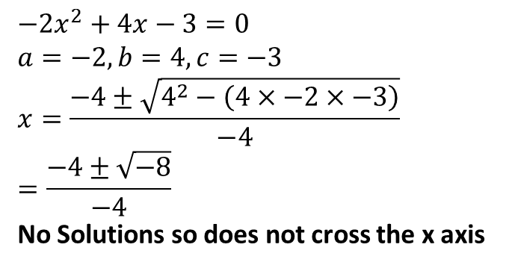

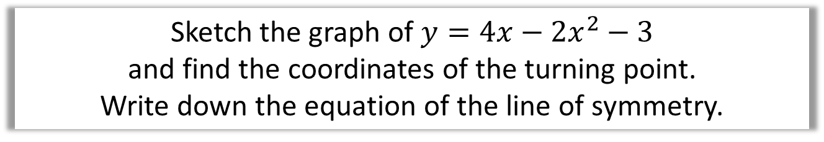

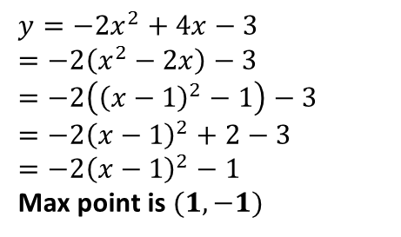



Sketching Quadratic Graphs
Sketch the graph of $y=4x−2x^{2}−3$
and find the coordinates of the turning point.
Write down the equation of the line of symmetry.
$$y$$
Roots:
$$−2x^{2}+4x−3=0 \\ a=−2, b=4, c=−3 \\ x=\frac{−4±\sqrt{4^{2}−\left(4×−2×−3\right)}}{−4}$$
$$=\frac{−4±\sqrt{−8}}{−4}$$
No Solutions so does not cross the x axis
$$x=1$$
$$x$$
$y$-intercept:
-3
$$\left(1,−1\right)$$
$$y=−2x^{2}+4x−3 \\ =−2\left(x^{2}−2x\right)−3 \\ =−2\left({\left(x−1\right)}^{2}−1\right)−3 \\ =−2{\left(x−1\right)}^{2}+2−3 \\ =−2{\left(x−1\right)}^{2}−1$$
Max point is $(1,−1)$
-3
Turning point:
Line of reflection:
$$x=1$$

Slide 5


















Sketching Quadratic Graphs
Sketch the following, indicating any intercepts with the axis,
the turning point and the equation of the line of symmetry.
a
$$y=x^{2}+4$$
c
$$y=5x+3−2x^{2}$$
$$y$$
$$\left(\frac{5}{4},\frac{49}{8}\right)$$
3
$$\left(0,4\right)$$
$$x$$
$$−\frac{1}{2}$$
3
$$x$$
$$x=0$$
$$x=\frac{5}{4}$$
b
$$y=x^{2}−7x+10$$
d
$$y=x^{2}+4x+11$$
$$x=\frac{7}{2}$$
11
10
$$\left(−2,7\right)$$
2
5
$$x$$
$$x$$
$$\left(\frac{7}{2}, −\frac{9}{4}\right)$$
$$x=−2$$

Slide 6
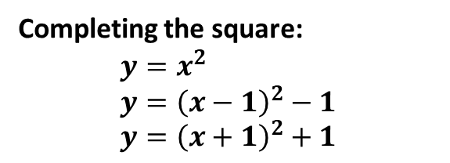
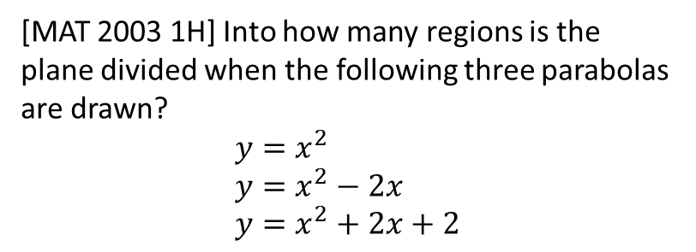


Exercise 2F
Complete before the lesson
Q1 a-c
In Class:
Green Complete Q1
Amber Q2
Red Q3
Pearson Pure Mathematics Year 1/AS
Page 30
Extension Question:
[MAT 2003 1H] Into how many regions is the plane divided when the following three parabolas are drawn?
$$y=x^{2} \\ y=x^{2}−2x \\ y=x^{2}+2x+2$$
$$y$$
?
Completing the square:
$$y=x^{2} \\ y={\left(x−1\right)}^{2}−1 \\ y={\left(x+1\right)}^{2}+1$$
2
5
3
6
7
1
4
$$x$$

