Slide 1

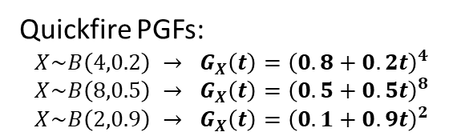


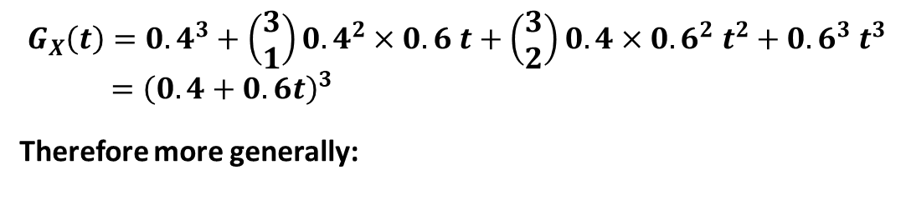
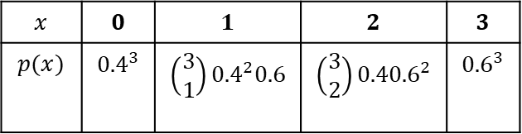
PGFs for common distributions
Binomial
[Textbook] An archer hits the bullseye with probability 0.6. She fires three shots at a target. The random variable $X$ represents the number of times she hits the bullseye. Find the probability generating function of $X$, and factorise your expression.
?
$$X\sim B\left(3, 0.6\right)$$
$$x$$ | $$0$$ | $$1$$ | $$2$$ | $$3$$
$$p(x)$$ | $${0.4}^{3}$$ | $$\left(\begin{matrix}3 \\ 1\end{matrix}\right){0.4}^{2}0.6$$ | $$\left(\begin{matrix}3 \\ 2\end{matrix}\right){0.40.6}^{2}$$ | $${0.6}^{3}$$
?
$$G_{X}\left(t\right)={0.4}^{3}+\left(\begin{matrix}3 \\ 1\end{matrix}\right){0.4}^{2}×0.6 t+\left(\begin{matrix}3 \\ 2\end{matrix}\right){0.4×0.6}^{2} t^{2}+{0.6}^{3} t^{3} \\ ={\left(0.4+0.6t\right)}^{3}$$
Therefore more generally:
?
? Factorised
Quickfire PGFs:
$$X\sim B\left(4,0.2\right) → G_{X}\left(t\right)={\left(0.8+0.2t\right)}^{4} \\ X\sim B\left(8,0.5\right) → G_{X}\left(t\right)={\left(0.5+0.5t\right)}^{8}$$
$$X\sim B\left(2,0.9\right) → G_{X}\left(t\right)={\left(0.1+0.9t\right)}^{2}$$
?
If $X\sim B(n,p)$ then $G_{X}\left(t\right)={\left(q+pt\right)}^{n}$
(where $q=1−p$ is probability of failure)
?
?
?

Slide 2

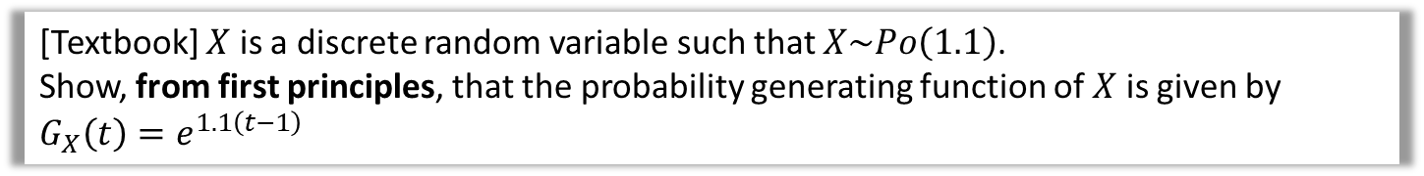
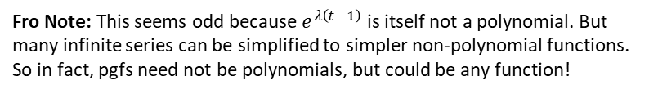


PGFs for common distributions
Poisson
Poisson distributions have infinitely many outcomes, thus the polynomial is infinitely long (known as an infinite series).
[Textbook] $X$ is a discrete random variable such that $X\sim Po\left(1.1\right)$.
Show, from first principles, that the probability generating function of $X$ is given by $G_{X}\left(t\right)=e^{1.1\left(t−1\right)}$
?
$p\left(x\right)=\frac{e^{−1.1}×{1.1}^{x}}{x!}$
$$∴G_{X}\left(t\right)=\left(\frac{e^{−1.1}×{1.1}^{0}}{0!}\right)+\left(\frac{e^{−1.1}×{1.1}^{1}}{1!}\right)t+\left(\frac{e^{−1.1}×{1.1}^{2}}{2!}\right)t^{2}+… \\ =e^{−1.1}\left(\frac{{1.1}^{0}t^{0}}{0!}+\frac{{1.1}^{1}t^{1}}{1!}+\frac{{1.1}^{2}t^{2}}{2!}+…\right) \\ =e^{−1.1}\left(\frac{{\left(1.1t\right)}^{0}}{0!}+\frac{{\left(1.1t\right)}^{1}}{1!}+\frac{{\left(1.1t\right)}^{2}}{2!}+…\right) \\ =e^{−1.1}e^{1.1t}$$
$=e^{1.1\left(t−1\right)}$
In Core Pure Year 2 you will learn that
$$e^{x}=\frac{x^{0}}{0!}+\frac{x^{1}}{1!}+\frac{x^{2}}{2!}+…$$
! If $X\sim Po\left(λ\right)$ then $G_{X}\left(t\right)=e^{λ\left(t−1\right)}$
Fro Note: This seems odd because $e^{λ\left(t−1\right)}$ is itself not a polynomial. But many infinite series can be simplified to simpler non-polynomial functions. So in fact, pgfs need not be polynomials, but could be any function!

Slide 3

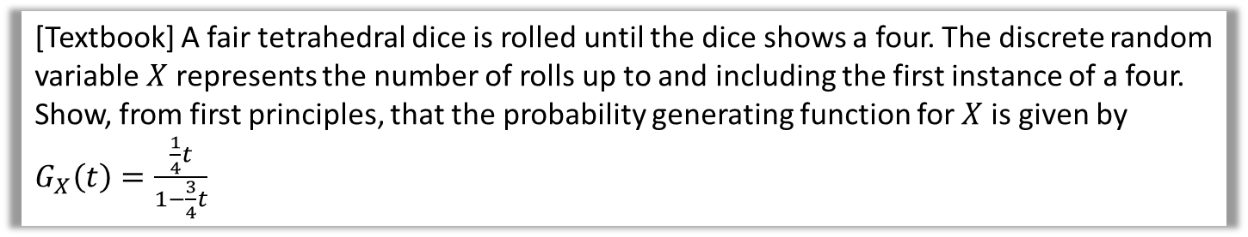

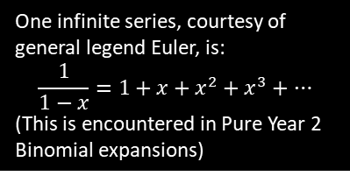
PGFs for common distributions
Geometric
[Textbook] A fair tetrahedral dice is rolled until the dice shows a four. The discrete random variable $X$ represents the number of rolls up to and including the first instance of a four.
Show, from first principles, that the probability generating function for $X$ is given by $G_{X}\left(t\right)=\frac{\frac{1}{4}t}{1−\frac{3}{4}t}$
?
$p\left(x\right)=Geo\left(\frac{1}{4}\right)$ as a quarter chance of getting a 4 on each throw
$G_{X}\left(t\right)=\frac{1}{4}t+\left(\frac{3}{4}\right)\left(\frac{1}{4}\right)t^{2}+{\left(\frac{3}{4}\right)}^{2}\left(\frac{1}{4}\right)t^{3}+…$
$=\frac{1}{4}t\left(1+\frac{3}{4}t+{\left(\frac{3}{4}t\right)}^{2}+{\left(\frac{3}{4}t\right)}^{3}+…\right)$
$=\frac{1}{4}t\left(\frac{1}{1−\frac{3}{4}t}\right)=\frac{\frac{1}{4}t}{1−\frac{3}{4}t}$
One infinite series, courtesy of general legend Euler, is:
$$\frac{1}{1−x}=1+x+x^{2}+x^{3}+…$$
(This is encountered in Pure Year 2 Binomial expansions)
! If $X\sim Geo\left(p\right)$ then $G_{X}\left(t\right)=\frac{pt}{1+qt}$

Slide 4

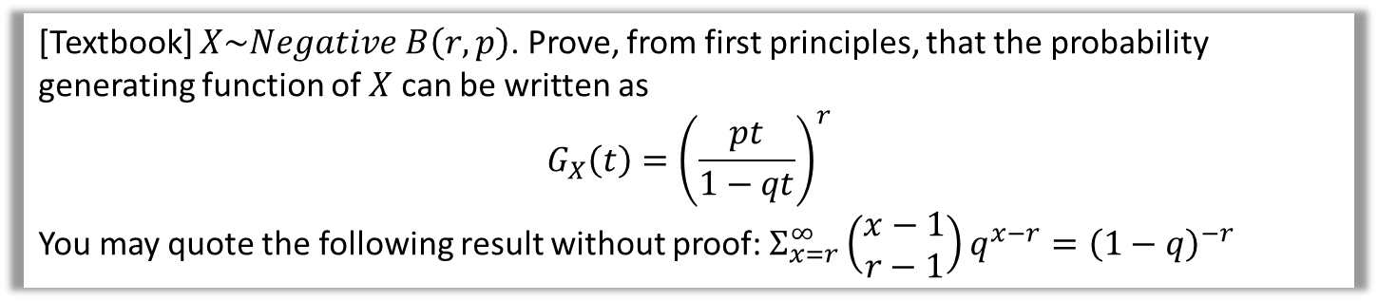


PGFs for common distributions
Negative Binomial
[Textbook] $X\sim Negative B\left(r,p\right)$. Prove, from first principles, that the probability generating function of $X$ can be written as
$$G_{X}\left(t\right)={\left(\frac{pt}{1−qt}\right)}^{r}$$
You may quote the following result without proof: $Σ_{x=r}^{∞}\left(\begin{matrix}x−1 \\ r−1\end{matrix}\right)q^{x−r}={\left(1−q\right)}^{−r}$
?
$$p\left(x\right)=\left(\begin{matrix}x−1 \\ r−1\end{matrix}\right)p^{r}q^{x−r}, x=r,r+1,r+2,… \\ G_{X}\left(t\right)=Σ_{x=r}^{∞}\left(\begin{matrix}x−1 \\ r−1\end{matrix}\right)p^{r}q^{x−r}t^{x} \\ =Σ_{x=r}^{∞}\left(\begin{matrix}x−1 \\ r−1\end{matrix}\right)p^{r}q^{x−r}t^{x−r}t^{r} \\ =p^{r}t^{r }Σ_{x=r}^{∞}\left(\begin{matrix}x−1 \\ r−1\end{matrix}\right)q^{x−r}t^{x−r} \\ =p^{r}t^{r }Σ_{x=r}^{∞}\left(\begin{matrix}x−1 \\ r−1\end{matrix}\right){\left(qt\right)}^{x−r} \\ =p^{r}t^{r}{\left(1−qt\right)}^{−r}={\left(\frac{pt}{1−qt}\right)}^{r} □$$
To use the provided result, we need the power to be $x−r$. So it makes sense to split the $t$ term in this way.
In general with summations, if a factor of the expression doesn’t depend on the variable being incremented, then it can be factorised out.
We can now finally use the provided result.
! If $X\sim Negative B\left(r,p\right)$ then $G_{X}\left(t\right)={\left(\frac{pt}{1−qt}\right)}^{r}$

Slide 5
Exercise 7B
Pearson Further Statistics 1
Pages 134-135
Complete before the lesson Q1-2
In Class:
Green Q3-5
Amber Q6-8
Red Q9-11

