Slide 1
Year 2 Applied Mathematics
Moments
- Resultant
Chapter 4
(Part 2 of 5)

Slide 2
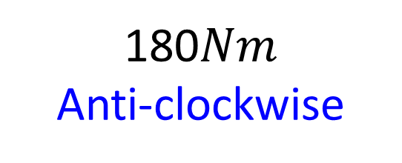


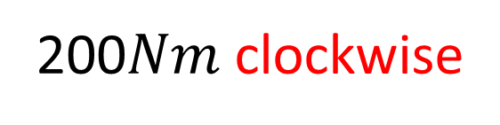



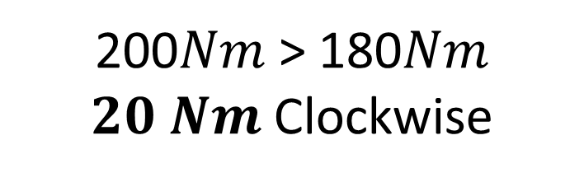
Moments - Resultant
Work out both moments.
$$F=20N$$
200$Nm$ clockwise
$$10m$$
$$P$$
$$12m$$
$$F=15N$$
180$Nm$
Anti-clockwise
What direction will the rotation be?
200$Nm$ > 180$Nm$
$20 Nm$ Clockwise

Slide 3
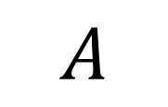
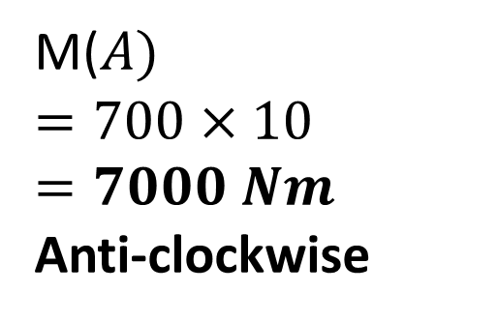
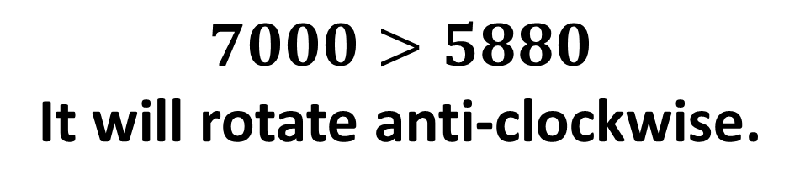

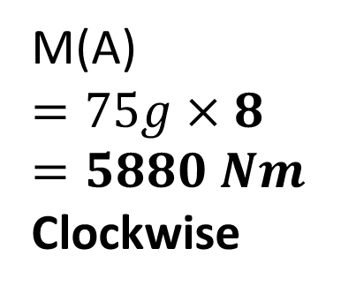
Moments
Will the rod rotate clockwise or anti-clockwise?
10m
8m
700 N
$$A$$
$$75g$$
M($A)$
$$=700×10$$
$$=7000 Nm$$
Anti-clockwise
M(A)
$$=75g×8$$
$$=5880 Nm$$
Clockwise
$$7000>5880$$
It will rotate anti-clockwise.

Slide 4
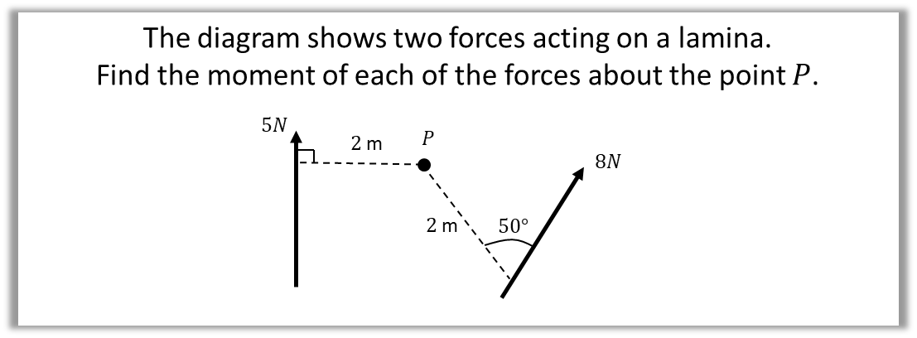
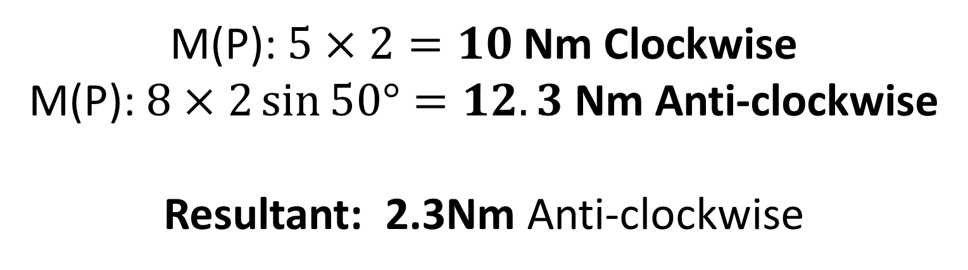
Moments - Resultant
Calculate the resultant moment about the point.
Terminology: A lamina is a 2D object whose thickness can be ignored.
M(P): $5×2=10$Nm Clockwise
M(P): $8×2\sin{50°}=12.3$Nm Anti-clockwise
Resultant: 2.3Nm Anti-clockwise

Slide 5
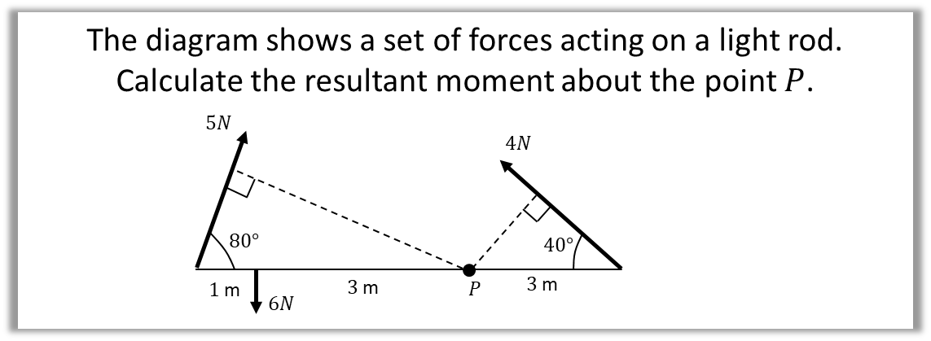
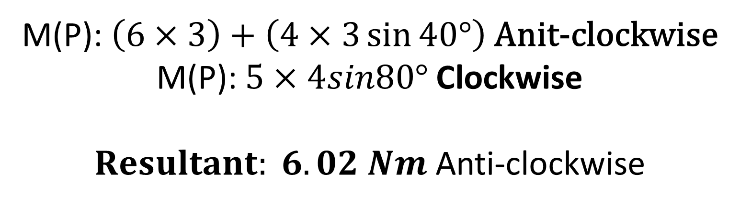
Moments - Resultant
M(P):$\left(6×3\right)+\left(4×3\sin{40°}\right)$ Anit-clockwise
M(P): $5×4sin80°$ Clockwise
Anti-clockwise

Slide 6
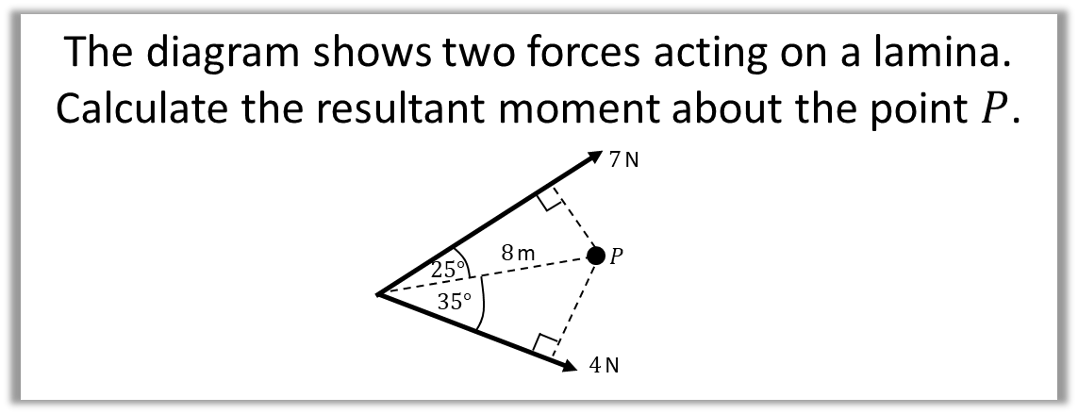
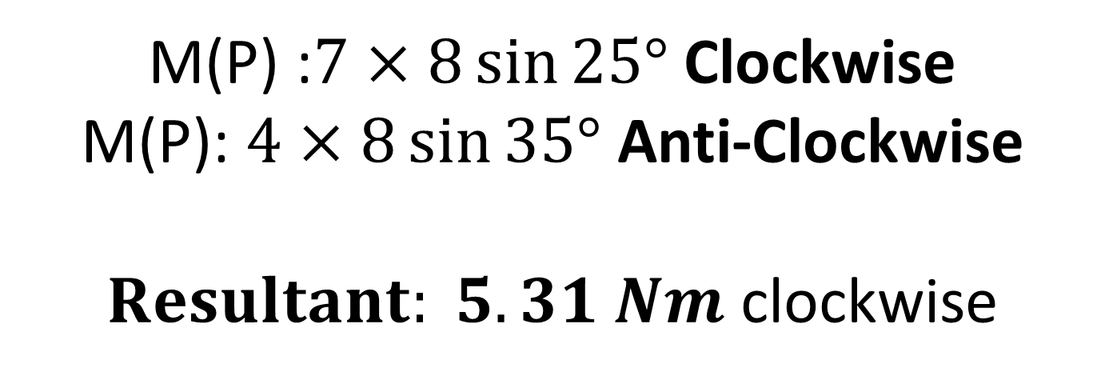
Moments - Resultant
M(P) :$7×8\sin{25°}$ Clockwise
M(P): $4×8\sin{35°}$ Anti-Clockwise
$Resultant: 5.31 Nm$ clockwise

Slide 7



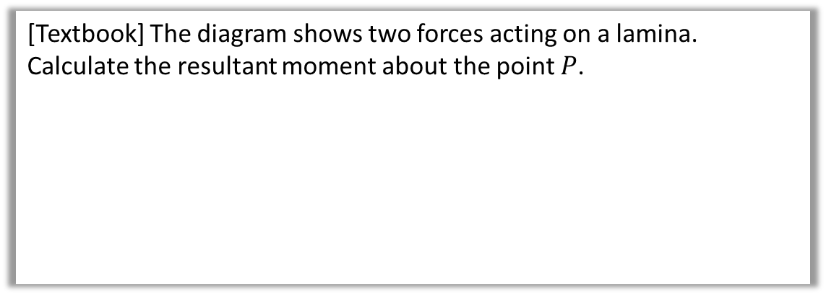



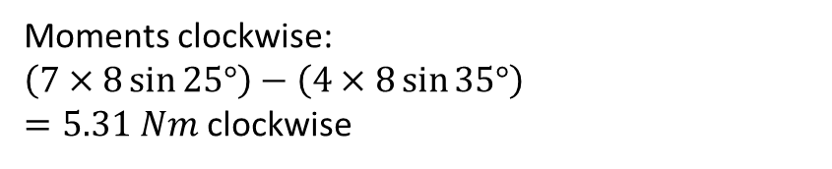
Test Your Understanding
[Textbook] The diagram shows two forces acting on a lamina.
Calculate the resultant moment about the point $P$.
$7$ N
$$25°$$
$8$ m
$$P$$
$$35°$$
Click to Fro-sketch perpendicular distances
$4$ N
Moments clockwise:
$\left(7×8\sin{25°}\right)−\left(4×8\sin{35°}\right)$
$=5.31 Nm$ clockwise
?

Slide 8
Exercise 4B
Pearson Stats/Mechanics Year 2
Page 74-76
Complete before the lesson Q1
In Class:
Green Q2
Amber Q3-4
Red Q5-6

