Slide 1
Year 2 Pure Mathematics
Algebraic Methods
- Proofs
Chapter 1
(Part 1 of 4)

Slide 2
Proof By Contradiction
To prove a statement is true by contradiction:
Assume that the statement is in fact false.
Prove that this assumption is false.
Therefore the original statement is true.

Slide 3

Proof By Contradiction
Prove that there is no greatest odd integer.
Assumption
Assume the greatest odd integer is $n$.
Show contradiction
$n+2=$ odd (because odd + 2 = odd)
$$n+2>n$$
This contradicts the assumption that
$n$ is the greatest odd integer.
Conclusion
Therefore, there is no greatest odd integer.

Slide 4

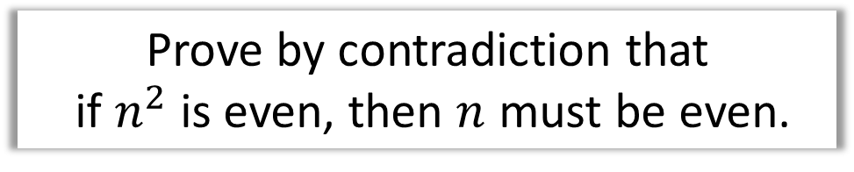
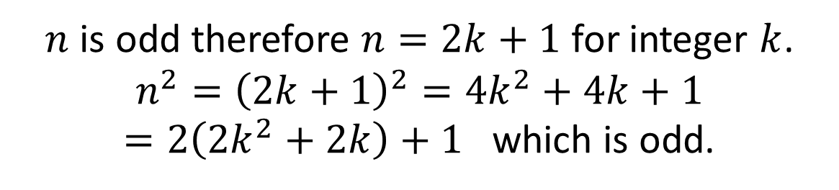
Proof By Contradiction - Example
Prove by contradiction that
if $n^{2}$ is even, then $n$ must be even.
Assumption
Assume $n^{2}$ is even when $n$ is odd.
Show contradiction
$n$ is odd therefore $n=2k+1$ for integer $k$.
$$n^{2}={\left(2k+1\right)}^{2}=4k^{2}+4k+1$$
$=2\left(2k^{2}+2k\right)+1$ which is odd.
Conclusion
This contradicts the assumption that $n^{2}$ is even.
Therefore if $n^{2}$ is even then $n$ must be even.

Slide 5
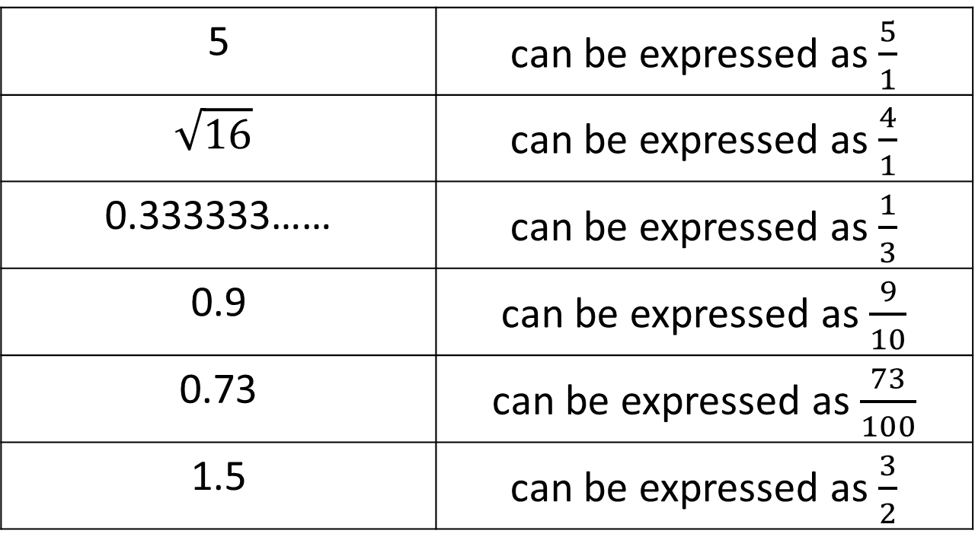
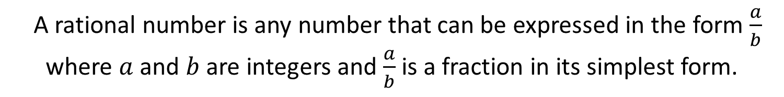
Proof By Contradiction – Rational Numbers
A rational number is any number that can be expressed in the form $\frac{a}{b}$
where $a$ and $b$ are integers and $\frac{a}{b}$ is a fraction in its simplest form.
5 | can be expressed as $\frac{5}{1}$
$$\sqrt{16}$$ | can be expressed as $\frac{4}{1}$
0.333333…… | can be expressed as $\frac{1}{3}$
0.9 | can be expressed as $\frac{9}{10}$
0.73 | can be expressed as $\frac{73}{100}$
1.5 | can be expressed as $\frac{3}{2}$

Slide 6
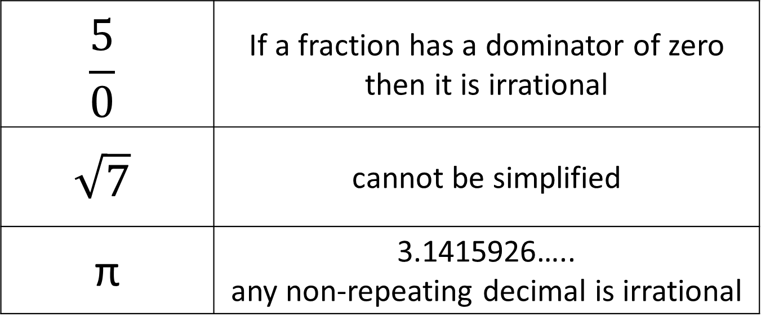
Proof By Contradiction – Irrational Numbers
A irrational number cannot be expressed as a fraction
(where the denominator is not a zero).
$$\frac{5}{0}$$ | If a fraction has a dominator of zero then it is irrational
$$\sqrt{7}$$ | cannot be simplified
π | 3.1415926….. any non-repeating decimal is irrational

Slide 7
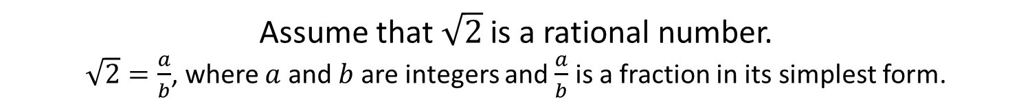
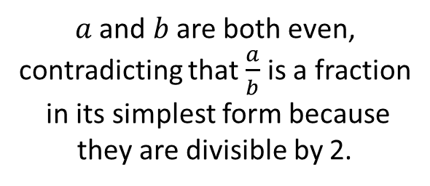

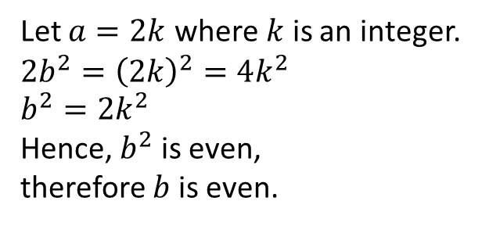
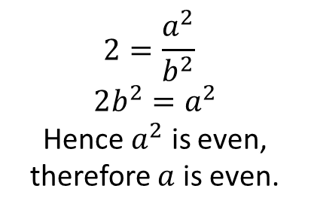
Proof By Contradiction - Example
Prove by contradiction that $\sqrt{2}$ is an irrational number.
Assumption
Assume that $\sqrt{2}$ is a rational number.
$\sqrt{2}=\frac{a}{b}$, where $a$ and $b$ are integers and $\frac{a}{b}$ is a fraction in its simplest form.
Show contradiction
$$2=\frac{a^{2}}{b^{2}}$$
$$2b^{2}=a^{2}$$
Hence $a^{2}$ is even,
therefore $a$ is even.
Let $a=2k$ where $k$ is an integer.
$$2b^{2}={\left(2k\right)}^{2}=4k^{2} \\ b^{2}=2k^{2}$$
Hence, $b^{2}$ is even,
therefore $b$ is even.
$a$ and $b$ are both even,
contradicting that $\frac{a}{b}$ is a fraction
in its simplest form because they are divisible by 2.
Conclusion
Therefore $\sqrt{2}$ is irrational.

Slide 8
Exercise 1A
Pearson Pure Mathematics Year 2/AS
Pages 4-5
Complete before the lesson Q1-4
In Class:
Green Q5-6
Amber Q7-9
Red Q10 & Problem Solving

