Slide 1
Year 1 Applied Mathematics
Statistical Distributions
- Cumulative
Binomial Distribution
Chapter 6 (Part 3)

Slide 2
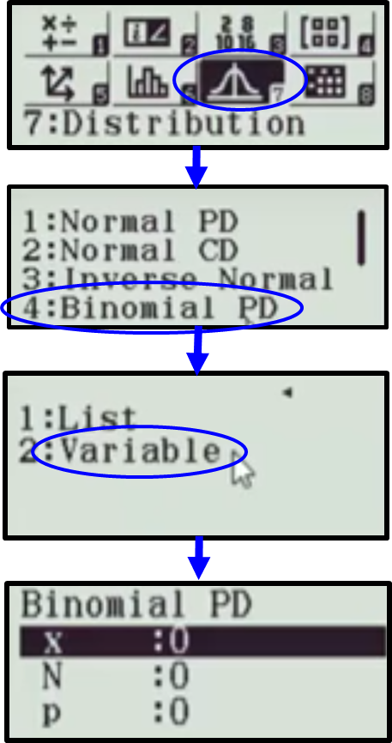
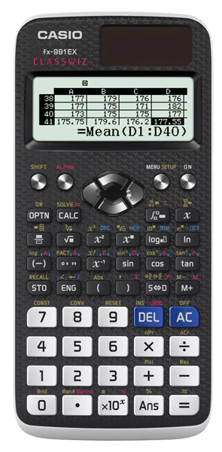
Binomial Probability Distributions – Individual
Individual Probabilities
P(X =1), P(X = 4), P(X = 5)
X = Required Successes
N = Total Outcomes
P = Probability of Success

Slide 3
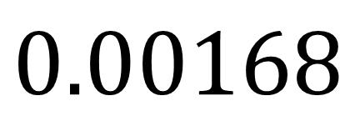
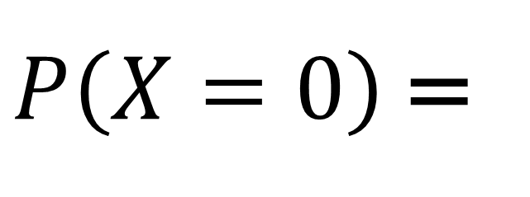
Binomial Probability Distributions – Individual
Total outcomes (N) = 8
Probability of success (P) = 0.55
What is the Probability of
0 success out of 8?
$P\left(X=0\right)$ =
$$0.00168$$

Slide 4
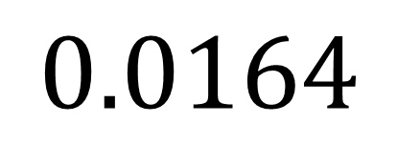
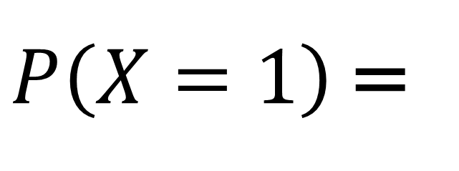
Binomial Probability Distributions – Individual
Total outcomes (N) = 8
Probability of success (P) = 0.55
What is the Probability of
1 success out of 8?
$P\left(X=1\right)$ =
$$0.0164$$

Slide 5
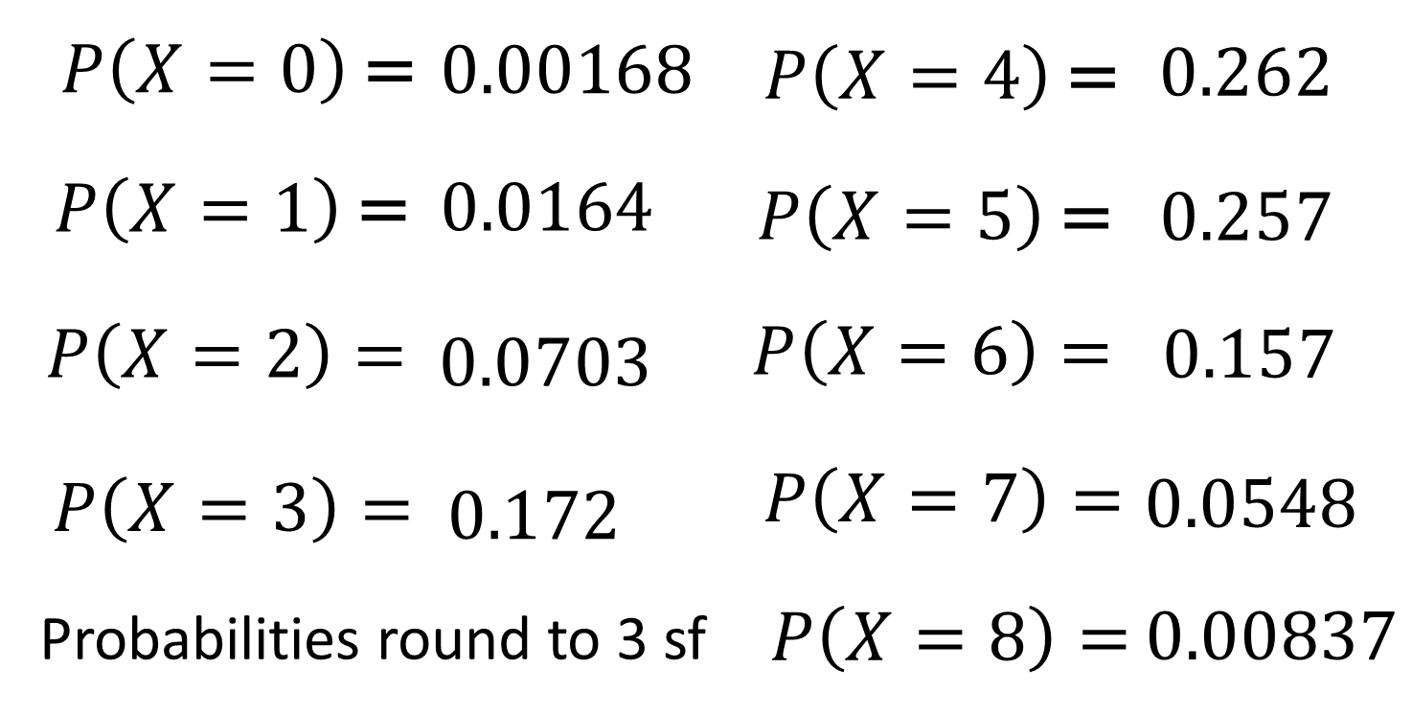
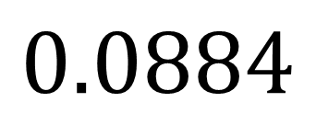
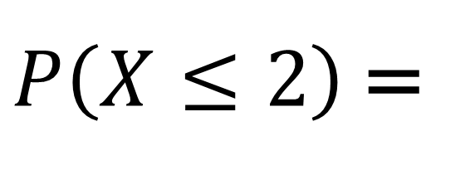
Binomial Probability Distributions – Individual
N = 8
P = 0.55
$P\left(X≤2\right)$ =
$$0.0884$$

Slide 6
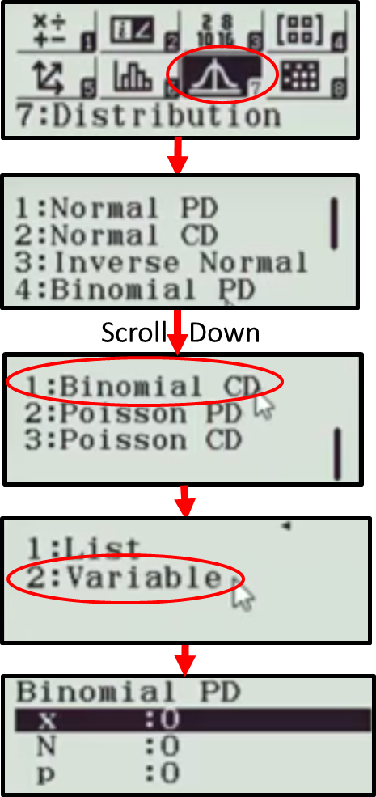
Binomial Probability Distributions – Cumulative
Cumulative Probabilities
P(X ≤ 1), P(X ≤ 4), P(X ≤ 5)
X = Required Successes
N = Total Outcomes
P = Probability of Success

Slide 7
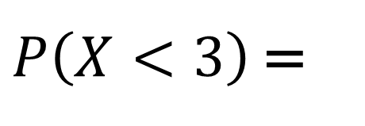
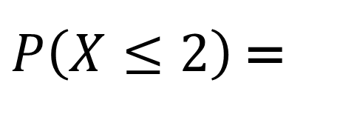
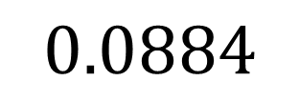
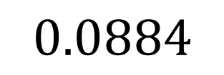
Binomial Probability Distributions – Cumulative
Total Outcomes = 8
Probability of Success = 0.55
0
1
2
$P\left(X≤2\right)$ =
$$0.0884$$
0
1
2
$P\left(X<3\right)$ =
$$0.0884$$

Slide 8
Binomial Probability Distributions – Cumulative
Warning!
The calculator only
gives you P(X ≤ x)
So watch out for questions that ask P(X < x)
P(X > x)
P(X ≥ x)

Slide 9
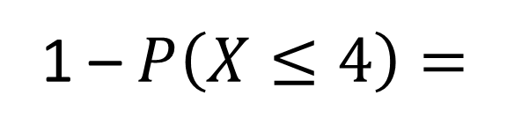
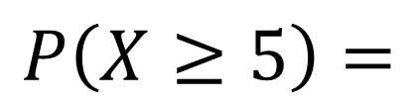


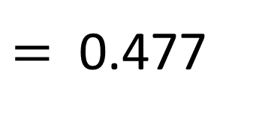
Binomial Probability Distributions – Cumulative
Total Outcomes = 8
Probability of Success = 0.55
$$P\left(X≥5\right)=$$
1 – $P\left(X≤4\right)=$
1 – 0.523
$=$ 0.477
0
1
2
3
4
5
6
7
8
1
0
1
2
3
4
$$P\left(X≤4\right)$$
5
6
7
8
$$P\left(X≥5\right)$$

Slide 10
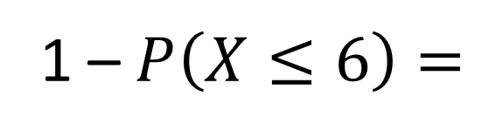
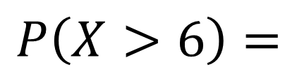


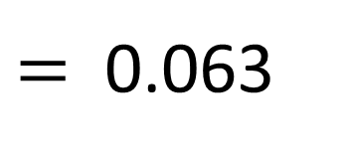
Binomial Probability Distributions – Cumulative
Total Outcomes = 8
Probability of Success = 0.55
$$P\left(X>6\right)=$$
1 – $P\left(X≤6\right)=$
1 – 0.937
$=$ 0.063
0
1
2
3
4
5
6
7
8
1
0
1
2
3
4
5
6
$$P\left(X≤6\right)$$
7
8
$$P\left(X>6\right)$$

Slide 11
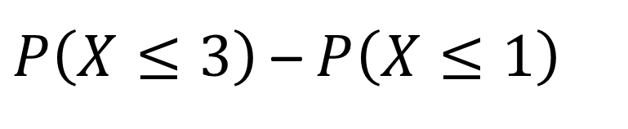




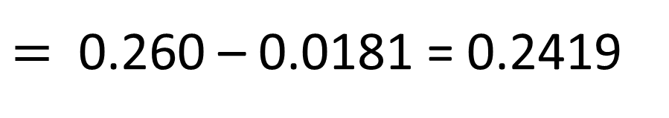
Binomial Probability Distributions – Cumulative
Total Outcomes = 8
Probability of Success = 0.55
$$P\left(2≤X<4\right)=$$
$P\left(X≤3\right)$ – $P\left(X≤1\right)$
$=$ 0.260 – 0.0181 = 0.2419
0
1
2
3
$$P\left(X≤3\right)$$
0
1
$$P\left(X≤1\right)$$
2
3
$$P\left(2≤X<4\right)$$

Slide 12

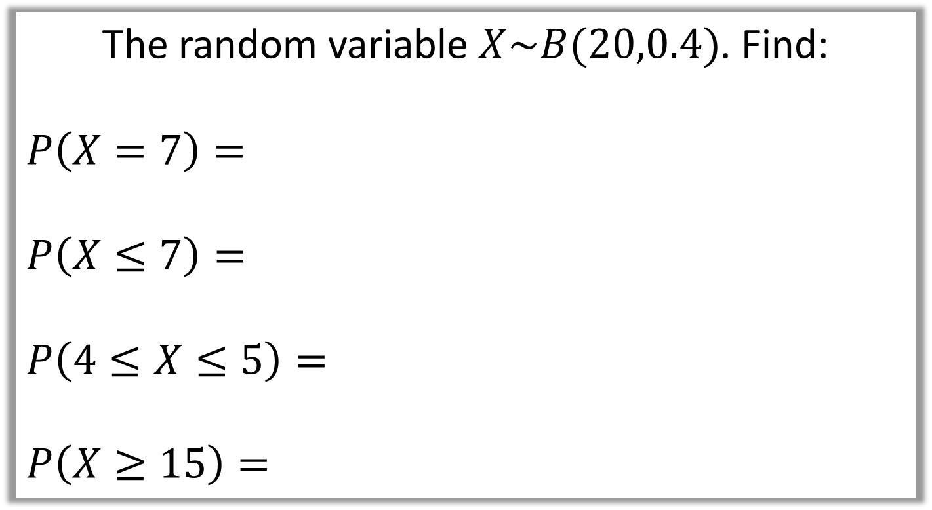
Binomial Probability Distributions – Cumulative
The random variable $X\sim B(20,0.4)$. Find:
$$P\left(X=7\right)=$$
$$P\left(X≤7\right)=$$
$$P\left(4≤X≤5\right)=$$
$$P\left(X≥15\right)=$$
0.166
$$0.4159$$
0.1255 – 0.0160 = 0.1095
$$1−P\left(X≤14\right)=1 −0.998=0.002$$

Slide 13
Exercise 6C
Pearson Pure Mathematics Year 1/AS
Pages 93-94
Complete before the lesson Q1-3
In Class:
Green Q4-5
Amber Q6
Red Q7-10

