Slide 1
Year 1 Pure Mathematics
Equations and Inequalities
- Simultaneous Equations
Chapter 3
(Part 1 of 3)

Slide 2
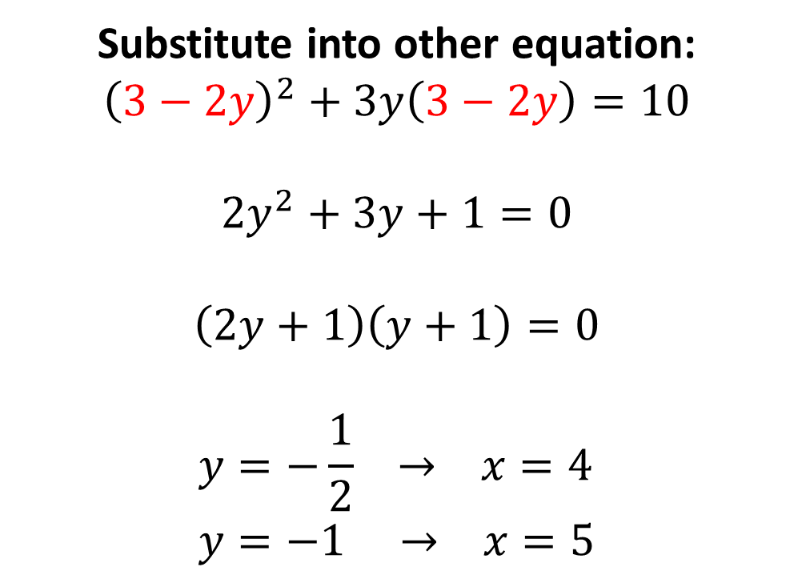
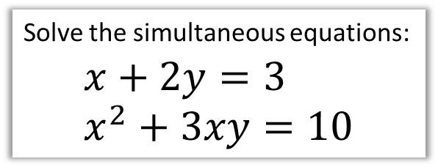

Simultaneous Equations
Solve the simultaneous equations:
$$x+2y=3 \\ x^{2}+3xy=10$$
$$x=3−2y$$
Substitute into other equation:
$${\left(3−2y\right)}^{2}+3y\left(3−2y\right)=10$$
$$2y^{2}+3y+1=0$$
$$\left(2y+1\right)\left(y+1\right)=0$$
$$y=−\frac{1}{2} → x=4 \\ y=−1 → x=5$$

Slide 3
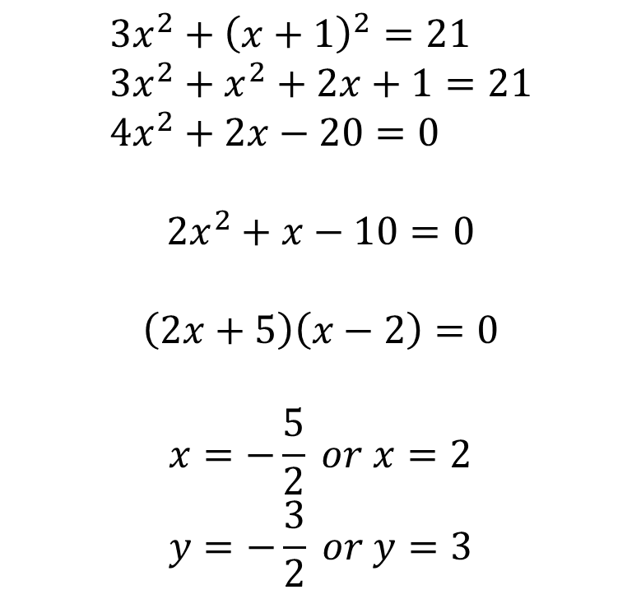
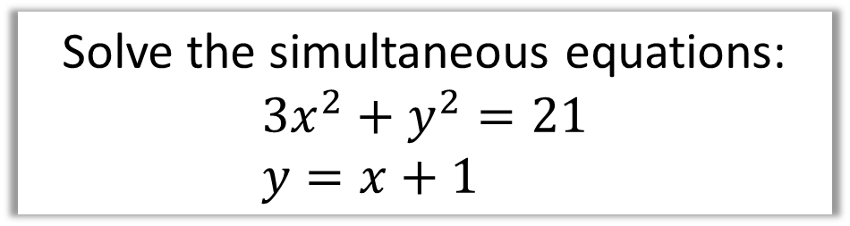
Simultaneous Equations
Solve the simultaneous equations:
$$3x^{2}+y^{2}=21 \\ y=x+1$$
$$3x^{2}+{\left(x+1\right)}^{2}=21 \\ 3x^{2}+x^{2}+2x+1=21 \\ 4x^{2}+2x−20=0$$
$$2x^{2}+x−10=0$$
$$\left(2x+5\right)\left(x−2\right)=0$$
$$x=−\frac{5}{2} or x=2 \\ y=−\frac{3}{2} or y=3$$

Slide 4
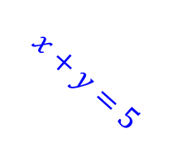
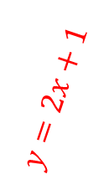
Simultaneous Equations and Graphs
When you are solving an simultaneous equation,
what you really are doing is finding
the POINT OF INTERSECTION.
$$x+y=5$$
$$y=2x+1$$
The point of intersection!

Slide 5
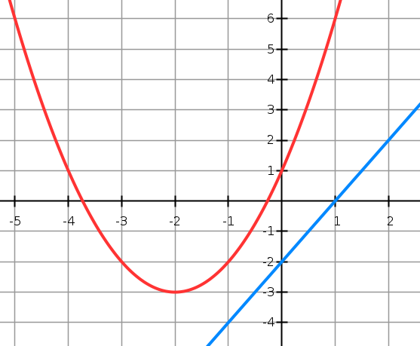
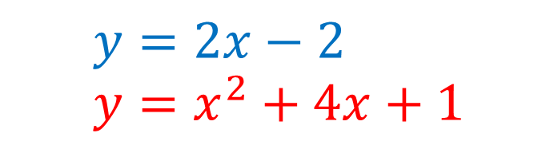
Simultaneous Equations and Graphs
$$y=2x−2 \\ y=x^{2}+4x+1$$
No solutions
means
no points of intersection

Slide 6
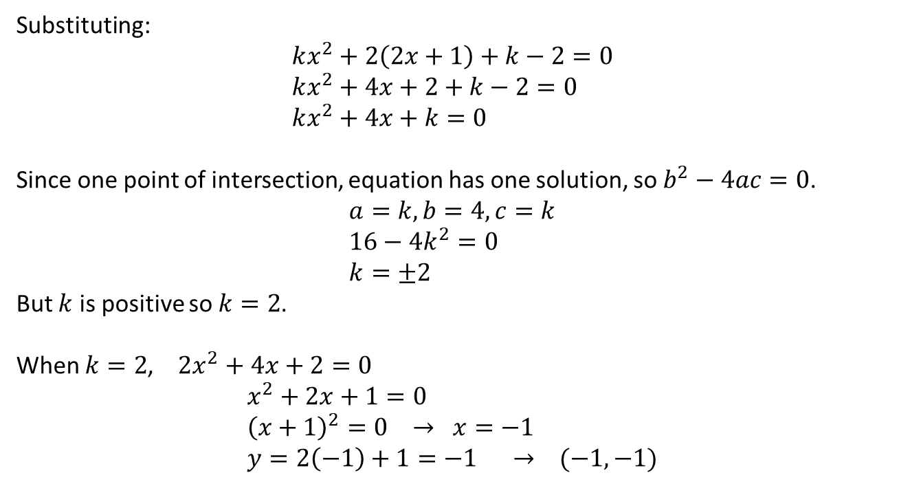
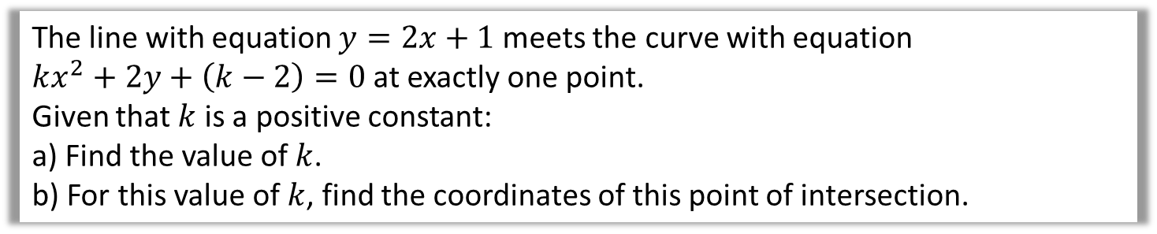
Simultaneous Equations and Graphs
The line with equation $y=2x+1$ meets the curve with equation
$kx^{2}+2y+\left(k−2\right)=0$ at exactly one point.
Given that $k$ is a positive constant:
a) Find the value of $k$.
b) For this value of $k$, find the coordinates of this point of intersection.
a
Substituting:
$$kx^{2}+2\left(2x+1\right)+k−2=0 \\ kx^{2}+4x+2+k−2=0 \\ kx^{2}+4x+k=0$$
Since one point of intersection, equation has one solution, so $b^{2}−4ac=0$.
$$a=k, b=4, c=k \\ 16−4k^{2}=0 \\ k=±2$$
But $k$ is positive so $k=2$.
When $k=2$, $2x^{2}+4x+2=0$
$$x^{2}+2x+1=0 \\ {\left(x+1\right)}^{2}=0 → x=−1 \\ y=2\left(−1\right)+1=−1 → (−1,−1)$$
We can breathe a sigh of relief as we were expecting one solution only.
b

Slide 7
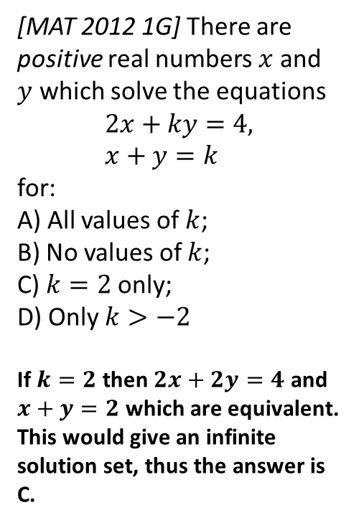
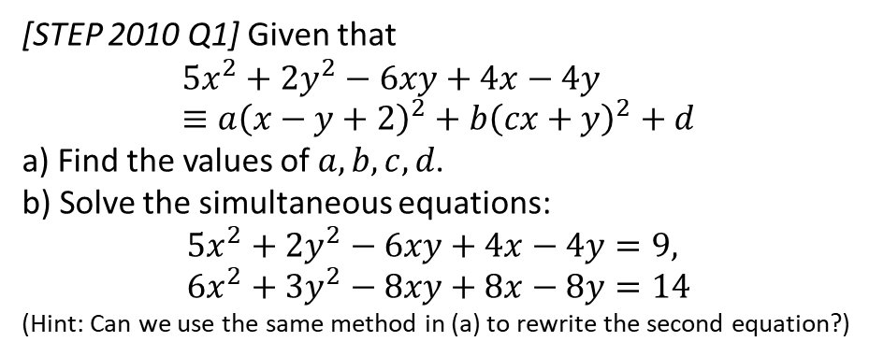

Exercise 3B/ C (Assume Ex3A is prior knowledge)
Pearson Pure Mathematics Year 1/AS Pages 40, 41
Complete before the lesson Ex3B Q2-4
Green Complete Ex3B
Amber Ex3C Q1-6
Red Ex3C Q7-9
Extension
2
[STEP 2010 Q1] Given that
$$5x^{2}+2y^{2}−6xy+4x−4y≡a{\left(x−y+2\right)}^{2}+b{\left(cx+y\right)}^{2}+d$$
a) Find the values of $a,b,c,d$.
b) Solve the simultaneous equations:
$$5x^{2}+2y^{2}−6xy+4x−4y=9, \\ 6x^{2}+3y^{2}−8xy+8x−8y=14$$
(Hint: Can we use the same method in (a) to rewrite the second equation?)
1
[MAT 2012 1G] There are positive real numbers $x$ and $y$ which solve the equations
$$2x+ky=4, \\ x+y=k$$
for:
A) All values of $k$;
B) No values of $k$;
C) $k=2$ only;
D) Only $k>−2$
If $k=2$ then $2x+2y=4$ and $x+y=2$ which are equivalent. This would give an infinite solution set, thus the answer is C.
a) Expanding RHS:
$$\left(a+bc^{2}\right)x^{2}+\left(a+b\right)y^{2}+\left(−2a+2bc\right)xy+4ax−4ay+(4a+d)$$
Comparing coefficients: $a=1, b=1, c=−2, d=−4$
b) ${\left(x−y+2\right)}^{2}+{\left(−2x+y\right)}^{2}−4=9$
Using method in (a): $2{\left(x−y+2\right)}^{2}+{\left(−2x+y\right)}^{2}−8=14$
Subtracting yields $y−2x=±2$ and $x−y+2=±3$
We have to consider each of 4 possibilities.
Final solution set: $x=−3, y=−4 or x=1, y=0$
or $x=3, y=8 or x=7,y=12$
? a
?
? b

