Slide 1
Year 1 Pure Mathematics
Circles
- Completing the Square
Chapter 6
(Part 3 of 5)

Slide 2
Completing the square
Find the centre and radius of the circle with equation
(x – 3)² + (y – 2)² = 9
(3,2)
Radius is 3

Slide 3
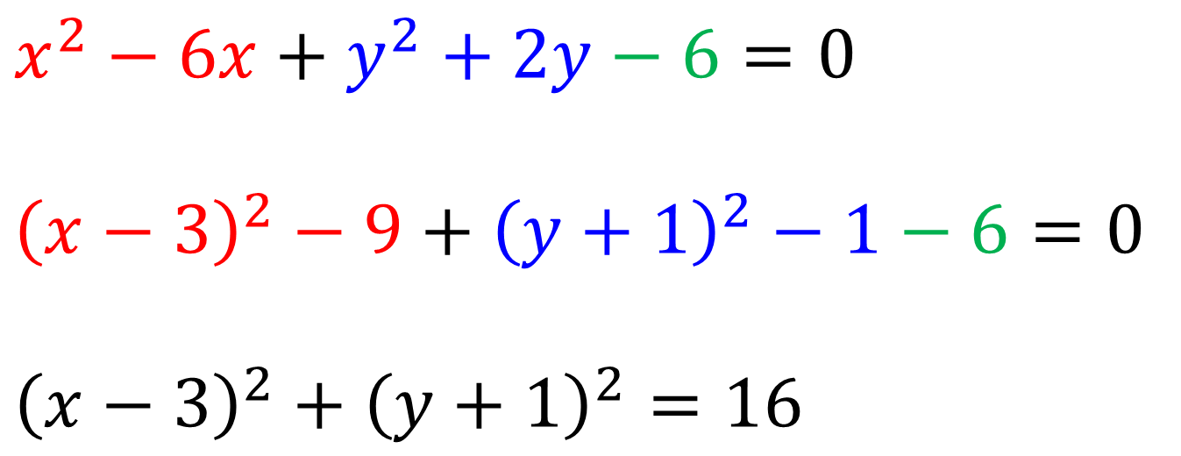
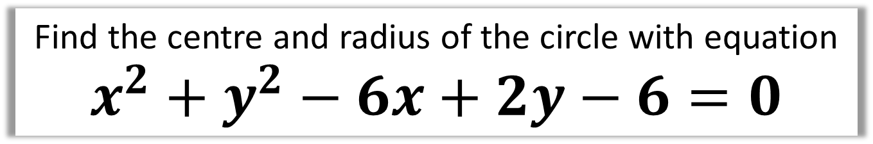
Completing the square
Find the centre and radius of the circle with equation
$$x^{2}+y^{2}−6x+2y−6=0$$
$$x^{2}−6x+y^{2}+2y−6=0$$
$${\left(x−3\right)}^{2}−9+{\left(y+1\right)}^{2}−1−6=0$$
$${\left(x−3\right)}^{2}+{\left(y+1\right)}^{2}=16$$
(3,-1) and the radius is 4

Slide 4
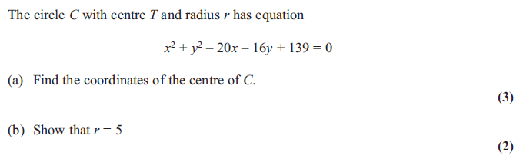
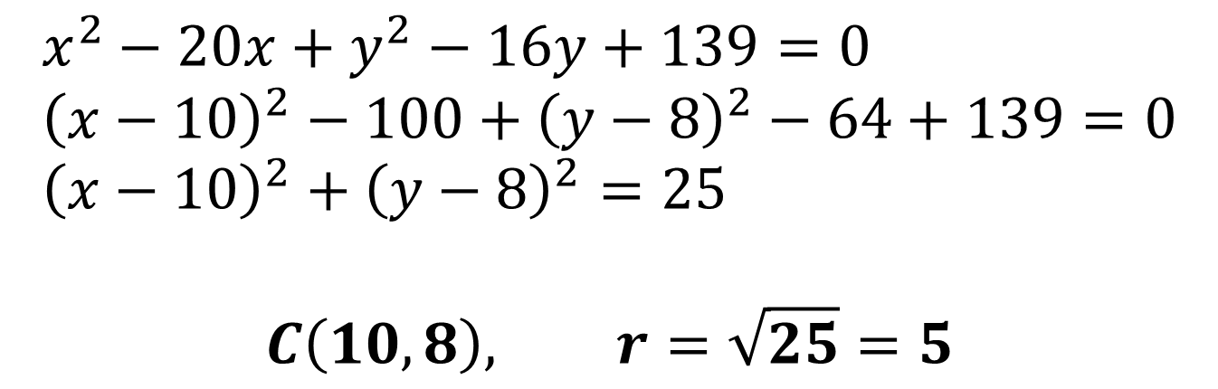
Completing the square
$$x^{2}−20x+y^{2}−16y+139=0 \\ {\left(x−10\right)}^{2}−100+{\left(y−8\right)}^{2}−64+139=0 \\ {\left(x−10\right)}^{2}+{\left(y−8\right)}^{2}=25$$
$$C\left(10,8\right), r=\sqrt{25}=5$$

