Slide 1
Year 1 Pure Mathematics
Straight Line Graphs
- Points of Intersection
Chapter 5
(Part 2 of 5)

Slide 2







Intersection of lines
To find the point of intersection
solve the two equations simultaneously.
$$y$$
$$y=3x$$
$$P$$
$$x+2y=4$$
$$x$$
$$O$$
$$Q$$

Slide 3





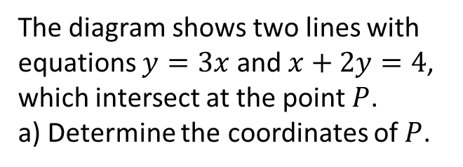
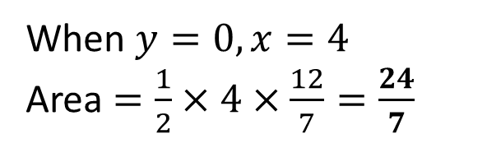

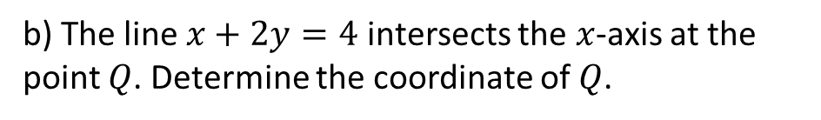


Intersection of lines
The diagram shows two lines with equations $y=3x$ and $x+2y=4$, which intersect at the point $P$.
a) Determine the coordinates of $P$.
$$y$$
$$y=3x$$
$$x+2\left(3x\right)=4$$
$$7x=4$$
$$x=\frac{4}{7} \\ y=3\left(\frac{4}{7}\right)=\frac{12}{7}$$
$$P$$
$$x+2y=4$$
$$x$$
$$O$$
$$Q$$
b) The line $x+2y=4$ intersects the $x$-axis at the point $Q$. Determine the coordinate of $Q$.
When $y=0, x=4$
Area $=\frac{1}{2}×4×\frac{12}{7}=\frac{24}{7}$

Slide 4
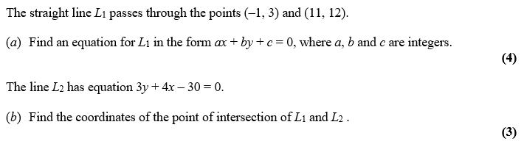
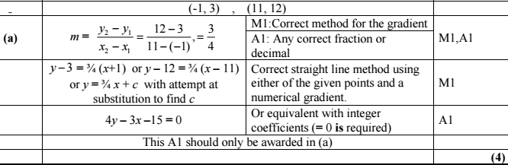
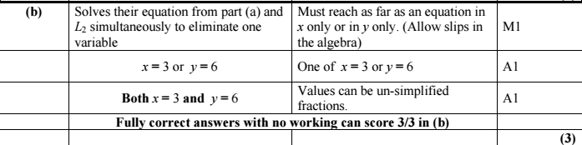
Intersection of lines

Slide 5
Exercise 5D
Pearson Pure Mathematics Year 1/AS
Page 96
Complete before the lesson Q1-3
Green Q4-8
Amber Q9-11
Red Q12-16

