Slide 1
Modelling with
Differential Equations
Twitter: @Owen134866
www.mathsfreeresourcelibrary.com

Slide 2
Teachings for
Exercise 8C

Slide 3
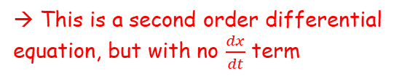

Modelling with Differential Equations
You need to be able to use differential equations when working with damped harmonic motion
In the previous section, the problems you solved related to simple harmonic motion
You saw that this was based on the trigonometrical graphs
However, in many cases harmonic motion will not continue indefinitely and experiences a ‘dampening’ effect which slows it down
For example, a swing is subject to air resistance so each oscillation becomes smaller than the previous one
They took the form $\frac{d^{2}x}{dt^{2}}+w^{2}x=0$
→ This is a second order differential equation, but with no $\frac{dx}{dt}$ term
8C

Slide 4
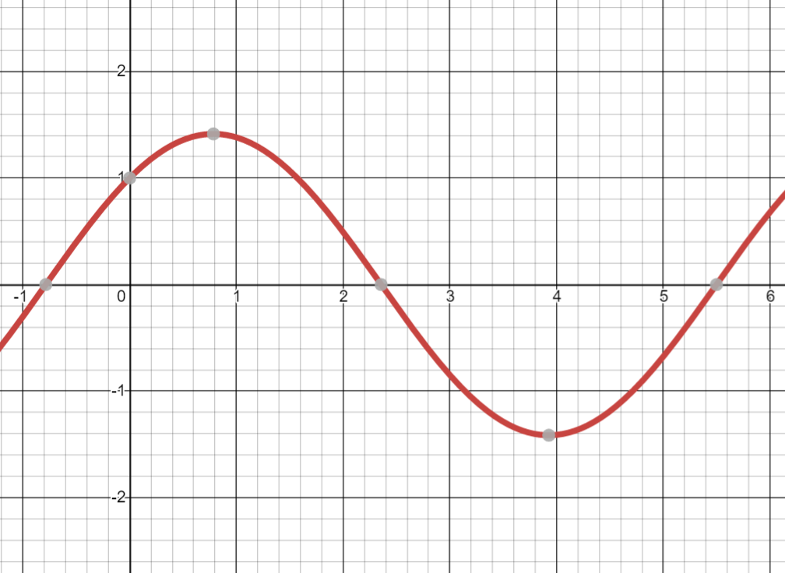




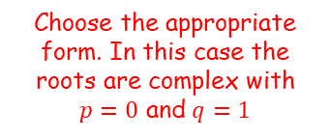
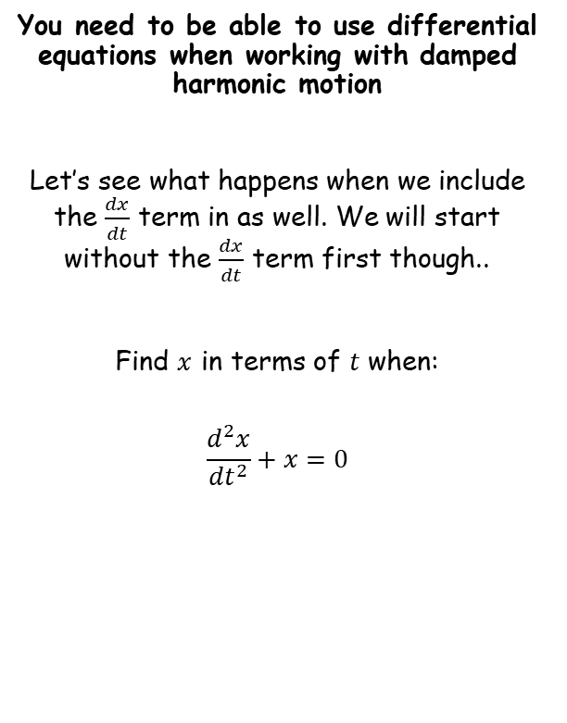





Modelling with Differential Equations
$$Ae^{m_{1}x}+Be^{m_{2}x}$$
$$(A+Bx)e^{mx}$$
$$e^{px}\left(Acosqx+Bsinqx\right)$$
$$\frac{d^{2}x}{{dt}^{2}}+x=0$$
You need to be able to use differential equations when working with damped harmonic motion
Let’s see what happens when we include the $\frac{dx}{dt}$ term in as well. We will start without the $\frac{dx}{dt}$ term first though..
Find $x$ in terms of $t$ when:
$$\frac{d^{2}x}{{dt}^{2}}+x=0$$
Write the auxiliary equation
$$m^{2}+1=0$$
Solve for $m$
$$m=±i$$
Choose the appropriate form. In this case the roots are complex with $p=0$ and $q=1$
$$x=Acost+Bsint$$
$$x=cost+sint$$
(I let A and B equal 1 just to get the graph drawn)
You can see from the graph that this motion will continue indefinitely!
8C

Slide 5
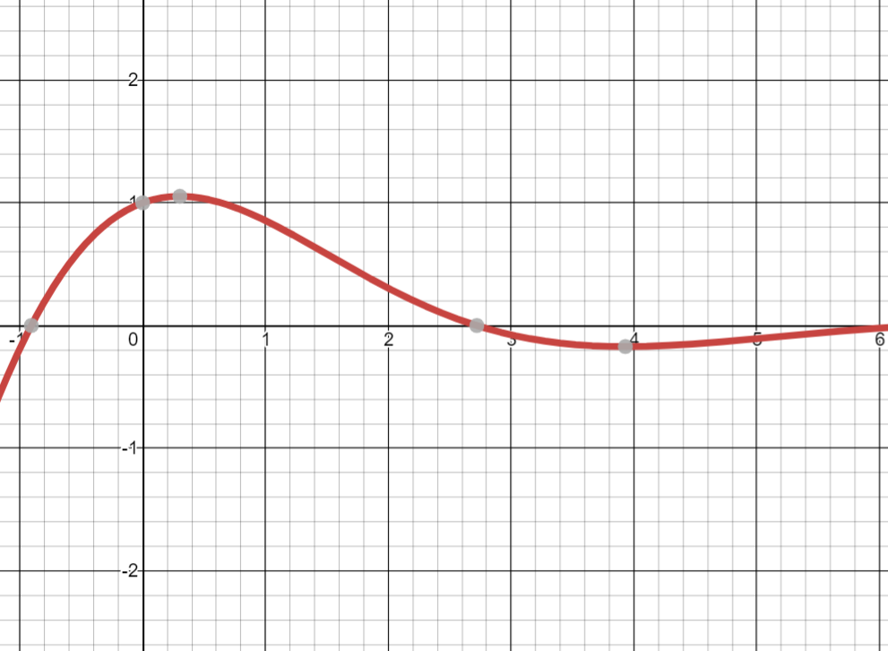
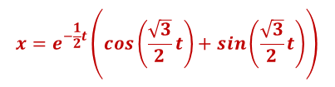

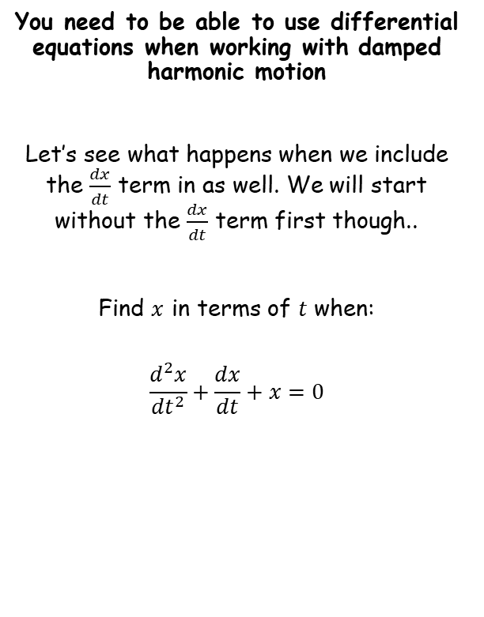
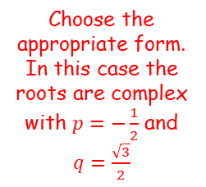



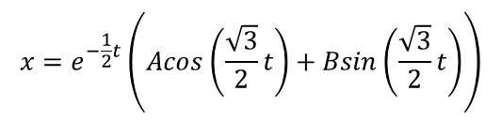
Modelling with Differential Equations
$$Ae^{m_{1}x}+Be^{m_{2}x}$$
$$(A+Bx)e^{mx}$$
$$e^{px}\left(Acosqx+Bsinqx\right)$$
$$\frac{d^{2}x}{{dt}^{2}}+\frac{dx}{dt}+x=0$$
You need to be able to use differential equations when working with damped harmonic motion
Let’s see what happens when we include the $\frac{dx}{dt}$ term in as well. We will start without the $\frac{dx}{dt}$ term first though..
Find $x$ in terms of $t$ when:
$$\frac{d^{2}x}{{dt}^{2}}+\frac{dx}{dt}+x=0$$
Write the auxiliary equation
$$m^{2}+m+1=0$$
Choose the appropriate form. In this case the roots are complex with $p=−\frac{1}{2}$ and $q=\frac{\sqrt{3}}{2}$
$$m=−\frac{1}{2}±\frac{\sqrt{3}}{2}i$$
Solve for $m$
$$x=e^{−\frac{1}{2}t}\left(Acos\left(\frac{\sqrt{3}}{2}t\right)+Bsin\left(\frac{\sqrt{3}}{2}t\right)\right)$$
$$x=e^{−\frac{1}{2}t}\left(cos\left(\frac{\sqrt{3}}{2}t\right)+sin\left(\frac{\sqrt{3}}{2}t\right)\right)$$
(I let A and B equal 1 just to get the graph drawn)
Notice that the oscillation slows down!
8C

Slide 6
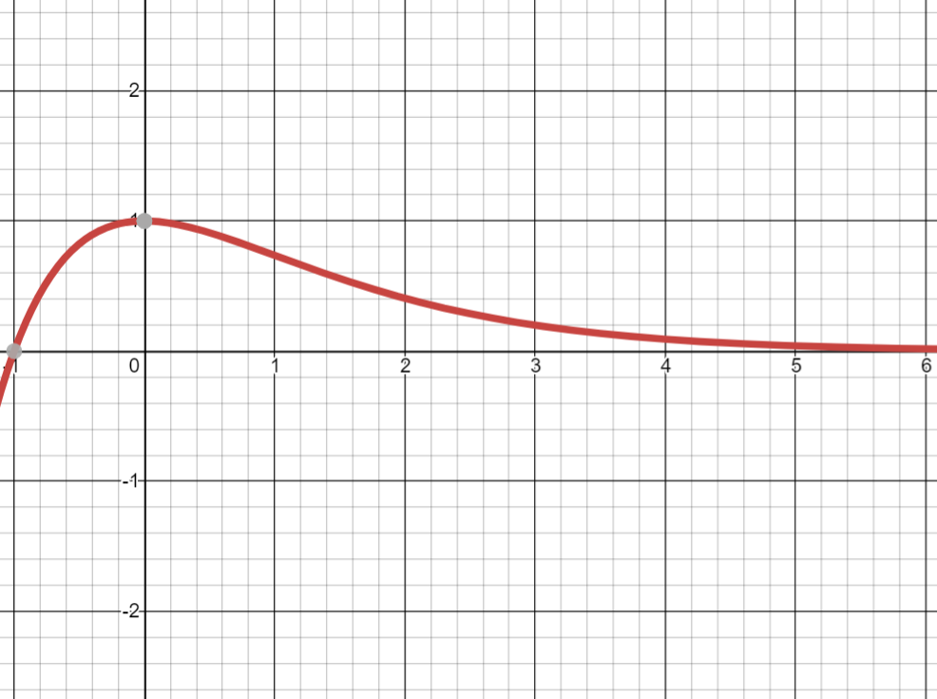


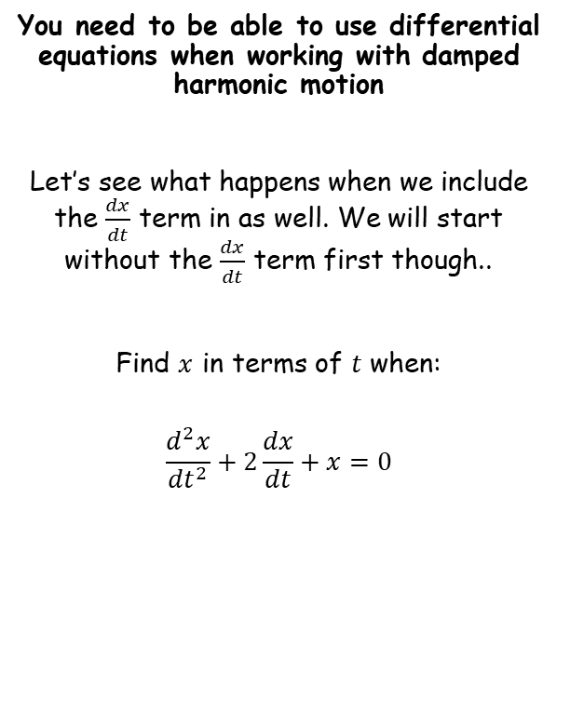
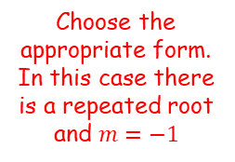



Modelling with Differential Equations
$$Ae^{m_{1}x}+Be^{m_{2}x}$$
$$(A+Bx)e^{mx}$$
$$e^{px}\left(Acosqx+Bsinqx\right)$$
$$\frac{d^{2}x}{{dt}^{2}}+2\frac{dx}{dt}+x=0$$
You need to be able to use differential equations when working with damped harmonic motion
Let’s see what happens when we include the $\frac{dx}{dt}$ term in as well. We will start without the $\frac{dx}{dt}$ term first though..
Find $x$ in terms of $t$ when:
$$\frac{d^{2}x}{{dt}^{2}}+2\frac{dx}{dt}+x=0$$
Write the auxiliary equation
$$m^{2}+2m+1=0$$
Solve for $m$
Choose the appropriate form. In this case there is a repeated root and $m=−1$
$$m=−1$$
$$x=\left(A+Bt\right)e^{−t}$$
$$x=\left(1+t\right)e^{−t}$$
(I let A and B equal 1 just to get the graph drawn)
Notice that there is no oscillation!
8C

Slide 7
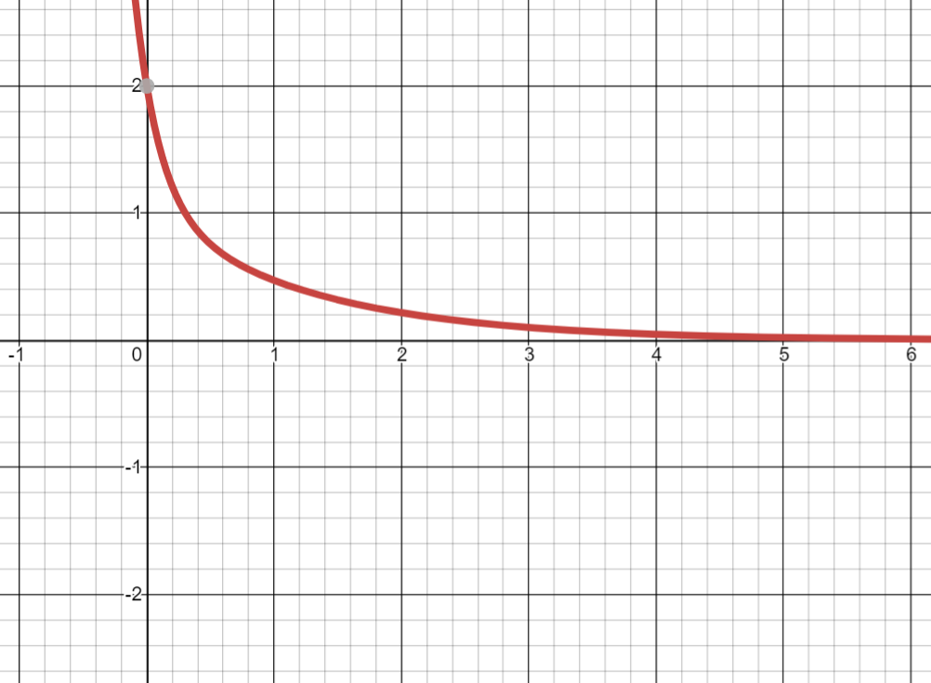


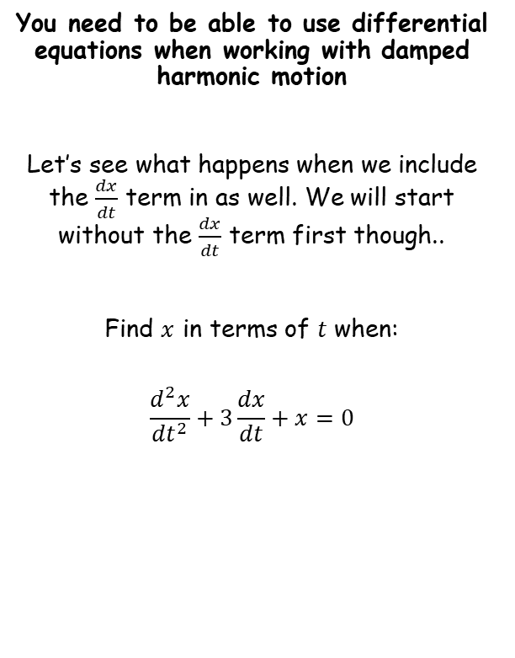
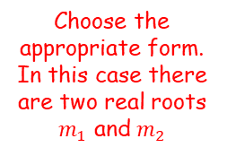



Modelling with Differential Equations
$$Ae^{m_{1}x}+Be^{m_{2}x}$$
$$(A+Bx)e^{mx}$$
$$e^{px}\left(Acosqx+Bsinqx\right)$$
$$\frac{d^{2}x}{{dt}^{2}}+3\frac{dx}{dt}+x=0$$
You need to be able to use differential equations when working with damped harmonic motion
Let’s see what happens when we include the $\frac{dx}{dt}$ term in as well. We will start without the $\frac{dx}{dt}$ term first though..
Find $x$ in terms of $t$ when:
$$\frac{d^{2}x}{{dt}^{2}}+3\frac{dx}{dt}+x=0$$
Write the auxiliary equation
$$m^{2}+3m+1=0$$
$$m=\frac{−3±\sqrt{5}}{2}$$
Solve for $m$
Choose the appropriate form. In this case there are two real roots $m_{1}$ and $m_{2}$
$$x=Ae^{\left(\frac{−3+\sqrt{5}}{2}\right)t}+Be^{\left(\frac{−3−\sqrt{5}}{2}\right)t}$$
$$x=e^{\left(\frac{−3+\sqrt{5}}{2}\right)t}+e^{\left(\frac{−3−\sqrt{5}}{2}\right)t}$$
(I let A and B equal 1 just to get the graph drawn)
Notice that there is no oscillation!
8C

Slide 8




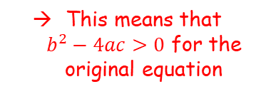


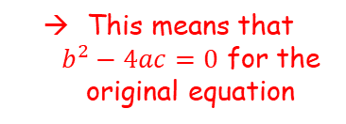



Modelling with Differential Equations
The point to take from this is that a second order differential equation will lead to a different type of harmonic motion, depending on the numbers within it!
You need to be able to use differential equations when working with damped harmonic motion
$$\frac{d^{2}x}{{dt}^{2}}+x=0$$
$$\frac{d^{2}x}{{dt}^{2}}+\frac{dx}{dt}+x=0$$
$$\frac{d^{2}x}{{dt}^{2}}+2\frac{dx}{dt}+x=0$$
$$\frac{d^{2}x}{{dt}^{2}}+3\frac{dx}{dt}+x=0$$
$$x=e^{−\frac{1}{2}t}\left(cos\left(\frac{\sqrt{3}}{2}t\right)+sin\left(\frac{\sqrt{3}}{2}t\right)\right)$$
$$x=e^{\left(\frac{−3+\sqrt{5}}{2}\right)t}+e^{\left(\frac{−3−\sqrt{5}}{2}\right)t}$$
$$x=cost+sint$$
$$x=\left(1+t\right)e^{−t}$$
Simple harmonic motion
Damped harmonic motion
‘Light damping’
Damped harmonic motion
‘Critical damping’
Damped harmonic motion
‘Heavy damping’
The original equation has complex roots
The original equation has repeated roots
The original equation has two real roots
This means that $b^{2}−4ac<0$ for the original equation
This means that $b^{2}−4ac=0$ for the original equation
This means that $b^{2}−4ac>0$ for the original equation
8C

Slide 9
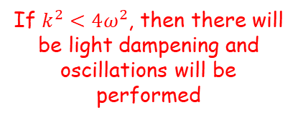

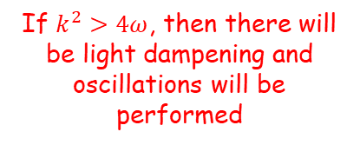
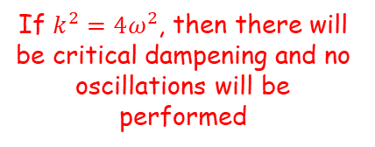
Modelling with Differential Equations
You need to be able to use differential equations when working with damped harmonic motion
If a particle is moving with damped harmonic motion given by:
$$\frac{d^{2}x}{{dt}^{2}}+k\frac{dx}{dt}+ω^{2}x=0$$
If $k^{2}<4ω^{2}$, then there will be light dampening and oscillations will be performed
If $k^{2}=4{\text{ω}}^{2}$, then there will be critical dampening and no oscillations will be performed
If $k^{2}>4ω$, then there will be light dampening and oscillations will be performed
Note that these are equivalent to the rules for $b^{2}−4ac$shown on the previous slide!
8C

Slide 10








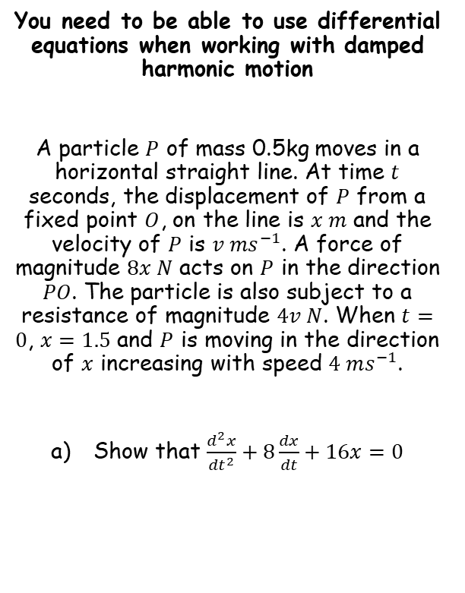












Modelling with Differential Equations
$$\frac{d^{2}x}{{dt}^{2}}+k\frac{dx}{dt}+ω^{2}x=0$$
$$k^{2}<4ω^{2}→Light damping$$
$$k^{2}=4ω^{2}→Critical damping$$
$$k^{2}>4ω^{2}→Heavy damping$$
$$Ae^{m_{1}x}+Be^{m_{2}x}$$
$$(A+Bx)e^{mx}$$
$$e^{px}\left(Acosqx+Bsinqx\right)$$
Draw a diagram, including forces
You need to be able to use differential equations when working with damped harmonic motion
A particle $P$ of mass 0.5kg moves in a horizontal straight line. At time $t$ seconds, the displacement of $P$ from a fixed point $O$, on the line is $x m$ and the velocity of $P$ is ${v ms}^{−1}$. A force of magnitude $8x N$ acts on $P$ in the direction $PO$. The particle is also subject to a resistance of magnitude $4v N$. When $t=0$, $x=1.5$ and $P$ is moving in the direction of $x$ increasing with speed $4 ms^{−1}$.
Show that $\frac{d^{2}x}{{dt}^{2}}+8\frac{dx}{dt}+16x=0$
$$4v$$
$$\ddot{x}$$
$$8x$$
$$O$$
$$P$$
$$x$$
Resolve horizontally (→)
$$F=ma$$
Sub in values
$$−8x−4v=0.5\ddot{x}$$
Rearrange
$$0=0.5\ddot{x}+4v+8x$$
Multiply by 2
$$0=\ddot{x}+8v+16x$$
Replace $\ddot{x}$ and $v$ with equivalent notation
$$0=\frac{d^{2}x}{{dt}^{2}}+8\frac{dx}{dt}+16x$$
→ Remember that although $x$ and $v$ are not forces, there are forces in this question which are based on them…
8C

Slide 11





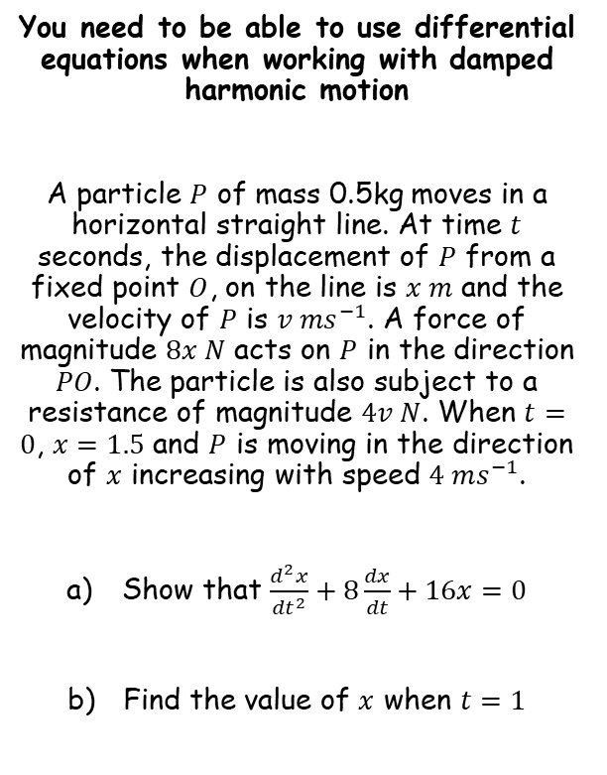








Modelling with Differential Equations
$$\frac{d^{2}x}{{dt}^{2}}+k\frac{dx}{dt}+ω^{2}x=0$$
$$k^{2}<4ω^{2}→Light damping$$
$$k^{2}=4ω^{2}→Critical damping$$
$$k^{2}>4ω^{2}→Heavy damping$$
$$Ae^{m_{1}x}+Be^{m_{2}x}$$
$$(A+Bx)e^{mx}$$
$$e^{px}\left(Acosqx+Bsinqx\right)$$
$$\frac{d^{2}x}{{dt}^{2}}+8\frac{dx}{dt}+16x=0$$
You need to be able to use differential equations when working with damped harmonic motion
A particle $P$ of mass 0.5kg moves in a horizontal straight line. At time $t$ seconds, the displacement of $P$ from a fixed point $O$, on the line is $x m$ and the velocity of $P$ is ${v ms}^{−1}$. A force of magnitude $8x N$ acts on $P$ in the direction $PO$. The particle is also subject to a resistance of magnitude $4v N$. When $t=0$, $x=1.5$ and $P$ is moving in the direction of $x$ increasing with speed $4 ms^{−1}$.
Show that $\frac{d^{2}x}{{dt}^{2}}+8\frac{dx}{dt}+16x=0$
Find the value of $x$ when $t=1$
Write the auxiliary equation
$$m^{2}+8m+16=0$$
Solve
$$m=−4$$
Choose the appropriate form. There is a repeated root $m=−4$
$$x=(A+Bt)e^{−4t}$$
Now we need to use the information we have to find $A$ and $B$
$$x=(A+Bt)e^{−4t}$$
When $t=0$, $x=1.5$
$$1.5=(A+B(0))e^{−4(0)}$$
Solve for $A$
$$1.5=A$$
Now we know $A$
$$x=(1.5+Bt)e^{−4t}$$
8C

Slide 12














Modelling with Differential Equations
$$\frac{d^{2}x}{{dt}^{2}}+k\frac{dx}{dt}+ω^{2}x=0$$
$$k^{2}<4ω^{2}→Light damping$$
$$k^{2}=4ω^{2}→Critical damping$$
$$k^{2}>4ω^{2}→Heavy damping$$
$$Ae^{m_{1}x}+Be^{m_{2}x}$$
$$(A+Bx)e^{mx}$$
$$e^{px}\left(Acosqx+Bsinqx\right)$$
$$x=(1.5+Bt)e^{−4t}$$
Expand the bracket
You need to be able to use differential equations when working with damped harmonic motion
A particle $P$ of mass 0.5kg moves in a horizontal straight line. At time $t$ seconds, the displacement of $P$ from a fixed point $O$, on the line is $x m$ and the velocity of $P$ is ${v ms}^{−1}$. A force of magnitude $8x N$ acts on $P$ in the direction $PO$. The particle is also subject to a resistance of magnitude $4v N$. When $t=0$, $x=1.5$ and $P$ is moving in the direction of $x$ increasing with speed $4 ms^{−1}$.
Show that $\frac{d^{2}x}{{dt}^{2}}+8\frac{dx}{dt}+16x=0$
Find the value of $x$ when $t=1$
$$x=1.5e^{−4t}+Bte^{−4t}$$
Differentiate (product rule needed)
$$\frac{dx}{dt}=$$
$$−6e^{−4t}$$
$$+\left(Bt\frac{d}{dt}\left(e^{−4t}\right)+\frac{d}{dt}\left(Bt\right)e^{−4t}\right)$$
Work out the bracket
$$\frac{dx}{dt}=$$
$$−6e^{−4t}$$
$$+ \left(Bt\left(−4e^{−4t}\right)+Be^{−4t}\right)$$
When $t=0$, $v=4$
$$4=−6e^{−4(0)}+ \left(B(0)\left(−4e^{−4(0)}\right)+Be^{−4(0)}\right)$$
Simplify
$$4=−6+B$$
Calculate $B$
$$10=B$$
Now we have the full relationship
$$x=(1.5+10t)e^{−4t}$$
Let $t=1$
$$x=(1.5+10(1))e^{−4(1)}$$
Calculate
$x=0.211$ (3sf)
8C

Slide 13


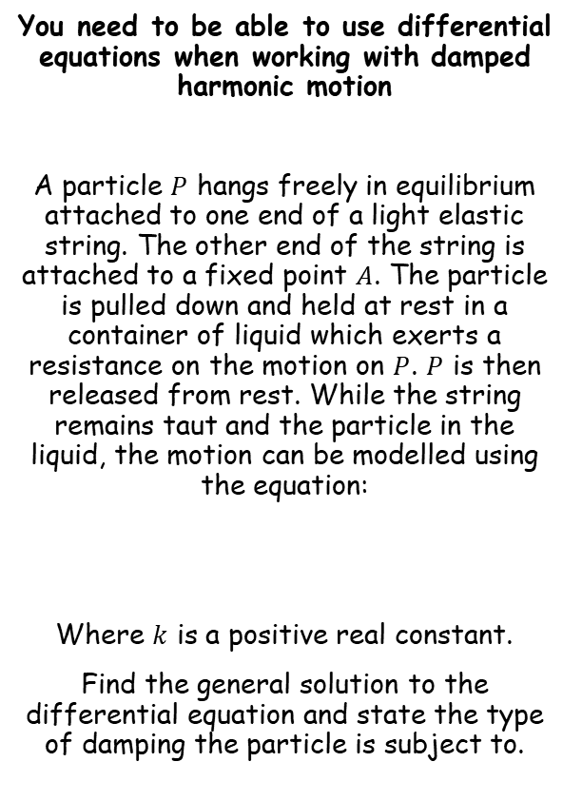





Modelling with Differential Equations
$$\frac{d^{2}x}{{dt}^{2}}+k\frac{dx}{dt}+ω^{2}x=0$$
$$k^{2}<4ω^{2}→Light damping$$
$$k^{2}=4ω^{2}→Critical damping$$
$$k^{2}>4ω^{2}→Heavy damping$$
$$Ae^{m_{1}x}+Be^{m_{2}x}$$
$$(A+Bx)e^{mx}$$
$$e^{px}\left(Acosqx+Bsinqx\right)$$
$$\frac{d^{2}x}{{dt}^{2}}+6k\frac{dx}{dt}+{5k}^{2}x=0$$
You need to be able to use differential equations when working with damped harmonic motion
A particle $P$ hangs freely in equilibrium attached to one end of a light elastic string. The other end of the string is attached to a fixed point $A$. The particle is pulled down and held at rest in a container of liquid which exerts a resistance on the motion on $P$. $P$ is then released from rest. While the string remains taut and the particle in the liquid, the motion can be modelled using the equation:
Where $k$ is a positive real constant.
Find the general solution to the differential equation and state the type of damping the particle is subject to.
Write the auxiliary equation
$$m^{2}+6km+{5k}^{2}=0$$
Factorise
$$\left(m+5k\right)\left(m+k\right)=0$$
Solve
Choose an appropriate form. Since $k$ is a real constant, the solutions will be as well.
$$m=−k,−5k$$
$$x=Ae^{−kt}+Be^{−5kt}$$
Since the auxiliary equation had 2 real roots, the particle will be subject to heavy dampening
$$\frac{d^{2}x}{{dt}^{2}}+6k\frac{dx}{dt}+{5k}^{2}x=0$$
8C

Slide 14


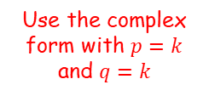


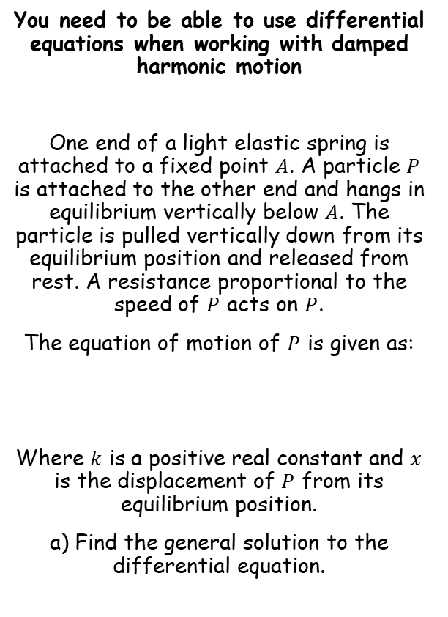







Modelling with Differential Equations
$$\frac{d^{2}x}{{dt}^{2}}+k\frac{dx}{dt}+ω^{2}x=0$$
$$k^{2}<4ω^{2}→Light damping$$
$$k^{2}=4ω^{2}→Critical damping$$
$$k^{2}>4ω^{2}→Heavy damping$$
$$Ae^{m_{1}x}+Be^{m_{2}x}$$
$$(A+Bx)e^{mx}$$
$$e^{px}\left(Acosqx+Bsinqx\right)$$
$$\frac{d^{2}x}{{dt}^{2}}+2k\frac{dx}{dt}+{2k}^{2}x=0$$
You need to be able to use differential equations when working with damped harmonic motion
One end of a light elastic spring is attached to a fixed point $A$. A particle $P$ is attached to the other end and hangs in equilibrium vertically below $A$. The particle is pulled vertically down from its equilibrium position and released from rest. A resistance proportional to the speed of $P$ acts on $P$.
The equation of motion of $P$ is given as:
Where $k$ is a positive real constant and $x$ is the displacement of $P$ from its equilibrium position.
a) Find the general solution to the differential equation.
Write the auxiliary equation
$$m^{2}+2km+{2k}^{2}=0$$
Use the quadratic formula
$$m=\frac{−b±\sqrt{b^{2}−4ac}}{2a}$$
Sub in $a$, $b$ and $c$
$$m=\frac{−2k±\sqrt{{(2k)}^{2}−4(1)(2k^{2})}}{2(1)}$$
Simplify
$$m=\frac{−2k±\sqrt{−4k^{2}}}{2}$$
$$\sqrt{−4k^{2}}=\sqrt{−4}\sqrt{k^{2}}=2ik$$
$$m=\frac{−2k±2ik}{2}$$
$$\frac{d^{2}x}{{dt}^{2}}+2k\frac{dx}{dt}+{2k}^{2}x=0$$
Simplify
$$m=−k±ik$$
Use the complex form with $p=k$ and $q=k$
$$x=e^{−kt}\left(Acoskt+Bsinkt\right)$$
8C

Slide 15
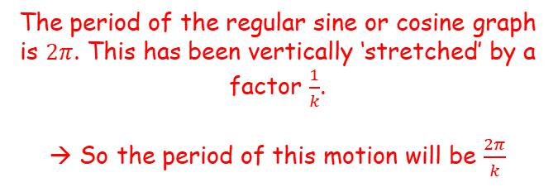
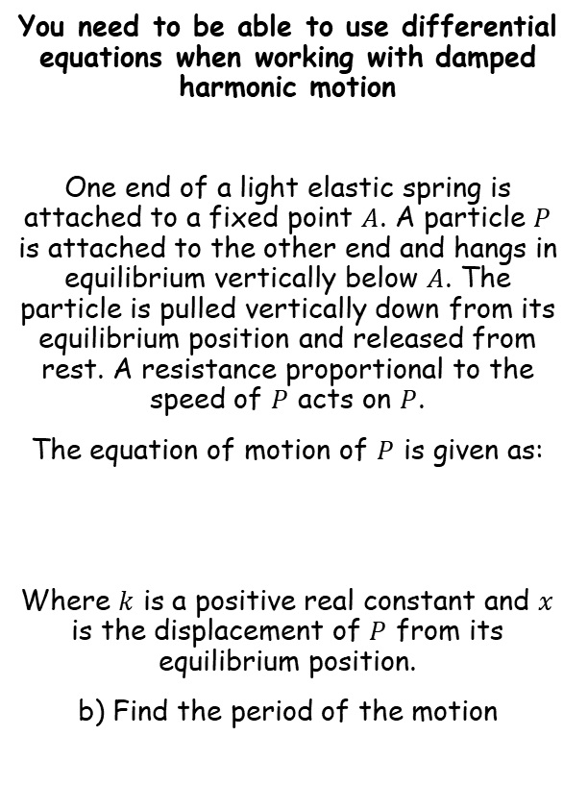

Modelling with Differential Equations
$$\frac{d^{2}x}{{dt}^{2}}+k\frac{dx}{dt}+ω^{2}x=0$$
$$k^{2}<4ω^{2}→Light damping$$
$$k^{2}=4ω^{2}→Critical damping$$
$$k^{2}>4ω^{2}→Heavy damping$$
$$Ae^{m_{1}x}+Be^{m_{2}x}$$
$$(A+Bx)e^{mx}$$
$$e^{px}\left(Acosqx+Bsinqx\right)$$
You need to be able to use differential equations when working with damped harmonic motion
One end of a light elastic spring is attached to a fixed point $A$. A particle $P$ is attached to the other end and hangs in equilibrium vertically below $A$. The particle is pulled vertically down from its equilibrium position and released from rest. A resistance proportional to the speed of $P$ acts on $P$.
The equation of motion of $P$ is given as:
Where $k$ is a positive real constant and $x$ is the displacement of $P$ from its equilibrium position.
b) Find the period of the motion
$$x=e^{−kt}\left(Acoskt+Bsinkt\right)$$
The period of the regular sine or cosine graph is $2π$. This has been vertically ‘stretched’ by a factor $\frac{1}{k}$.
→ So the period of this motion will be $\frac{2π}{k}$
$$\frac{d^{2}x}{{dt}^{2}}+2k\frac{dx}{dt}+{2k}^{2}x=0$$
8C

Slide 16
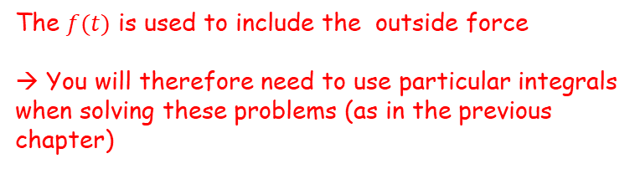

Modelling with Differential Equations
$$\frac{d^{2}x}{{dt}^{2}}+k\frac{dx}{dt}+ω^{2}x=0$$
$$k^{2}<4ω^{2}→Light damping$$
$$k^{2}=4ω^{2}→Critical damping$$
$$k^{2}>4ω^{2}→Heavy damping$$
$$Ae^{m_{1}x}+Be^{m_{2}x}$$
$$(A+Bx)e^{mx}$$
$$e^{px}\left(Acosqx+Bsinqx\right)$$
You need to be able to use differential equations when working with forced harmonic motion
Forced harmonic motion involved situations when an outside force affects the motion.
For example, someone pushing a swing means the swing will oscillate differently to what it would do naturally.
Second-order non-homogenous differential equations can be used to model this…
The $f(t)$ is used to include the outside force
→ You will therefore need to use particular integrals when solving these problems (as in the previous chapter)
$$\frac{d^{2}x}{{dt}^{2}}+k\frac{dx}{dt}+ω^{2}x=f(t)$$
8C

Slide 17




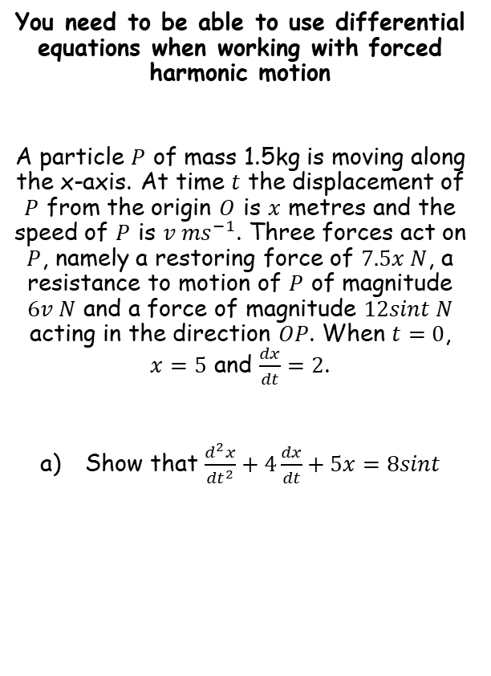



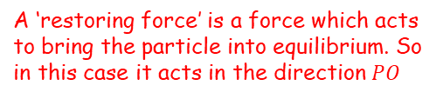


Modelling with Differential Equations
$$\frac{d^{2}x}{{dt}^{2}}+k\frac{dx}{dt}+ω^{2}x=0$$
$$k^{2}<4ω^{2}→Light damping$$
$$k^{2}=4ω^{2}→Critical damping$$
$$k^{2}>4ω^{2}→Heavy damping$$
$$Ae^{m_{1}x}+Be^{m_{2}x}$$
$$(A+Bx)e^{mx}$$
$$e^{px}\left(Acosqx+Bsinqx\right)$$
Draw a diagram, including forces
You need to be able to use differential equations when working with forced harmonic motion
A particle $P$ of mass 1.5kg is moving along the x-axis. At time $t$ the displacement of $P$ from the origin $O$ is $x$ metres and the speed of $P$ is $v {ms}^{−1}$. Three forces act on $P$, namely a restoring force of $7.5x N$, a resistance to motion of $P$ of magnitude $6v N$ and a force of magnitude $12sint N$ acting in the direction $OP$. When $t=0$, $x=5$ and $\frac{dx}{dt}=2$.
Show that $\frac{d^{2}x}{{dt}^{2}}+4\frac{dx}{dt}+5x=8sint$
$$12sint$$
$$6v$$
$$\ddot{x}$$
$$7.5x$$
$$O$$
$$P$$
$$x$$
Resolve horizontally (→)
$$F=ma$$
Sub in values
$$12sint−6v−7.5x=1.5\ddot{x}$$
Rearrange
$$12sint=1.5\ddot{x}+6v+7.5x$$
A ‘restoring force’ is a force which acts to bring the particle into equilibrium. So in this case it acts in the direction $PO$
Divide by 1.5
$$8sint=\ddot{x}+4v+5x$$
Replace with equivalent notation
$$8sint=\frac{d^{2}x}{{dt}^{2}}+4\frac{dx}{dt}+5x$$
8C

Slide 18


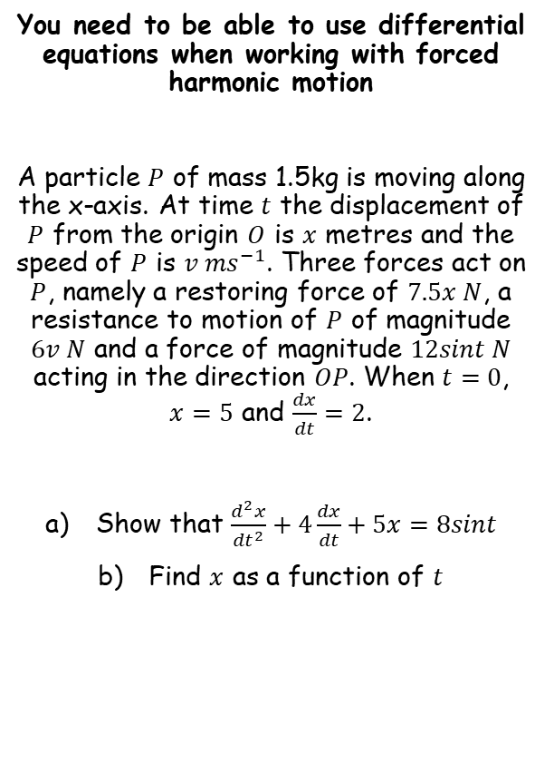




Modelling with Differential Equations
$$\frac{d^{2}x}{{dt}^{2}}+k\frac{dx}{dt}+ω^{2}x=0$$
$$k^{2}<4ω^{2}→Light damping$$
$$k^{2}=4ω^{2}→Critical damping$$
$$k^{2}>4ω^{2}→Heavy damping$$
$$Ae^{m_{1}x}+Be^{m_{2}x}$$
$$(A+Bx)e^{mx}$$
$$e^{px}\left(Acosqx+Bsinqx\right)$$
You need to be able to use differential equations when working with forced harmonic motion
A particle $P$ of mass 1.5kg is moving along the x-axis. At time $t$ the displacement of $P$ from the origin $O$ is $x$ metres and the speed of $P$ is $v {ms}^{−1}$. Three forces act on $P$, namely a restoring force of $7.5x N$, a resistance to motion of $P$ of magnitude $6v N$ and a force of magnitude $12sint N$ acting in the direction $OP$. When $t=0$, $x=5$ and $\frac{dx}{dt}=2$.
Show that $\frac{d^{2}x}{{dt}^{2}}+4\frac{dx}{dt}+5x=8sint$
Find $x$ as a function of $t$
Complementary function
$$\frac{d^{2}x}{{dt}^{2}}+4\frac{dx}{dt}+5x=0$$
Write the auxiliary equation
$$m^{2}+4m+5=0$$
Solve
$$m=−2±i$$
Roots are complex with $p=−2$ and $q=1$
$$x=e^{−2t}\left(Acost+Bsint\right)$$
$$CF=e^{−2t}\left(Acost+Bsint\right)$$
8C

Slide 19








Modelling with Differential Equations
$$\frac{d^{2}x}{{dt}^{2}}+k\frac{dx}{dt}+ω^{2}x=0$$
$$k^{2}<4ω^{2}→Light damping$$
$$k^{2}=4ω^{2}→Critical damping$$
$$k^{2}>4ω^{2}→Heavy damping$$
$$Ae^{m_{1}x}+Be^{m_{2}x}$$
$$(A+Bx)e^{mx}$$
$$e^{px}\left(Acosqx+Bsinqx\right)$$
You need to be able to use differential equations when working with forced harmonic motion
A particle $P$ of mass 1.5kg is moving along the x-axis. At time $t$ the displacement of $P$ from the origin $O$ is $x$ metres and the speed of $P$ is $v {ms}^{−1}$. Three forces act on $P$, namely a restoring force of $7.5x N$, a resistance to motion of $P$ of magnitude $6v N$ and a force of magnitude $12sint N$ acting in the direction $OP$. When $t=0$, $x=5$ and $\frac{dx}{dt}=2$.
Show that $\frac{d^{2}x}{{dt}^{2}}+4\frac{dx}{dt}+5x=8sint$
Find $x$ as a function of $t$
Particular Integral
→ Since the function involves $sint$, we should consider $x=psint+qcost$ as a possible form
$$x=psint+qcost$$
$$\frac{dx}{dt}=pcost−qsint$$
Differentiate
$$\frac{d^{2}x}{dt^{2}}=−psint−qcost$$
Differentiate again
→ Remember that these need to make the original equation work!
$$\frac{d^{2}x}{{dt}^{2}}+4\frac{dx}{dt}+5x=8sint$$
Sub in from above
$$\left(−psint−qcost\right)+4\left(pcost−qsint\right)+5\left(psint+qcost\right)=8sint$$
Simplify
$$CF=e^{−2t}\left(Acost+Bsint\right)$$
$$\left(4p−4q\right)sint+\left(4p+4q\right)cost=8sint$$
Compare coefficients
$$4p−4q=8$$
$$4p+4q=0$$
8C

Slide 20

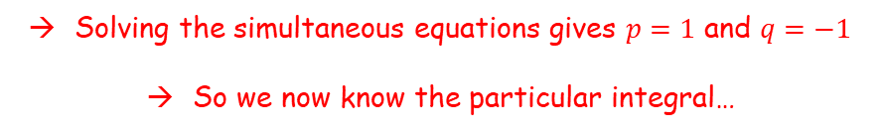



Modelling with Differential Equations
$$\frac{d^{2}x}{{dt}^{2}}+k\frac{dx}{dt}+ω^{2}x=0$$
$$k^{2}<4ω^{2}→Light damping$$
$$k^{2}=4ω^{2}→Critical damping$$
$$k^{2}>4ω^{2}→Heavy damping$$
$$Ae^{m_{1}x}+Be^{m_{2}x}$$
$$(A+Bx)e^{mx}$$
$$e^{px}\left(Acosqx+Bsinqx\right)$$
You need to be able to use differential equations when working with forced harmonic motion
A particle $P$ of mass 1.5kg is moving along the x-axis. At time $t$ the displacement of $P$ from the origin $O$ is $x$ metres and the speed of $P$ is $v {ms}^{−1}$. Three forces act on $P$, namely a restoring force of $7.5x N$, a resistance to motion of $P$ of magnitude $6v N$ and a force of magnitude $12sint N$ acting in the direction $OP$. When $t=0$, $x=5$ and $\frac{dx}{dt}=2$.
Show that $\frac{d^{2}x}{{dt}^{2}}+4\frac{dx}{dt}+5x=8sint$
Find $x$ as a function of $t$
Particular Integral
→ Since the function involves $sint$, we should consider $x=psint+qcost$ as a possible form
$$x=psint+qcost$$
$$\frac{dx}{dt}=pcost−qsint$$
Differentiate
$$\frac{d^{2}x}{dt^{2}}=−psint−qcost$$
Differentiate again
$$4p−4q=8$$
$$4p+4q=0$$
Solving the simultaneous equations gives $p=1$ and $q=−1$
So we now know the particular integral…
$$x=sint−cost$$
$$CF=e^{−2t}\left(Acost+Bsint\right)$$
Therefore…
$$PI=sint−cost$$
$$x=e^{−2t}\left(Acost+Bsint\right)+sint−cost$$
8C

Slide 21



Modelling with Differential Equations
$$\frac{d^{2}x}{{dt}^{2}}+k\frac{dx}{dt}+ω^{2}x=0$$
$$k^{2}<4ω^{2}→Light damping$$
$$k^{2}=4ω^{2}→Critical damping$$
$$k^{2}>4ω^{2}→Heavy damping$$
$$Ae^{m_{1}x}+Be^{m_{2}x}$$
$$(A+Bx)e^{mx}$$
$$e^{px}\left(Acosqx+Bsinqx\right)$$
You need to be able to use differential equations when working with forced harmonic motion
A particle $P$ of mass 1.5kg is moving along the x-axis. At time $t$ the displacement of $P$ from the origin $O$ is $x$ metres and the speed of $P$ is $v {ms}^{−1}$. Three forces act on $P$, namely a restoring force of $7.5x N$, a resistance to motion of $P$ of magnitude $6v N$ and a force of magnitude $12sint N$ acting in the direction $OP$. When $t=0$, $x=5$ and $\frac{dx}{dt}=2$.
Show that $\frac{d^{2}x}{{dt}^{2}}+4\frac{dx}{dt}+5x=8sint$
Find $x$ as a function of $t$
$$x=e^{−2t}\left(Acost+Bsint\right)+sint−cost$$
When $t=0$, $x=5$
$$5=e^{−2(0)}\left(Acos(0)+Bsin(0)\right)+sin⁡(0)−cos⁡(0)$$
Simplify
$$5=A−1$$
Add 1
$$6=A$$
$$x=e^{−2t}\left(6cost+Bsint\right)+sint−cost$$
Now we need to use the other piece of information…
$$x=e^{−2t}\left(Acost+Bsint\right)+sint−cost$$
8C

Slide 22



Modelling with Differential Equations
$$\frac{d^{2}x}{{dt}^{2}}+k\frac{dx}{dt}+ω^{2}x=0$$
$$k^{2}<4ω^{2}→Light damping$$
$$k^{2}=4ω^{2}→Critical damping$$
$$k^{2}>4ω^{2}→Heavy damping$$
$$Ae^{m_{1}x}+Be^{m_{2}x}$$
$$(A+Bx)e^{mx}$$
$$e^{px}\left(Acosqx+Bsinqx\right)$$
You need to be able to use differential equations when working with forced harmonic motion
$$x=e^{−2t}\left(6cost+Bsint\right)+sint−cost$$
Differentiate using the product rule where needed
$$\frac{dx}{dt}=e^{−2t}\frac{d}{dt}\left(6cost+Bsint\right)+\frac{d}{dt}\left(e^{−2t}\right)\left(6cost+Bsint\right)+cost+sint$$
Calculate the differentials
$$\frac{dx}{dt}=e^{−2t}\left(−6sint+Bcost\right)−2e^{−2t}\left(6cost+Bsint\right)+cost+sint$$
When $t=0$, $\frac{dx}{dt}=2$
$$2=e^{−2(0)}\left(−6sin⁡(0)+Bcos(0)\right)−2e^{−2(0)}\left(6cos(0)+Bsin(0)\right)+cos(0)+sin(0)$$
Calculate parts
$$2=B−12+1$$
Calculate
$$13=B$$
Now we know the full relationship!
$$x=e^{−2t}\left(6cost+13sint\right)+sint−cost$$
8C

Slide 23







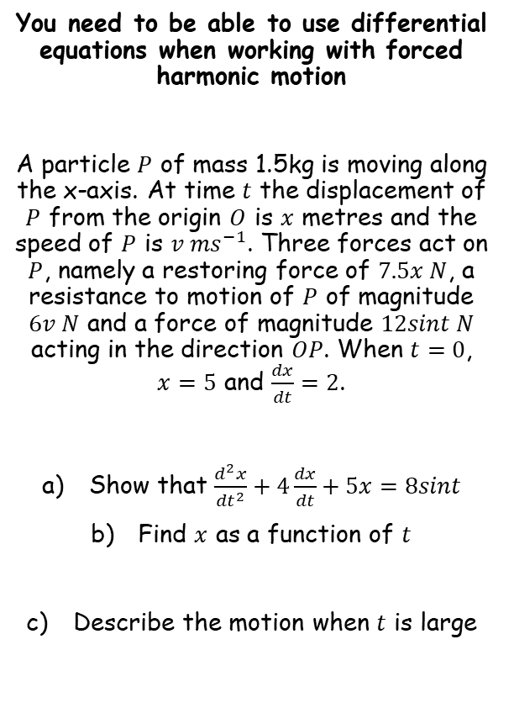







Modelling with Differential Equations
$$\frac{d^{2}x}{{dt}^{2}}+k\frac{dx}{dt}+ω^{2}x=0$$
$$k^{2}<4ω^{2}→Light damping$$
$$k^{2}=4ω^{2}→Critical damping$$
$$k^{2}>4ω^{2}→Heavy damping$$
$$Ae^{m_{1}x}+Be^{m_{2}x}$$
$$(A+Bx)e^{mx}$$
$$e^{px}\left(Acosqx+Bsinqx\right)$$
$$x=e^{−2t}\left(6cost+13sint\right)+sint−cost$$
You need to be able to use differential equations when working with forced harmonic motion
A particle $P$ of mass 1.5kg is moving along the x-axis. At time $t$ the displacement of $P$ from the origin $O$ is $x$ metres and the speed of $P$ is $v {ms}^{−1}$. Three forces act on $P$, namely a restoring force of $7.5x N$, a resistance to motion of $P$ of magnitude $6v N$ and a force of magnitude $12sint N$ acting in the direction $OP$. When $t=0$, $x=5$ and $\frac{dx}{dt}=2$.
Show that $\frac{d^{2}x}{{dt}^{2}}+4\frac{dx}{dt}+5x=8sint$
Find $x$ as a function of $t$
Describe the motion when $t$ is large
As $t→∞$, $e^{−2t}→0$
$$x=sint−cost$$
Write $x$ as a single trig function
$$Rsin(t−α)=sint−cost$$
Expand
$$Rsintcosα−Rsinαcost=sint−cost$$
Compare coefficients of $sint$ and $cost$
$$Rcosα=1$$
$$Rsinα=1$$
Divide
$$tanα=1$$
$$α=\frac{π}{4}$$
Solve for $α$
Use $α$ to find $R$
$$R=\sqrt{2}$$
Bring together
$$x=\sqrt{2}sin\left(t−\frac{π}{4}\right)$$
$$x=e^{−2t}\left(6cost+13sint\right)+sint−cost$$
So as $t→∞$, the motion becomes simple harmonic motion with amplitude $\sqrt{2}$ and period $2π$
8C

Slide 24
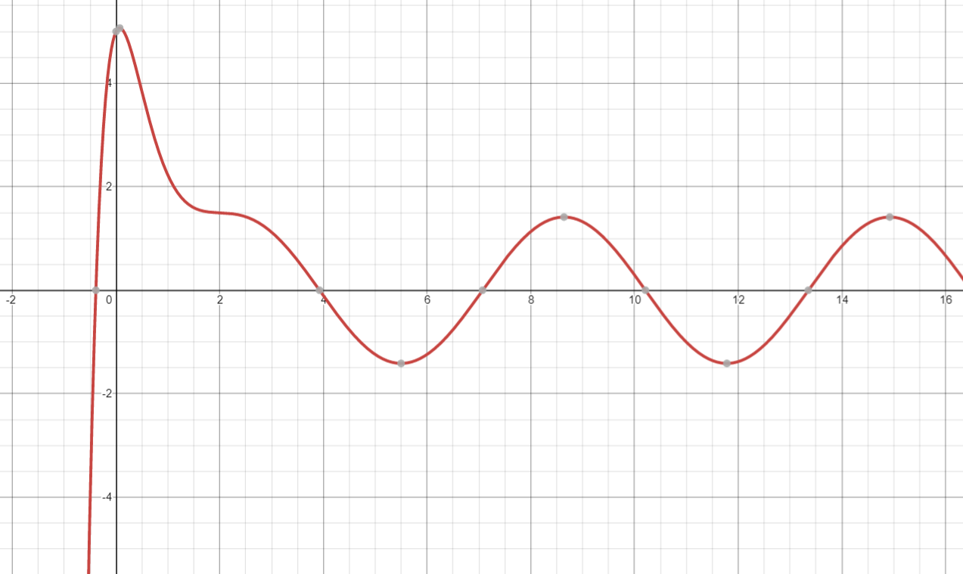
Modelling with Differential Equations
$$\frac{d^{2}x}{{dt}^{2}}+k\frac{dx}{dt}+ω^{2}x=0$$
$$k^{2}<4ω^{2}→Light damping$$
$$k^{2}=4ω^{2}→Critical damping$$
$$k^{2}>4ω^{2}→Heavy damping$$
$$Ae^{m_{1}x}+Be^{m_{2}x}$$
$$(A+Bx)e^{mx}$$
$$e^{px}\left(Acosqx+Bsinqx\right)$$
You need to be able to use differential equations when working with forced harmonic motion
A particle $P$ of mass 1.5kg is moving along the x-axis. At time $t$ the displacement of $P$ from the origin $O$ is $x$ metres and the speed of $P$ is $v {ms}^{−1}$. Three forces act on $P$, namely a restoring force of $7.5x N$, a resistance to motion of $P$ of magnitude $6v N$ and a force of magnitude $12sint N$ acting in the direction $OP$. When $t=0$, $x=5$ and $\frac{dx}{dt}=2$.
Show that $\frac{d^{2}x}{{dt}^{2}}+4\frac{dx}{dt}+5x=8sint$
Find $x$ as a function of $t$
Describe the motion when $t$ is large
$$x=e^{−2t}\left(6cost+13sint\right)+sint−cost$$
$$x=e^{−2t}\left(6cost+13sint\right)+sint−cost$$
8C

Slide 25
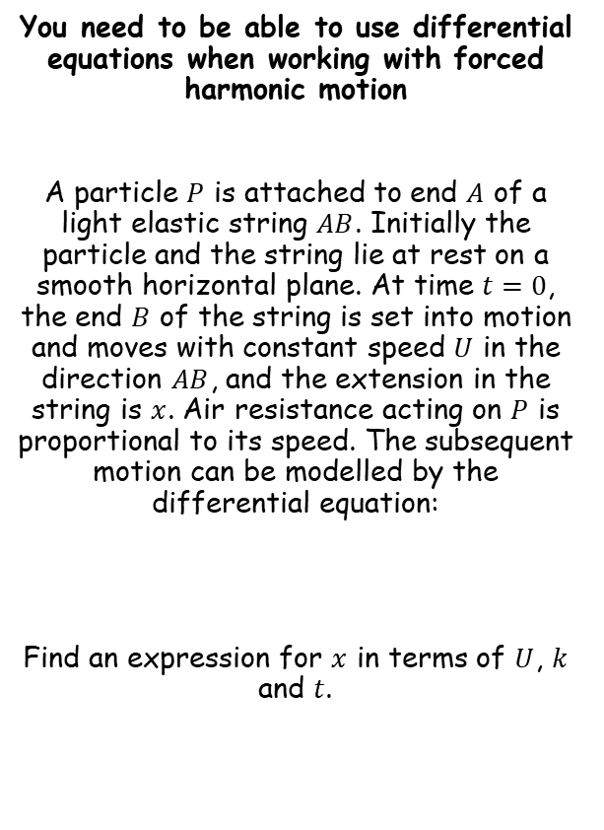

Modelling with Differential Equations
$$\frac{d^{2}x}{{dt}^{2}}+k\frac{dx}{dt}+ω^{2}x=0$$
$$k^{2}<4ω^{2}→Light damping$$
$$k^{2}=4ω^{2}→Critical damping$$
$$k^{2}>4ω^{2}→Heavy damping$$
$$Ae^{m_{1}x}+Be^{m_{2}x}$$
$$(A+Bx)e^{mx}$$
$$e^{px}\left(Acosqx+Bsinqx\right)$$
Before we start answering the question, what is going on here?
You need to be able to use differential equations when working with forced harmonic motion
A particle $P$ is attached to end $A$ of a light elastic string $AB$. Initially the particle and the string lie at rest on a smooth horizontal plane. At time $t=0$, the end $B$ of the string is set into motion and moves with constant speed $U$ in the direction $AB$, and the extension in the string is $x$. Air resistance acting on $P$ is proportional to its speed. The subsequent motion can be modelled by the differential equation:
Find an expression for $x$ in terms of $U$, $k$ and $t$.
Elastic string
Imagine you start walking away from the box at a constant speed
As the tension increases the box will start to move towards you
However, as the tension then decreases, as well as friction/air resistance coming into play, it then slows down again
We end up with a movement where the box keeps moving, but with variable speed
This is essentially what is happening in the question!
The extension of the string will keep increasing and decreasing, which is what we are modelling
$$\frac{d^{2}x}{{dt}^{2}}+2k\frac{dx}{dt}+k^{2}x=2kU$$
Please note this question has been slightly modified from the book. Myself and several other Maths teachers felt that it didn’t quite make sense!
8C

Slide 26







Modelling with Differential Equations
$$\frac{d^{2}x}{{dt}^{2}}+k\frac{dx}{dt}+ω^{2}x=0$$
$$k^{2}<4ω^{2}→Light damping$$
$$k^{2}=4ω^{2}→Critical damping$$
$$k^{2}>4ω^{2}→Heavy damping$$
$$Ae^{m_{1}x}+Be^{m_{2}x}$$
$$(A+Bx)e^{mx}$$
$$e^{px}\left(Acosqx+Bsinqx\right)$$
You need to be able to use differential equations when working with forced harmonic motion
A particle $P$ is attached to end $A$ of a light elastic string $AB$. Initially the particle and the string lie at rest on a smooth horizontal plane. At time $t=0$, the end $B$ of the string is set into motion and moves with constant speed $U$ in the direction $AB$, and the extension in the string is $x$. Air resistance acting on $P$ is proportional to its speed. The subsequent motion can be modelled by the differential equation:
Find an expression for $x$ in terms of $U$, $k$ and $t$.
Complementary function
$$\frac{d^{2}x}{{dt}^{2}}+2k\frac{dx}{dt}+k^{2}x=0$$
Write the auxiliary equation
$$m^{2}+2km+k^{2}=0$$
Factorise
$$\left(m+k\right)\left(m+k\right)=0$$
Solve
$$m=−k$$
Choose the appropriate form. The is a repeated root $m=−k$
$$x=(A+Bt)e^{−kt}$$
$$\frac{d^{2}x}{{dt}^{2}}+2k\frac{dx}{dt}+k^{2}x=2kU$$
$$CF=(A+Bt)e^{−kt}$$
8C

Slide 27










Modelling with Differential Equations
$$\frac{d^{2}x}{{dt}^{2}}+k\frac{dx}{dt}+ω^{2}x=0$$
$$k^{2}<4ω^{2}→Light damping$$
$$k^{2}=4ω^{2}→Critical damping$$
$$k^{2}>4ω^{2}→Heavy damping$$
$$Ae^{m_{1}x}+Be^{m_{2}x}$$
$$(A+Bx)e^{mx}$$
$$e^{px}\left(Acosqx+Bsinqx\right)$$
You need to be able to use differential equations when working with forced harmonic motion
A particle $P$ is attached to end $A$ of a light elastic string $AB$. Initially the particle and the string lie at rest on a smooth horizontal plane. At time $t=0$, the end $B$ of the string is set into motion and moves with constant speed $U$ in the direction $AB$, and the extension in the string is $x$. Air resistance acting on $P$ is proportional to its speed. The subsequent motion can be modelled by the differential equation:
Find an expression for $x$ in terms of $U$, $k$ and $t$.
Particular Integral
→ Since the right hand side of the equation is a constant, we should consider $x=a$ as a possible form
$$x=a$$
$$\frac{dx}{dt}=0$$
Differentiate
$$\frac{d^{2}x}{{dt}^{2}}=0$$
Differentiate
→ Remember that these need to make the original equation work!
$$\frac{d^{2}x}{{dt}^{2}}+2k\frac{dx}{dt}+k^{2}x=2kU$$
$$\frac{d^{2}x}{{dt}^{2}}+2k\frac{dx}{dt}+k^{2}x=2kU$$
The first 2 terms will cancel
$$k^{2}(a)=2kU$$
$$a=\frac{2U}{k}$$
Divide by $k^{2}$
$$CF=(A+Bt)e^{−kt}$$
$$PI=\frac{2U}{k}$$
This is the particular integral
$$x=\frac{2U}{k}$$
8C

Slide 28






Modelling with Differential Equations
$$\frac{d^{2}x}{{dt}^{2}}+k\frac{dx}{dt}+ω^{2}x=0$$
$$k^{2}<4ω^{2}→Light damping$$
$$k^{2}=4ω^{2}→Critical damping$$
$$k^{2}>4ω^{2}→Heavy damping$$
$$Ae^{m_{1}x}+Be^{m_{2}x}$$
$$(A+Bx)e^{mx}$$
$$e^{px}\left(Acosqx+Bsinqx\right)$$
Add together the Complementary Function and the Particular Integral
You need to be able to use differential equations when working with forced harmonic motion
A particle $P$ is attached to end $A$ of a light elastic string $AB$. Initially the particle and the string lie at rest on a smooth horizontal plane. At time $t=0$, the end $B$ of the string is set into motion and moves with constant speed $U$ in the direction $AB$, and the extension in the string is $x$. Air resistance acting on $P$ is proportional to its speed. The subsequent motion can be modelled by the differential equation:
Find an expression for $x$ in terms of $U$, $k$ and $t$.
$$x=\left(A+Bt\right)e^{−kt}+\frac{2U}{k}$$
When $t=0$, the extension in the string is 0
$$0=\left(A+B(0)\right)e^{−k(0)}+\frac{2U}{k}$$
Calculate $A$
$$−\frac{2U}{k}=A$$
We now know more of the relationship
$$x=\left(−\frac{2U}{k}+Bt\right)e^{−kt}+\frac{2U}{k}$$
$$\frac{d^{2}x}{{dt}^{2}}+2k\frac{dx}{dt}+k^{2}x=2kU$$
$$CF=(A+Bt)e^{−kt}$$
$$PI=\frac{2U}{k}$$
8C

Slide 29









Modelling with Differential Equations
$$\frac{d^{2}x}{{dt}^{2}}+k\frac{dx}{dt}+ω^{2}x=0$$
$$k^{2}<4ω^{2}→Light damping$$
$$k^{2}=4ω^{2}→Critical damping$$
$$k^{2}>4ω^{2}→Heavy damping$$
$$Ae^{m_{1}x}+Be^{m_{2}x}$$
$$(A+Bx)e^{mx}$$
$$e^{px}\left(Acosqx+Bsinqx\right)$$
You need to be able to use differential equations when working with forced harmonic motion
A particle $P$ is attached to end $A$ of a light elastic string $AB$. Initially the particle and the string lie at rest on a smooth horizontal plane. At time $t=0$, the end $B$ of the string is set into motion and moves with constant speed $U$ in the direction $AB$, and the extension in the string is $x$. Air resistance acting on $P$ is proportional to its speed. The subsequent motion can be modelled by the differential equation:
Find an expression for $x$ in terms of $U$, $k$ and $t$.
$$x=\left(−\frac{2U}{k}+Bt\right)e^{−kt}+\frac{2U}{k}$$
Differentiate using the product rule where needed
$$\frac{dx}{dt}=\left(−\frac{2U}{k}+Bt\right)\frac{d}{dt}\left(e^{−kt}\right)+\frac{d}{dt}\left(−\frac{2U}{k}+Bt\right)\left(e^{−kt}\right)$$
Calculate differentials
$$\frac{dx}{dt}=−k\left(−\frac{2U}{k}+Bt\right)e^{−kt}+Be^{−kt}$$
When $t=0$, $v=U$
$$U=−k\left(−\frac{2U}{k}+B(0)\right)e^{−k(0)}+Be^{−k(0)}$$
Simplify
$$U=2U+B$$
Subtract $2U$
$$\frac{d^{2}x}{{dt}^{2}}+2k\frac{dx}{dt}+k^{2}x=2kU$$
$$−U=B$$
We now know the full relationship!
$$x=\left(−\frac{2U}{k}−Ut\right)e^{−kt}+\frac{2U}{k}$$
$$CF=(A+Bt)e^{−kt}$$
$$PI=\frac{2U}{k}$$
8C

Slide 30
Exercise 8C
Pearson Core Pure Year 2
Pages 184-186
Complete before the lesson Q1
In Class:
Green Q2
Amber Q3-5
Red Q6-8

